Slide 1
Benchmark
2022/03/17

Slide 2
Benchmark of gromacs on PDIS
計算資源
PDIS 17: poweredge R640 intel-xeon gold 5218 16 coresx2
PDIS 18: poweredge R650 intel-xeon gold 6338 32 core x 2
PDIS 19: poweredge R650 intel-xeon gold 6330 28 core x 2
PDIS 20: poweredge R650 intel-xeon silver 4314 16 core x 1

Slide 3
Benchmark of gromacs on PDIS
Solid-line: gromacs-2022-beta1
Dashed-line: gromacs-2018.8
Chignolin in water(14,948 atoms), dt=2fs
Lysozyme in water(35,984 atoms), dt=2fs
SAM50-TOM40 in hydrated-membrane(149,052 atoms), dt=4fs(HMR)
SAM50-TOM40 in hydrated-membrane(154,885 atoms), dt=2fs
Protein+DNA in water(274,917 atoms), dt=2fs

Slide 4
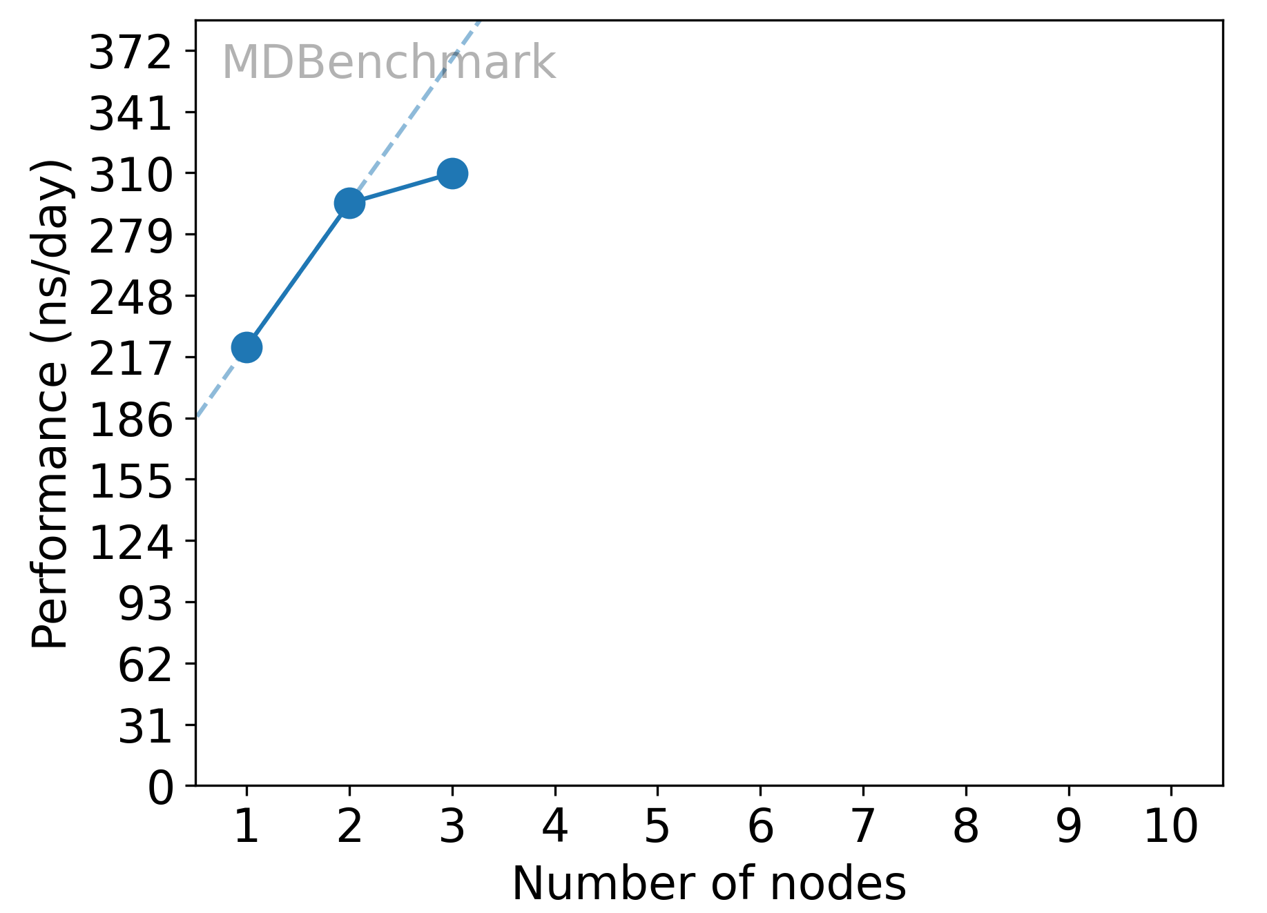
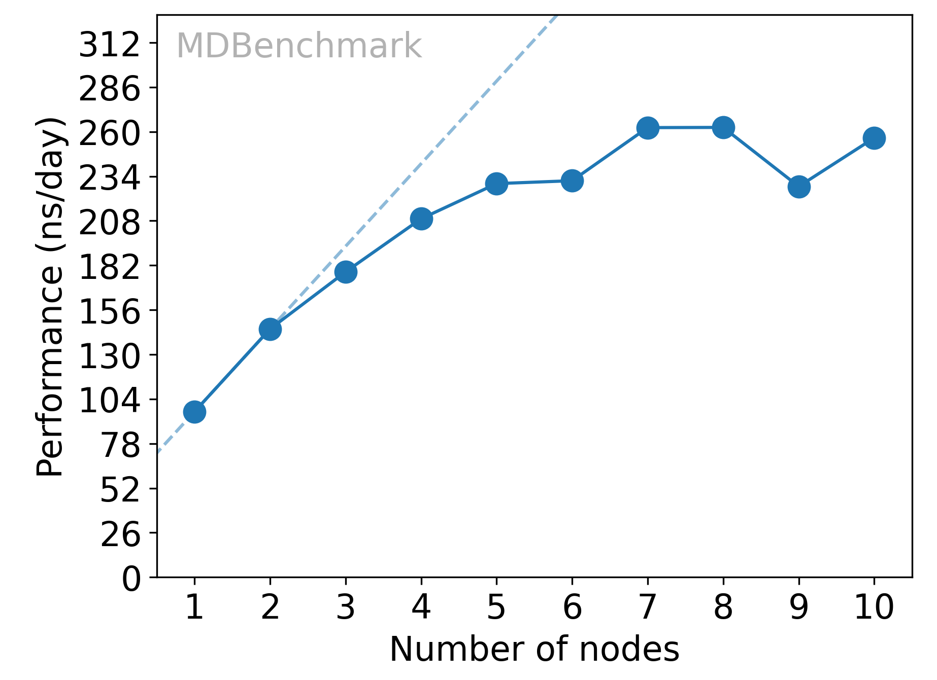
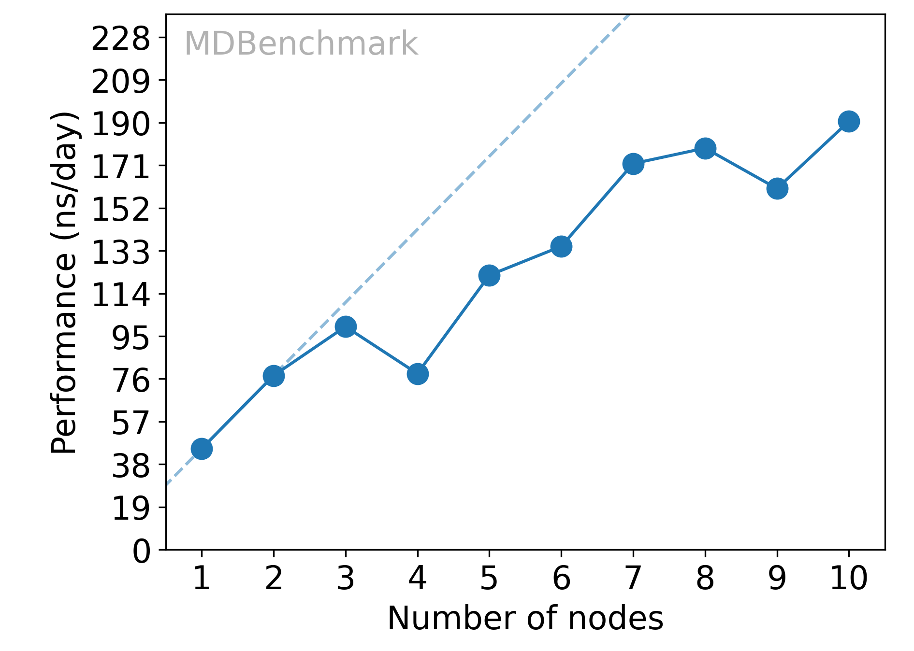
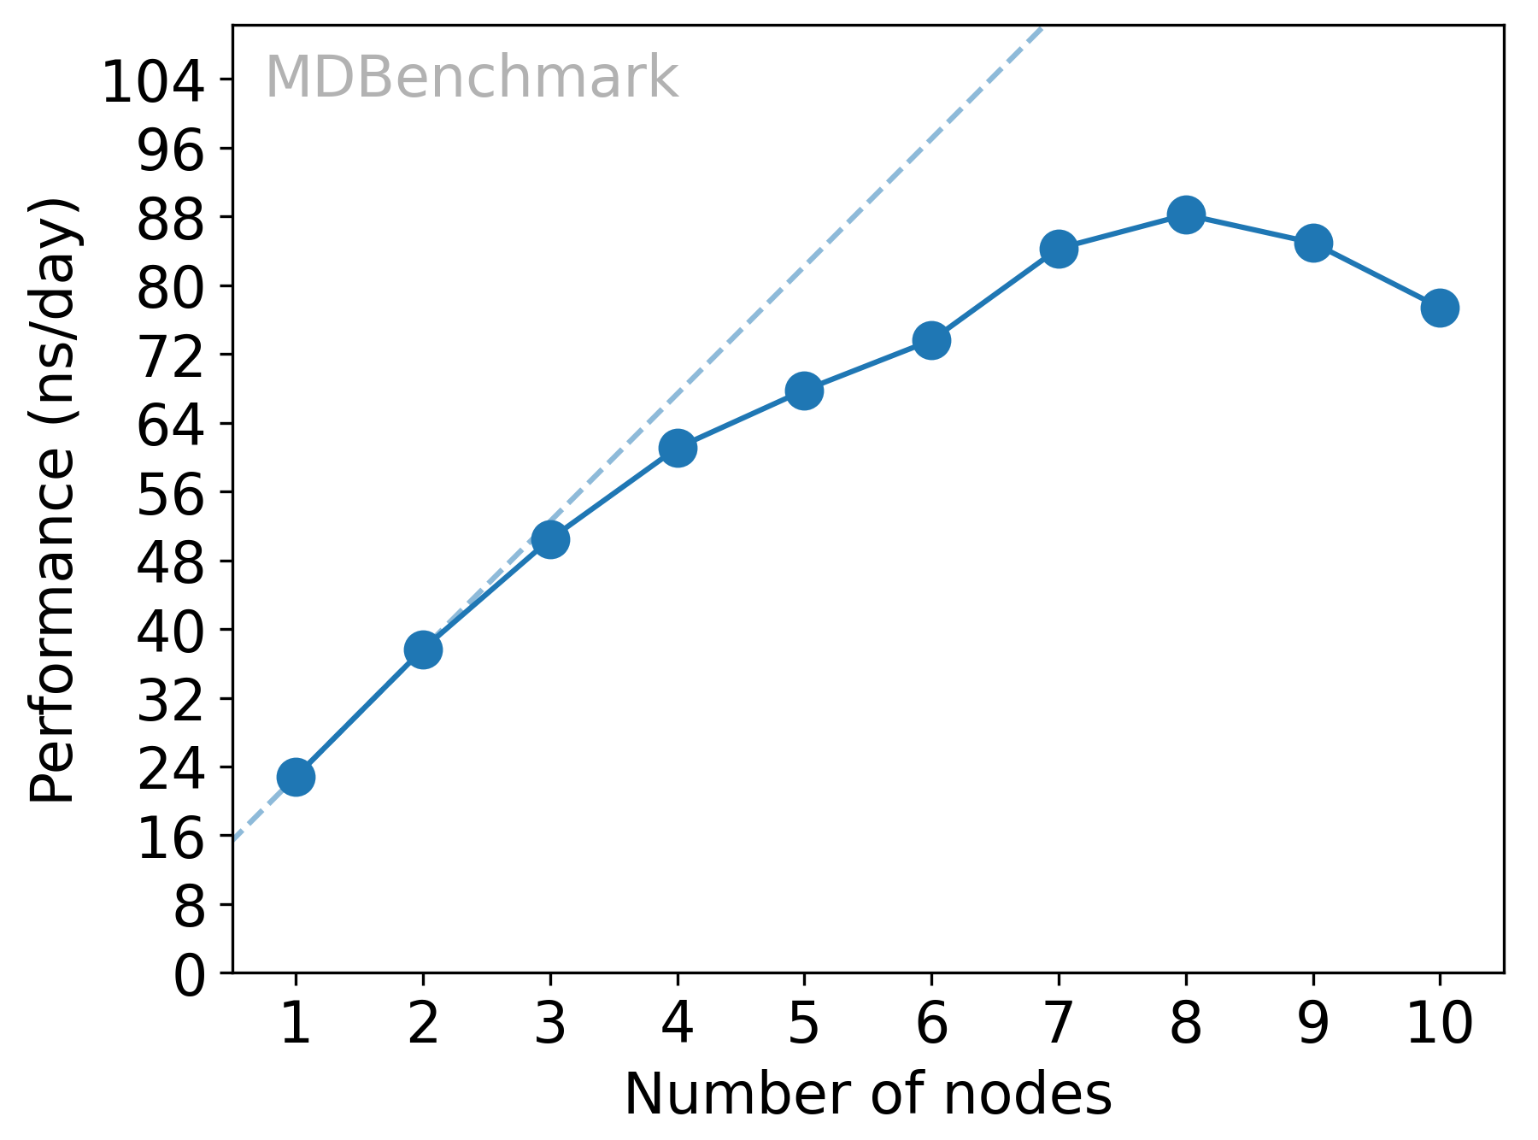
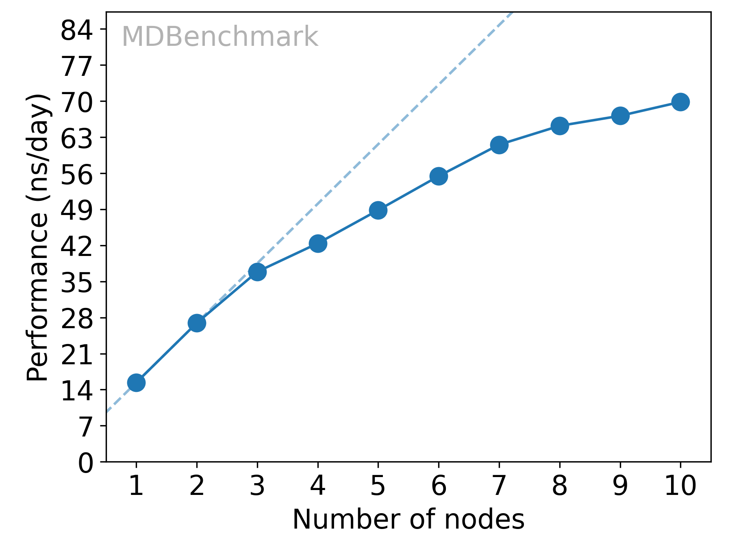
Benchmark of gromacs on ABCI
(a)
(b)
(b)
(d)
(e)
Gromacs-2018.8
1 node=40cpu
Chignolin in water(14,948 atoms), dt=2fs
Lysozyme in water(35,984 atoms), dt=2fs
SAM50-TOM40 in hydrated-membrane(149,052 atoms), dt=4fs(HMR)
SAM50-TOM40 in hydrated-membrane(154,885 atoms), dt=2fs
Protein+DNA in water(274,917 atoms), dt=2fs

Slide 5
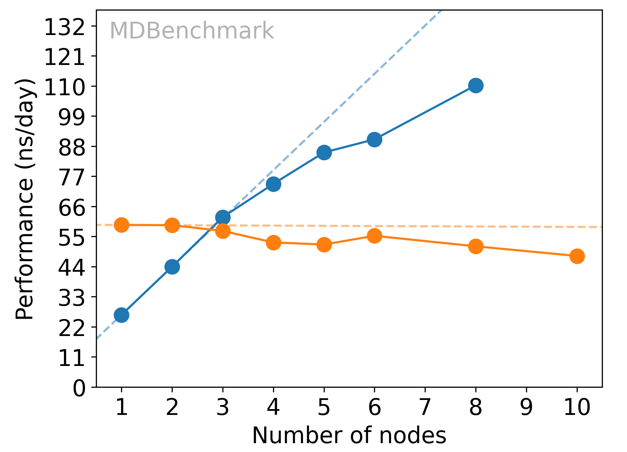
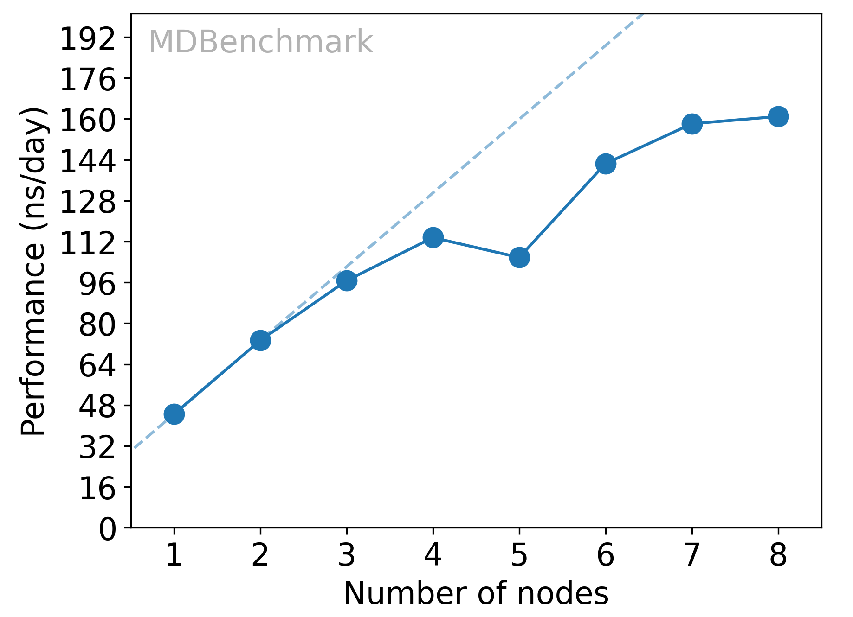
BENCHMARK (GROMACS-2018.8,14 K atoms)
1 node of ABCI = 40cores
Maximum # of nodes / 1 job = 30
Points vs. days/1 μ s simulation
cpu
10 nodes
WO HMR
gpu
8 nodes
Points for multiple μ s simulation
23ns/day PDIS(32 cores)
WO HMR
6 nodes
 | 3 nodes | 4 nodes | 6 nodes
# of sim | 10 days | 8 days | 7 days
1 | 745 | 845 | 1062
2 | 1489 | 1691 | 2125
3 | 2234 | 2536 | 3187
4 | 2979 | 3382 | 4250
5 | 3723 | 4227 | 5312
5 nodes
8 nodes
4 nodes
3 nodes
2 nodes
BENCHMARK (GROMACS-2018.8,14 K atoms)
7 nodes
6 nodes
1 node
cpu
4 nodes
W HMR
3 nodes
2 nodes
1 node
W HMR
13ns/day PDIS(32 cores)
Hydrogen Mass Repartioning (*) was adopted.
(*) JCTC, 15, 8, 2019

Slide 6
Size dependence

Slide 7
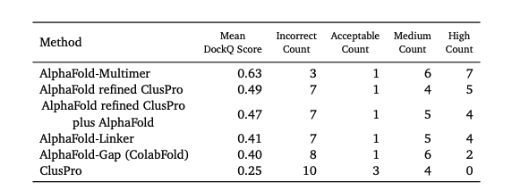
Alphafold – latest version
Alphafold-Multimer (Alphafold2.1.1) Richard Evans et al. bioRxiv, 2021.
Alphafold-linker (“GGS”x7)
Alphafold-Gap(ColabFold)
Alphafold-Cluspro Usman Ghani et al. bioRxiv, 2021.
Alphafold-refined-Cluspro Usman Ghani et al. bioRxiv, 2021.
Alphafold-refined-Cluspro+Alphafold Usman Ghani et al. bioRxiv, 2021.
Folddock Patrick Bryant, Gabriele Pozzati, and Arne Elofsson. bioRxiv, 2021.

Slide 8
Alphafold – latest version
Alphafold-Multimer (Alphafold2.1.1)-> Alphafold2.2.0 Richard Evans et al. bioRxiv, 2021.
Alphafold-linker (“GGS”x7)
Alphafold-Gap(ColabFold)
Alphafold-Cluspro Usman Ghani et al. bioRxiv, 2021.
Alphafold-refined-Cluspro Usman Ghani et al. bioRxiv, 2021.
Alphafold-refined-Cluspro+Alphafold Usman Ghani et al. bioRxiv, 2021.
Folddock ->MoLPC Patrick Bryant, Gabriele Pozzati, and Arne Elofsson. bioRxiv, 2021.

Slide 9
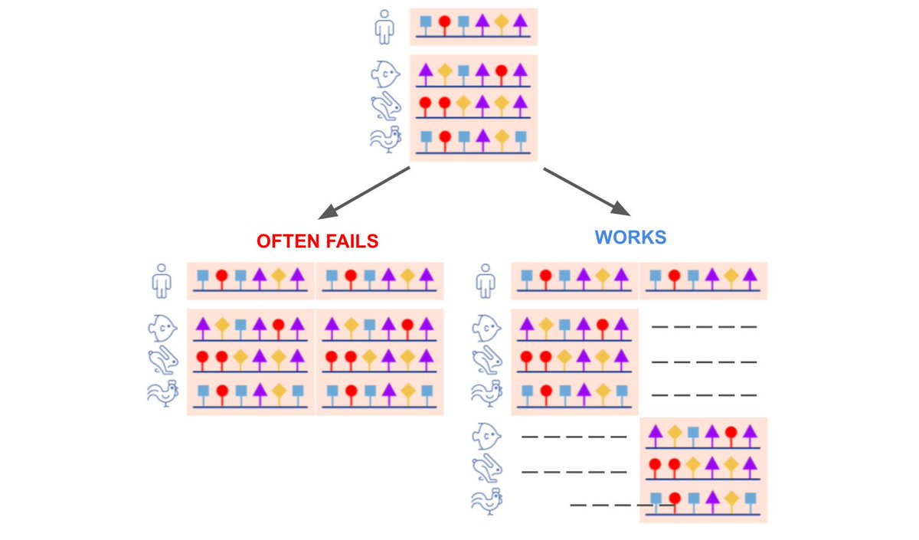
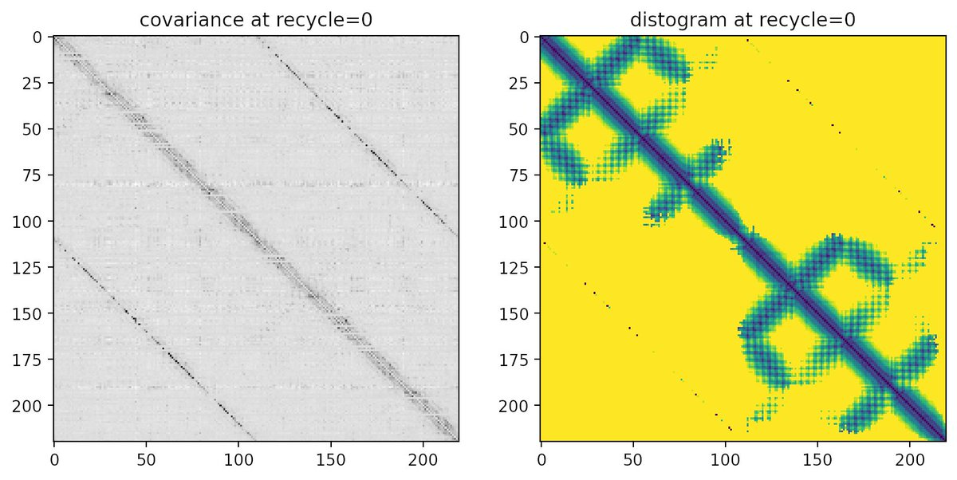
Problem about homo-multimer
まちがったコンタクト予測-> clash
https://twitter.com/sokrypton/status/1457639018141728770

Slide 10
Benchmark on ABCI
 |  |  |  | DockQ/iRMS/LRMS | DockQ/iRMS/LRMS/iPTM+PTM | DockQ/iRMS/LRMS/iPTM+PTM
ID CASP14(PDB) | Stoio. | Res.(sum.) | MSA size | Folddock(*) | Alphafold-multimer(v-2.1.1) | Alphafold-multimer(v-2.2.0)
T1032(6N64) | A2 | 568 | 2589 | 0.493/4.877/6.925 | 0.471/4.980/7.352/0.712 | 0.450/5.111/7.696/0.688
H1036(6VN1) | A3B3C3 | 2568 | 11237 |  | - | - rt_G/rt_G.large でアロケーションエラー
T1038(6YA2) | A2 | 398 | 64 |  | 0.928/0.504/2.232/0.840 | 0.954/0.418/1.937/0.852
H1045(6XOD) | AB | 330 | 2213 | 0.024/8.600/40.855 | 0.019/13.646/39.466/0.868 | 0.018/13.564/40.128/0.874
H1046(6PX4) | AB | 225 | 106 | 0.737/1.430/2.667 | 0.776/1.344/1.805/0.903 | 0.760/1.423/2.181/0.903
T1054(6V4V) | A2 | 380 | 5600 | 0.027/17.858/29.814 | 0.015/19.521/42.029/0.625 | 0.033/13.538/29.545/0.242
H1065(7M5F) | AB | 215 | 1596 | 0.017/16.573/40.516 | 0.878/0.878/1.118/0.913 | 0.889/0.842/0.919/0.889
H1072(6R17) | A2B2 | 340 | 192 |  | 0.723/1.951/2.238/0.756 0.726/1.921/2.125/0.756 | 0.760/1.599/1.785/0.784 (ABvsAB) 0.759/1.607/1.974/0.774 (AAvsBB)
T1073 | A4 | 1020 | 3622
T1078(7CWP) | A2 | 276 | 543 | 0.787/1.022/1.448 | 0.046/16.381/25.319/0.563 | 0.517/2.236/2.710/0.777
T1080 | A3 | 2766 | 8971 |  | - | - rt_G でアロケーションエラー
* 2mer のみ対応
５model 中の DockQ 最高値構造
25 model 中の DockQ 最高値構造
0.00 <= DockQ < 0.23 - Incorrect
0.23 <= DockQ < 0.49 - Acceptable quality
0.49 <= DockQ < 0.80 - Medium quality
DockQ >= 0.80 - High quality
--db_preset full_dbs
--max_template_date 2020-10-01

Slide 12
iPTM+PTM score

Slide 13
