Slide 1


Spring 2021
SKKU Biostats and Big data
CHOONG-WAN WOO | COCOAN lab | http://cocoanlab.github.io

Slide 2
GBME Probability and Statistics
Lecture 06
Lecture 06
Linear regression
CHOONG-WAN WOO | COCOAN lab | http://cocoanlab.github.io

Slide 3
Lecture 06
Review: Key Points
Chapter 7: Scatterplots, Correlation
Scatterplots (direction, form, strength, outliers)
x- and y-variables: explanatory/independent vs. response/dependent variables
Correlation: strength and direction
Assumptions and conditions:
Quantitative variables condition
Straight enough condition
No outliers condition
Non-parametric correlations: Kendall’s tau, Spearman’s rho
Correlation ≠ Causation
Correlation table/matrix
CHOONG-WAN WOO | COCOAN lab | http://cocoanlab.github.io

Slide 4
Lecture 06
We need more than correlation!
Correlation only tells us the strength of a linear relationship.
Correlation doesn’t tell us what the line is.
We need a linear model!!
Simple regression
Mathematical model for describing a linear relationship between an explanatory variable, x, and a response variable, y.
It is a straight line that describes how y changes with x.
It can be used to predict the value of y for a given value of x.
CHOONG-WAN WOO | COCOAN lab | http://cocoanlab.github.io

Slide 5
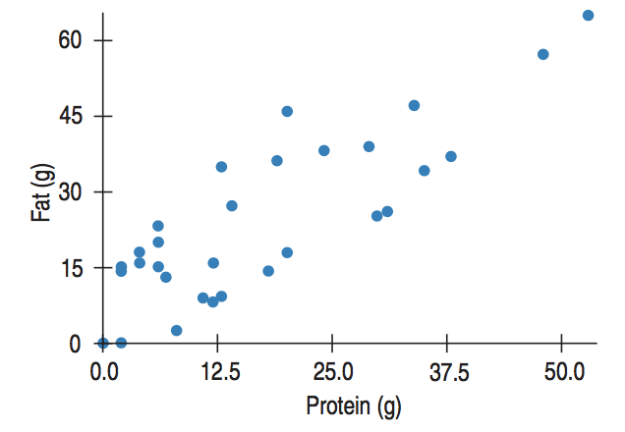

Lecture 06
Least squares: The Line of “Best Fit”
Predicted value,
$$\hat{y}$$
Observed value, y
x
CHOONG-WAN WOO | COCOAN lab | http://cocoanlab.github.io

Slide 6
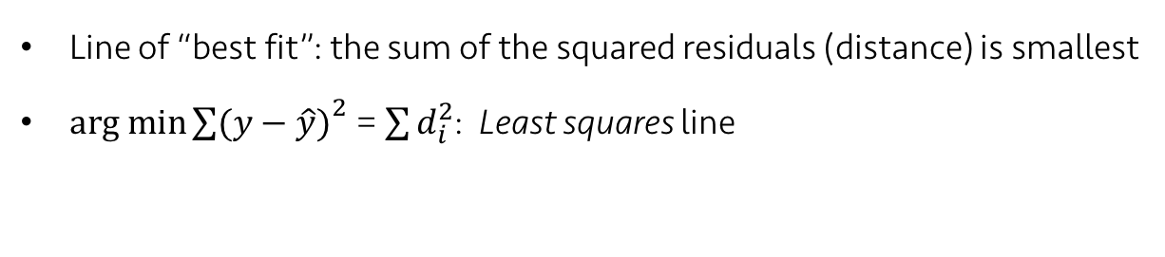
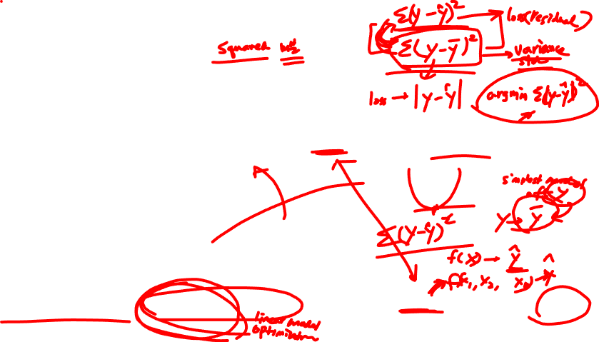
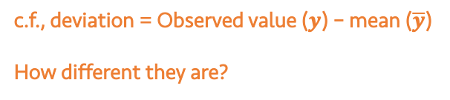
Lecture 06
Least squares: The Line of “Best Fit”
residual = Observed value ($y$) – Predicted value ($\hat{y}$)
x
Line of “best fit”: the sum of the squared residuals (distance) is smallest
$arg min{\sum{(y−\hat{y})}}^{2}$ = $\sum{d_{i}^{2}}$: Least squares line
c.f., deviation = Observed value ($y$) – mean ($\overline{y}$)
How different they are?
CHOONG-WAN WOO | COCOAN lab | http://cocoanlab.github.io

Slide 7

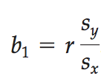

Lecture 06
Linear Model
b: coefficients
b₁: slope
b₀: intercept
Slope,
Correlations do not have units, but slopes have units.
Standard deviation as a ruler!
Intercept,
CHOONG-WAN WOO | COCOAN lab | http://cocoanlab.github.io

Slide 8
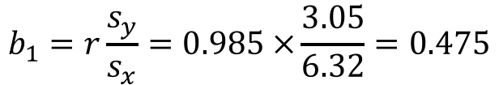
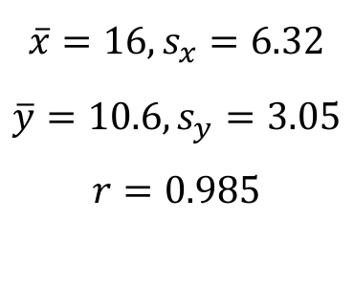
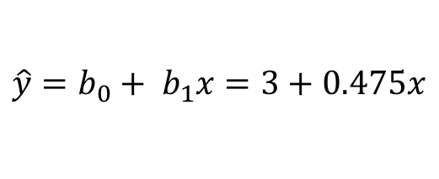
Lecture 06
Example: Sleep Study
Sleep deprivation and study can have more errors
Errors | 7 | 8 | 11 | 13 | 14
Hours without sleep | 8 | 12 | 16 | 20 | 24
y
x
$$\overline{x}=16, s_{x}=6.32$$
$$\overline{y}=10.6, s_{y}=3.05$$
$$r=0.985$$
$$b_{1}=r\frac{s_{y}}{s_{x}}=0.985 ×\frac{3.05}{6.32}=0.475$$
$$b_{0}=\overline{y}−b\overline{x}=10.6−0.475×16=3$$
Least-squares regression line:
$$\hat{y}=b_{0}+ b_{1}x=3+0.475x$$
Slide from Martin Lindquist
CHOONG-WAN WOO | COCOAN lab | http://cocoanlab.github.io

Slide 9
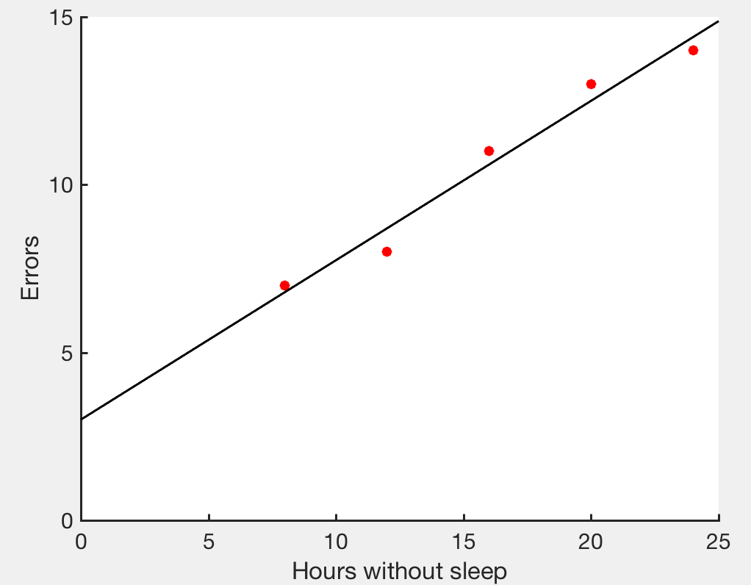
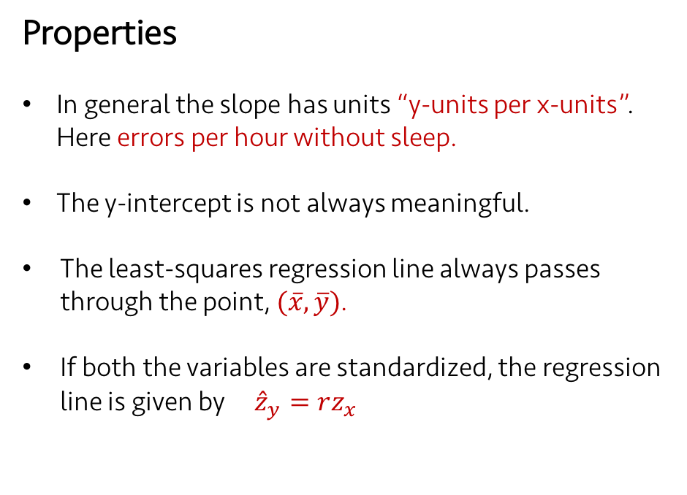
Lecture 06
Example: Sleep Study
Properties
In general the slope has units “y-units per x-units”. Here errors per hour without sleep.
The y-intercept is not always meaningful.
The least-squares regression line always passes through the point, $(\overline{x}, \overline{y})$.
If both the variables are standardized, the regression line is given by ${\hat{z}}_{y}=rz_{x}$
Least-squares regression line:
$$\hat{y}=b_{0}+ b_{1}x=3+0.475x$$
Slide from Martin Lindquist
CHOONG-WAN WOO | COCOAN lab | http://cocoanlab.github.io

Slide 10
Lecture 06
Quiz 06-1
https://forms.gle/L4NaxSXARbw1bqGW7
CHOONG-WAN WOO | COCOAN lab | http://cocoanlab.github.io

Slide 11
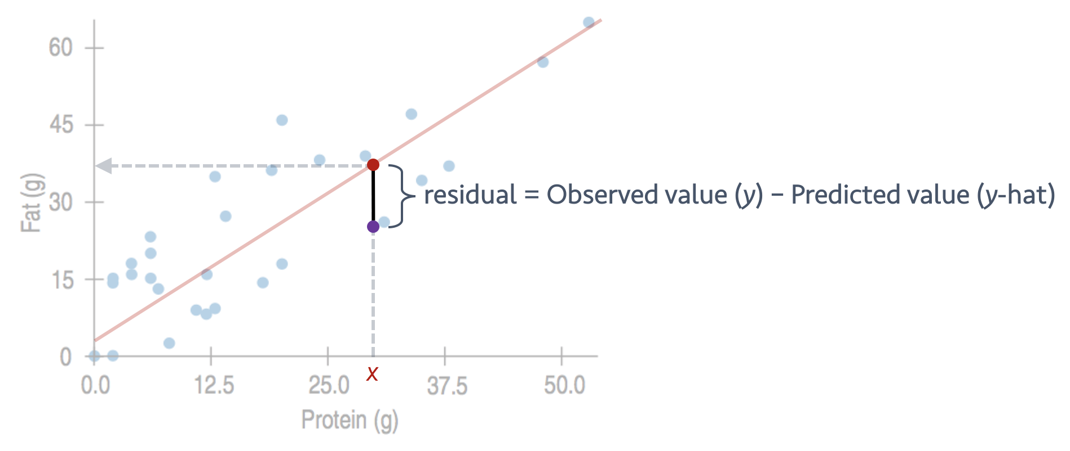
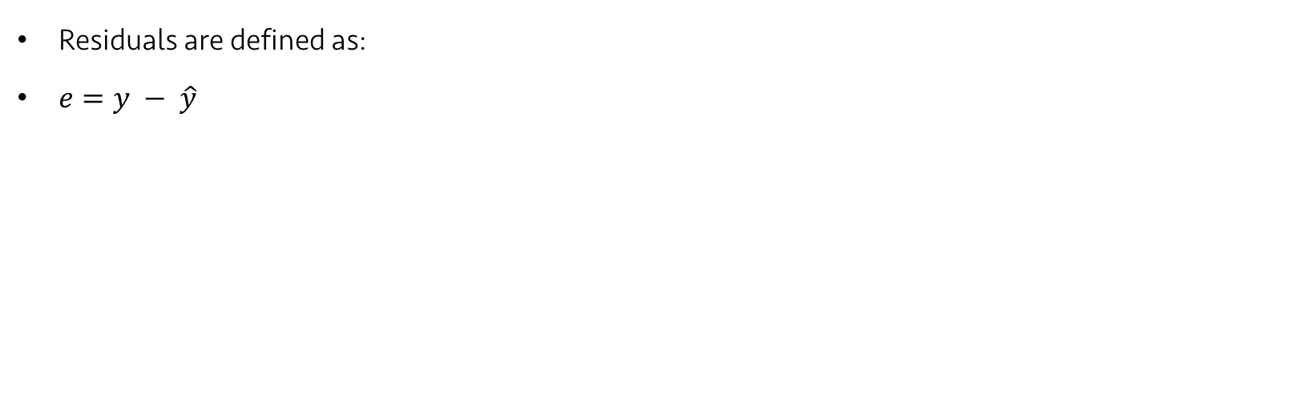
Lecture 06
Examining the residuals
Residuals are defined as:
$e=y − \hat{y}$
CHOONG-WAN WOO | COCOAN lab | http://cocoanlab.github.io

Slide 12
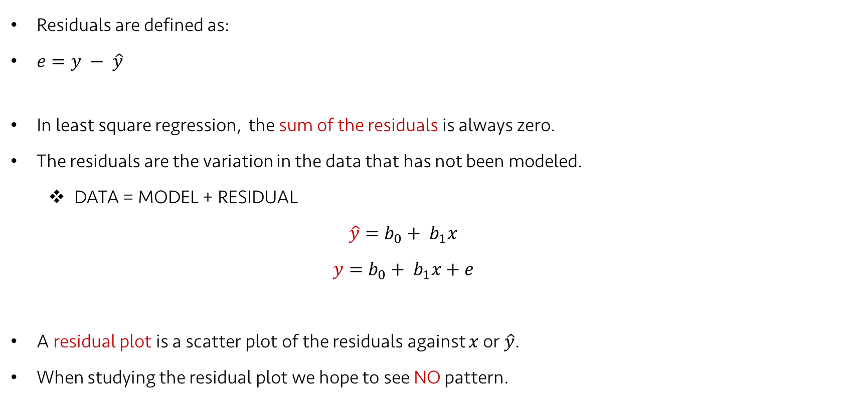
Lecture 06
Examining the residuals
Residuals are defined as:
$e=y − \hat{y}$
In least square regression, the sum of the residuals is always zero.
The residuals are the variation in the data that has not been modeled.
DATA = MODEL + RESIDUAL
$$\hat{y}=b_{0}+ b_{1}x$$
$$y=b_{0}+ b_{1}x+e$$
A residual plot is a scatter plot of the residuals against $x$ or $\hat{y}$.
When studying the residual plot we hope to see NO pattern.
Slide partly from Martin Lindquist
CHOONG-WAN WOO | COCOAN lab | http://cocoanlab.github.io

Slide 13
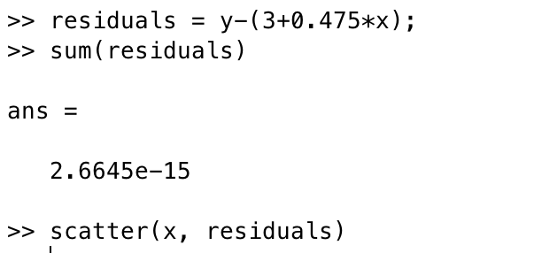
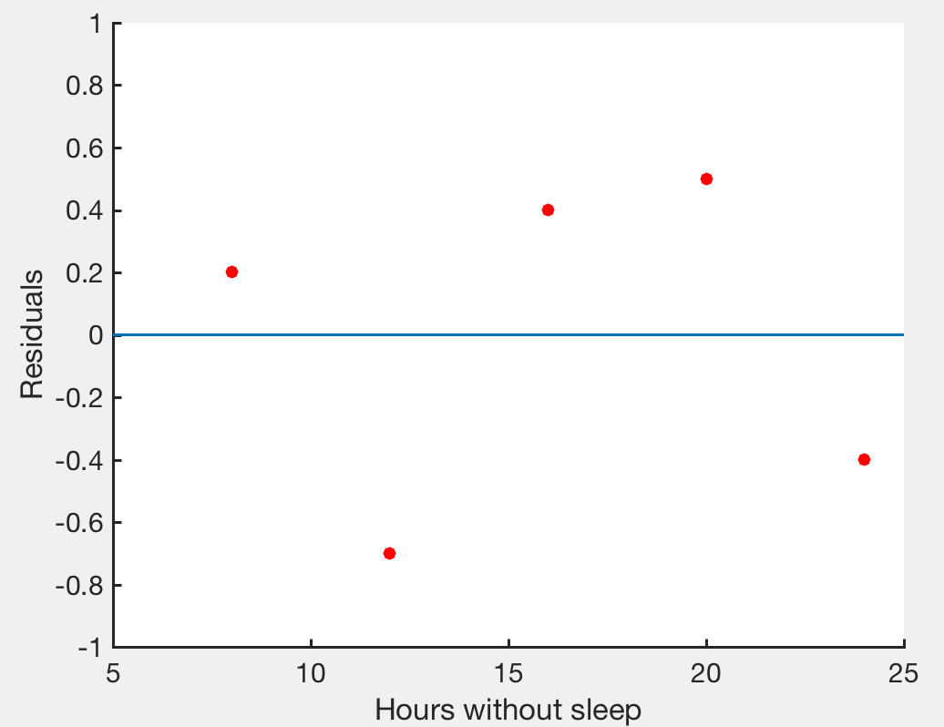
Lecture 06
Examining the residuals: Sleep study
Errors | 7 | 8 | 11 | 13 | 14
Hours without sleep | 8 | 12 | 16 | 20 | 24
The sum of the residuals is zero.
should be the most boring scatterplot you’ve ever seen!
shouldn’t have any interesting features, direction or shape
should stretch horizontally, with about same amount of scatter throughout
No bends, no outliers
CHOONG-WAN WOO | COCOAN lab | http://cocoanlab.github.io

Slide 14
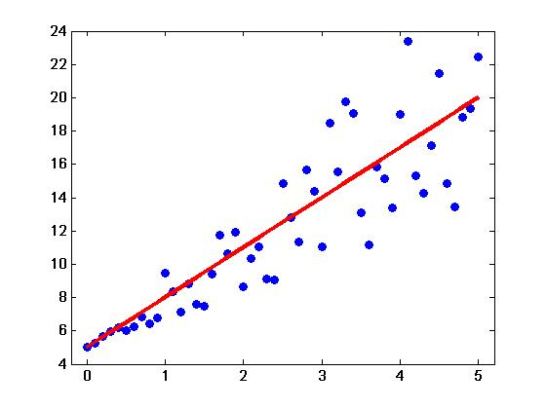
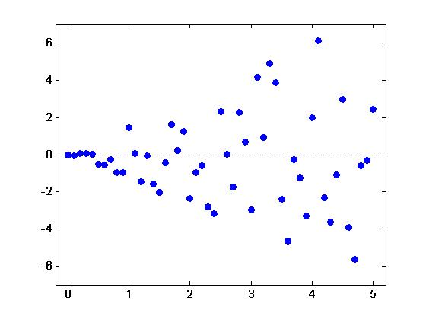

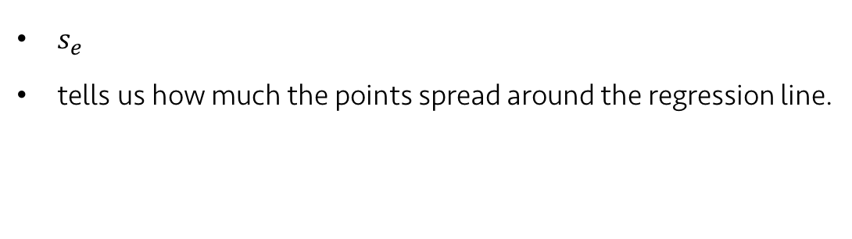
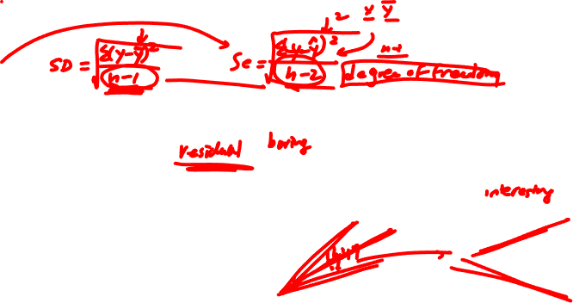
Lecture 06
Residual standard deviation
$s_{e}$
tells us how much the points spread around the regression line.
$$s_{e}=\sqrt{\frac{\sum{e^{2}}}{n−2}}$$
Revisit: Correlation assumptions and conditions
Quantitative variables condition
Straight enough condition
No outliers condition
In regression, one more condition:
Does the Plot Thicken? Condition
Equal variance assumption
The spread around the line should not increase as x or the predicted values increase.
CHOONG-WAN WOO | COCOAN lab | http://cocoanlab.github.io

Slide 15
Lecture 06
Regression Assumptions and Conditions
Quantitative Variable Condition
Straight Enough Condition
Outlier Condition
Does the Plot Thicken? Condition
Examining residual plots:
No bends (Straight Enough Condition)
No outlier (Outlier Condition): “examine points with large residuals”
No changes in the spread (Does the Plot Thicken? Condition)
CHOONG-WAN WOO | COCOAN lab | http://cocoanlab.github.io

Slide 16
Lecture 06
Quiz 06-2
https://forms.gle/mxkQrTJrbWgNNcwS6
CHOONG-WAN WOO | COCOAN lab | http://cocoanlab.github.io

Slide 17
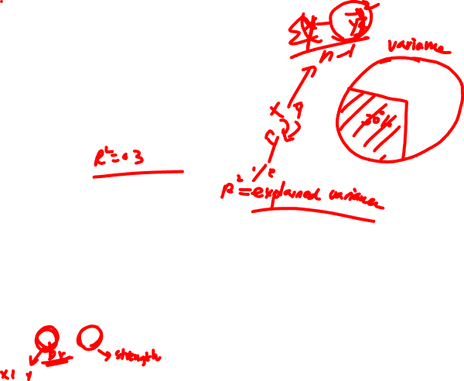
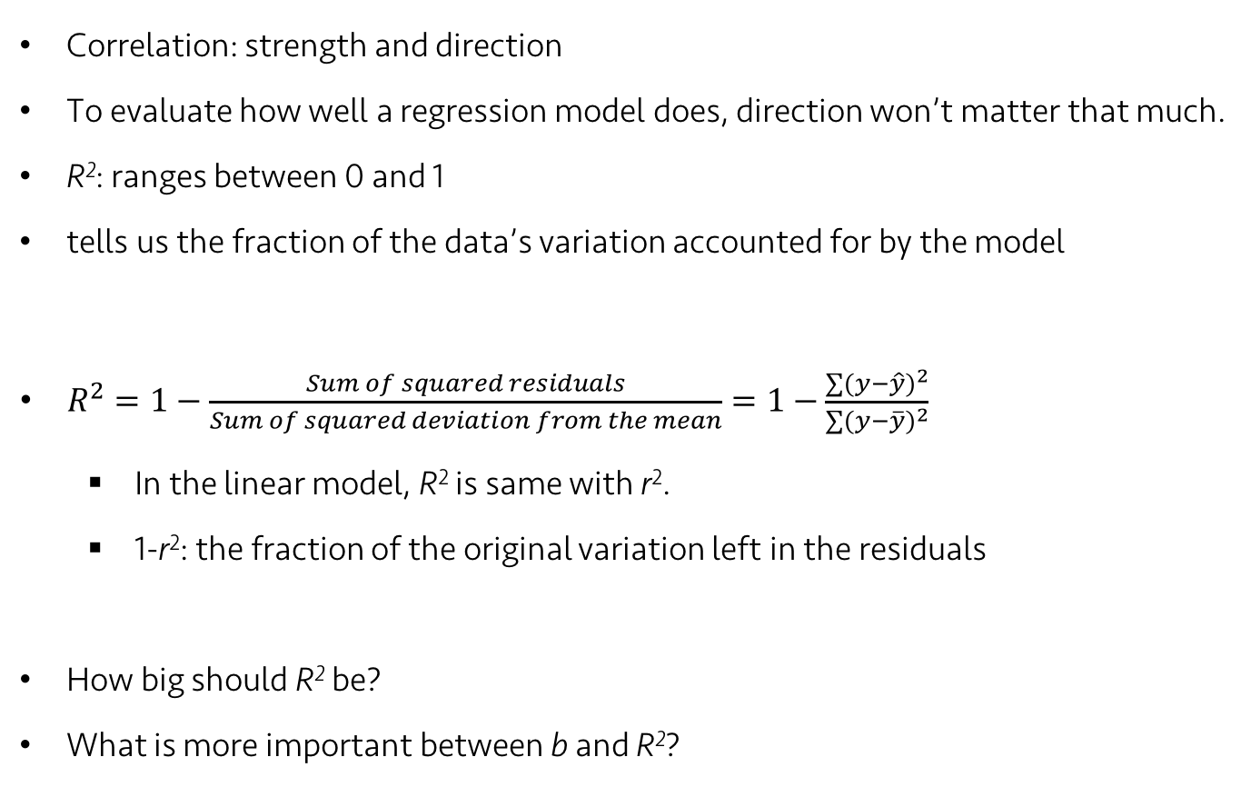
Lecture 06
Assessing regression model: R²
Correlation: strength and direction
To evaluate how well a regression model does, direction won’t matter that much.
R²: ranges between 0 and 1
tells us the fraction of the data’s variation accounted for by the model
$R^{2}=1−\frac{Sum of squared residuals}{Sum of squared deviation from the mean}=1−\frac{\sum{{(y−\hat{y})}^{2}}}{\sum{{(y−\overline{y})}^{2}}}$
In the linear model, R² is same with r².
1-r²: the fraction of the original variation left in the residuals
How big should R² be?
What is more important between b and R²?
It depends! Data type, field, etc.
It depends! Data type, field, research question, etc.
CHOONG-WAN WOO | COCOAN lab | http://cocoanlab.github.io

Slide 18
Lecture 06
Quiz 06-3
https://forms.gle/5QmnpuRBqnKiJHjn9
CHOONG-WAN WOO | COCOAN lab | http://cocoanlab.github.io

Slide 19
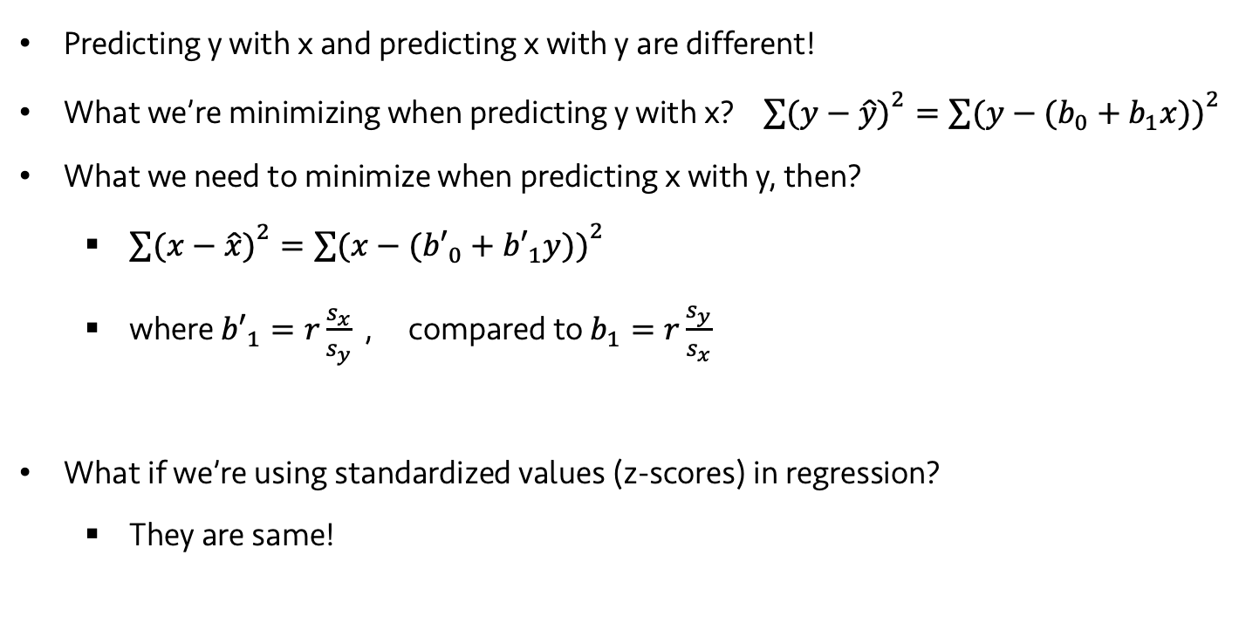
Lecture 06
Predicting in the Other Direction
Predicting y with x and predicting x with y are different!
What we’re minimizing when predicting y with x? ${\sum{(y−\hat{y})}}^{2}={\sum{(y−(b_{0}+b_{1}x))}}^{2}$
What we need to minimize when predicting x with y, then?
${\sum{(x−\hat{x})}}^{2}={\sum{(x−({b′}_{0}+{b′}_{1}y))}}^{2}$
where ${b′}_{1}=r\frac{s_{x}}{s_{y}}$ , compared to $b_{1}=r\frac{s_{y}}{s_{x}}$
What if we’re using standardized values (z-scores) in regression?
They are same!
CHOONG-WAN WOO | COCOAN lab | http://cocoanlab.github.io

Slide 20
Lecture 06
Quiz 06-4
https://forms.gle/kBPPWdpbxqKUwTsG7
CHOONG-WAN WOO | COCOAN lab | http://cocoanlab.github.io

Slide 21
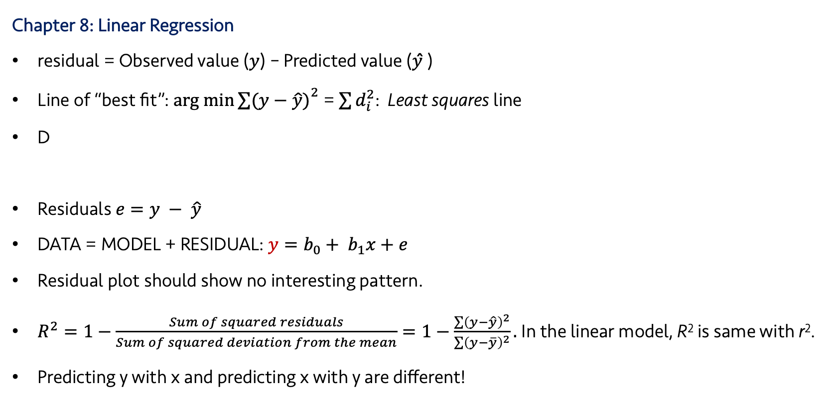
Lecture 06
Key Points
Chapter 8: Linear Regression
residual = Observed value (𝑦) – Predicted value (𝑦 ̂)
Line of “best fit”: $arg min{\sum{(y−\hat{y})}}^{2}$ = $\sum{d_{i}^{2}}$: Least squares line
D
Residuals $e=y − \hat{y}$
DATA = MODEL + RESIDUAL: $y=b_{0}+ b_{1}x+e$
Residual plot should show no interesting pattern.
$R^{2}=1−\frac{Sum of squared residuals}{Sum of squared deviation from the mean}=1−\frac{\sum{{\left(y−\hat{y}\right)}^{2}}}{\sum{{\left(y−\overline{y}\right)}^{2}}}.$In the linear model, R² is same with r².
Predicting y with x and predicting x with y are different!
Slope,
Intercept,
CHOONG-WAN WOO | COCOAN lab | http://cocoanlab.github.io

