Slide 1


Spring 2021
SKKU Biostats and Big data
CHOONG-WAN WOO | COCOAN lab | http://cocoanlab.github.io

Slide 2
GBME Probability and Statistics
Lecture 19
Lecture 19
Comparing Groups
CHOONG-WAN WOO | COCOAN lab | http://cocoanlab.github.io

Slide 3
Lecture 19
Review: Key Points
More about Tests and Intervals
Type I error: the null hypothesis is true, but we mistakenly reject it (false positive)
Type II error: The null hypothesis is false, but we fail to reject it (false negative)
Alpha: how small the P-value should be, P(Type I error)
Beta: the probability of Type II error
Power = 1 – beta
Winner’s curse: increased bias in low powered studies
Effect size: the distance between the null hypothesis value and the truth, but similar to signal-to-noise ratio
CHOONG-WAN WOO | COCOAN lab | http://cocoanlab.github.io

Slide 4
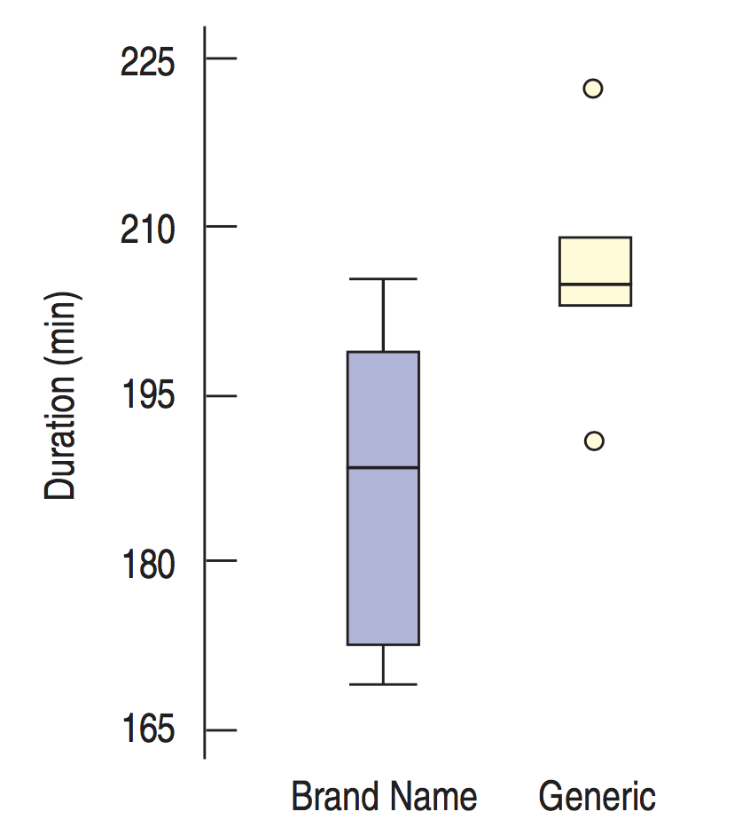
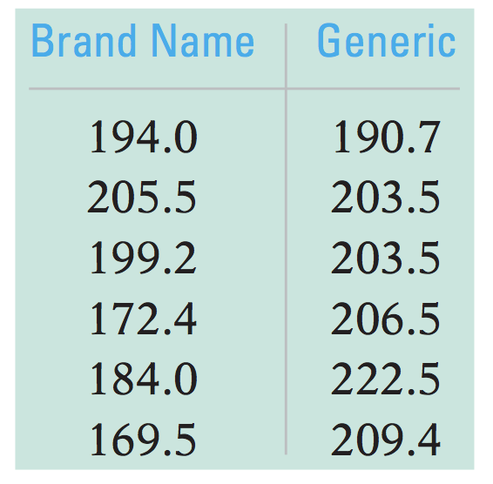

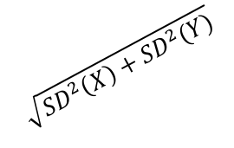

Lecture 19
Standard deviation of a difference
Mean lifetime of brand-name vs. generic batteries:
Pythagorean Theorem of Statistics
$$\sqrt{{SD}^{2}\left(X\right)+{SD}^{2}(Y)}$$
$$SD(Y)$$
$$SD(X)$$
We observed the difference between two groups.
What’s the true difference for the general population?
Pythagorean Theorem of Statistics: “The variance of the sum or difference of two independent random variables is the sum of their variances.”
CHOONG-WAN WOO | COCOAN lab | http://cocoanlab.github.io

Slide 5
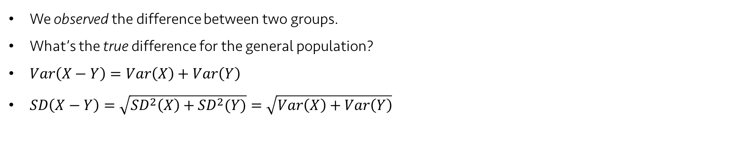
Lecture 19
Standard deviation of a difference
Mean lifetime of brand-name vs. generic batteries:
Pythagorean Theorem of Statistics
$$\sqrt{{SD}^{2}\left(X\right)+{SD}^{2}(Y)}$$
$$SD(Y)$$
$$SD(X)$$
We observed the difference between two groups.
What’s the true difference for the general population?
$Var\left(X−Y\right)=Var\left(X\right)+Var\left(Y\right)$
$SD\left(X−Y\right)=\sqrt{{SD}^{2}\left(X\right)+{SD}^{2}(Y)}=\sqrt{Var\left(X\right)+Var\left(Y\right)}$
These works only for independent random variables.
CHOONG-WAN WOO | COCOAN lab | http://cocoanlab.github.io

Slide 6
Lecture 19
Quiz 19-1
https://forms.gle/fo1ELjjP3tbtmBwX7
CHOONG-WAN WOO | COCOAN lab | http://cocoanlab.github.io

Slide 7

Lecture 19
The standard deviation of the difference between two proportions
$SD\left({\hat{p}}_{1}\right)= \sqrt{\frac{p_{1}q_{1}}{n_{1}}}$ and $SD\left({\hat{p}}_{2}\right)= \sqrt{\frac{p_{2}q_{2}}{n_{2}}}$
$Var\left({\hat{p}}_{1}−{\hat{p}}_{2}\right)={(\sqrt{\frac{p_{1}q_{1}}{n_{1}}})}^{2}+{(\sqrt{\frac{p_{2}q_{2}}{n_{2}}} )}^{2}=\frac{p_{1}q_{1}}{n_{1}}+\frac{p_{2}q_{2}}{n_{2}}$
$SD\left({\hat{p}}_{1}−{\hat{p}}_{2}\right)=\sqrt{\frac{p_{1}q_{1}}{n_{1}}+\frac{p_{2}q_{2}}{n_{2}}}$
$SE\left({\hat{p}}_{1}−{\hat{p}}_{2}\right)=\sqrt{\frac{{\hat{p}}_{1}{\hat{q}}_{1}}{n_{1}}+\frac{{\hat{p}}_{2}{\hat{q}}_{2}}{n_{2}}}$
CHOONG-WAN WOO | COCOAN lab | http://cocoanlab.github.io

Slide 8
Lecture 19
Assumptions and Conditions for Comparing Proportions
Independence Assumption
Randomization condition
The 10% condition
Sample Size
Success/Failure Condition: at least 10 successes and 10 failures
Independent Groups Assumption
Usually, this assumption is evident from the way the data were collected.
E.g., comparing husbands with their wives,
or comparing subjects before vs. after some treatment
CHOONG-WAN WOO | COCOAN lab | http://cocoanlab.github.io

Slide 9
Lecture 19
Quiz 19-2
https://forms.gle/6LBgL5wh3JoPebcC6
CHOONG-WAN WOO | COCOAN lab | http://cocoanlab.github.io

Slide 10
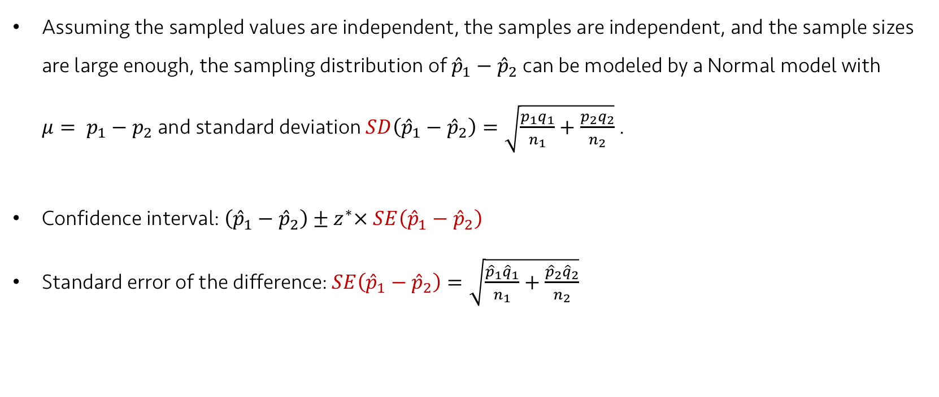
Lecture 19
Confidence Interval for the Difference between two proportions
Assuming the sampled values are independent, the samples are independent, and the sample sizes are large enough, the sampling distribution of ${\hat{p}}_{1}−{\hat{p}}_{2}$ can be modeled by a Normal model with $μ= p_{1}−$ $p_{2}$ and standard deviation $SD\left({\hat{p}}_{1}−{\hat{p}}_{2}\right)=\sqrt{\frac{p_{1}q_{1}}{n_{1}}+\frac{p_{2}q_{2}}{n_{2}}}$ .
Confidence interval: $\left({\hat{p}}_{1}−{\hat{p}}_{2}\right)±z^{∗}× SE\left({\hat{p}}_{1}−{\hat{p}}_{2}\right)$
Standard error of the difference: $SE\left({\hat{p}}_{1}−{\hat{p}}_{2}\right)=\sqrt{\frac{{\hat{p}}_{1}{\hat{q}}_{1}}{n_{1}}+\frac{{\hat{p}}_{2}{\hat{q}}_{2}}{n_{2}}}$
CHOONG-WAN WOO | COCOAN lab | http://cocoanlab.github.io

Slide 11
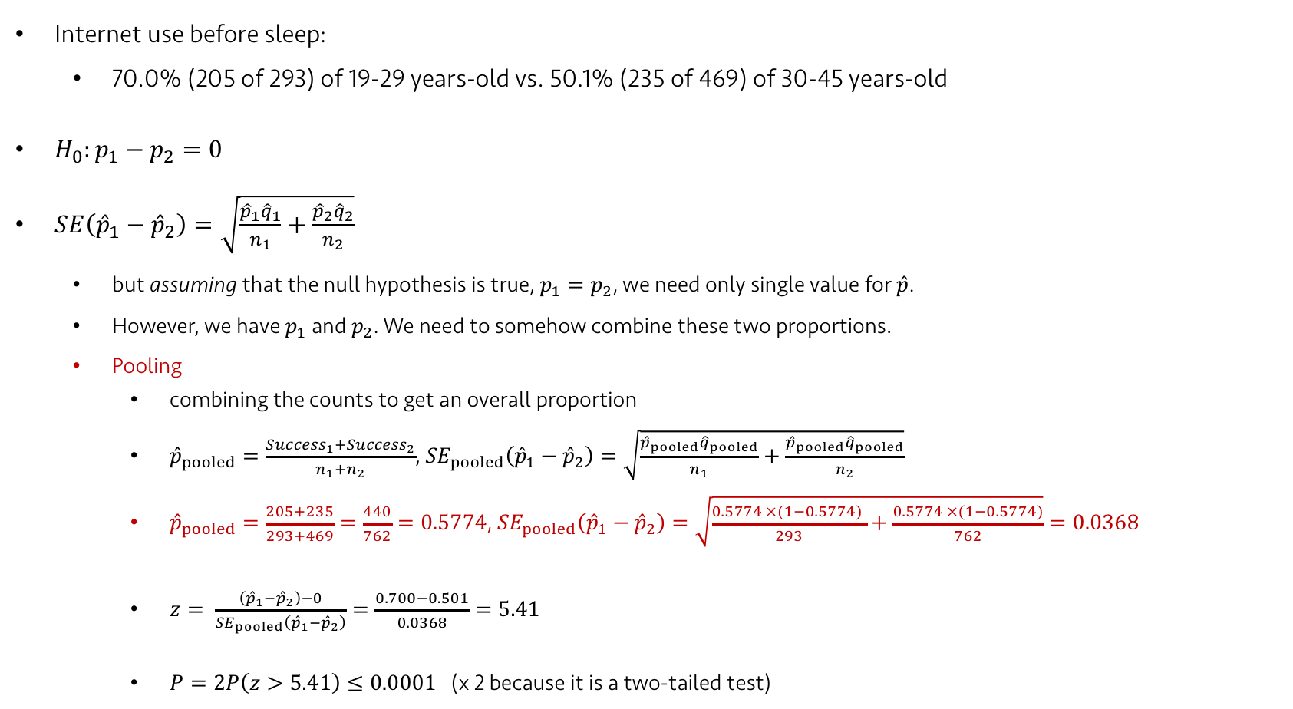
Lecture 19
Two sample z-test: Testing for the differences between proportions
Internet use before sleep:
70.0% (205 of 293) of 19-29 years-old vs. 50.1% (235 of 469) of 30-45 years-old
$H_{0}:p_{1}−p_{2}=0$
$SE\left({\hat{p}}_{1}−{\hat{p}}_{2}\right)=\sqrt{\frac{{\hat{p}}_{1}{\hat{q}}_{1}}{n_{1}}+\frac{{\hat{p}}_{2}{\hat{q}}_{2}}{n_{2}}}$
but assuming that the null hypothesis is true, $p_{1}=p_{2}$, we need only single value for $\hat{p}$.
However, we have $p_{1}$ and $p_{2}$. We need to somehow combine these two proportions.
Pooling
combining the counts to get an overall proportion
${\hat{p}}_{pooled}=\frac{{Success}_{1}+{Success}_{2}}{n_{1}+n_{2}}$, ${SE}_{pooled}\left({\hat{p}}_{1}−{\hat{p}}_{2}\right)=\sqrt{\frac{{\hat{p}}_{pooled}{\hat{q}}_{pooled}}{n_{1}}+\frac{{\hat{p}}_{pooled}{\hat{q}}_{pooled}}{n_{2}}}$
${\hat{p}}_{pooled}=\frac{205+235}{293+469}=\frac{440}{762}=0.5774$, ${SE}_{pooled}\left({\hat{p}}_{1}−{\hat{p}}_{2}\right)=\sqrt{\frac{0.5774 ×(1−0.5774) }{293}+\frac{0.5774 ×(1−0.5774)}{762}}=0.0368$
$z= \frac{\left({\hat{p}}_{1}−{\hat{p}}_{2}\right)−0}{{SE}_{pooled}\left({\hat{p}}_{1}−{\hat{p}}_{2}\right)}=\frac{0.700−0.501}{0.0368}=5.41$
$P=2P\left(z>5.41\right)≤0.0001$ (x 2 because it is a two-tailed test)
CHOONG-WAN WOO | COCOAN lab | http://cocoanlab.github.io

Slide 12
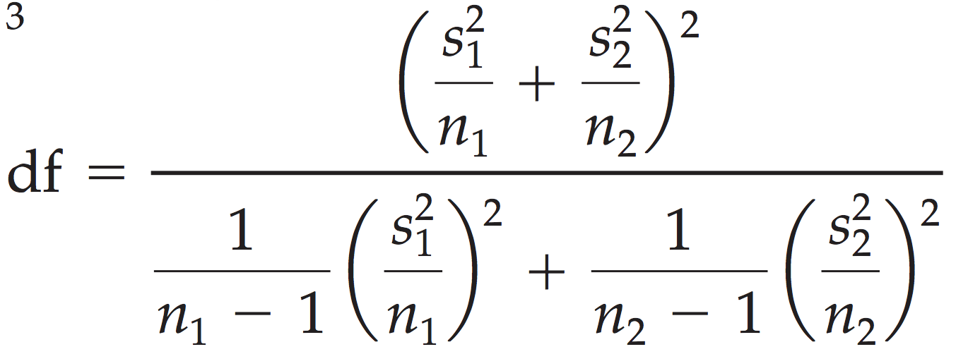

Lecture 19
Confidence Interval for the Difference between two means
$SD\left({\overline{y}}_{1}−{\overline{y}}_{2}\right)=\sqrt{Var\left({\overline{y}}_{1}\right)+Var({\overline{y}}_{2})}=\sqrt{\frac{σ_{1}^{2}}{n_{1}}+\frac{σ_{2}^{2}}{n_{2}}}$
$SE\left({\overline{y}}_{1}−{\overline{y}}_{2}\right)=\sqrt{\frac{s_{1}^{2}}{n_{1}}+\frac{s_{2}^{2}}{n_{2}}}$
Two-sample t-interval: The sampling model is Student’s t with adjusted degrees-of-freedom value
$\left({\overline{y}}_{1}−{\overline{y}}_{2}\right)±ME, where ME=t_{df}^{∗}× SE\left({\overline{y}}_{1}−{\overline{y}}_{2}\right)$
CHOONG-WAN WOO | COCOAN lab | http://cocoanlab.github.io

Slide 13

Lecture 19
Two-Sample t-test
$H_{0}:μ_{1}−μ_{2}=Δ_{0}$
many times $Δ_{0}$ = 0
$t= \frac{\left({\overline{y}}_{1}−{\overline{y}}_{2}\right)−Δ_{0}}{SE\left({\overline{y}}_{1}−{\overline{y}}_{2}\right)}$
$SE\left({\overline{y}}_{1}−{\overline{y}}_{2}\right)=\sqrt{\frac{s_{1}^{2}}{n_{1}}+\frac{s_{2}^{2}}{n_{2}}}$
When the conditions are met and the null hypothesis is true, the statistic can be closely modeled by a Student’s t-model with a number of degrees of freedom (adjusted). We use that model to obtain P-value.
CHOONG-WAN WOO | COCOAN lab | http://cocoanlab.github.io

Slide 14
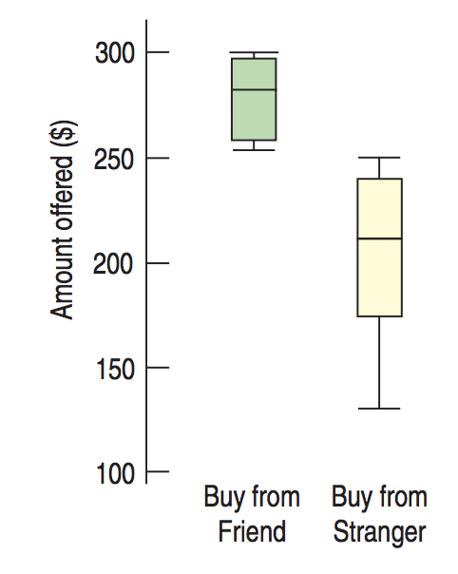
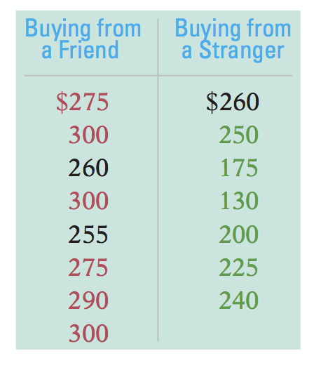
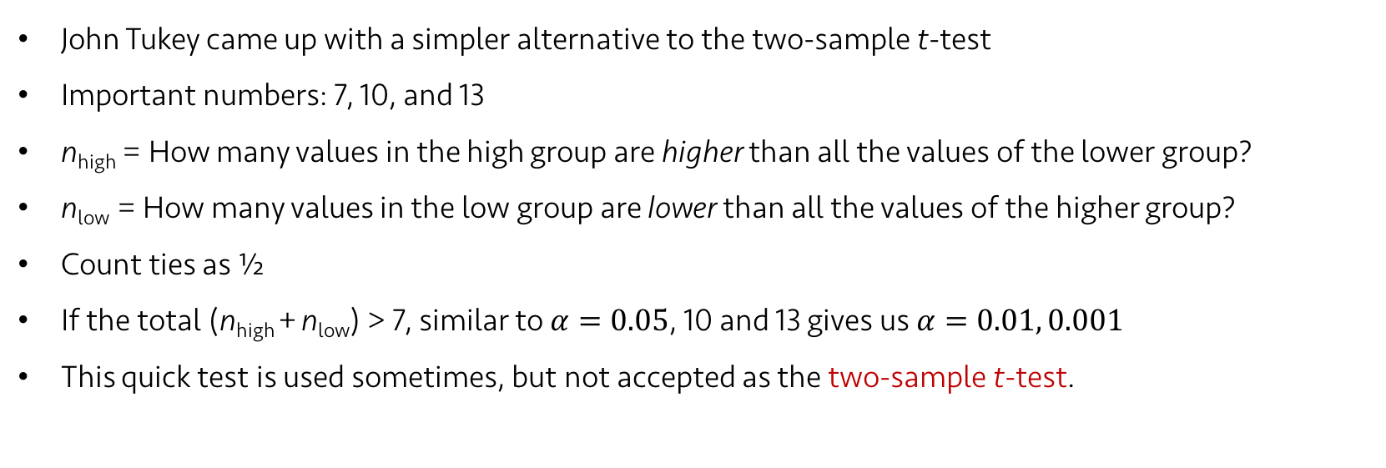
Lecture 19
Distribution-free test: 1) Tukey’s Quick Test
John Tukey came up with a simpler alternative to the two-sample t-test
Important numbers: 7, 10, and 13
n_{high} = How many values in the high group are higher than all the values of the lower group?
n_{low} = How many values in the low group are lower than all the values of the higher group?
Count ties as ½
If the total (n_{high} + n_{low}) > 7, similar to $α=0.05$, 10 and 13 gives us $α=0.01, 0.001$
This quick test is used sometimes, but not accepted as the two-sample t-test.
n_{high} = 6.5 (1 tie: $260)
n_{low} = 6
12.5, thus P-value is between 0.01 and 0.001
CHOONG-WAN WOO | COCOAN lab | http://cocoanlab.github.io

Slide 15
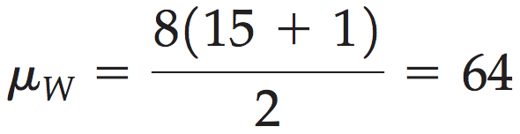
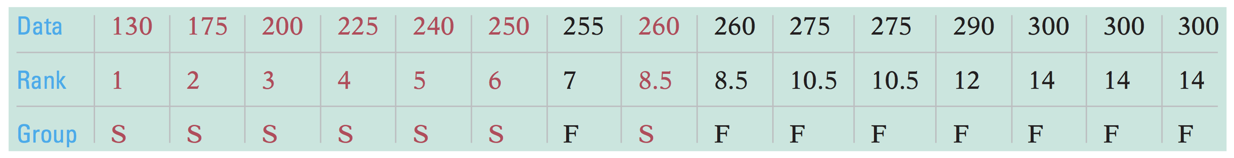
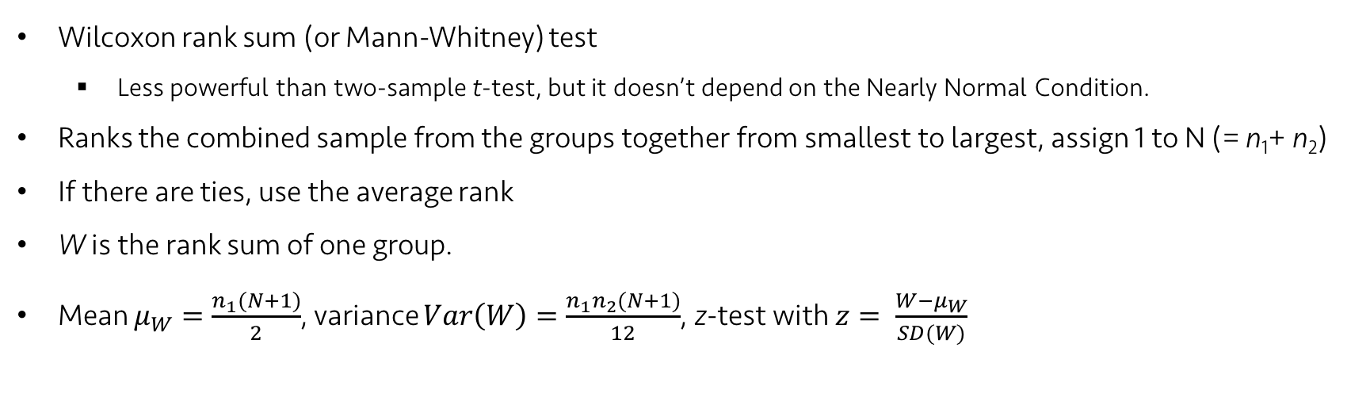
Lecture 19
Distribution-free test: 2) Rank Sum test
Wilcoxon rank sum (or Mann-Whitney) test
Less powerful than two-sample t-test, but it doesn’t depend on the Nearly Normal Condition.
Ranks the combined sample from the groups together from smallest to largest, assign 1 to N (= n₁+ n₂)
If there are ties, use the average rank
W is the rank sum of one group.
Mean $μ_{W}=\frac{n_{1}(N+1)}{2}$, variance $Var\left(W\right)=\frac{n_{1}n_{2}(N+1)}{12}$, z-test with $z= \frac{W−μ_{W}}{SD(W)}$
CHOONG-WAN WOO | COCOAN lab | http://cocoanlab.github.io

Slide 16
Lecture 19
Quiz 19-3
https://forms.gle/Bk6i7pCmqgHN3rrP6
CHOONG-WAN WOO | COCOAN lab | http://cocoanlab.github.io

Slide 17
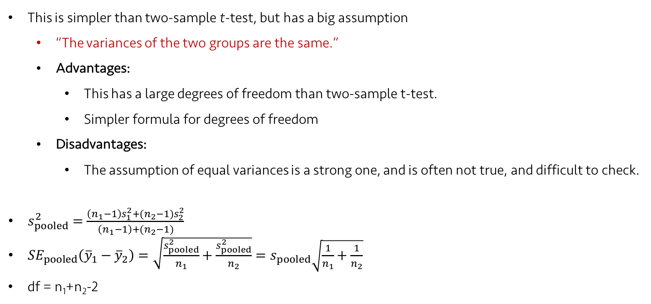
Lecture 19
Pooled t-test
This is simpler than two-sample t-test, but has a big assumption
“The variances of the two groups are the same.”
Advantages:
This has a large degrees of freedom than two-sample t-test.
Simpler formula for degrees of freedom
Disadvantages:
The assumption of equal variances is a strong one, and is often not true, and difficult to check.
$s_{pooled}^{2}=\frac{\left(n_{1}−1\right)s_{1}^{2}+(n_{2}−1)s_{2}^{2}}{\left(n_{1}−1\right)+(n_{2}−1)}$
${SE}_{pooled}\left({\overline{y}}_{1}−{\overline{y}}_{2}\right)=\sqrt{\frac{s_{pooled}^{2}}{n_{1}}+\frac{s_{pooled}^{2}}{n_{2}}}=s_{pooled}\sqrt{\frac{1}{n_{1}}+\frac{1}{n_{2}}}$
df = n₁+n₂-2
CHOONG-WAN WOO | COCOAN lab | http://cocoanlab.github.io

Slide 18
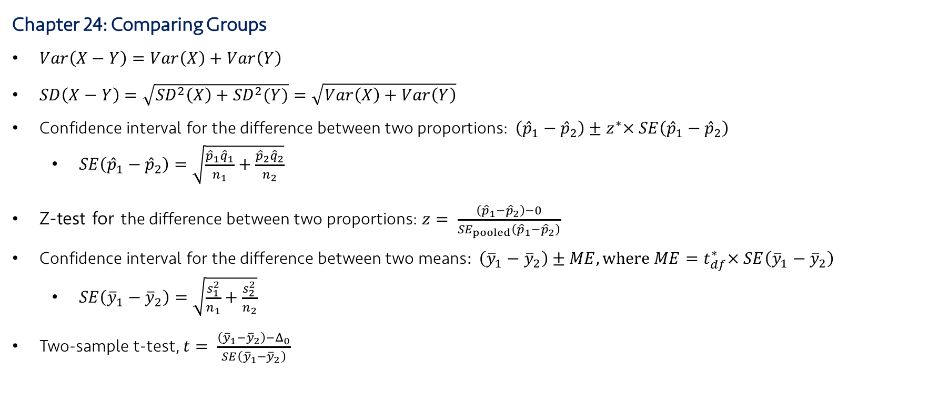
Lecture 19
Key Points
Chapter 24: Comparing Groups
$Var\left(X−Y\right)=Var\left(X\right)+Var\left(Y\right)$
$SD\left(X−Y\right)=\sqrt{{SD}^{2}\left(X\right)+{SD}^{2}(Y)}=\sqrt{Var\left(X\right)+Var\left(Y\right)}$
Confidence interval for the difference between two proportions: $\left({\hat{p}}_{1}−{\hat{p}}_{2}\right)±z^{∗}× SE\left({\hat{p}}_{1}−{\hat{p}}_{2}\right)$
$SE\left({\hat{p}}_{1}−{\hat{p}}_{2}\right)=\sqrt{\frac{{\hat{p}}_{1}{\hat{q}}_{1}}{n_{1}}+\frac{{\hat{p}}_{2}{\hat{q}}_{2}}{n_{2}}}$
Z-test for the difference between two proportions: $z= \frac{\left({\hat{p}}_{1}−{\hat{p}}_{2}\right)−0}{{SE}_{pooled}\left({\hat{p}}_{1}−{\hat{p}}_{2}\right)}$
$\text{Confidence} \text{interval} \text{for} \text{the} \text{difference} \text{between} \text{two} \text{means}: \left({\overline{y}}_{1}−{\overline{y}}_{2}\right)±ME, where ME=t_{df}^{∗}× SE\left({\overline{y}}_{1}−{\overline{y}}_{2}\right)$
$SE\left({\overline{y}}_{1}−{\overline{y}}_{2}\right)=\sqrt{\frac{s_{1}^{2}}{n_{1}}+\frac{s_{2}^{2}}{n_{2}}}$
Two-sample t-test, $t= \frac{\left({\overline{y}}_{1}−{\overline{y}}_{2}\right)−Δ_{0}}{SE\left({\overline{y}}_{1}−{\overline{y}}_{2}\right)}$
CHOONG-WAN WOO | COCOAN lab | http://cocoanlab.github.io

