Slide 1

Introduction
Dr Fan Bi
毕凡

Slide 2
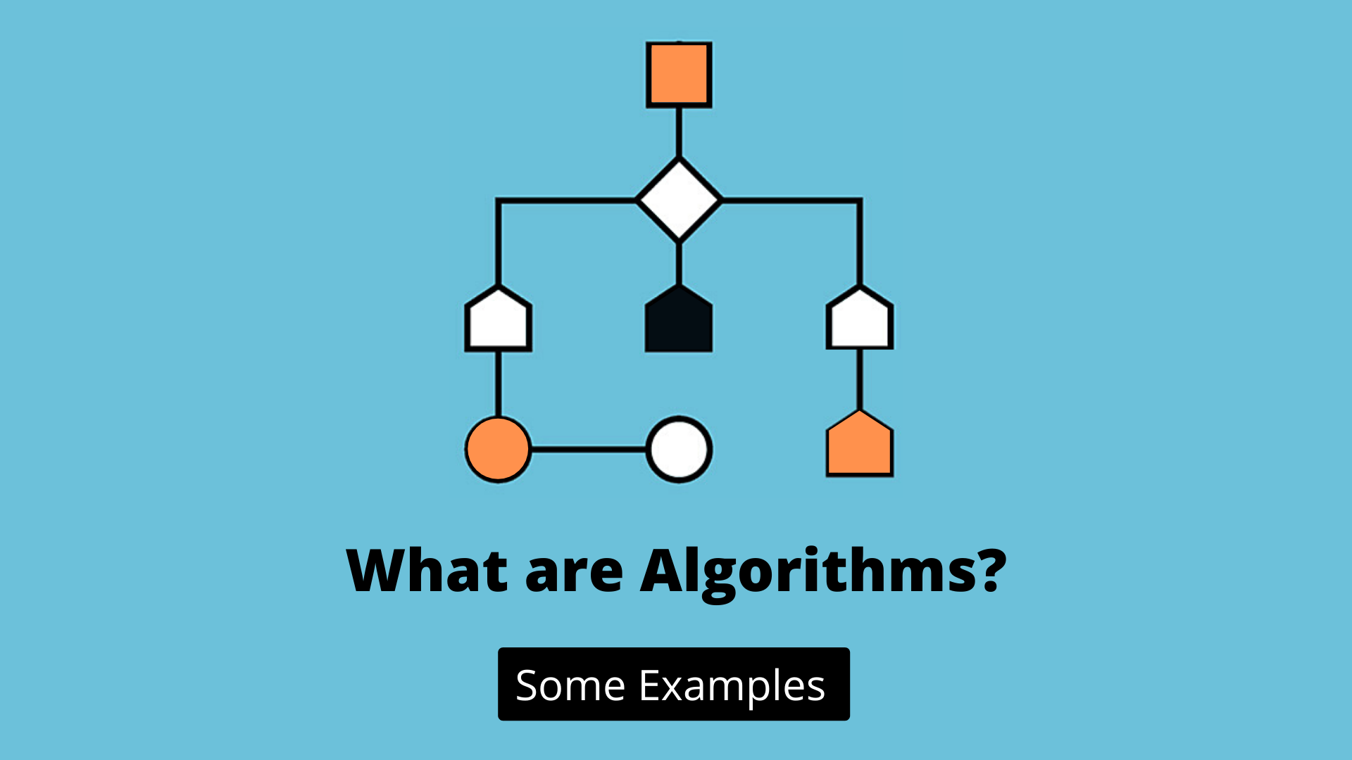

Slide 3
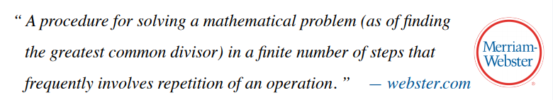
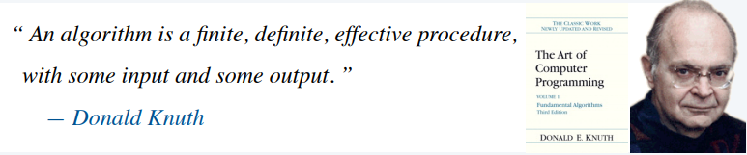
Algorithm definitions

Slide 4
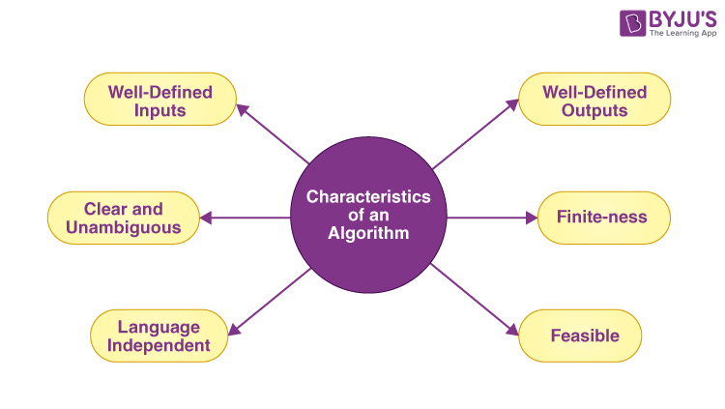

Slide 5

网络视频
https://www.youtube.com/watch?v=oRkNaF0QvnI
温馨提示：此视频框在点击“上传手机课件”时会进行转换，用手机进行观看时则会变为可点击的视频。此视频框可被拖动移位和修改大小

Slide 6
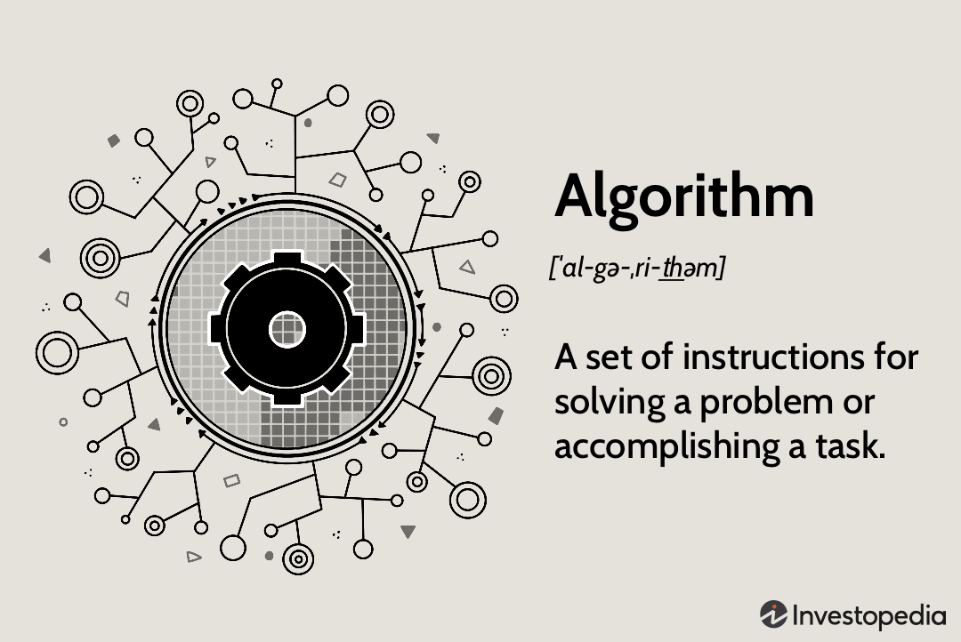
Why study algorithms?

Slide 7
Grades
Class Participation: 30%
Exercise: 70%
  Grading. We will determine your course grade based primarily on weekly problem sets, using class participation and staff discretion to resolve borderline situations. We will grade your problem sets for correctness, clarity, and conciseness. (You can write in word, LaTeX or Markdown etc. Please send me pdf files for grading.)

Slide 8
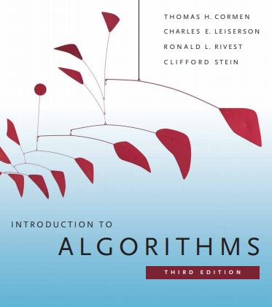
Recommended Resources
Algorithm Design by Jon Kleinberg and Éva Tardos. Addison-Wesley, 2005.
Introduction to Algorithms, Third Edition by Thomas Cormen, Charles Leiserson, Ronald Rivest, and Clifford Stein. MIT Press, 2009.
Algorithms by Jeff Erickson.
Algorithms by Sanjoy Dasgupta, Christos Papadimitriou, and Umesh Vazirani. McGraw Hill, 2006.
Data Structures and Network Algorithms by Robert Tarjan. Society for Industrial and Applied Mathematics, 1987.

Slide 9

Any questions

