Slide 1
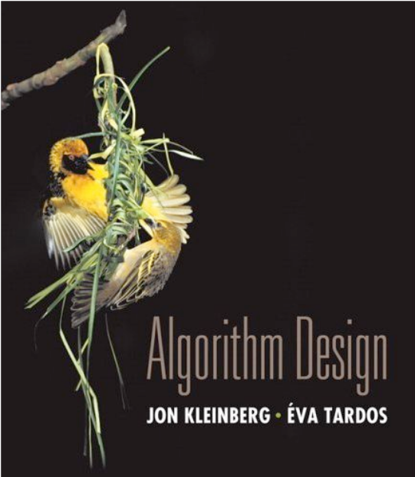

1. Representative Problems
stable matching
five representative problems
Lecture slides by Kevin Wayne Copyright © 2005 Pearson-Addison Wesley
Copyright © 2013 Kevin Wayne
http://www.cs.princeton.edu/~wayne/kleinberg-tardos
Last updated on Mar 14, 2014, 5:36 PM

Slide 2
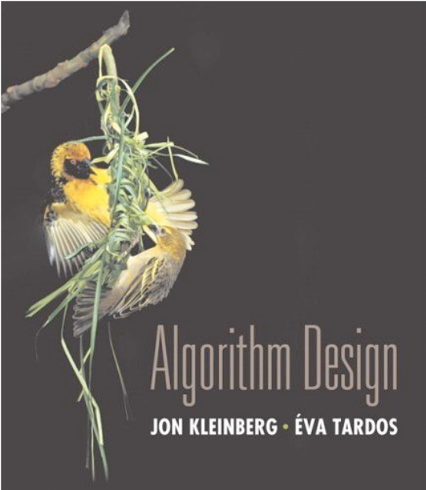

1. Representative Problems
stable matching
five representative problems
Section 1.1

Slide 3

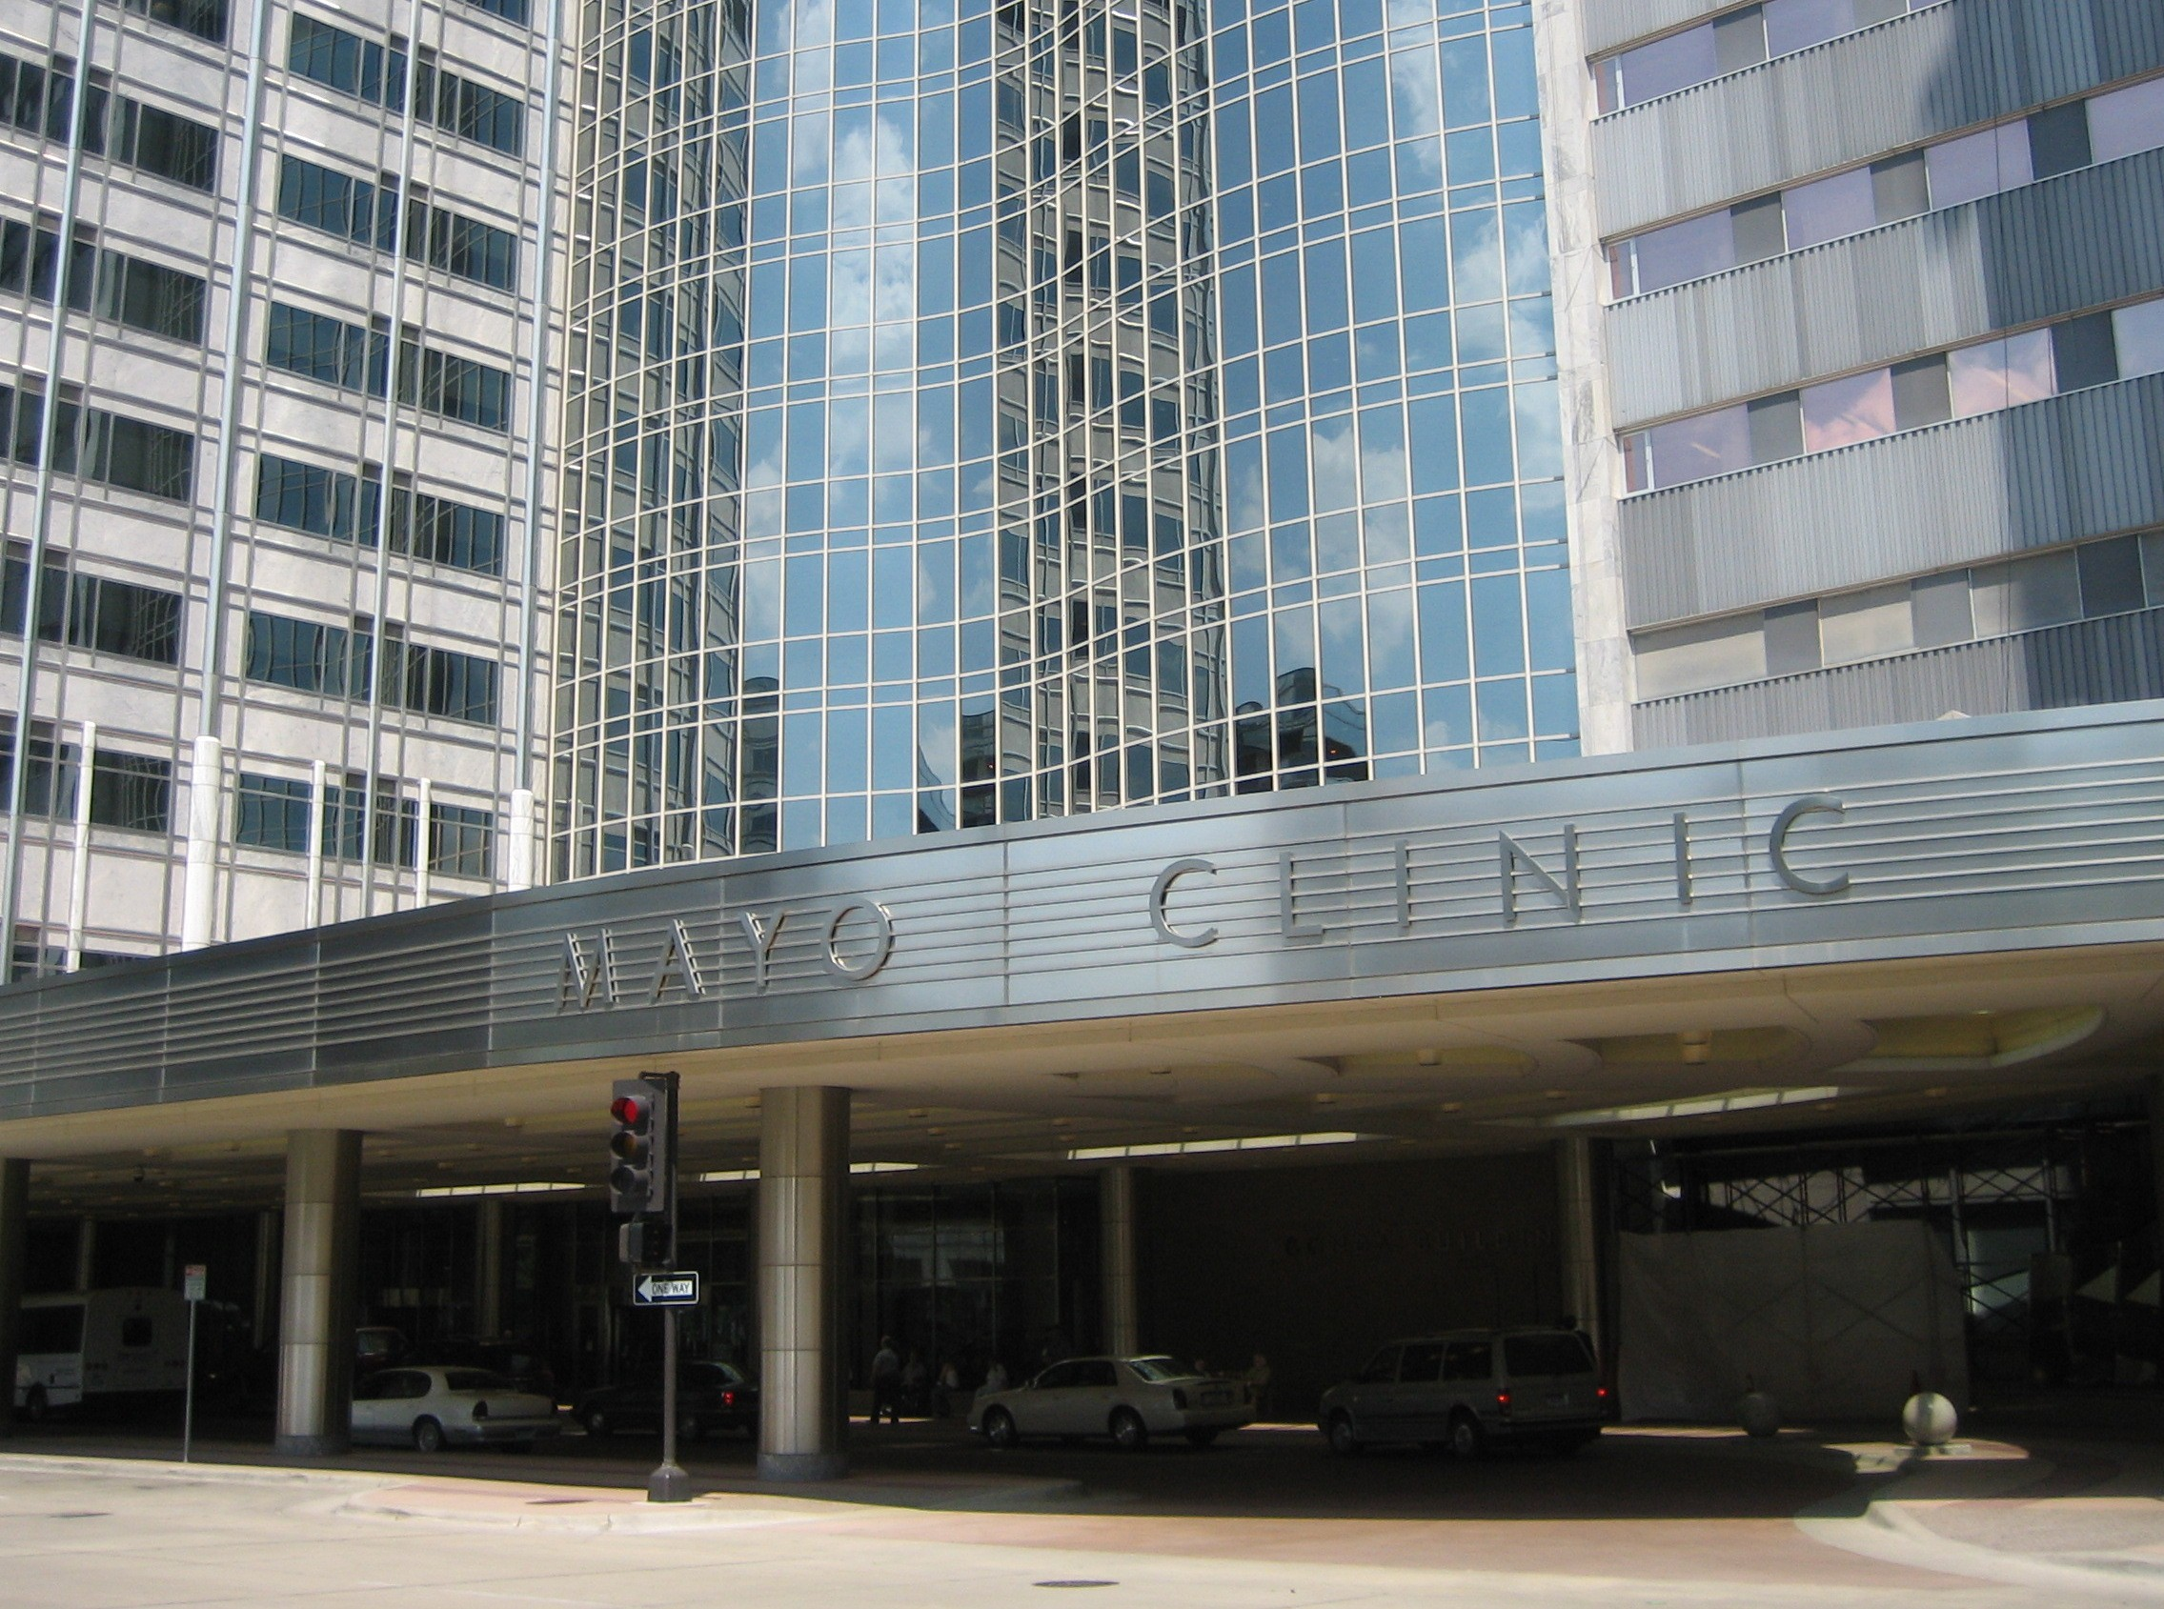
Matching med-school students to hospitals
Goal. Given a set of preferences among hospitals and med-school students, design a self-reinforcing admissions process.
Unstable pair: student x and hospital y are unstable if:
・x prefers y to its assigned hospital.
・y prefers x to one of its admitted students.
Stable assignment. Assignment with no unstable pairs.
・Natural and desirable condition.
・Individual self-interest prevents any hospital–student side deal.

Slide 4
Stable matching problem
Goal. Given a set of n men and a set of n women, find a "suitable" matching.
・Participants rank members of opposite sex.
・Each man lists women in order of preference from best to worst.
・Each woman lists men in order of preference from best to worst.
favorite
least favorite
favorite
least favorite
 | ₁st | ₂nd | ₃rd
Xavier | Amy | Bertha | Clare
Yancey | Bertha | Amy | Clare
Zeus | Amy | Bertha | Clare
 | ₁st | ₂nd | ₃rd
Amy | Yancey | Xavier | Zeus
Bertha | Xavier | Yancey | Zeus
Clare | Xavier | Yancey | Zeus
men's preference list
women's preference list

Slide 5
Perfect matching
Def. A matching S is a set of ordered pairs m–w with m ∈ M and w ∈ W s.t.
・Each man m ∈ M appears in at most one pair of S.
・Each woman w ∈ W appears in at most one pair of S.
Def. A matching S is perfect if | S | = | M | = | W | = n.
 | ₁st | ₂nd | ₃rd
Xavier | Amy | Bertha | Clare
Yancey | Bertha | Amy | Clare
Zeus | Amy | Bertha | Clare
 | ₁st | ₂nd | ₃rd
Amy | Yancey | Xavier | Zeus
Bertha | Xavier | Yancey | Zeus
Clare | Xavier | Yancey | Zeus
a perfect matching S = { X–C, Y–B, Z–A }

Slide 6
Unstable pair
Def. Given a perfect matching S, man m and woman w are unstable if:
・m prefers w to his current partner.
・w prefers m to her current partner.
Key point. An unstable pair m–w could each improve partner by joint action.
 | ₁st | ₂nd | ₃rd
Xavier | Amy | Bertha | Clare
Yancey | Bertha | Amy | Clare
Zeus | Amy | Bertha | Clare
 | ₁st | ₂nd | ₃rd
Amy | Yancey | Xavier | Zeus
Bertha | Xavier | Yancey | Zeus
Clare | Xavier | Yancey | Zeus
Bertha and Xavier are an unstable pair
6

Slide 7
Stable matching problem
Def. A stable matching is a perfect matching with no unstable pairs.
Stable matching problem. Given the preference lists of n men and
n women, find a stable matching (if one exists).
・Natural, desirable, and self-reinforcing condition.
・Individual self-interest prevents any man–woman pair from eloping.
 | ₁st | ₂nd | ₃rd
Xavier | Amy | Bertha | Clare
Yancey | Bertha | Amy | Clare
Zeus | Amy | Bertha | Clare
 | ₁st | ₂nd | ₃rd
Amy | Yancey | Xavier | Zeus
Bertha | Xavier | Yancey | Zeus
Clare | Xavier | Yancey | Zeus
a perfect matching S = { X–A, Y–B, Z–C }

Slide 8
Stable roommate problem
Q. Do stable matchings always exist?
A. Not obvious a priori.
Stable roommate problem.
・2 n people; each person ranks others from 1 to 2 n – 1.
・Assign roommate pairs so that no unstable pairs.
 | ₁st | ₂nd | ₃rd
Adam | B | C | D
Bob | C | A | D
Chris | A | B | D
Doofus | A | B | C
no perfect matching is stable
A–B, C–D
A–C, B–D
A–D, B–C
⇒ B–C unstable
⇒ A–B unstable
⇒ A–C unstable
Observation. Stable matchings need not exist for stable roommate problem.

Slide 9

Gale-Shapley deferred acceptance algorithm
An intuitive method that guarantees to find a stable matching.
GALE–SHAPLEY (preference lists for men and women) INITIALIZE S to empty matching.
WHILE (some man m is unmatched and hasn't proposed to every woman)
w ← first woman on m's list to whom m has not yet proposed.
IF (w is unmatched)
Add pair m–w to matching S.
ELSE IF (w prefers m to her current partner m') Remove pair m'–w from matching S.
Add pair m–w to matching S.
ELSE
w rejects m.
RETURN stable matching S.

Slide 10
Proof of correctness: termination
Observation 1. Men propose to women in decreasing order of preference.
Observation 2. Once a woman is matched, she never becomes unmatched; she only "trades up."
Claim. Algorithm terminates after at most n ² iterations of while loop. Pf. Each time through the while loop a man proposes to a new woman. There are only n ² possible proposals. ▪
 | ₁st | ₂nd | ₃rd | ₄th | ₅th
Victor | A | B | C | D | E
Wyatt | B | C | D | A | E
Xavier | C | D | A | B | E
Yancey | D | A | B | C | E
Zeus | A | B | C | D | E
 | ₁st | ₂nd | ₃rd | ₄th | ₅th
Amy | W | X | Y | Z | V
Bertha | X | Y | Z | V | W
Clare | Y | Z | V | W | X
Diane | Z | V | W | X | Y
Erika | V | W | X | Y | Z
n(n-1) + 1 proposals required

Slide 11
Proof of correctness: perfection
Claim. In Gale-Shapley matching, all men and women get matched. Pf. [by contradiction]
・Suppose, for sake of contradiction, that Zeus is not matched upon
・Then some woman, say Amy, is not matched upon termination.
termination of GS algorithm.
・By Observation 2, Amy was never proposed to.
・But, Zeus proposes to everyone, since he ends up unmatched. ▪

Slide 12
Proof of correctness: stability
Claim. In Gale-Shapley matching, there are no unstable pairs.
Pf. Suppose the GS matching S* does not contain the pair A–Z.
・Case 1: Z never proposed to A.
⇒ Z prefers his GS partner B to A.
men propose in decreasing order
of preference
⇒ A–Z is stable.
・Case 2: Z proposed to A.
⇒ A rejected Z (right away or later)
A – Y
B – Z
⋮
⇒ A prefers her GS partner Y to Z.
⇒ A–Z is stable.
women only trade up
・In either case, the pair A–Z is stable. ▪
Gale-Shapley matching S*

Slide 13
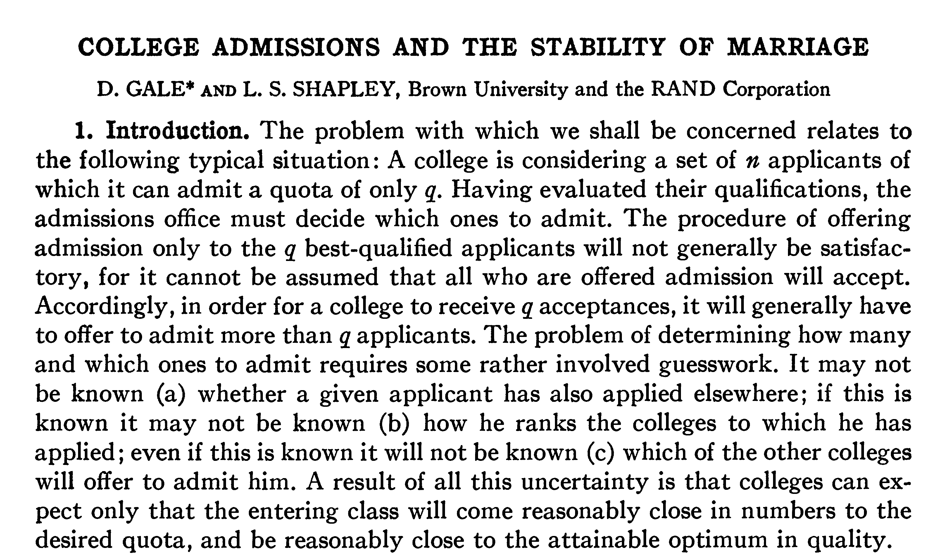
Summary
Stable matching problem. Given n men and n women, and their preferences, find a stable matching if one exists.
Theorem. [Gale-Shapley 1962] The Gale-Shapley algorithm guarantees to find a stable matching for any problem instance.
Q. How to implement GS algorithm efficiently?
Q. If there are multiple stable matchings, which one does GS find?

Slide 14
Efficient implementation
Efficient implementation. We describe an O(n ²) time implementation.
Representing men and women.
・Assume men are named 1, …, n.
・Assume women are named 1', …, n'.
Representing the matching.
・Maintain a list of free men (in a stack or queue).
・Maintain two arrays wife[m] and husband[w].
- if m matched to w, then wife[m] = w and husband[w] = m
set entry to 0 if unmatched
Men proposing.
・For each man, maintain a list of women, ordered by preference.
・For each man, maintain a pointer to woman in list for next proposal.

Slide 15
Efficient implementation (continued)
Women rejecting/accepting.
・Does woman w prefer man m to man m' ?
・For each woman, create inverse of preference list of men.
・Constant time access for each query after O(n) preprocessing.
₁st | ₂nd | ₃rd | ₄th | ₅th | ₆th | ₇th | ₈th
8 | 3 | 7 | 1 | 4 | 5 | 6 | 2
 |  |  |  |  |  |  |  | woman prefers man 3 to 6 since inverse[3] < inverse[6]
1 | 2 | 3 | 4 | 5 | 6 | 7 | 8
₄th | ₈th | ₂nd | ₅th | ₆th | ₇th | ₃rd | ₁st
pref[]
inverse[]
for i = 1 to n inverse[pref[i]] = i

Slide 16
Understanding the solution
For a given problem instance, there may be several stable matchings.
・Do all executions of GS algorithm yield the same stable matching?
・If so, which one?
 | ₁st | ₂nd | ₃rd
Xavier | Amy | Bertha | Clare
Yancey | Bertha | Amy | Clare
Zeus | Amy | Bertha | Clare
 | ₁st | ₂nd | ₃rd
Amy | Yancey | Xavier | Zeus
Bertha | Xavier | Yancey | Zeus
Clare | Xavier | Yancey | Zeus
an instance with two stable matching: M = { A-X, B-Y, C-Z } and M' = { A-Y, B-X, C-Z }

Slide 17
Understanding the solution
Def. Woman w is a valid partner of man m if there exists some stable matching in which m and w are matched.
Ex.
・Both Amy and Bertha are valid partners for Xavier.
・Both Amy and Bertha are valid partners for Yancey.
・Clare is the only valid partner for Zeus.
 | ₁st | ₂nd | ₃rd
Xavier | Amy | Bertha | Clare
Yancey | Bertha | Amy | Clare
Zeus | Amy | Bertha | Clare
 | ₁st | ₂nd | ₃rd
Amy | Yancey | Xavier | Zeus
Bertha | Xavier | Yancey | Zeus
Clare | Xavier | Yancey | Zeus
an instance with two stable matching: M = { A-X, B-Y, C-Z } and M' = { A-Y, B-X, C-Z }

Slide 18
Understanding the solution
Def. Woman w is a valid partner of man m if there exists some stable matching in which m and w are matched.
Man-optimal assignment. Each man receives best valid partner.
・Is it perfect?
・Is it stable?
Claim. All executions of GS yield man-optimal assignment. Corollary. Man-optimal assignment is a stable matching!

Slide 19
Man optimality
Claim. GS matching S* is man-optimal. Pf. [by contradiction]
・Suppose a man is matched with someone other than best valid partner.
・Men propose in decreasing order of preference
⇒ some man is rejected by valid partner during GS.
・Let Y be first such man, and let A be the first
A – Y
B – Z
⋮
valid woman that rejects him.
・Let S be a stable matching where A and Y are matched.
・When Y is rejected by A in GS, A forms (or reaffirms) engagement with a man, say Z.
⇒
A prefers Z to Y.
stable matching S
・Let B be partner of Z in S.
・Z has not been rejected by any valid partner
(including B) at the point when Y is rejected by A.
because this is the first rejection by a valid partner
・
Thus, Z has not yet proposed to B when he proposes to A.
⇒
Z prefers A to B.
・Thus A–Z is unstable in S, a contradiction. ▪
19

Slide 20
Woman pessimality
Q. Does man-optimality come at the expense of the women?
A. Yes.
Woman-pessimal assignment. Each woman receives worst valid partner. Claim. GS finds woman-pessimal stable matching S*.
Pf. [by contradiction]
・Suppose A–Z matched in S* but Z is not worst valid partner for A.
・There exists stable matching S in which A is paired with a man, say Y, whom she likes less than Z.
⇒
A prefers Z to Y.
A – Y
B – Z
⋮
・Let B be the partner of Z in S. By man-optimality,
A is the best valid partner for Z.
⇒
Z prefers A to B.
・Thus, A–Z is an unstable pair in S, a contradiction. ▪
stable matching S

Slide 21
Deceit: Machiavelli meets Gale-Shapley
Q. Can there be an incentive to misrepresent your preference list?
・Assume you know men’s propose-and-reject algorithm will be run.
・Assume preference lists of all other participants are known.
Fact. No, for any man; yes, for some women.
men's preference list
women's preference list
 | ₁st | ₂nd | ₃rd
X | A | B | C
Y | B | A | C
Z | A | B | C
 | ₁st | ₂nd | ₃rd
A | Y | X | Z
B | X | Y | Z
C | X | Y | Z
Amy lies
 | ₁st | ₂nd | ₃rd
A | Y | Z | X
B | X | Y | Z
C | X | Y | Z

Slide 22
Extensions: matching residents to hospitals
Ex: Men ≈ hospitals, Women ≈ med school residents.
Variant 1. Some participants declare others as unacceptable.
Variant 2. Unequal number of men and women.
resident A unwilling to work in Cleveland
Variant 3. Limited polygamy.
hospital X wants to hire 3 residents
Def. Matching is S unstable if there is a hospital h and resident r such that:
・h and r are acceptable to each other; and
・Either r is unmatched, or r prefers h to her assigned hospital; and
・Either h does not have all its places filled, or h prefers r to at least one of its assigned residents.

Slide 23
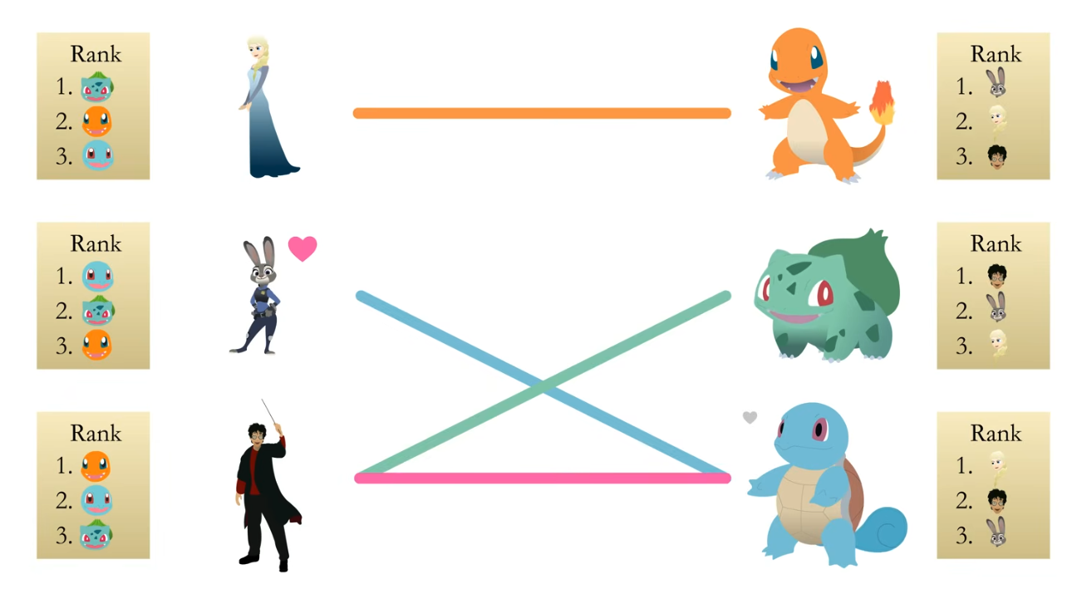
https://www.youtube.com/watch?v=fudb8DuzQlM

Slide 24
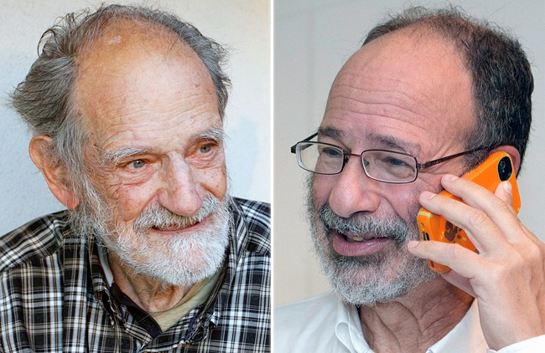

2012 Nobel Prize in Economics
Lloyd Shapley. Stable matching theory and Gale-Shapley algorithm.
Alvin Roth. Applied Gale-Shapley to matching new doctors with hospitals, students with schools, and organ donors with patients.
Lloyd Shapley
Alvin Roth

Slide 25
Lessons learned
Powerful ideas learned in course.
・Isolate underlying structure of problem.
・Create useful and efficient algorithms.
Potentially deep social ramifications. [legal disclaimer]
・Historically, men propose to women. Why not vice versa?
・Men: propose early and often; be honest.
・Women: ask out the men.
・Theory can be socially enriching and fun!
・COS majors get the best partners (and jobs)!

Slide 26
1. Representative Problems
stable matching
five representative problems
Section 1.2

Slide 27
Interval scheduling
Input. Set of jobs with start times and finish times.
Goal. Find maximum cardinality subset of mutually compatible jobs.
jobs don't overlap
a
 | b
 |  |  | c
 |  |  | d
 |  |  |  | e
 |  |  |  |  | f
 |  |  |  |  |  | g
 |  |  |  |  |  |  |  | h
b
e
h
time
0
1
2
3
4
5
6
7
8
9
10
11

Slide 28
Weighted interval scheduling
Input. Set of jobs with start times, finish times, and weights. Goal. Find maximum weight subset of mutually compatible jobs.
23
12
20
26
26
13
20
11
16
16
time
0
1
2
3
4
5
6
7
8
9
10
11

Slide 29
Bipartite matching
Problem. Given a bipartite graph G = (L ∪ R, E), find a max cardinality matching.
Def. A subset of edges M ⊆ E is a matching if each node appears in exactly one edge in M.
matching

Slide 30
Independent set
Problem. Given a graph G = (V, E), find a max cardinality independent set.
Def. A subset S ⊆ V is independent if for every (u, v) ∈ E, either u ∉ S
or v ∉ S (or both).
independent set

Slide 31
Competitive facility location
Input. Graph with weight on each node.
Game. Two competing players alternate in selecting nodes.
Not allowed to select a node if any of its neighbors have been selected.
Goal. Select a maximum weight subset of nodes.
10
1
5
15
5
1
5
1
15
10
Second player can guarantee 20, but not 25.

Slide 32
Five representative problems
Variations on a theme: independent set.
Interval scheduling: O(n log n) greedy algorithm.
Weighted interval scheduling: O(n log n) dynamic programming algorithm. Bipartite matching: O(n^{k}) max-flow based algorithm.
Independent set: NP-complete.
Competitive facility location: PSPACE-complete.

