Slide 1


2. Algorithm Analysis
computational tractability
asymptotic order of growth
survey of common running times

Slide 2


2. Algorithm Analysis
computational tractability
asymptotic order of growth
survey of common running times
Section 2.1

Slide 3
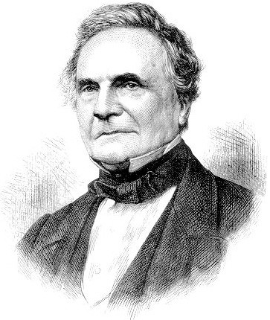
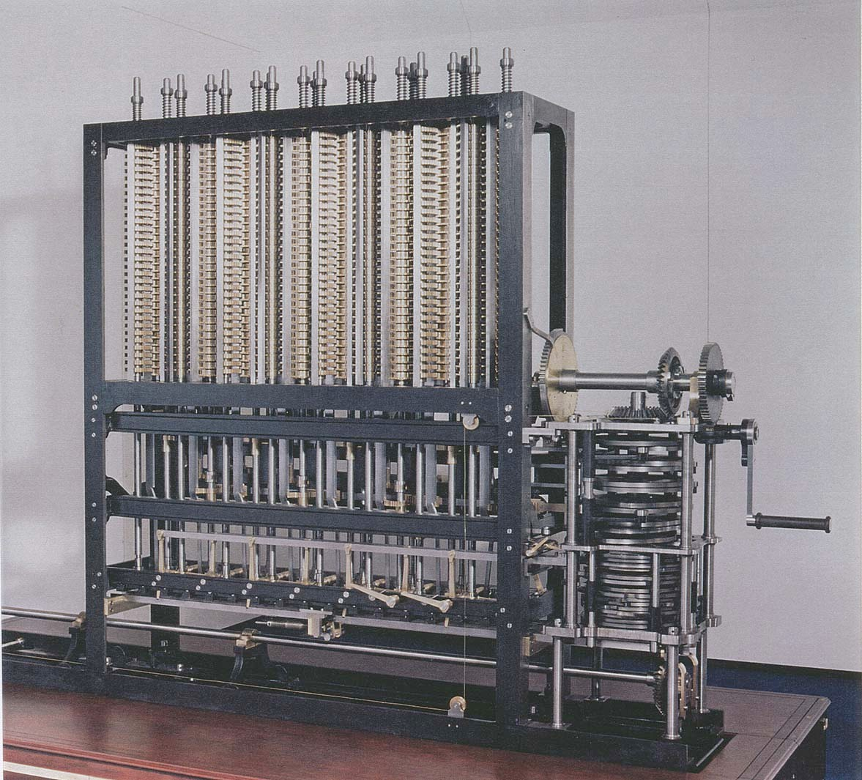
A strikingly modern thought
“ As soon as an Analytic Engine exists, it will necessarily guide the future course of the science. Whenever any result is sought by its aid, the question will arise—By what course of calculation can these results be arrived at by the machine in the shortest time? ” — Charles Babbage (1864)
how many times do you have to turn the crank?
Analytic Engine

Slide 4

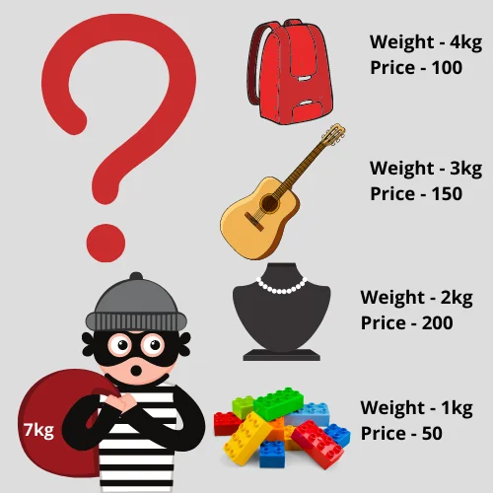
Brute force
Brute force. For many nontrivial problems, there is a natural brute-force search algorithm that checks every possible solution.
・Typically takes 2^{n} time or worse for inputs of size n.
・Unacceptable in practice.

Slide 5
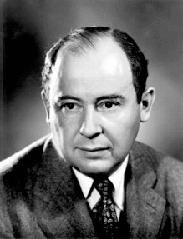
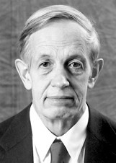
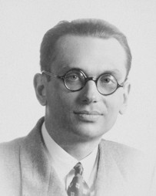



Polynomial running time
Desirable scaling property. When the input size doubles, the algorithm should only slow down by some constant factor C.
Def. An algorithm is poly-time if the above scaling property holds.
There exists constants c > 0 and d > 0 such that on every input of size n, its running time is bounded
by c n^{d} primitive computational steps.
choose C = 2^{d}
von Neumann (1953)
Nash (1955)
Gödel (1956)
Cobham (1964)
Edmonds (1965)
Rabin (1966)

Slide 6
Polynomial running time
We say that an algorithm is efficient if has a polynomial running time.
Justification. It really works in practice!
・In practice, the poly-time algorithms that people develop have low
・Breaking through the exponential barrier of brute force typically exposes some crucial structure of the problem.
constants and low exponents.
Exceptions. Some poly-time algorithms do have high constants and/or exponents, and/or are useless in practice.
Map graphs in polynomial time
Mikkel Thorup
Department of Computer Science, University of Copenhagen Universitetsparken 1, DK-2100 Copenhagen East, Denmark mthorup@diku.dk
Abstract
Chen, Grigni, and Papadimitriou (WADS’97 and STOC’98) have introduced a modified notion of planarity, where two faces are considered adjacent if they share at least one point. The corresponding abstract graphs are called map graphs. Chen et.al. raised the question of whether map graphs can be recognized in polynomial time. They showed that the decision problem is in NP and presented a polynomial time algorithm for the special case where we allow at most 4 faces to intersect in any point — if only 3 are allowed to intersect in a point, we get the usual planar graphs.
Chen et.al. conjectured that map graphs can be recognized in polynomial time, and in this paper, their conjecture is settled affirmatively.
Q. Which would you prefer
_{20 n}100 _{vs. n}1 + 0.02 ln n
?

Slide 7

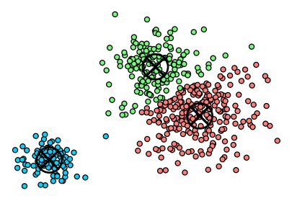
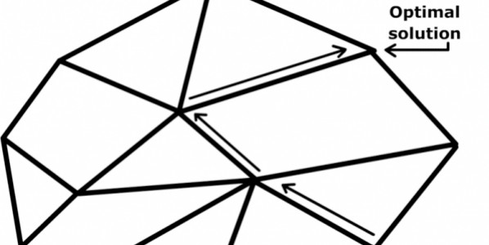
Worst-case analysis
Worst case. Running time guarantee for any input of size n.
・Generally captures efficiency in practice.
・Draconian view, but hard to find effective alternative.
Exceptions. Some exponential-time algorithms are used widely in practice because the worst-case instances seem to be rare.
simplex algorithm
Linux grep
k-means algorithm

Slide 8
Types of analyses
Worst case. Running time guarantee for any input of size n.
Ex. Heapsort requires at most 2 n log2 n compares to sort n elements.
Probabilistic. Expected running time of a randomized algorithm.
Ex. The expected number of compares to quicksort n elements is ~ 2n ln n.
Amortized. Worst-case running time for any sequence of n operations. Ex. Starting from an empty stack, any sequence of n push and pop operations takes O(n) operations using a resizing array.
Average-case. Expected running time for a random input of size n.
Ex. The expected number of character compares performed by 3-way radix quicksort on n uniformly random strings is ~ 2n ln n.
Also. Smoothed analysis, competitive analysis, ...

Slide 9
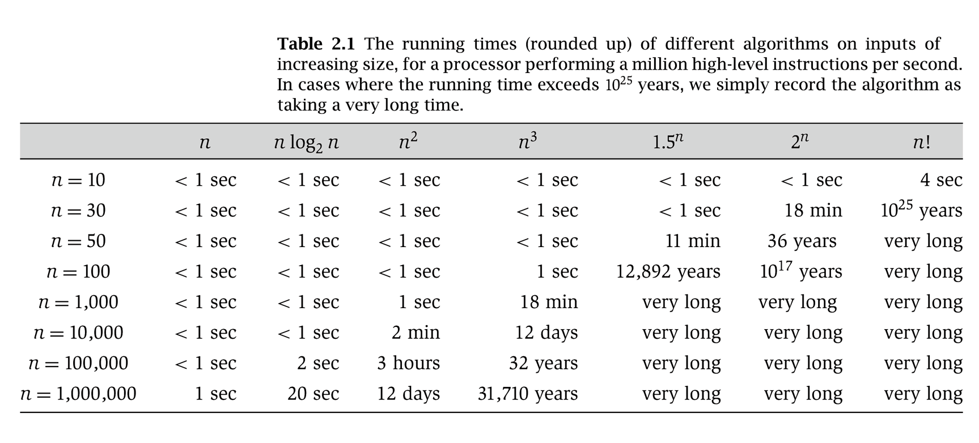
Why it matters

Slide 10
2. Algorithm Analysis
computational tractability
asymptotic order of growth
survey of common running times
Section 2.2

Slide 11
Big-Oh notation
Upper bounds. T(n) is O( f (n)) if there exist constants c > 0 and n₀ ≥ 0
such that T(n) ≤ c · f (n) for all n ≥ n₀.
c · f (n)
Ex. T(n) = 32n² + 17n + 1.
T(n)
・T(n) is O(n²).
choose c = 50, n0 = 1
・T(n) is also O(n³).
・T(n) is neither O(n) nor O(n log n).
n0
n
Typical usage. Insertion makes O(n²) compares to sort n elements.
Alternate definition. T(n) is O( f (n)) if
lim sup
n→∞
T (n)
< ∞.
f (n)

Slide 12
Notational abuses
Equals sign. O( f (n)) is a set of functions, but computer scientists often write
T(n) = O( f (n)) instead of T(n) ∈ O( f (n)).
Ex. Consider f (n) = 5n³ and g (n) = 3n² .
・We have f (n) = O(n³) = g(n).
・Thus, f (n) = g(n).
Domain. The domain of f (n) is typically the natural numbers { 0, 1, 2, … }.
・Sometimes we restrict to a subset of the natural numbers.
Other times we extend to the reals.
Bottom line. OK to abuse notation; not OK to misuse it.

Slide 13
Big-Omega notation
Lower bounds. T(n) is Ω( f (n)) if there exist constants c > 0 and n₀ ≥ 0
such that T(n) ≥ c · f (n) for all n ≥ n₀.
T(n)
Ex. T(n) = 32n² + 17n + 1.
c · f (n)
・T(n) is both Ω(n²) and Ω(n).
choose c = 32, n0 = 1
・T(n) is neither Ω(n³) nor Ω(n³ log n).
n0
n
Typical usage. Any compare-based sorting algorithm requires Ω(n log n)
compares in the worst case.

Slide 14
Big-Theta notation
Tight bounds. T(n) is Θ( f (n)) if there exist constants c1 > 0, c2 > 0, and n₀ ≥ 0
such that c1 · f (n) ≤ T(n) ≤ c2 · f (n) for all n ≥ n₀.
c2 · f (n)
T(n)
Ex. T(n) = 32n² + 17n + 1.
・T(n) is Θ(n²).
c1 · f (n)
choose c1 = 32, c2 = 50, n0 = 1
・T(n) is neither Θ(n) nor Θ(n³).
n0
n
Typical usage. Mergesort makes Θ(n log n) compares to sort n elements.

Slide 15
2. Algorithm Analysis
computational tractability
asymptotic order of growth
survey of common running times
Section 2.4

Slide 16
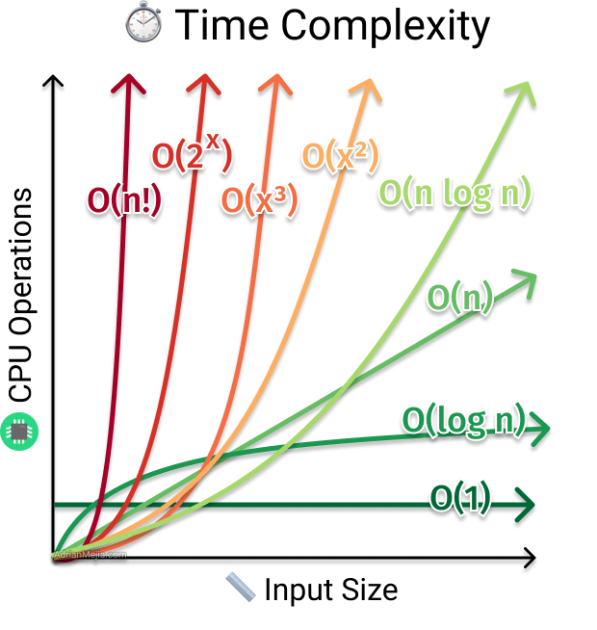
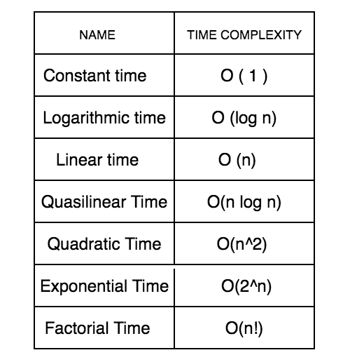
Common Time Complexity

Slide 17
Linear time: O(n)
Linear time. Running time is proportional to input size.
Computing the maximum. Compute maximum of n numbers a₁, …, a_{n}.
max ← a₁
for i = 2 to n {
if (a_{i}
max
> max)
← a_{i}
}

Slide 18
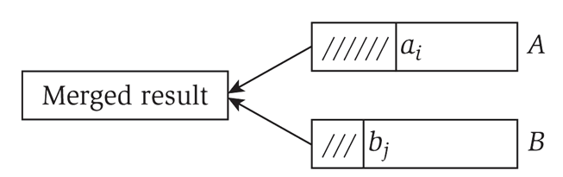
Linear time: O(n)
Merge. Combine two sorted lists A = a₁, a₂, …, a_{n} with B = b₁, b₂, …, b_{n} into sorted whole.
i = 1, j = 1
while (both lists are nonempty) {
if (a_{i} ≤ b_{j}) append a_{i} to output list and increment i
else append b_{j} to output list and increment j
}
append remainder of nonempty list to output list
Claim. Merging two lists of size n takes O(n) time.
Pf. After each compare, the length of output list increases by 1.

Slide 19
Linearithmic time: O(n log n)
O(n log n) time. Arises in divide-and-conquer algorithms.
Sorting. Mergesort and heapsort are sorting algorithms that perform
O(n log n) compares.
Largest empty interval. Given n time-stamps x₁, …, x_{n} on which copies of a file arrive at a server, what is largest interval when no copies of file arrive?
O(n log n) solution. Sort the time-stamps. Scan the sorted list in order, identifying the maximum gap between successive time-stamps.

Slide 20
Quadratic time: O(n²)
Ex. Enumerate all pairs of elements.
Closest pair of points. Given a list of n points in the plane (x₁, y₁), …, (x_{n}, y_{n}), find the pair that is closest.
O(n²) solution. Try all pairs of points.
min ← (x₁ - x₂)² + (y₁ - y₂)²
for i = 1 to n {
for j = i+1 to n {
d ← (x_{i} - x_{j})² + (y_{i} - y_{j})²
if (d < min) min ← d
}
}
Remark. Ω(n²) seems inevitable, but this is just an illusion. [see Chapter 5]

Slide 21
Cubic time: O(n³)
Cubic time. Enumerate all triples of elements.
Set disjointness. Given n sets S₁, …, S_{n} each of which is a subset of
1, 2, …, n, is there some pair of these which are disjoint?
O(n³) solution. For each pair of sets, determine if they are disjoint.
foreach set S_{i} {
foreach other set S_{j} { foreach element p of S_{i} {
determine whether p also belongs to S_{j}
}
if (no element of S_{i} belongs to S_{j})
report that S_{i} and S_{j} are disjoint
}
}

Slide 22

Polynomial time: O(n^{k})
Independent set of size k. Given a graph, are there k nodes such that no two are joined by an edge?
k is a constant
O(n^{k}) solution. Enumerate all subsets of k nodes.
foreach subset S of k nodes {
check whether S in an independent set if (S is an independent set)
report S is an independent set
}
}
・Check whether S is an independent set takes O(k²) time.
・Number of k element subsets =
n k
_{n}k k!
=
n(n — 1)(n — 2) × ·· · × (n — k + 1)
≤
・O(k² n^{k} / k!) = O(n^{k}).
poly-time for k=17, but not practical
k(k — 1)(k — 2) × ·· · × 1

Slide 23
Exponential time
Independent set. Given a graph, what is maximum cardinality of an independent set?
O(n² 2^{n}) solution. Enumerate all subsets.
S* ← φ
foreach subset S of nodes {
check whether S in an independent set
if (S is largest independent set seen so far) update S* ← S
}
}

Slide 24
Sublinear time
Search in a sorted array. Given a sorted array A of n numbers, is a given number x in the array?
O(log n) solution. Binary search.
lo ← 1, hi ← n
while (lo ≤ hi) {
mid ← (lo + hi) / 2
if (x < A[mid]) hi
← mid - 1
← mid + 1
else if (x > A[mid]) lo else return yes
}
return no

