Slide 1


5. Divide And Conquer I
mergesort
counting inversions
closest pair of points
randomized quicksort
median and selection
Lecture slides by Kevin Wayne Copyright © 2005 Pearson-Addison Wesley
Copyright © 2013 Kevin Wayne
http://www.cs.princeton.edu/~wayne/kleinberg-tardos
Last updated on Oct 2, 2013 9:51 AM

Slide 2

Divide-and-conquer paradigm
Divide-and-conquer.
・Divide up problem into several subproblems.
・Solve each subproblem recursively.
・Combine solutions to subproblems into overall solution.
Most common usage.
・Divide problem of size n into two subproblems of size n / 2 in linear time.
・Solve two subproblems recursively.
・Combine two solutions into overall solution in linear time.
Consequence.
・Brute force: Θ(n²).
・Divide-and-conquer: Θ(n log n).

Slide 3


5. Divide and Conquer
mergesort
counting inversions
closest pair of points
randomized quicksort
median and selection
Section 5.1

Slide 4

Sorting problem
Problem. Given a list of n elements from a totally-ordered universe, rearrange them in ascending order.
4

Slide 5
Sorting applications
Obvious applications.
・Organize an MP3 library.
・Display Google PageRank results.
・List RSS news items in reverse chronological order.
Some problems become easier once elements are sorted.
・Identify statistical outliers.
・Binary search in a database.
・Remove duplicates in a mailing list.
Non-obvious applications.
・Convex hull.
・Closest pair of points.
・Interval scheduling / interval partitioning.
・Minimum spanning trees (Kruskal's algorithm).
・Scheduling to minimize maximum lateness or average completion time.
・...
5

Slide 6
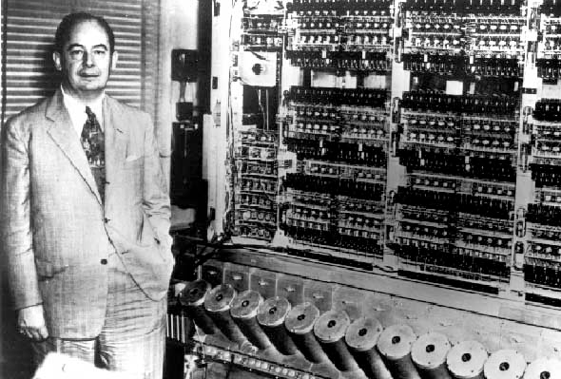

Mergesort
・Recursively sort left half.
・Recursively sort right half.
・Merge two halves to make sorted whole.
input
A | L | G | O | R | I | T | H | M | S
sort left half
A | G | L | O | R
I | T | H | M | S
sort right half
A | G | L | O | R
H | I | M | S | T
merge results
A | G | H | I | L | M | O | R | S | T

Slide 7

Merging
Goal. Combine two sorted lists A and B into a sorted whole C.
・Scan A and B from left to right.
・Compare ai and bj.
・If ai ≤ bj, append ai to C (no larger than any remaining element in B).
> bj, append bj to C (smaller than every remaining element in A).
・If ai
sorted list A
sorted list B
3 | 7 | 10 | ai | 18
2 | 11 | bj | 17 | 23
5
2
merge to form sorted list C
2 | 3 | 7 | 10 | 11

Slide 8
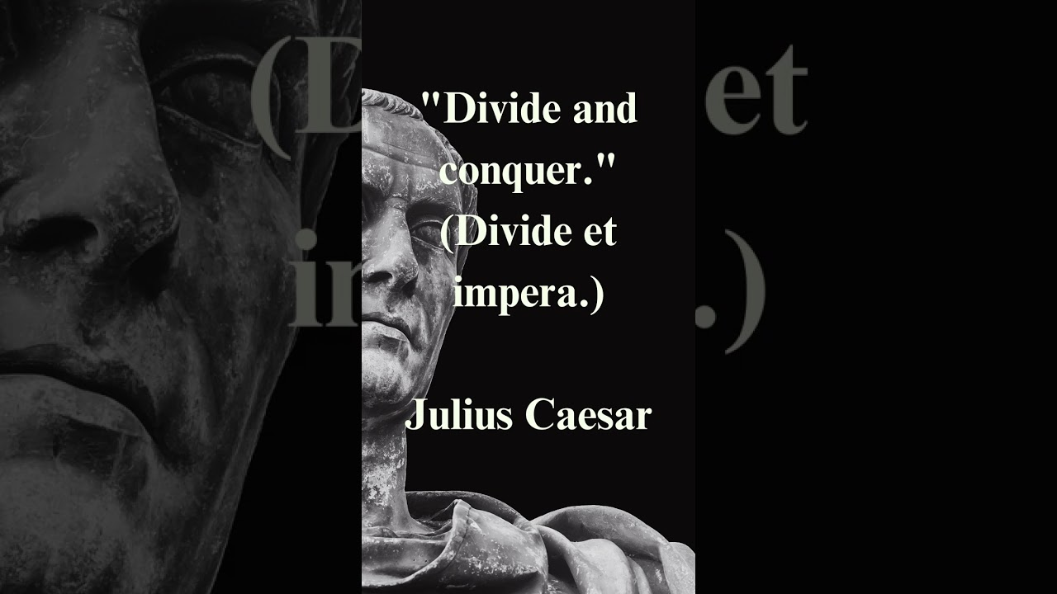
https://www.youtube.com/watch?v=ib4BHvr5-Ao

Slide 9
A useful recurrence relation
Def. T (n) = max number of compares to mergesort a list of size ≤ n. Note. T (n) is monotone nondecreasing.
Mergesort recurrence.
T(n) ≤
0 |  |  |  | if n = 1
T ( ⎡n / 2⎤⎤ ) | + | T ( ⎣n / 2⎦ ) | + n | otherwise
Solution. T (n) is O(n log₂ n).
Assorted proofs. We describe several ways to prove this recurrence. Initially we assume n is a power of 2 and replace ≤ with =.

Slide 10

Divide-and-conquer recurrence: proof by recursion tree
Proposition. If T (n) satisfies the following recurrence, then T (n) = n log2 n.
0
2 T (n / 2) + n
if n = 1 otherwise
assuming n is a power of 2
T(n) =
Pf 1.
T (n)
n
= n
T (n / 2)
T (n / 2)
2 (n/2)
= n
T (n / 4)
T (n / 4)
T (n / 4)
T (n / 4)
4 (n/4)
= n
log 2 n
T (n / 8)
T (n / 8)
T (n / 8)
T (n / 8)
T (n / 8)
T (n / 8)
T (n / 8)
T (n / 8)
8 (n/8)
= n
⋮
⋮
T(n) = n lg n
9

Slide 11
Proof by induction
Proposition. If T (n) satisfies the following recurrence, then T (n) = n log2 n.
0
2 T (n / 2) + n
if n = 1 otherwise
assuming n is a power of 2
T(n) =
Pf 2. [by induction on n]
・Base case: when n = 1, T(1) = 0.
・Inductive hypothesis: assume T(n) = n log₂ n.
・Goal: show that T(2n) = 2n log₂ (2n).
T(2n) = 2 T(n) + 2n
= 2 n log2 n + 2n
= 2 n (log2 (2n) – 1) + 2n
= 2 n log2 (2n). ▪

Slide 12

Analysis of mergesort recurrence
Claim. If T(n) satisfies the following recurrence, then T(n) ≤ n ⎡log2 n⎤⎤.
0
T ( ⎡n / 2⎤⎤ ) +
if n = 1 otherwise
T(n) ≤
T ( ⎣n / 2⎦ ) + n
Pf. [by strong induction on n]
・Base case: n = 1.
・Define n₁ = ⎣n / 2⎦ and n₂ = ⎡n / 2⎤⎤.
・Induction step: assume true for 1, 2, ... , n – 1.
n₂ = dn/2e
^{l}₂dlog₂ ne _{/ 2}
₌ ₂dlog₂ ne _{/ 2}
T(n)
≤ T(n1) + T(n2) + n
≤ n1 ⎡log2 n1⎤⎤ + n2 ⎡log2 n2⎤⎤ + n
≤ n1 ⎡log2 n2⎤⎤ + n2 ⎡log2 n2⎤⎤ + n
= n ⎡log2 n2⎤⎤ + n
log₂ n₂ ≤ [log₂ n| — 1
≤ n (⎡log2 n⎤⎤ – 1) + n
= n ⎡log2 n⎤⎤. ▪

Slide 13
5. Divide and Conquer
mergesort
counting inversions
closest pair of points
randomized quicksort
median and selection
Section 5.3

Slide 14
Counting inversions
Music site tries to match your song preferences with others.
・You rank n songs.
・Music site consults database to find people with similar tastes.
Similarity metric: number of inversions between two rankings.
・My rank: 1, 2, …, n.
・Your rank: a₁, a₂, …, a_{n}.
・Songs i and j are inverted if i < j, but a_{i} > a_{j}.
 | A | B | C | D | E
me | 1 | 2 | 3 | 4 | 5
you | 1 | 3 | 4 | 2 | 5
2 inversions: 3-2, 4-2
Brute force: check all Θ(n²) pairs.

Slide 15






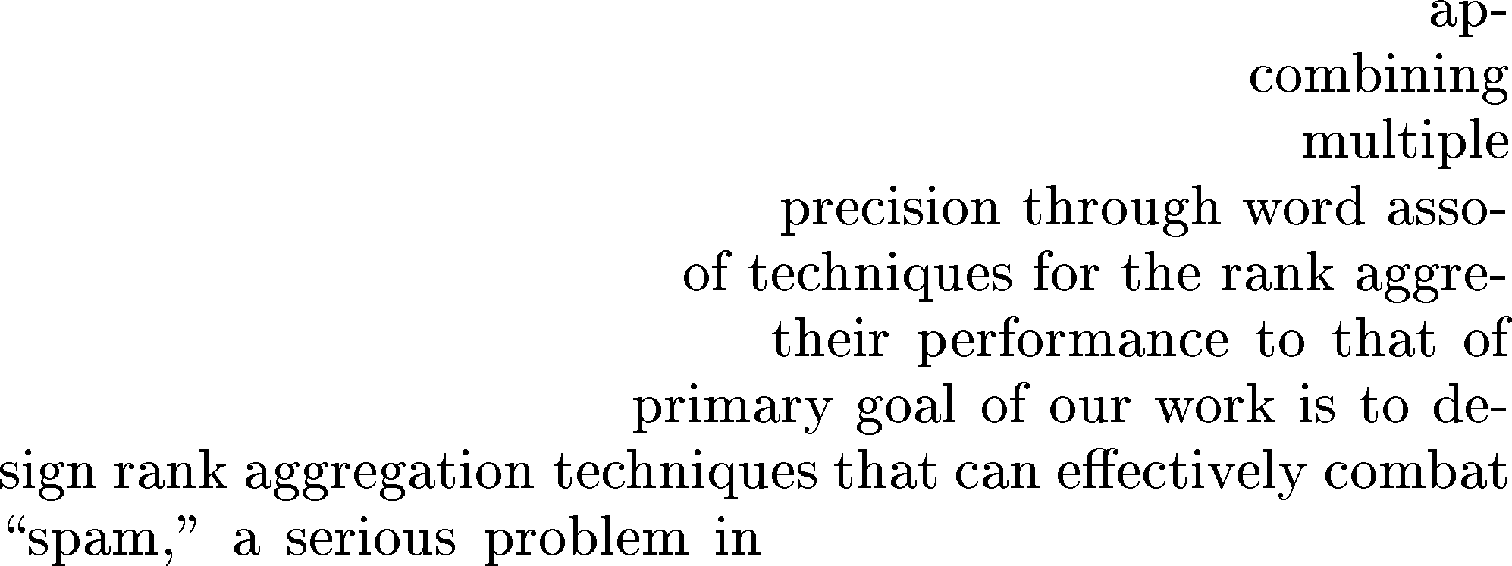



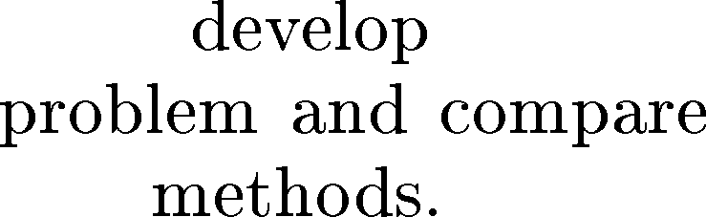














Counting inversions: applications
・Voting theory.
・Collaborative filtering.
・Measuring the "sortedness" of an array.
・Sensitivity analysis of Google's ranking function.
・Rank aggregation for meta-searching on the Web.
・Nonparametric statistics (e.g., Kendall's tau distance).
Rank Aggregation Methods for the Web
Cynthia Dwork Ravi Kumar
ABSTRACT
Moni Naor
D. Sivakumar

Slide 16
Counting inversions: divide-and-conquer
・Divide: separate list into two halves A and B.
・Conquer: recursively count inversions in each list.
・Combine: count inversions (a, b) with a ∈ A and b ∈ B.
・Return sum of three counts.
input
1 | 5 | 4 | 8 | 10 | 2 | 6 | 9 | 3 | 7
count inversions in left half A
count inversions in right half B
1 | 5 | 4 | 8 | 10
2 | 6 | 9 | 3 | 7
5-4
6-3 9-3 9-7
count inversions (a, b) with a ∈ A and b ∈ B
1 | 5 | 4 | 8 | 10
2 | 6 | 9 | 3 | 7
4-2 4-3 5-2 5-3 8-2 8-3 8-6 8-7 10-2 10-3 10-6 10-7 10-9
output 1 + 3 + 13 = 17
15

Slide 17
Counting inversions: how to combine two subproblems?
Q. How to count inversions (a, b) with a ∈ A and b ∈ B?
A. Easy if A and B are sorted!
Warmup algorithm.
・Sort A and B.
・For each element b ∈ B,
- binary search in A to find how elements in A are greater than b.
list A
list B
7 | 10 | 18 | 3 | 14
17 | 23 | 2 | 11 | 16
sort A
sort B
3 | 7 | 10 | 14 | 18
2 | 11 | 16 | 17 | 23
binary search to count inversions (a, b) with a ∈ A and b ∈ B
3 | 7 | 10 | 14 | 18
2 | 11 | 16 | 17 | 23
5
2
1
1
0

Slide 18

Counting inversions: how to combine two subproblems?
Count inversions (a, b) with a ∈ A and b ∈ B, assuming A and B are sorted.
・Scan A and B from left to right.
・Compare ai and bj.
・If ai < bj, then ai is not inverted with any element left in B.
・If ai > bj, then bj is inverted with every element left in A.
・Append smaller element to sorted list C.
count inversions (a, b) with a ∈ A and b ∈ B
3 | 7 | 10 | ai | 18
2 | 11 | bj | 17 | 23
5
2
merge to form sorted list C
2 | 3 | 7 | 10 | 11

Slide 19
Counting inversions: divide-and-conquer algorithm implementation
Input. List L.
Output. Number of inversions in L and sorted list of elements L'.
Sort-And-Count (L)
IF list L has one element RETURN (0, L).
DIVIDE the list into two halves A and B.
(rA , A) ← SORT-AND-COUNT(A).
(rB , B) ← SORT-AND-COUNT(B).
(rAB , L') ← MERGE-AND-COUNT(A, B).
RETURN (rA + rB + rAB , L').

Slide 20
Counting inversions: divide-and-conquer algorithm analysis
Proposition. The sort-and-count algorithm counts the number of inversions in a permutation of size n in O(n log n) time.
Pf. The worst-case running time T(n) satisfies the recurrence:
T(n) =
Θ(1) |  |  | if n = 1
T ( ⎡n / 2⎤⎤ ) | + | T ( ⎣n / 2⎦ ) + Θ(n) | otherwise

Slide 21

https://www.youtube.com/watch?v=7_AJfusC6UQ

Slide 22
5. Divide and Conquer
mergesort
counting inversions
closest pair of points
randomized quicksort
median and selection
Section 5.4

Slide 23
Closest pair of points
Closest pair problem. Given n points in the plane, find a pair of points with the smallest Euclidean distance between them.
Fundamental geometric primitive.
・Graphics, computer vision, geographic information systems, molecular modeling, air traffic control.
・Special case of nearest neighbor, Euclidean MST, Voronoi.
fast closest pair inspired fast algorithms for these problems

Slide 24
Closest pair of points
Closest pair problem. Given n points in the plane, find a pair of points with the smallest Euclidean distance between them.
Brute force. Check all pairs with Θ(n²) distance calculations. 1d version. Easy O(n log n) algorithm if points are on a line.
Nondegeneracy assumption. No two points have the same x-coordinate.

Slide 25
Closest pair of points: first attempt
Sorting solution.
・Sort by x-coordinate and consider nearby points.
・Sort by y-coordinate and consider nearby points.

Slide 26
Closest pair of points: first attempt
Sorting solution.
・Sort by x-coordinate and consider nearby points.
・Sort by y-coordinate and consider nearby points.
8

Slide 27
Closest pair of points: second attempt
Divide. Subdivide region into 4 quadrants.

Slide 28
Closest pair of points: second attempt
Divide. Subdivide region into 4 quadrants.
Obstacle. Impossible to ensure n / 4 points in each piece.

Slide 29

Closest pair of points: divide-and-conquer algorithm
・Divide: draw vertical line L so that n / 2 points on each side.
・Conquer: find closest pair in each side recursively.
・Combine: find closest pair with one point in each side.
・Return best of 3 solutions.
seems like Θ(N²)
L
8
21
12

Slide 30
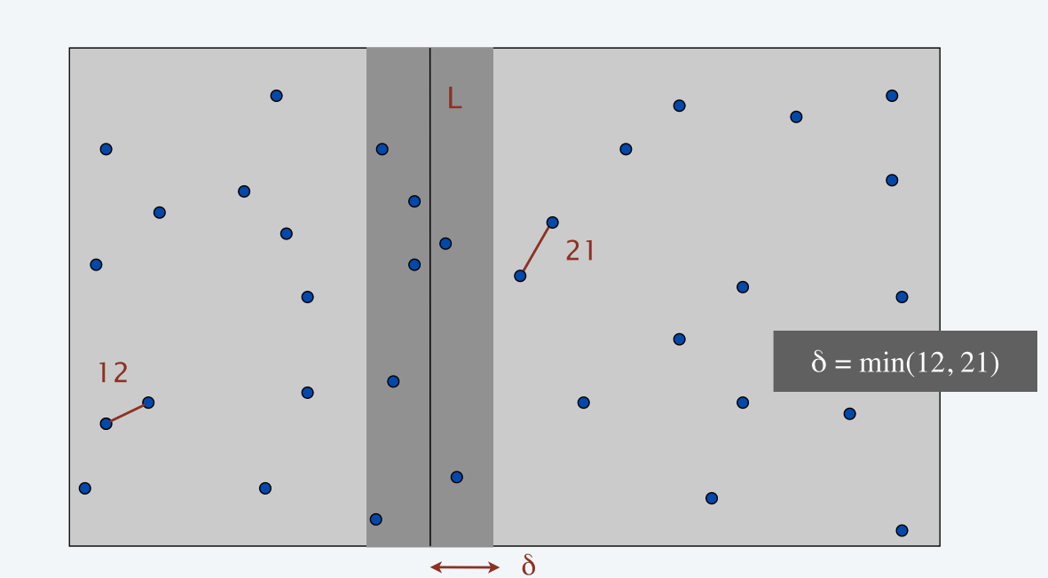
How to find closest pair with one point in each side?
Find closest pair with one point in each side, assuming that distance < δ.
・Observation: only need to consider points within δ of line L.

Slide 31

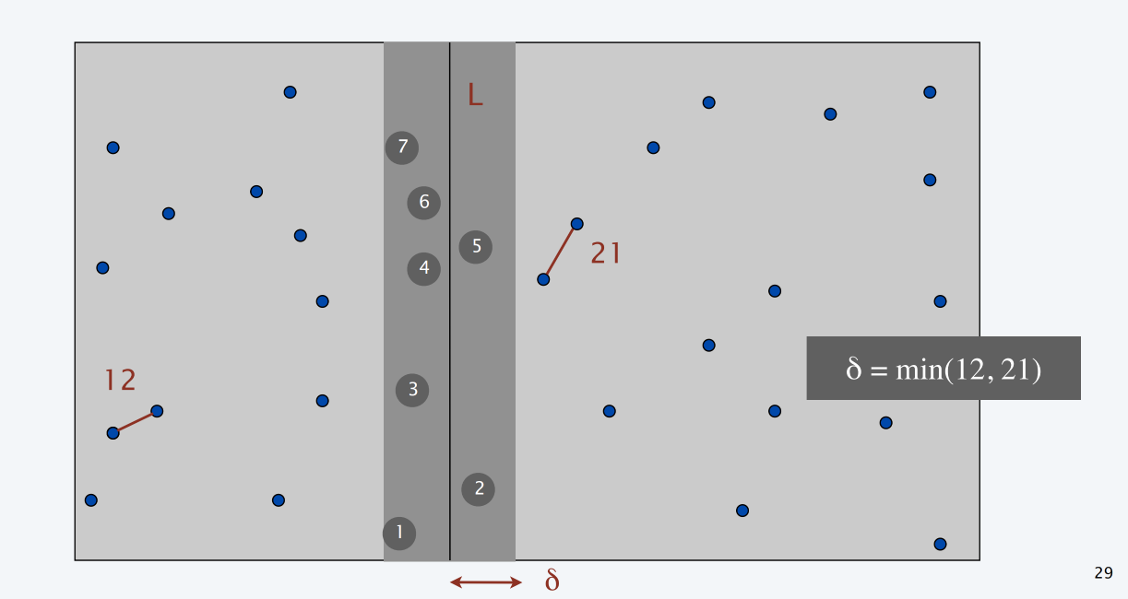
How to find closest pair with one point in each side?
Find closest pair with one point in each side, assuming that distance < δ.
・Observation: only need to consider points within δ of line L.
・Sort points in 2 δ-strip by their y-coordinate.
・Only check distances of those within 11 positions in sorted list!
why 11?

Slide 32







How to find closest pair with one point in each side?
Def. Let s_{i} be the point in the 2 δ-strip, with the i^{th} smallest y-coordinate.
Claim. If | i – j | ≥ 12, then the distance between s_{i} and s_{j} is at least δ.
Pf.
⋮ 31 |  | 39 j
29 |  | 30
27 |  |  | 28
26 ⋮ |  | 25
・No two points lie in same ½ δ-by-½ δ box.
・Two points at least 2 rows apart have distance ≥ 2 (½ δ). ▪
½δ
2 rows
½δ
½δ
i
Fact. Claim remains true if we replace 12 with 7.
δ
δ

Slide 33
Closest pair of points: divide-and-conquer algorithm
CLOSEST-PAIR (p1, p2, …, pn)
Compute separation line L such that half the points are on each side of the line.
δ1 ← CLOSEST-PAIR (points in left half). δ2 ← CLOSEST-PAIR (points in right half). δ ← min { δ1 , δ2 }.
Delete all points further than δ from line L. Sort remaining points by y-coordinate.
Scan points in y-order and compare distance between each point and next 11 neighbors. If any of these distances is less than δ, update δ.
RETURN δ.
O(n log n)
2 T(n / 2)
O(n)
O(n log n)
O(n)

Slide 34
Closest pair of points: analysis
Theorem. The divide-and-conquer algorithm for finding the closest pair of points in the plane can be implemented in O(n log² n) time.
T(n) =
Θ(1) |  |  | if n = 1
T ( ⎡n / 2⎤⎤ ) | + | T ( ⎣n / 2⎦ ) + O(n log n) | otherwise
(x1 - x2) ² + (y1 - y2) ²
Lower bound. In quadratic decision tree model, any algorithm for closest pair (even in 1D) requires Ω(n log n) quadratic tests.

Slide 35

Improved closest pair algorithm
Q. How to improve to O(n log n) ?
A. Yes. Don't sort points in strip from scratch each time.
・Each recursive returns two lists: all points sorted by x-coordinate, and all points sorted by y-coordinate.
・Sort by merging two pre-sorted lists.
Theorem. [Shamos 1975] The divide-and-conquer algorithm for finding the closest pair of points in the plane can be implemented in O(n log n) time.
Θ(1)
T ( ⎡n / 2⎤⎤ ) +
if n = 1 otherwise
Pf.
T(n) =
T ( ⎣n / 2⎦ ) + Θ(n)
Note. See SECTION 13.7 for a randomized O(n) time algorithm.
not subject to lower bound since it uses the floor function
33

Slide 36

https://www.youtube.com/watch?v=6u_hWxbOc7E

Slide 37
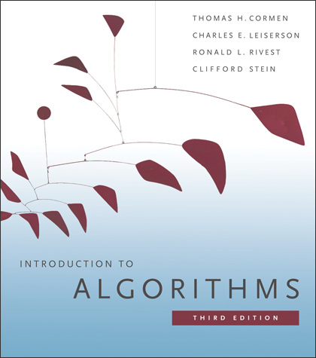
5. Divide and Conquer
mergesort
counting inversions
closest pair of points
randomized quicksort
median and selection
Chapter 7

Slide 38
Randomized quicksort
3-way partition array so that:
the array A
・Pivot element p is in place.
7 | 6 | 12 | 3 | 11 | 8 | 9 | 1 | 4 | 10 | 2
・Smaller elements in left subarray L.
p
・Equal elements in middle subarray M.
the partitioned array A
・Larger elements in right subarray R.
Recur in both left and right subarrays.
3 | 1 | 4 | 2 | 6 | 7 | 12 | 11 | 8 | 9 | 10
L
M
R
Randomized-Quicksort (A)
IF list A has zero or one element RETURN.
Pick pivot p ∈ A uniformly at random.
(L, M, R) ← Partition-3-way (A, ai). Randomized-Quicksort(L).
Randomized-Quicksort(R).
3-way partitioning can be done in-place (using n–1 compares)

Slide 39
Analysis of randomized quicksort
Proposition. The expected number of compares to quicksort an array of n distinct elements is O(n log n).
Pf. Consider BST representation of partitioning elements.
the original array of elements A
7
6
12
3
11
8
9
1
4
10
2
13
5
first partitioning element (chosen uniformly at random)
first partitioning element in
left subarray
9
3
11
1
8
10
13
2
4
12
6
5
7

Slide 40
Analysis of randomized quicksort
Proposition. The expected number of compares to quicksort an array of n distinct elements is O(n log n).
Pf. Consider BST representation of partitioning elements.
・An element is compared with only its ancestors and descendants.
3 and 6 are compared (when 3 is partitioning element)
first partitioning element (chosen uniformly at random)
first partitioning element in
left subarray
9
3
11
1
8
10
13
2
4
12
6
5
7

Slide 41
Analysis of randomized quicksort
Proposition. The expected number of compares to quicksort an array of n distinct elements is O(n log n).
Pf. Consider BST representation of partitioning elements.
・An element is compared with only its ancestors and descendants.
2 and 8 are not compared (because 3 partitions them)
first partitioning element (chosen uniformly at random)
first partitioning element in
left subarray
9
3
11
1
8
10
13
2
4
12
6
5
7

Slide 42
Analysis of randomized quicksort
Proposition. The expected number of compares to quicksort an array of n distinct elements is O(n log n).
Pf. Consider BST representation of partitioning elements.
・An element is compared with only its ancestors and descendants.
・Pr [ ai and aj are compared ] = 2 / | j - i + 1|.
Pr[2 and 8 compared] = 2/7 (compared if either 2 or 8 are chosen as partition before 3, 4, 5, 6 or 7)
first partitioning element (chosen uniformly at random)
first partitioning element in
left subarray
9
3
11
1
8
10
13
2
4
12
6
5
7

Slide 43
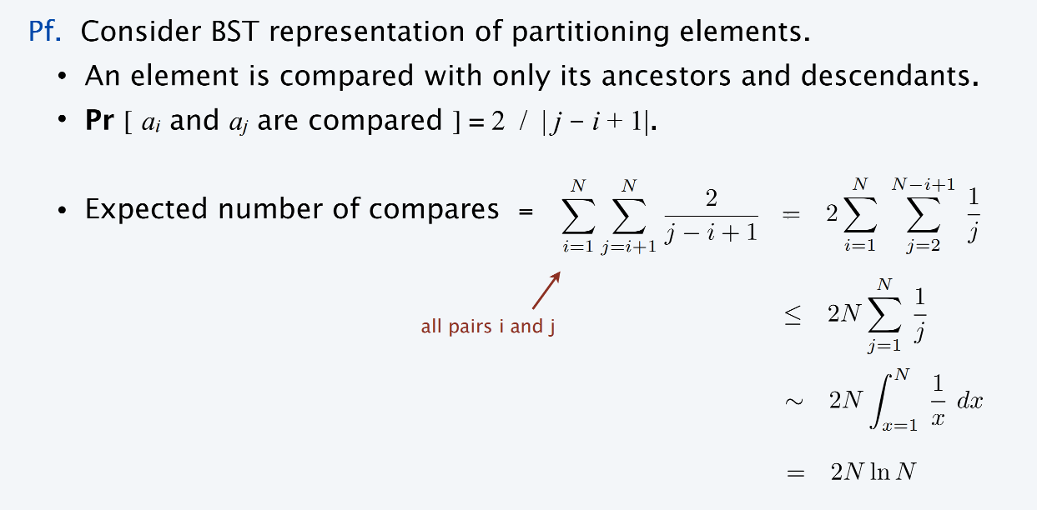
Analysis of randomized quicksort
Proposition. The expected number of compares to quicksort an array of n distinct elements is O(n log n).
Remark. Number of compares only decreases if equal elements.

Slide 44
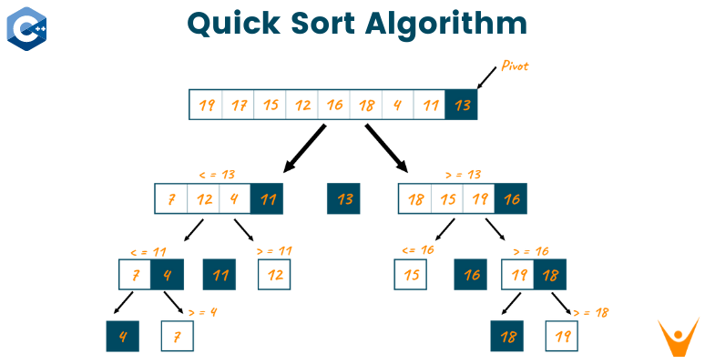
https://www.youtube.com/watch?v=Hoixgm4-P4M

Slide 45
5. Divide and Conquer
mergesort
counting inversions
closest pair of points
randomized quicksort
median and selection
Chapter 9

Slide 46
Median and selection problems
Selection. Given n elements from a totally ordered universe, find k^{th} smallest.
・Minimum: k = 1; maximum: k = n.
・Median: k = ⎣(n + 1) / 2⎦.
・O(n) compares for min or max.
・O(n log n) compares by sorting.
・O(n log k) compares with a binary heap.
Applications. Order statistics; find the "top k"; bottleneck paths, …
Q. Can we do it with O(n) compares?
A. Yes! Selection is easier than sorting.

Slide 47
Quickselect
3-way partition array so that:
・Pivot element p is in place.
・Smaller elements in left subarray L.
・Equal elements in middle subarray M.
・Larger elements in right subarray R.
Recur in one subarray—the one containing the k^{th} smallest element.
Quick-Select (A, k)
Pick pivot p ∈ A uniformly at random. (L, M, R) ← PARTITION-3-WAY (A, p).
3-way partitioning can be done in-place (using n–1 compares)
If k ≤ | L | return Quick-Select (L, k).
else if k > | L | + | M | return Quick-Select (R, k – | L | – | M |)
ELSE
RETURN p.

Slide 48

https://www.youtube.com/watch?v=sNtu2oGDRvU

Slide 49
Quickselect analysis
Intuition. Split candy bar uniformly ⇒ expected size of larger piece is ¾.
T(n) ≤ T(¾ n) + n ⇒ T(n) ≤ 4 n
Def. T(n, k) = expected # compares to select k^{th} smallest in an array of size ≤ n. Def. T(n) = maxk T(n, k).
Proposition. T(n) ≤ 4 n.
Pf. [by strong induction on n]
can assume we always recur on largest subarray since T(n) is monotonic and
we are trying to get an upper bound
・Assume true for 1, 2, …, n – 1.
・T(n) satisfies the following recurrence:
T(n) ≤ n + 2 / n [ T(n / 2) + … + T(n – 3) + T(n – 2) + T(n – 1) ]
≤ n + 2 / n [ 4 n / 2 + … + 4(n – 3) + 4(n – 2) + 4(n – 1) ]
= n + 4 (3/4 n)
= 4 n. ▪
tiny cheat: sum should start at T(⎣n/2⎦)

Slide 50
Selection in worst case linear time
Goal. Find pivot element p that divides list of n elements into two pieces so that each piece is guaranteed to have ≤ 7/10 n elements.
Q. How to find approximate median in linear time?
A. Recursively compute median of sample of ≤ 2/10 n elements.
Θ(1) |  |  | if n = 1
T (7/10 n) | + | T (2/10 n) + Θ(n) | otherwise
T(n) =
two subproblems of different sizes!

Slide 51
Choosing the pivot element
・Divide n elements into ⎣n / 5⎦ groups of 5 elements each (plus extra).
29
10
38
37
2
55
18
24
34
35
36
22
44
52
11
53
12
13
43
20
4
27
28
23
6
26
40
19
1
46
31
49
8
14
9
5
3
54
30
48
47
32
51
21
45
39
50
15
25
16
41
17
22
7
N = 54

Slide 52
Choosing the pivot element
・Divide n elements into ⎣n / 5⎦ groups of 5 elements each (plus extra).
・Find median of each group (except extra).
medians
29
10
38
37
2
55
18
24
34
35
36
22
44
52
11
53
12
13
43
20
4
27
28
23
6
26
40
19
1
46
31
49
8
14
9
5
3
54
30
48
47
32
51
21
45
39
50
15
25
16
41
17
22
7
N = 54

Slide 53
Choosing the pivot element
・Divide n elements into ⎣n / 5⎦ groups of 5 elements each (plus extra).
・Find median of each group (except extra).
・Find median of ⎣n / 5⎦ medians recursively.
・Use median-of-medians as pivot element.
medians
median of medians
29
10
38
37
2
55
18
24
34
35
36
22
44
52
11
53
12
13
43
20
4
27
28
23
6
26
40
19
1
46
31
49
8
14
9
5
3
54
30
48
47
32
51
21
45
39
50
15
25
16
41
17
22
7
N = 54

Slide 54
Median-of-medians selection algorithm
Mom-Select (A, k)
n ← | A |.
IF n < 50 RETURN k^{th} smallest of element of A via mergesort.
Group A into ⎣n / 5⎦ groups of 5 elements each (plus extra).
B ← median of each group of 5.
p ← MOM-SELECT(B, ⎣n / 10⎦)
median of medians
(L, M, R) ← PARTITION-3-WAY (A, p).
If k ≤ | L | return Mom-Select (L, k).
else if k > | L | + | M | return Mom-Select (R, k – | L | – | M |)
ELSE
RETURN p.
49

Slide 55
Analysis of median-of-medians selection algorithm
・At least half of 5-element medians ≤ p.
median of medians p
29
10
38
37
2
55
18
24
34
35
36
22
44
52
11
53
12
13
43
20
4
27
28
23
6
26
40
19
1
46
31
49
8
14
9
5
3
54
30
48
47
32
51
21
45
39
50
15
25
16
41
17
22
7
N = 54

Slide 56
Analysis of median-of-medians selection algorithm
・At least half of 5-element medians ≤ p.
・At least ⎣⎣n / 5⎦ / 2⎦ = ⎣n / 10⎦ medians ≤ p.
median of medians p
29
10
38
37
2
55
18
24
34
35
36
22
44
52
11
53
12
13
43
20
4
27
28
23
6
26
40
19
1
46
31
49
8
14
9
5
3
54
30
48
47
32
51
21
45
39
50
15
25
16
41
17
22
7
N = 54

Slide 57
Analysis of median-of-medians selection algorithm
・At least half of 5-element medians ≤ p.
・At least ⎣⎣n / 5⎦ / 2⎦ = ⎣n / 10⎦ medians ≤ p.
・At least 3 ⎣n / 10⎦ elements ≤ p.
median of medians p
29
10
38
37
2
55
18
24
34
35
36
22
44
52
11
53
12
13
43
20
4
27
28
23
6
26
40
19
1
46
31
49
8
14
9
5
3
54
30
48
47
32
51
21
45
39
50
15
25
16
41
17
22
7
N = 54

Slide 58
Analysis of median-of-medians selection algorithm
・At least half of 5-element medians ≥ p.
median of medians p
29
10
38
37
2
55
18
24
34
35
36
22
44
52
11
53
12
13
43
20
4
27
28
23
6
26
40
19
1
46
31
49
8
14
9
5
3
54
30
48
47
32
51
21
45
39
50
15
25
16
41
17
22
7
N = 54

Slide 59
Analysis of median-of-medians selection algorithm
・At least half of 5-element medians ≥ p.
・Symmetrically, at least ⎣n / 10⎦ medians ≥ p.
median of medians p
29
10
38
37
2
55
18
24
34
35
36
22
44
52
11
53
12
13
43
20
4
27
28
23
6
26
40
19
1
46
31
49
8
14
9
5
3
54
30
48
47
32
51
21
45
39
50
15
25
16
41
17
22
7
N = 54

Slide 60
Analysis of median-of-medians selection algorithm
・At least half of 5-element medians ≥ p.
・Symmetrically, at least ⎣n / 10⎦ medians ≥ p.
・At least 3 ⎣n / 10⎦ elements ≥ p.
median of medians p
29
10
38
37
2
55
18
24
34
35
36
22
44
52
11
53
12
13
43
20
4
27
28
23
6
26
40
19
1
46
31
49
8
14
9
5
3
54
30
48
47
32
51
21
45
39
50
15
25
16
41
17
22
7
N = 54

Slide 61

Median-of-medians selection algorithm recurrence
Median-of-medians selection algorithm recurrence.
・Select called recursively with ⎣n / 5⎦ elements to compute MOM p.
・At least 3 ⎣n / 10⎦ elements ≤ p.
・At least 3 ⎣n / 10⎦ elements ≥ p.
・Select called recursively with at most n – 3 ⎣n / 10⎦ elements.
Def. C(n) = max # compares on an array of n elements.
C(n) ≤ C( ⎣n /5⎦)+ C (n − 3 ⎣n /10⎦) +
11 _{n}
5
computing median of 5 (6 compares per group)
partitioning (n compares)
median of medians
recursive select
Now, solve recurrence.
・Assume n is both a power of 5 and a power of 10?
・Assume C(n) is monotone nondecreasing?

Slide 62

Median-of-medians selection algorithm recurrence
Analysis of selection algorithm recurrence.
・T(n) = max # compares on an array of ≤ n elements.
・T(n) is monotone, but C(n) is not!
⎧ 6 n
⎩ T( ⎣n /5⎦ ) + T(n − 3⎣n /10⎦ ) +
if n < 50 otherwise
T(n) ≤ ⎨
11 _{n}
5
Claim. T(n) ≤ 44 n.
・Base case: T(n) ≤ 6 n for n < 50 (mergesort).
・Inductive hypothesis: assume true for 1, 2, …, n – 1.
・Induction step: for n ≥ 50, we have:
T(n) ≤ T(⎣n / 5⎦) + T(n – 3 ⎣n / 10⎦) + 11/5 n
≤ 44 (⎣n / 5⎦) + 44 (n – 3 ⎣n / 10⎦) + 11/5 n
≤ 44 (n / 5) + 44 n – 44 (n / 4) + 11/5 n
= 44 n. ▪
for n ≥ 50, 3 ⎣n / 10⎦ ≥ n / 4

Slide 63







Linear-time selection postmortem
Proposition. [Blum-Floyd-Pratt-Rivest-Tarjan 1973] There exists a compare- based selection algorithm whose worst-case running time is O(n).
Time Bounds for Selection
.
Manuel Robert W. Floyd, Vaughan Ronald and Robert E.
Abstract
The number of comparisons required to select the i-th smallest of
n numbers is shown to be at most a linear function of n by analysis of
a new selection algorithm -- PICK.
Specifically, no more than
n comparisons are ever required. This bound is improved for
Theory.
・Optimized version of BFPRT: ≤ 5.4305 n compares.
・Best known upper bound [Dor-Zwick 1995]: ≤ 2.95 n compares.
・Best known lower bound [Dor-Zwick 1999]: ≥ (2 + ε) n compares.

Slide 64
Linear-time selection postmortem
Proposition. [Blum-Floyd-Pratt-Rivest-Tarjan 1973] There exists a compare- based selection algorithm whose worst-case running time is O(n).
Time Bounds for Selection
.
Manuel Robert W. Floyd, Vaughan Ronald and Robert E.
Abstract
The number of comparisons required to select the i-th smallest of
n numbers is shown to be at most a linear function of n by analysis of
a new selection algorithm -- PICK.
Specifically, no more than
n comparisons are ever required. This bound is improved for
Practice. Constant and overhead (currently) too large to be useful.
Open. Practical selection algorithm whose worst-case running time is O(n).

