Slide 1


6. Dynamic Programming I
weighted interval scheduling
segmented least squares
knapsack problem
RNA secondary structure
Lecture slides by Kevin Wayne Copyright © 2005 Pearson-Addison Wesley
Copyright © 2013 Kevin Wayne
http://www.cs.princeton.edu/~wayne/kleinberg-tardos
Last updated on Sep 8, 2013 6:33 AM

Slide 2
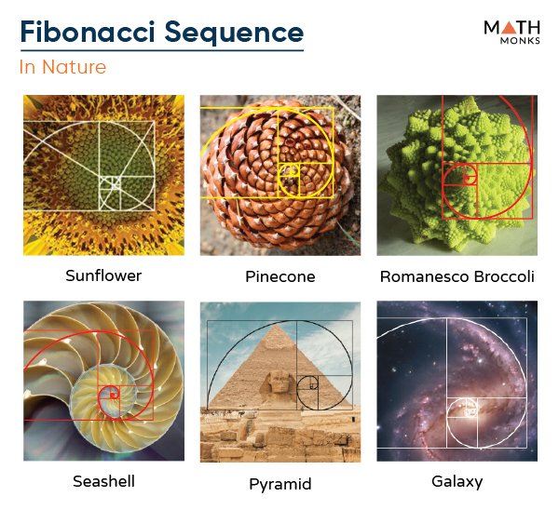
Algorithmic paradigms
Greedy. Build up a solution incrementally, myopically optimizing some local criterion.
Divide-and-conquer. Break up a problem into independent subproblems, solve each subproblem, and combine solution to subproblems to form solution to original problem.
Dynamic programming. Break up a problem into a series of overlapping subproblems, and build up solutions to larger and larger subproblems.
fancy name for
caching away intermediate results in a table for later reuse

Slide 3
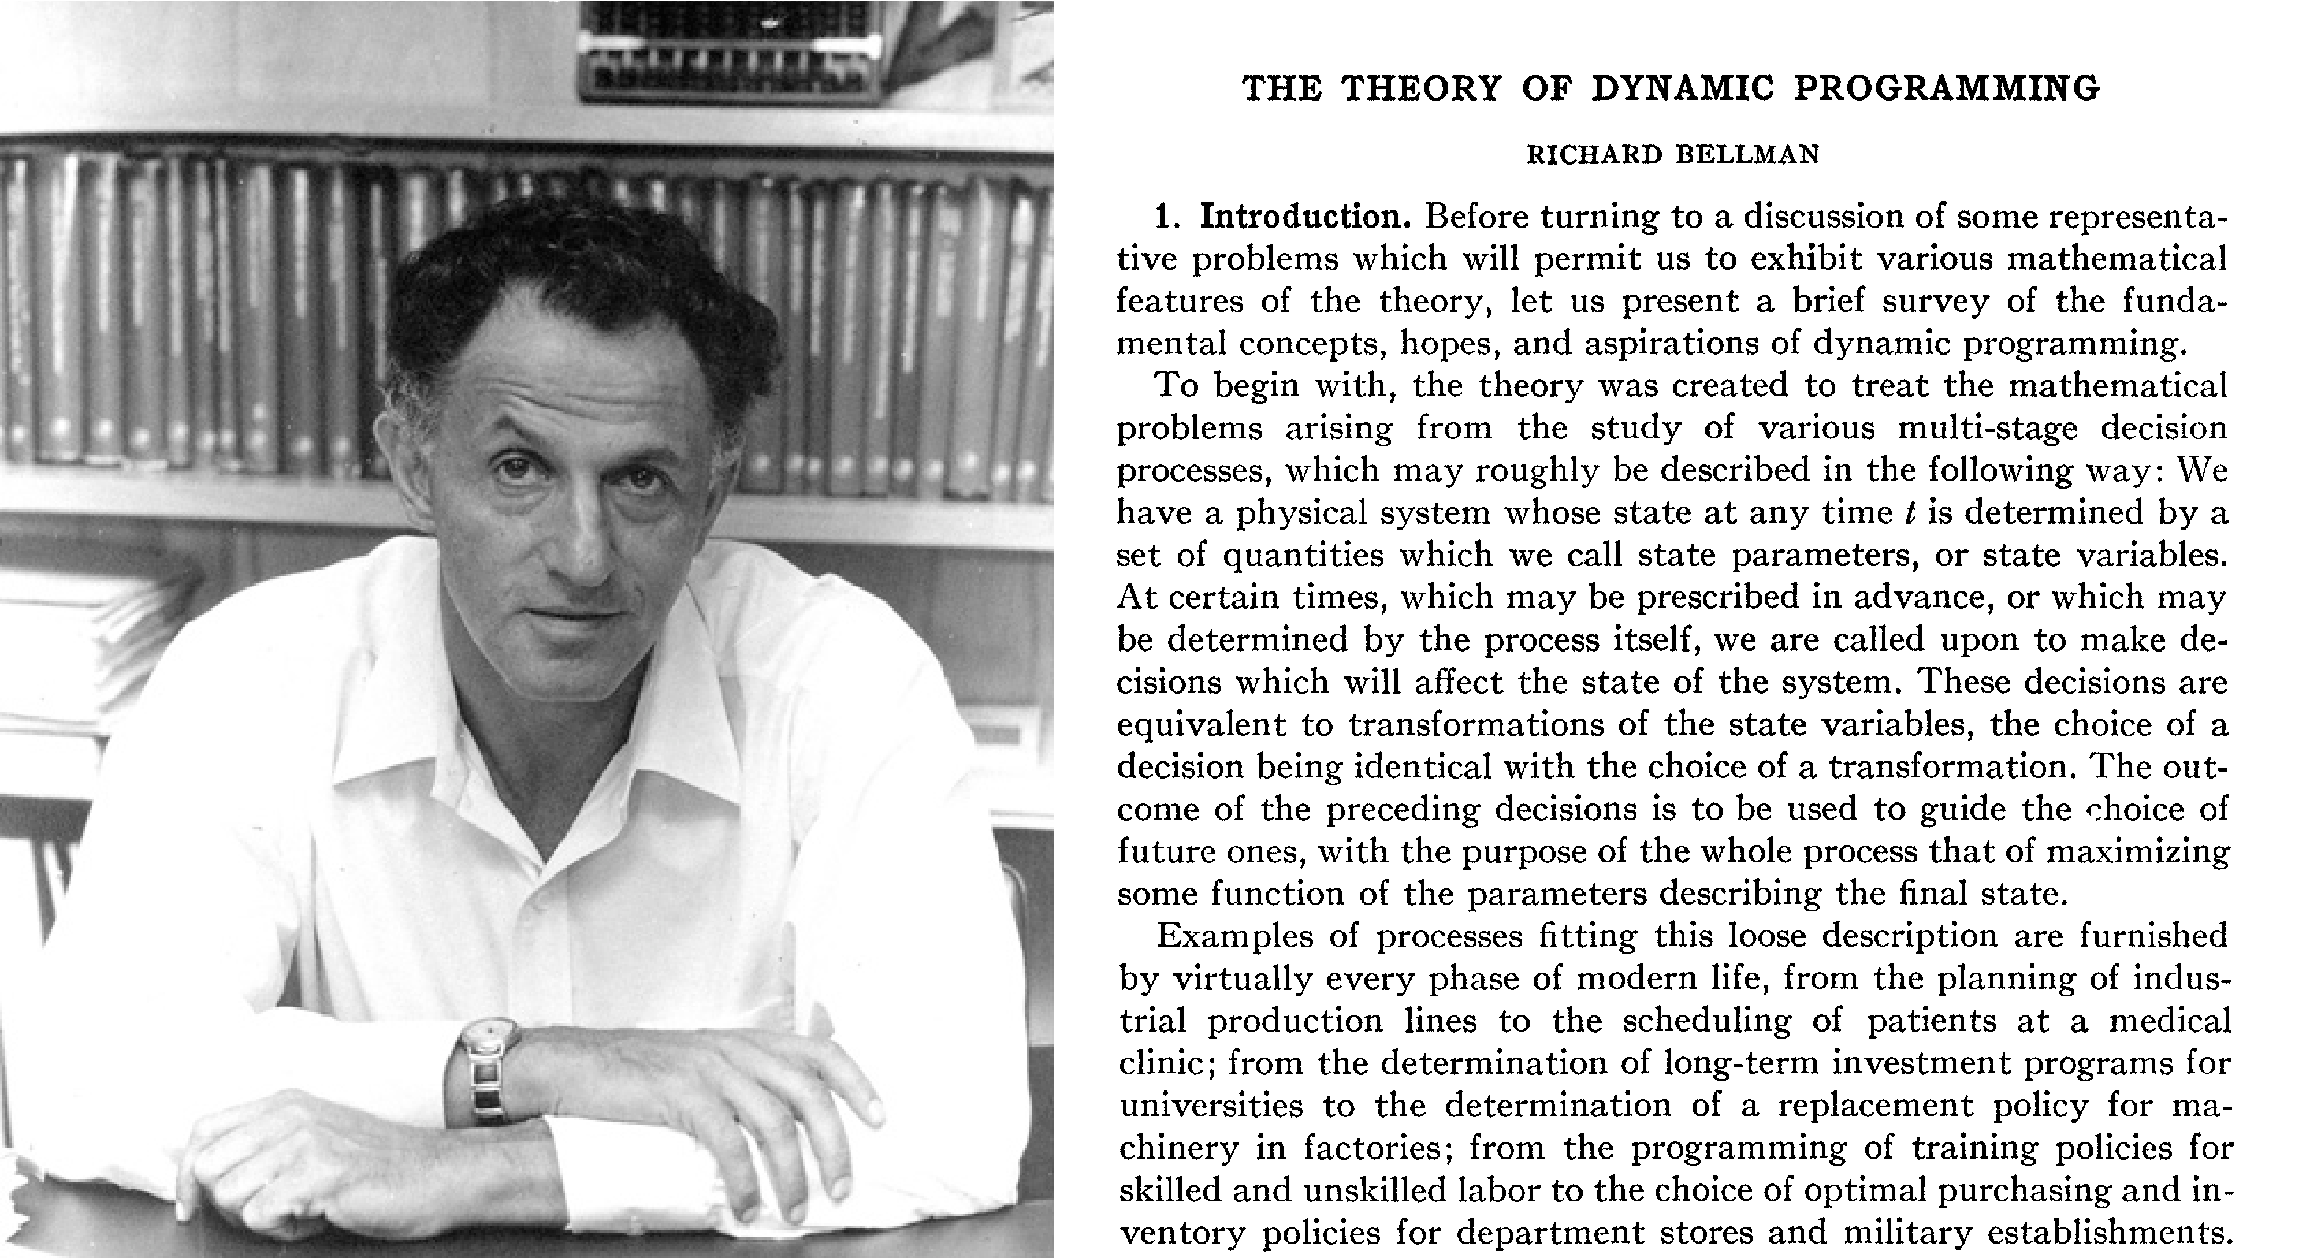
Dynamic programming history
Bellman. Pioneered the systematic study of dynamic programming in 1950s.
Etymology.
・Dynamic programming = planning over time.
・Secretary of Defense was hostile to mathematical research.
・Bellman sought an impressive name to avoid confrontation.

Slide 4
Dynamic programming applications
Areas.
・Bioinformatics.
・Control theory.
・Information theory.
・Operations research.
・Computer science: theory, graphics, AI, compilers, systems, ….
・...
Some famous dynamic programming algorithms.
・Unix diff for comparing two files.
・Viterbi for hidden Markov models.
・De Boor for evaluating spline curves.
・Smith-Waterman for genetic sequence alignment.
・Bellman-Ford for shortest path routing in networks.
・Cocke-Kasami-Younger for parsing context-free grammars.
・...

Slide 5


6. Dynamic Programming I
weighted interval scheduling
segmented least squares
knapsack problem
RNA secondary structure
SECTION 6.1-6.2

Slide 6
Weighted interval scheduling
Weighted interval scheduling problem.
・Job j starts at sj, finishes at fj, and has weight or value vj.
・Two jobs compatible if they don't overlap.
・Goal: find maximum weight subset of mutually compatible jobs.
a
b
c
d
e
f
g
h
0
1
2
3
4
5
6
7
8 9 10 11
time
6

Slide 7
Earliest-finish-time first algorithm
Earliest finish-time first.
・Consider jobs in ascending order of finish time.
・Add job to subset if it is compatible with previously chosen jobs.
Recall. Greedy algorithm is correct if all weights are 1.
Observation. Greedy algorithm fails spectacularly for weighted version.
weight = 999
b
weight = 1
a
h
0
1
2
3
4
5
6
7
8
9 10
11
time

Slide 8
Weighted interval scheduling
Notation. Label jobs by finishing time: f₁ ≤ f₂ ≤ . . . ≤ f_{n} .
Def. p ( j ) = largest index i < j such that job i is compatible with j. Ex. p(8) = 5, p(7) = 3, p(2) = 0.
1
2
3
4
5
6
7
8
0
1
2
3
4
5
6
7
8
9 10
time
11

Slide 9
Dynamic programming: binary choice
Notation. OPT(j) = value of optimal solution to the problem consisting of job requests 1, 2, ..., j.
Case 1. OPT selects job j.
・Collect profit vj.
・Can't use incompatible jobs { p(j) + 1, p(j) + 2, ..., j – 1 }.
・Must include optimal solution to problem consisting of remaining compatible jobs 1, 2, ..., p(j).
optimal substructure property (proof via exchange argument)
Case 2. OPT does not select job j.
・Must include optimal solution to problem consisting of remaining compatible jobs 1, 2, ..., j – 1.
⎧ 0
OPT( j) = ⎨
⎩max ⎨ v _{j} + OPT( p( j)), OPT( j −1) ⎬
if j = 0 otherwise

Slide 10
Weighted interval scheduling: brute force
Input: n, s[1..n], f[1..n], v[1..n]
Sort jobs by finish time so that f[1] ≤ f[2] ≤ … ≤ f[n]. Compute p[1], p[2], …, p[n].
Compute-Opt(j) if j = 0
return 0. else
return max(v[j] + Compute-Opt(p[j], Compute-Opt(j–1))).

Slide 11





Weighted interval scheduling: brute force
Observation. Recursive algorithm fails spectacularly because of redundant subproblems ⇒ exponential algorithms.
Ex. Number of recursive calls for family of "layered" instances grows like Fibonacci sequence.
5
1
4
3
2
3
3
2
2
1
4
1
1
1
0
1
0
5
p(1) = 0, p(j) = j-2
1
0
recursion tree

Slide 12
Weighted interval scheduling: memoization
Memoization. Cache results of each subproblem; lookup as needed.
Input: n, s[1..n], f[1..n], v[1..n]
Sort jobs by finish time so that f[1] ≤ f[2] ≤ … ≤ f[n]. Compute p[1], p[2], …, p[n].
for j = 1 to n M[j] ← empty.
M[0] ← 0.
M-Compute-Opt(j) if M[j] is empty
M[j] ← max(v[j] + M-Compute-Opt(p[j]), M-Compute-Opt(j – 1)). return M[j].
global array

Slide 13
Weighted interval scheduling: running time
Claim. Memoized version of algorithm takes O(n log n) time.
・Sort by finish time: O(n log n).
・Computing p(⋅) : O(n log n) via sorting by start time.
・M-COMPUTE-OPT(j): each invocation takes O(1) time and either
(i) returns an existing value M[j]
(ii) fills in one new entry M[j] and makes two recursive calls
・Progress measure Φ = # nonempty entries of M[].
initially Φ = 0, throughout Φ ≤ n.
(ii) increases Φ by 1 ⇒ at most 2n recursive calls.
・Overall running time of M-COMPUTE-OPT(n) is O(n). ▪
Remark. O(n) if jobs are presorted by start and finish times.

Slide 14
Weighted interval scheduling: finding a solution
Q. DP algorithm computes optimal value. How to find solution itself?
A. Make a second pass.
Find-Solution(j) if j = 0
return ∅.
else if (v[j] + M[p[j]] > M[j–1]) return { j } ∪ Find-Solution(p[j]).
else
return Find-Solution(j–1).
Analysis. # of recursive calls ≤ n ⇒ O(n).

Slide 15
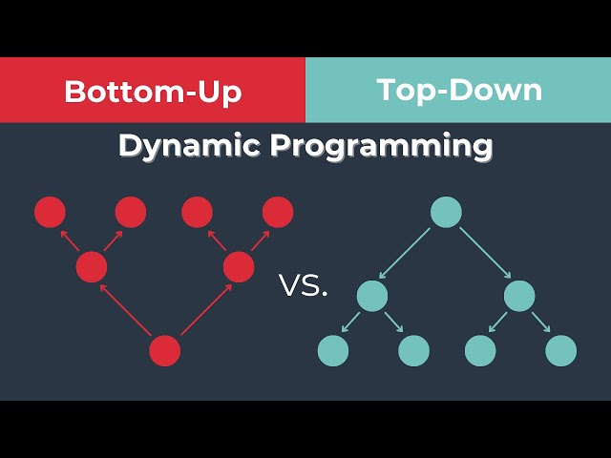
Weighted interval scheduling: bottom-up
Bottom-up dynamic programming. Unwind recursion.
BOTTOM-UP (n, s1, …, sn , f1, …, fn , v1, …, vn)
Sort jobs by finish time so that f1 ≤ f2 ≤ … ≤ fn. Compute p(1), p(2), …, p(n).
M [0] ← 0. FOR j = 1 TO n
M [ j ] ← max { vj + M [ p(j) ], M [ j – 1] }.
_

Slide 16

网络视频
https://www.youtube.com/watch?v=Hdr64lKQ3e4
温馨提示：此视频框在点击“上传手机课件”时会进行转换，用手机进行观看时则会变为可点击的视频。此视频框可被拖动移位和修改大小。

Slide 17
6. Dynamic Programming I
weighted interval scheduling
segmented least squares
knapsack problem
RNA secondary structure
Section 6.3

Slide 18
Least squares
Least squares. Foundational problem in statistics.
・Given n points in the plane: (x1, y1), (x2, y2) , …, (xn, yn).
・Find a line y = ax + b that minimizes the sum of the squared errors:
n
SSE = ∑ ( y_{i} − ax_{i} − b)²
i=1
y
x
Solution. Calculus ⇒ min error is achieved when
n ∑_{i} x_{i} y_{i}
a =
− (∑_{i} x_{i} ) (∑_{i} y_{i} )
,
∑_{i} y_{i} − a ∑_{i} x_{i} b = _{n}
n ∑
x
2
− (∑ x )
2
i
i
i
i
17

Slide 19
Segmented least squares
Segmented least squares.
・Points lie roughly on a sequence of several line segments.
・Given n points in the plane: (x1, y1), (x2, y2) , …, (xn, yn) with
x1 < x2 < ... < xn, find a sequence of lines that minimizes f (x).
Q. What is a reasonable choice for f (x) to balance accuracy and parsimony?
goodness of fit
number of lines
y
x

Slide 20
Segmented least squares
Given n points in the plane: (x1, y1), (x2, y2) , …, (xn, yn) with x1 < x2 < ... < xn and a constant c > 0, find a sequence of lines that minimizes f (x) = E + c L:
・E = the sum of the sums of the squared errors in each segment.
・L = the number of lines.
y
x

Slide 21
・OPT(j) = minimum cost for points p1, p2, …, pj.
Dynamic programming: multiway choice
Notation.
・e(i, j) = minimum sum of squares for points pi, pi+1, …, pj.
To compute OPT(j):
・Last segment uses points pi, pi+1, …, pj for some i.
・Cost = e(i, j) + c + OPT(i – 1).
optimal substructure property (proof via exchange argument)
⎧⎮ 0
if j = 0 otherwise
OPT
^{( j) = ⎨} min ⎨ e(i, j) + c + OPT(i −1) ⎬
⎮⎩1 ≤ i ≤ j

Slide 22
Segmented least squares algorithm
SEGMENTED-LEAST-SQUARES (n, p1, …, pn , c) FOR j = 1 TO n
FOR i = 1 TO j
Compute the least squares e(i, j) for the segment pi, pi+1, …, pj.
M [0] ← 0. FOR j = 1 TO n
M [ j ] ← min 1 ≤ i ≤ j { eij + c + M [ i – 1] }.
Return M[n].

Slide 23
Segmented least squares analysis
Theorem. [Bellman 1961] The dynamic programming algorithm solves the segmented least squares problem in O(n³) time and O(n²) space.
Pf.
・Bottleneck = computing e(i, j) for O(n²) pairs.
・O(n) per pair using formula. ▪
n ∑_{i} x_{i} y_{i}
a =
− (∑_{i} x_{i} ) (∑_{i} y_{i} )
,
∑_{i} y_{i} − a ∑_{i} x_{i}
b =
n ∑
x
2
− (∑ x )
2
n
i
i
i
i
Remark. Can be improved to O(n²) time and O(n) space by precomputing various statistics. How?

Slide 24
6. Dynamic Programming I
weighted interval scheduling
segmented least squares
knapsack problem
RNA secondary structure
Section 6.4

Slide 25
Knapsack problem
・Given n objects and a "knapsack."
・Item i weighs wi > 0 and has value vi > 0.
・Knapsack has capacity of W.
・Goal: fill knapsack so as to maximize total value.
- Note： wi, and W are integers.
Ex. { 1, 2, 5 } has value 35.
Ex. { 3, 4 } has value 40.
Ex. { 3, 5 } has value 46 (but exceeds weight limit).
i | vi | wi
1 | 1 | 1
2 | 6 | 2
3 | 18 | 5
4 | 22 | 6
5 | 28 | 7
knapsack instance (weight limit W = 11)
Greedy by value. Repeatedly add item with maximum vi. Greedy by weight. Repeatedly add item with minimum wi.
Greedy by ratio. Repeatedly add item with maximum ratio vi / wi.
Observation. None of greedy algorithms is optimal.

Slide 26
Dynamic programming: false start
Def. OPT(i) = max profit subset of items 1, …, i.
Case 1. OPT does not select item i.
・OPT selects best of { 1, 2, …, i – 1 }.
optimal substructure property (proof via exchange argument)
Case 2. OPT selects item i.
・Selecting item i does not immediately imply that we will have to reject
・Without knowing what other items were selected before i, we don't even know if we have enough room for i.
other items.
Conclusion. Need more subproblems!

Slide 27
Dynamic programming: adding a new variable
Def. OPT(i, w) = max profit subset of items 1, …, i with weight limit w. Case 1. OPT does not select item i.
・OPT selects best of { 1, 2, …, i – 1 } using weight limit w.
Case 2. OPT selects item i.
optimal substructure property (proof via exchange argument)
・New weight limit = w – wi.
・OPT selects best of { 1, 2, …, i – 1 } using this new weight limit.
⎧ 0
OPT(i, w) = ⎮OPT(i −1, w)
⎨
if i = 0
if w > w
i
otherwise
⎮max⎨ OPT(i −1, w),
v_{i} + OPT(i −1, w − w_{i} ) ⎬
⎩

Slide 28
Knapsack problem: bottom-up
KNAPSACK (n, W, w1, …, wn, v1, …, vn )
FOR w = 0 TO W M [0, w] ← 0.
For i = 1 to n
For w = 1 to W
IF (wi > w) M [ i, w ] ← M [ i – 1, w].
ELSE M [ i, w ] ← max { M [ i – 1, w], vi + M [ i – 1, w – wi] }.
Return M[n, W].

Slide 29
Knapsack problem: bottom-up demo
i | vi | wi
1 | 1 | 1
2 | 6 | 2
3 | 18 | 5
4 | 22 | 6
5 | 28 | 7
⎧ 0
OPT(i, w) = ⎮OPT(i −1, w)
⎨
if i = 0
if w > w
i
otherwise
⎮max⎨ OPT(i −1, w),
v_{i} + OPT(i −1, w − w_{i} ) ⎬
⎩
weight limit w
 |  | 0 | 1 | 2 | 3 | 4 | 5 | 6 | 7 | 8 | 9 | 10 | 11
 | { } | 0 | 0 | 0 | 0 | 0 | 0 | 0 | 0 | 0 | 0 | 0 | 0
 | { 1 } | 0 | 1 | 1 | 1 | 1 | 1 | 1 | 1 | 1 | 1 | 1 | 1
subset | { 1, 2 } | 0 | 1 | 6 | 7 | 7 | 7 | 7 | 7 | 7 | 7 | 7 | 7
of items 1, …, i | { 1, 2, 3 } | 0 | 1 | 6 | 7 | 7 | 18 | 19 | 24 | 25 | 25 | 25 | 25
 | { 1, 2, 3, 4 } | 0 | 1 | 6 | 7 | 7 | 18 | 22 | 24 | 28 | 29 | 29 | 40
 | { 1, 2, 3, 4, 5 } | 0 | 1 | 6 | 7 | 7 | 18 | 22 | 28 | 29 | 34 | 34 | 40
OPT(i, w) = max profit subset of items 1, …, i with weight limit w.

Slide 30
Knapsack problem: running time
Theorem. There exists an algorithm to solve the knapsack problem with n
items and maximum weight W in Θ(n W) time and Θ(n W) space.
Pf.
weights are integers between 1 and W
・Takes O(1) time per table entry.
・There are Θ(n W) table entries.
・After computing optimal values, can trace back to find solution: take item i in OPT(i, w) iff M [i, w] < M [i – 1, w]. ▪
Remarks.
・Not polynomial in input size!
"pseudo-polynomial"
・Decision version of knapsack problem is NP-COMPLETE. [ CHAPTER 8 ]
・There exists a poly-time algorithm that produces a feasible solution that has value within 1% of optimum. [ SECTION 11.8 ]

Slide 31
6. Dynamic Programming I
weighted interval scheduling
segmented least squares
knapsack problem
RNA secondary structure
Section 6.5

Slide 32
RNA secondary structure
RNA. String B = b₁b₂…b_{n} over alphabet { A, C, G, U }.
Secondary structure. RNA is single-stranded so it tends to loop back and form base pairs with itself. This structure is essential for understanding behavior of molecule.
C
A
A
A
A
U
G
C
C
G
U
A
A
G
U
G
A
U
U
A
A
C
G
C
U
G
G
C
G
C
G
A
G
C
G
A
U
G
RNA secondary structure for GUCGAUUGAGCGAAUGUAACAACGUGGCUACGGCGAGA

Slide 33
RNA secondary structure
Secondary structure. A set of pairs S = { (b_{i}, b_{j}) } that satisfy:
・[Watson-Crick] S is a matching and each pair in S is a Watson-Crick complement: A–U, U–A, C–G, or G–C.
・[No sharp turns] The ends of each pair are separated by at least 4
intervening bases. If (b_{i}, b_{j}) ∈ S, then i < j – 4.
・[Non-crossing] If (b_{i}, b_{j}) and (b_{k}, bℓ) are two pairs in S, then we cannot have i < k < j <ℓ.
Free energy. Usual hypothesis is that an RNA molecule will form the secondary structure with the minimum total free energy.
approximate by number of base pairs
Goal. Given an RNA molecule B = b₁b₂…b_{n}, find a secondary structure S
that maximizes the number of base pairs.

Slide 34
RNA secondary structure
Examples.
G
G
G
G
G
C
U
G
G
C
U
C
G
C
G
C
U
A
U
A
U
A
G
U
A
U
A
U
A
base pair
A
U G U G G C C A U
A
U G G G G C A U
A
G U U G G C C A U
ok
sharp turn
(≤4 intervening bases)
crossing

Slide 35
RNA secondary structure: subproblems
First attempt. OPT(j) = maximum number of base pairs in a secondary structure of the substring b₁b₂ … b_{j}.
Choice. Match b_{t} and b_{n}.
match bt and bn
1
t
n
Difficulty. Results in two subproblems but one of wrong form.
・Find secondary structure in b₁b₂ … b_{t–1}.
・Find secondary structure in
OPT(t–1)
^{b}t+1^{b}t+2 ^{… b}n–1.
need more subproblems

Slide 36
Dynamic programming over intervals
Notation. OPT( i, j ) = maximum number of base pairs in a secondary structure of the substring b_{i} b_{i+1} … b_{j}.
Case 1. If i ≥ j – 4.
・OPT(i, j) = 0 by no-sharp turns condition.
Case 2. Base bj is not involved in a pair.
・OPT(i, j) = OPT(i, j – 1).
Case 3. Base bj pairs with bt for some i ≤ t < j – 4.
・Noncrossing constraint decouples resulting subproblems.
・OPT(i, j) = 1 + max t { OPT(i, t – 1) + OPT(t + 1, j – 1) }.
take max over t such that i ≤ t < j – 4 and bt and bj are Watson-Crick complements

Slide 37

Bottom-up dynamic programming over intervals
Q. In which order to solve the subproblems?
A. Do shortest intervals first.
RNA (n, b1, …, bn ) FOR k = 5 TO n – 1
For i = 1 to n – k
j ← i + k.
Compute M[i, j] using formula.
Return M[1, n].
j
6
7
8
9
10
4
0
0
0
3 0
0
i
2
0
1
order in which to solve subproblems
Theorem. The dynamic programming algorithm solves the RNA secondary substructure problem in O(n³) time and O(n²) space.

Slide 38
Dynamic programming summary
Outline.
・Polynomial number of subproblems.
・Solution to original problem can be computed from subproblems.
・Natural ordering of subproblems from smallest to largest, with an easy- to-compute recurrence that allows one to determine the solution to a subproblem from the solution to smaller subproblems.
Techniques.
・Binary choice: weighted interval scheduling.
・Multiway choice: segmented least squares.
・Adding a new variable: knapsack problem.
・Dynamic programming over intervals: RNA secondary structure.
Top-down vs. bottom-up. Different people have different intuitions.

