Slide 1
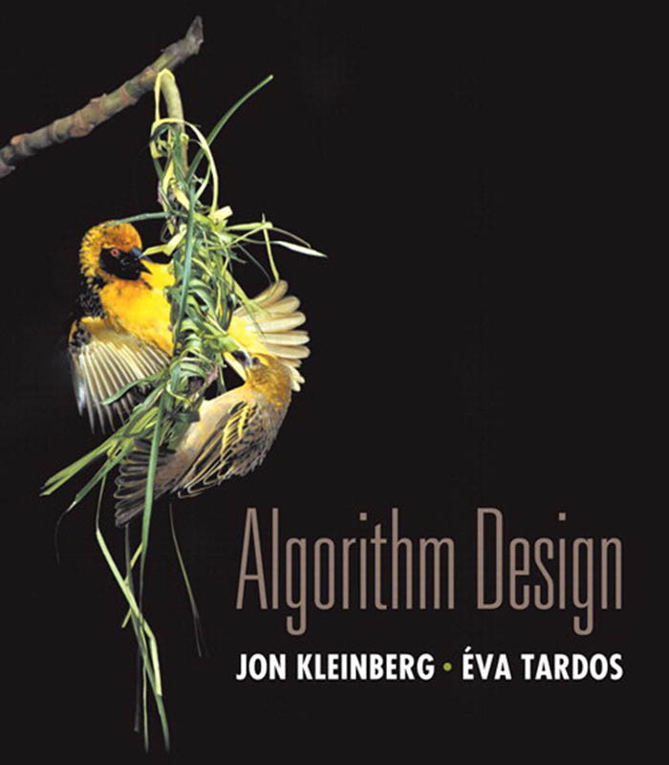

11. Approximation Algorithms
load balancing
center selection
pricing method: weighted vertex cover
LP rounding: weighted vertex cover
generalized load balancing
knapsack problem
Lecture slides by Kevin Wayne Copyright © 2005 Pearson-Addison Wesley
http:// www.cs.princeton.edu/ ~wayne/ kleinberg-tardos
Last updated on 2/26/20 11:14 AM

Slide 2
Coping with NP-completeness
Q. Suppose I need to solve an NP-hard optimization problem. What should I do?
A. Sacrifice one of three desired features.
Runs in polynomial time.
Solves arbitrary instances of the problem.
Finds optimal solution to problem.
ρ-approximation algorithm.
・Runs in polynomial time.
・Solves arbitrary instances of the problem
・Finds solution that is within ratio ρ of optimum.
Challenge. Need to prove a solution’s value is close to optimum, without even knowing what is optimum value.
2

Slide 3


11. Approximation Algorithms
load balancing
center selection
pricing method: weighted vertex cover
LP rounding: weighted vertex cover
generalized load balancing
knapsack problem
Section 11.1

Slide 4
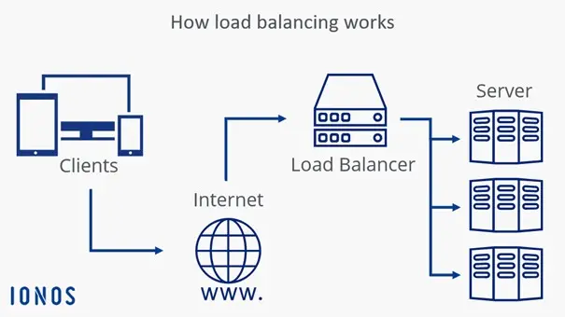
Load balancing
Input. m identical machines; n ≥ m jobs, job j
has processing time t_{j}.
・Job j must run contiguously on one machine.
・A machine can process at most one job at a time.
Def. Let S[i] be the subset of jobs assigned to machine i. The load of machine i is L[i] = Σ_{j ∈ S[i]} t_{j}.
Def. The makespan is the maximum load on any machine L = max_{i} L[i]. Load balancing. Assign each job to a machine to minimize makespan.
machine 1
a
d
Mac
h
ine 1
f
b | c h | e | g
machine 2
Mac
ine 2
0
L[1]
L[2]
time

Slide 5
Load balancing on 2 machines is NP-hard
Claim. Load balancing is hard even if m = 2 machines. Pf. PARTITION ≤ _{P} LOAD-BALANCE.
NP-complete by Exercise 8.26
a
b
c
d
e
f
g
length of job f
machine 1
a
d
Mac
h
ine 1
f
yes
b | c h | e | g
machine 2
Mac
ine 2
0
L
time

Slide 6

Load balancing: list scheduling
List-scheduling algorithm.
・Consider n jobs in some fixed order.
・Assign job j to machine i whose load is smallest so far.
LIST-SCHEDULING (m, n, t1, t2, …, tn)
For i = 1 to m
L[i] ← 0.
S[i] ← ∅.
load on machine i
jobs assigned to machine i
For j = 1 to n
i ← argmin k L[k]. S[i] ← S[i] ∪ { j }.
L[i] ← L[i] + tj.
machine i has smallest load
assign job j to machine i
update load of machine i
RETURN S[1], S[2], …, S[m].
Implementation.
O(n log m) using a priority queue for loads L[k].

Slide 7
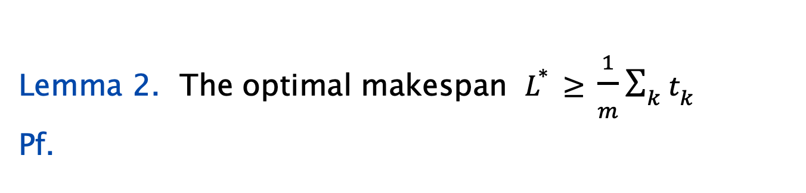
Load balancing: list scheduling analysis
Theorem. [Graham 1966] Greedy algorithm is a 2-approximation.
・First worst-case analysis of an approximation algorithm.
・Need to compare resulting solution with optimal makespan L*.
Lemma 1. For all k : the optimal makespan L* ≥ t_{k} .
Pf. Some machine must process the most time-consuming job. ▪
Lemma 2. The optimal makespan $L^{∗}≥\frac{1}{m}\sum_{k}{t_{k}}$
Pf.
・The total processing time is Σ_{k} t_{k} .
・One of m machines must do at least a 1 / m fraction of total work. ▪

Slide 8
Load balancing: list scheduling analysis
Theorem. Greedy algorithm is a 2-approximation.
Pf. Consider load L[i] of bottleneck machine i.
machine that ends up with highest load
・Let j be last job scheduled on machine i.
・When job j assigned to machine i, i had smallest load.
Its load before assignment is L[i] – t_{j} ; hence L[i] – t_{j} ≤ L[k] for all 1 ≤ k ≤ m.
blue jobs scheduled before j
machine i
j
0
L[i] - tj
L = L[i]
time
8

Slide 9
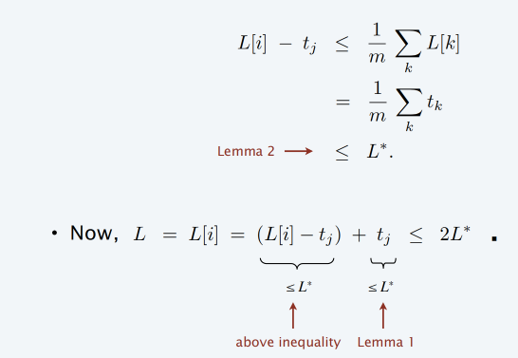
Load balancing: list scheduling analysis
Theorem. Greedy algorithm is a 2-approximation.
Pf. Consider load L[i] of bottleneck machine i.
machine that ends up with highest load
・Let j be last job scheduled on machine i.
・When job j assigned to machine i, i had smallest load.
Its load before assignment is L[i] – t_{j} ; hence L[i] – t_{j} ≤ L[k] for all 1 ≤ k ≤ m.
・Sum inequalities over all k and divide by m:
9

Slide 10
Load balancing: list scheduling analysis
Q. Is our analysis tight?
A. Essentially yes.
Ex: m machines, first m (m – 1) jobs have length 1, last job has length m.
list scheduling makespan = 19 = 2m - 1
 |  |  |  |  |  |  |  |  | machine 2 idle
 |  |  |  |  |  |  |  |  | machine 3 idle
 |  |  |  |  |  |  |  |  | machine 4 idle
 |  |  |  |  |  |  |  |  | machine 5 idle
 |  |  |  |  |  |  |  |  | machine 6 idle
 |  |  |  |  |  |  |  |  | machine 7 idle
 |  |  |  |  |  |  |  |  | machine 8 idle
 |  |  |  |  |  |  |  |  | machine 9 idle
 |  |  |  |  |  |  |  |  | machine 10 idle
m = 10
0
9
19

Slide 11
Load balancing: list scheduling analysis
Q. Is our analysis tight?
A. Essentially yes.
Ex: m machines, first m (m – 1) jobs have length 1, last job has length m.
optimal makespan = 10 = m
m = 10
0
9
19

Slide 12
Load balancing: LPT rule
Longest processing time (LPT). Sort n jobs in decreasing order of processing times; then run list scheduling algorithm.
LPT-LIST-SCHEDULING (m, n, t1, t2, …, tn)
SORT jobs and renumber so that t1 ≥ t2 ≥ … ≥ tn.
For i = 1 to m
L[i] ← 0.
S[i] ← ∅.
load on machine i
jobs assigned to machine i
For j = 1 to n
i ← argmin k L[k]. S[i] ← S[i] ∪ { j }.
L[i] ← L[i] + tj.
machine i has smallest load
assign job j to machine i
update load of machine i
RETURN S[1], S[2], …, S[m].

Slide 13
Load balancing: LPT rule
Observation. If bottleneck machine i has only 1 job, then optimal. Pf. Any solution must schedule that job. ▪
Lemma 3. If there are more than m jobs, L* ≥ 2 t_{m+1} . Pf.
・Consider processing times of first m+1 jobs t₁ ≥ t₂ ≥ … ≥ t_{m+1}.
・Each takes at least t_{m+1} time.
・There are m + 1 jobs and m machines, so by pigeonhole principle, at least one machine gets two jobs. ▪
Theorem. LPT rule is a 3/2-approximation algorithm. Pf. [ similar to proof for list scheduling ]
・Consider load L[i] of bottleneck machine i.
・Let j be last job scheduled on machine i.
assuming machine i has at least 2 jobs, we have j ≥ m + 1
3
_{L}*
L = L[i] = (L[i] — t_{j} ) + t_{j} ≤
▪
2
as before
≤ L*
≤ ½ L*
Lemma 3 (since t_{m+1} ≥ t_{j} )

Slide 14
Load balancing: LPT rule
Q. Is our 3/2 analysis tight?
A. No.
Theorem. [Graham 1969] LPT rule is a 4/3-approximation. Pf. More sophisticated analysis of same algorithm.
Q. Is Graham’s 4/3 analysis tight?
A. Essentially yes.
Ex.
・m machines
・n = 2m + 1 jobs
・2 jobs of length m, m + 1, …, 2m – 1 and one more job of length m.
・Then, L / L* = (4m − 1) / (3m)

Slide 15
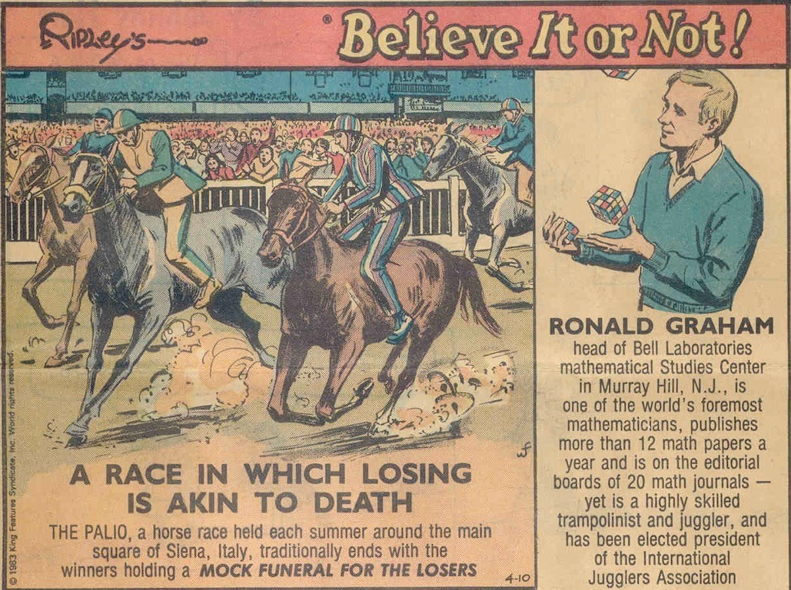
Believe it or not
L * ≥
1
m
∑
t _{j} .
j

Slide 16
11. Approximation Algorithms
load balancing
center selection
pricing method: weighted vertex cover
LP rounding: weighted vertex cover
generalized load balancing
knapsack problem
Section 11.2

Slide 17



Center selection problem
Input. Set of n sites s₁, …, s_{n} and an integer k > 0.
Center selection problem. Select set of k centers C so that maximum distance r(C) from a site to nearest center is minimized.
k = 4 centers
r(C)
center site

Slide 18
Center selection problem
Input. Set of n sites s₁, …, s_{n} and an integer k > 0.
Center selection problem. Select set of k centers C so that maximum distance r(C) from a site to nearest center is minimized.
Notation.
・dist(x, y) = distance between sites x and y.
・dist(s_{i}, C) = min _{c ∈ C} dist(s_{i}, c) = distance from s_{i} to closest center.
・r(C) = max_{i} dist(s_{i}, C) = smallest covering radius.
Goal. Find set of centers C that minimizes r(C), subject to | C | = k.
Distance function properties.
・dist(x, x) = 0
・dist(x, y) = dist(y, x)
・dist(x, y) ≤ dist(x, z) + dist(z, y)
[ identity ]
[ symmetry ]
[ triangle inequality ]

Slide 19
Center selection example
Ex: each site is a point in the plane, a center can be any point in the plane,
dist(x, y) = Euclidean distance.
Remark: search can be infinite!
k = 4 centers
r(C)
center site

Slide 20
Greedy algorithm: a false start
Greedy algorithm. Put the first center at the best possible site for a single center, and then keep adding centers so as to reduce the covering radius each time by as much as possible.
Remark: arbitrarily bad!
k = 2 centers
greedy center 1
center site

Slide 21
Center selection: greedy algorithm
Repeatedly choose next center to be site farthest from any existing center.
GREEDY-CENTER-SELECTION (k, n, s1, s2, … , sn)
C ← ∅. REPEAT k times
Select a site si with maximum distance dist(si, C). C ← C ∪ si.
site farthest
Return C.
from any center
Property. Upon termination, all centers in C are pairwise at least r(C) apart. Pf. By construction of algorithm.

Slide 22
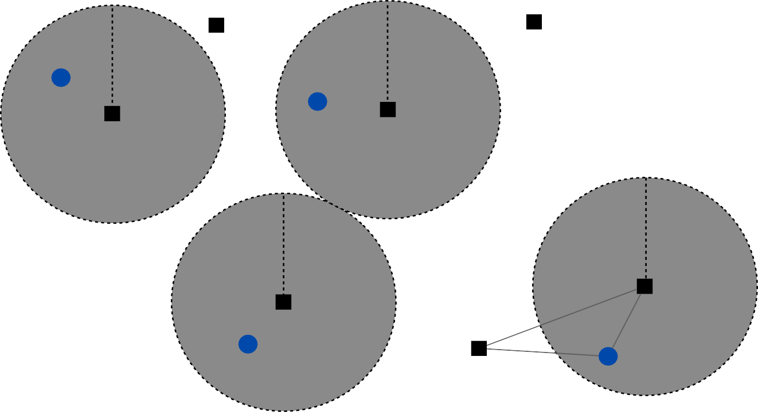
Center selection: analysis of greedy algorithm
Lemma. Let C* be an optimal set of centers. Then r(C) ≤ 2r(C*). Pf. [by contradiction] Assume r(C*) < ½ r(C).
・For each site c_{i} ∈ C, consider ball of radius ½ r(C) around it.
・Exactly one c_{i}* in each ball; let c_{i} be the site paired with c_{i} .
*
・Consider any site s and its closest center c_{i} ∈ C*.
*
・dist(s, C) ≤ dist(s, c_{i}) ≤ dist(s, c_{i}*) + dist(c_{i}*, c_{i}) ≤ 2r(C*).
・Thus, r(C) ≤ 2r(C*). ▪
≤ r(C*) since c_{i}* is closest center
Δ-inequality
½ r(C)
½ r(C)
c_{i}
½ r(C)
C* site
s
c_{i}*

Slide 23
Center selection
Lemma. Let C* be an optimal set of centers. Then r(C) ≤ 2r (C*).
Theorem. Greedy algorithm is a 2-approximation for center selection problem.
Remark. Greedy algorithm always places centers at sites, but is still within a factor of 2 of best solution that is allowed to place centers anywhere.
e.g., points in the plane
Question. Is there hope of a 3/2-approximation? 4/3?

Slide 24
Dominating set reduces to center selection
Theorem. Unless P = NP, there no ρ-approximation for center selection problem for any ρ < 2.
Pf. We show how we could use a (2 – ε) approximation algorithm for CENTER-SELECTION selection to solve DOMINATING-SET in poly-time.
・Let G = (V, E), k be an instance of DOMINATING-SET.
・Construct instance Gʹ of CENTER-SELECTION with sites V and distances
-
-
dist(u, v) = 1 if (u, v) ∈ E
dist(u, v) = 2 if (u, v) ∉ E
・Note that Gʹ satisfies the triangle inequality.
・G has dominating set of size k iff there exists k centers C* with r(C*) = 1.
・Thus, if G has a dominating set of size k, a (2 – ε)-approximation algorithm for CENTER-SELECTION would find a solution C* with r(C*) = 1 since it cannot use any edge of distance 2. ▪

Slide 25
11. Approximation Algorithms
load balancing
center selection
pricing method: weighted vertex cover
LP rounding: weighted vertex cover
generalized load balancing
knapsack problem
Section 11.4

Slide 26
Weighted vertex cover
Definition. Given a graph G = (V, E), a vertex cover is a set S ⊆ V such that each edge in E has at least one end in S.
Weighted vertex cover. Given a graph G with vertex weights, find a vertex cover of minimum weight.
2
4
2
4
2
9
2
9
weight = 2 + 2 + 4
weight = 11

Slide 27

Pricing method
Pricing method. Each edge must be covered by some vertex. Edge e = (i, j) pays price pe ≥ 0 to use both vertex i and j.
Fairness. Edges incident to vertex i should pay ≤ wi in total.
2
4
for each vertex i :
∑
e=(i , j )
p_{e} ≤ w_{i}
2
9
Fairness lemma. For any vertex cover S and any fair prices pe : ∑e pe
≤ w(S).
Pf.
▪
each edge e covered by at least one node in S
sum fairness inequalities for each node in S

Slide 28

Pricing method
Set prices and find vertex cover simultaneously.
Weighted-Vertex-Cover (G, w)
S ← ∅.
Foreach e ∈ E
pe ← 0.
WHILE (there exists an edge (i, j) such that neither i nor j is tight) Select such an edge e = (i, j).
Increase pe as much as possible until i or j tight.
S ← set of all tight nodes. RETURN S.

Slide 29
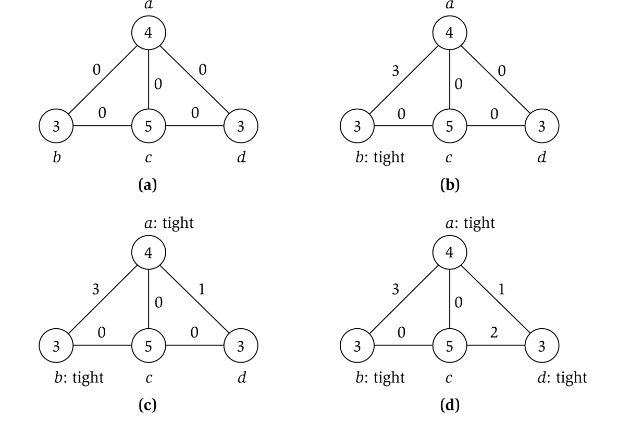

Pricing method example
price of edge a-b
vertex weight

Slide 30
Pricing method: analysis
Theorem. Pricing method is a 2-approximation for WEIGHTED-VERTEX-COVER. Pf.
・Algorithm terminates since at least one new node becomes tight after each iteration of while loop.
・Let S = set of all tight nodes upon termination of algorithm.
S is a vertex cover: if some edge (i, j) is uncovered, then neither i nor j
is tight. But then while loop would not terminate.
・Let S* be optimal vertex cover. We show w(S) ≤ 2 w(S*).
w(S) =
∑ w_{i} = ∑ ∑ p_{e} ≤ ∑ p_{e}
i ∈ S i ∈ S e=(i, j )
= 2 ∑ p_{e}
e ∈ E
≤ 2w(S*).
∑
i ∈V e=(i, j )
all nodes in S are tight
S ⊆ V,
prices ≥ 0
each edge counted twice
fairness lemma

Slide 31
11. Approximation Algorithms
load balancing
center selection
pricing method: weighted vertex cover
LP rounding: weighted vertex cover
generalized load balancing
knapsack problem
Section 11.6

Slide 32
Weighted vertex cover
Given a graph G = (V, E) with vertex weights w_{i} ≥ 0, find a min-weight subset of vertices S ⊆ V such that every edge is incident to at least one vertex in S.
10
69
16
170
36
9
23
33
7
1302
total weight = 6 + 9 + 10 + 32 = 57

Slide 33
Weighted vertex cover: ILP formulation
Given a graph G = (V, E) with vertex weights w_{i} ≥ 0, find a min-weight subset of vertices S ⊆ V such that every edge is incident to at least one vertex in S.
Integer linear programming formulation.
・Model inclusion of each vertex i using a 0/1 variable x_{i}.
⎧ 0
if vertex i is not in vertex cover if vertex i is in vertex cover
x_{i} = ⎨ ₁
⎩
Vertex covers in 1–1 correspondence with 0/1 assignments:
S = { i ∈ V : x_{i} = 1}.
・Objective function: minimize Σ_{i} w_{i} x_{i}.
・For every edge (i, j), must take either vertex i or j (or both):
x_{i} + x_{j} ≥ 1.

Slide 34
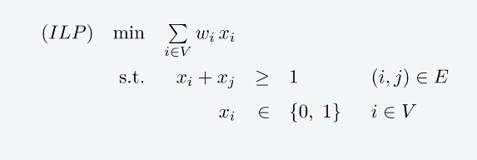
Weighted vertex cover: ILP formulation
Weighted vertex cover. Integer linear programming formulation.
Observation. If x* is optimal solution to ILP, then S = { i ∈ V : x_{i}* = 1}
is a min-weight vertex cover.

Slide 35
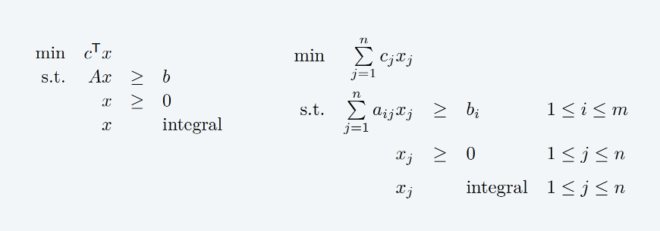
Integer linear programming
Given integers a_{ij}, b_{i}, and c_{j}, find integers x_{j} that satisfy:
Observation. Vertex cover formulation proves that INTEGER-PROGRAMMING is an NP-hard optimization problem.

Slide 36
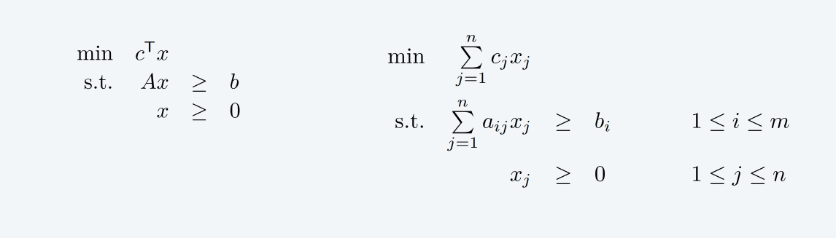
Linear programming
Given integers a_{ij}, b_{i}, and c_{j}, find real numbers x_{j} that satisfy:
Linear. No x ², xy, arccos(x), x (1 – x), etc.
Simplex algorithm. [Dantzig 1947] Can solve LP in practice. Ellipsoid algorithm. [Khachiyan 1979] Can solve LP in poly-time. Interior point algorithms. [Karmarkar 1984, Renegar 1988, … ] Can solve LP both in poly-time and in practice.

Slide 37
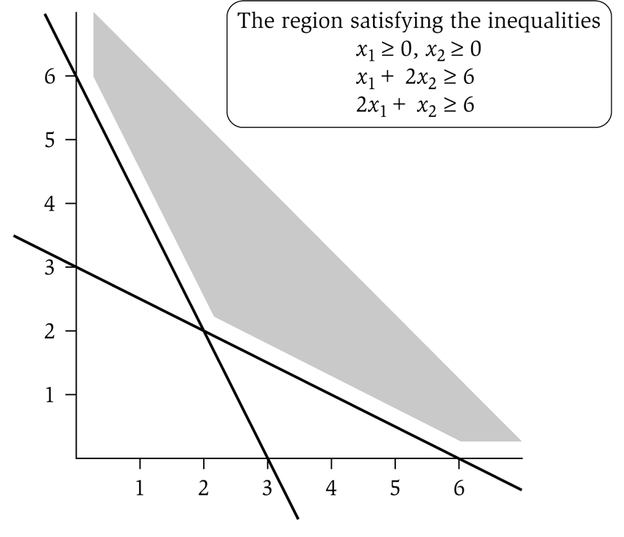
LP feasible region
LP geometry in 2D.
x₁ = 0
x₂ = 0
x₁ + 2x₂ = 6
2x₁ + x₂ = 6

Slide 38
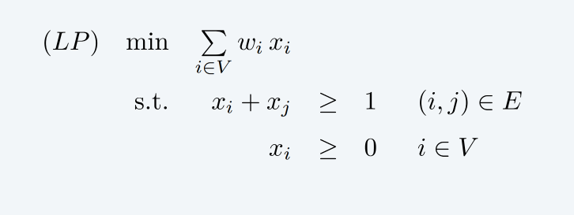

Weighted vertex cover: LP relaxation
Linear programming relaxation.
Observation. Optimal value of LP is ≤ optimal value of ILP. Pf. LP has fewer constraints.
½
½
Note.
LP solution x* may not correspond to a vertex cover. (even if all weights are 1)
½
Q. How can solving LP help us find a low-weight vertex cover?
A. Solve LP and round fractional values in x*.

Slide 39
Weighted vertex cover: LP rounding algorithm
Lemma. If x* is optimal solution to LP, then S = { i ∈ V : x_{i}* ≥ ½ } is a vertex cover whose weight is at most twice the min possible weight.
Pf. [ S is a vertex cover ]
・Consider an edge (i, j) ∈ E.
・Since x_{i}* + x_{j}* ≥ 1, either x_{i}* ≥ ½ or x_{j}* ≥ ½ (or both) ⇒ (i, j) covered.
Pf. [ S has desired weight ]
・Let S* be optimal vertex cover. Then
∑ w ≥ ∑ w x* ≥ ∑ w
1
2
i i i
i
i ∈ S* i ∈ S
i ∈ S
LP is a relaxation
_{xi}*
≥ ½
Theorem. The rounding algorithm is a 2-approximation algorithm. Pf. Lemma + fact that LP can be solved in poly-time.

Slide 40
Weighted vertex cover inapproximability
Theorem. [Dinur–Safra 2004] If P ≠ NP, then no ρ-approximation algorithm for WEIGHTED-VERTEX-COVER for any ρ < 1.3606 (even if all weights are 1).
On the Hardness of Approximating Minimum Vertex Cover
Irit Dinur∗ Samuel Safra† May 26, 2004
Abstract
We prove the Minimum Vertex Cover problem to be NP-hard to approximate to within a factor of 1.3606, extending on previous PCP and hardness of approximation technique. To that end, one needs to develop a new proof framework, and borrow and extend ideas from several fields.
Open research problem.
Close the gap.

Slide 41


Weighted vertex cover inapproximability
Theorem. [Kohot–Regev 2008] If Unique Games Conjecture is true, then no
2 − ε approximation algorithm for WEIGHTED-VERTEX-COVER for any ε > 0.
Journal of Computer and System Sciences 74 (2008) 335–349
Vertex cover might be hard to approximate to within 2 − ε
Subhash Khot ^{a,1}, Oded Regev ^{b,∗,2}
ª Department of Computer Science, Princeton University, Princeton, NJ 08544, USA
^{b} Department of Computer Science, Tel-Aviv University, Tel-Aviv 69978, Israel
Received 28 May 2003; received in revised form 25 April 2006
Available online 13 June 2007
Abstract
Based on a conjecture regarding the power of unique 2-prover-1-round games presented in [S. Khot, On the power of unique 2-Prover 1-Round games, in: Proc. 34th ACM Symp. on Theory of Computing, STOC, May 2002, pp. 767–775], we show that vertex cover is hard to approximate within any constant factor better than 2. We actually show a stronger result, namely, based on the same conjecture, vertex cover on k-uniform hypergraphs is hard to approximate within any constant factor better than k.
© 2007 Elsevier Inc. All rights reserved.
Keywords: Hardness of approximation; Vertex cover; Unique games conjecture
Open research problem. Prove the Unique Games Conjecture.

Slide 42

Linear Programming Relaxation
网络视频
https://www.youtube.com/watch?v=RhHhy-8sz-4
温馨提示：此视频框在点击“上传手机课件”时会进行转换，用手机进行观看时则会变为可点击的视频。此视频框可被拖动移位和修改大小。

Slide 43
11. Approximation Algorithms
load balancing
center selection
pricing method: weighted vertex cover
LP rounding: weighted vertex cover
generalized load balancing
knapsack problem
Section 11.7

Slide 44
Generalized load balancing
Input. Set of m machines M; set of n jobs J.
・Job j ∈ J must run contiguously on an authorized machine in M_{j} ⊆ M.
・Job j ∈ J has processing time t_{j}.
・Each machine can process at most one job at a time.
Def. Let Ji be the subset of jobs assigned to machine i. The load of machine i is L_{i} = Σ_{j ∈ Ji} t_{j}.
Def. The makespan is the maximum load on any machine = max_{i} L_{i}.
Generalized load balancing. Assign each job to an authorized machine to minimize makespan.

Slide 45
Generalized load balancing: integer linear program and relaxation
ILP formulation. x_{ij} = time machine i spends processing job j.
(IP) min L
s. t. ∑ x_{i j} i
^{∑ x}i j j
^{x}i j
^{x}i j
LP relaxation.
= | t _{j} | for all j ∈ J
≤ | L | for all i ∈ M
∈ | {0, t _{j} } | for all j ∈ J and i ∈ M _{j}
= | 0 | for all j ∈ J and i ∉ M _{j}
(LP) min L
s. t. ∑ x_{i j} i
^{∑ x}i j j
^{x}i j
^{x}i j
= t _{j} for all j ∈ J
≤ L
for all i ∈ M
≥ 0 for all j ∈ J and i ∈ M _{j}
= 0 for all j ∈ J and i ∉ M _{j}

Slide 46
Generalized load balancing: lower bounds
Lemma 1. The optimal makespan L* ≥ max_{j} t_{j}.
Pf. Some machine must process the most time-consuming job. ▪
Lemma 2. Let L be optimal value to the LP. Then, optimal makespan L* ≥ L. Pf. LP has fewer constraints than ILP formulation. ▪

Slide 47
Generalized load balancing: structure of LP solution
Lemma 3. Let x be solution to LP. Let G(x) be the graph with an edge between machine i and job j if x_{ij} > 0. Then G(x) is acyclic.
Pf. (deferred)
can transform x into another LP solution where G(x) is acyclic if LP solver doesn’t return such an x
^{x}ij
> 0
G(x) acyclic
G(x) cyclic
job
machine

Slide 48
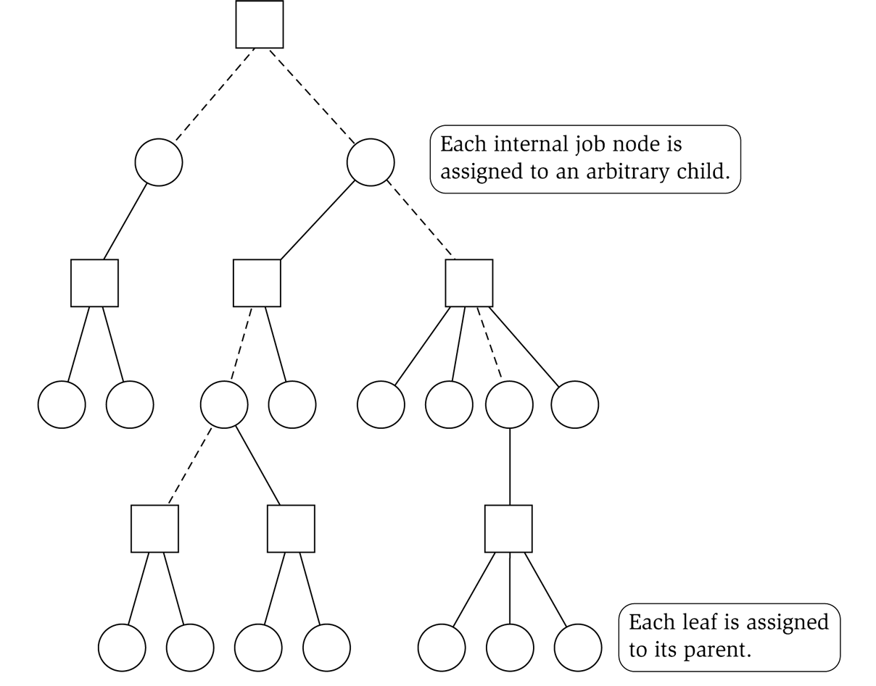
Generalized load balancing: rounding
Rounded solution. Find LP solution x where G(x) is a forest. Root forest G(x)
at some arbitrary machine node r.
・If job j is a leaf node, assign j to its parent machine i.
・If job j is not a leaf node, assign j to any one of its children.
Lemma 4. Rounded solution only assigns jobs to authorized machines.
Pf. If job j is assigned to machine i, then x_{ij} > 0. LP solution can only assign positive value to authorized machines. ▪
job
machine

Slide 49
Generalized load balancing: analysis
Lemma 5. If job j is a leaf node and machine i = parent(j), then x_{ij} = t_{j}. Pf.
・Since i is a leaf, x_{ij} = 0 for all j ≠ parent(i).
・LP constraint guarantees Σ_{i} x_{ij} = t_{j}. ▪
Lemma 6. At most one non-leaf job is assigned to a machine.
Pf. The only possible non-leaf job assigned to machine i is parent(i). ▪
job
machine

Slide 50
Generalized load balancing: analysis
Theorem. Rounded solution is a 2-approximation. Pf.
・Let J(i) be the jobs assigned to machine i.
・By LEMMA 6, the load L_{i} on machine i has two components:
-
leaf nodes:
LP Lemma 2 (LP is a relaxation)
≤ L ≤ L *
Lemma 5
∑ t _{j} =
j ∈ J (i)
j is a leaf
^{∑ x}ij
j ∈ J (i)
j is a leaf
≤
^{∑ x}ij
j ∈ J
optimal value of LP
Lemma 1
-
parent:
^{t}parent(i)
≤ L *
・Thus, the overall load L_{i} ≤ 2 L*. ▪

Slide 51
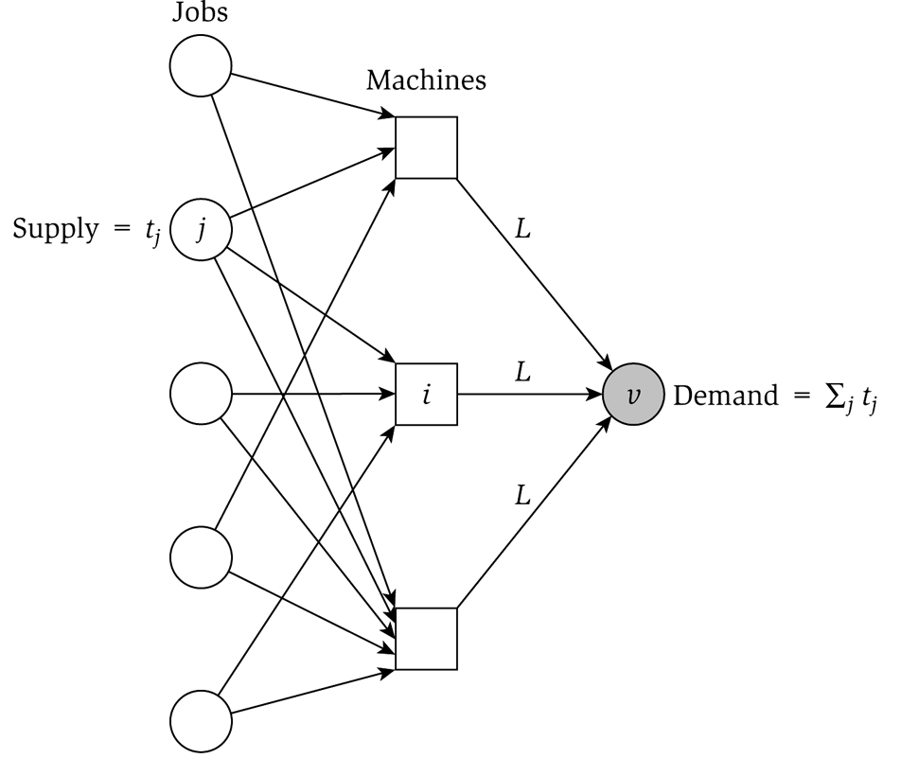
Generalized load balancing: flow formulation
Flow formulation of LP.
^{∑ x}i j i
^{∑ x}i j j
^{x}i j
^{x}i j
= t _{j} for all j ∈ J
≤ L
∞
for all i ∈ M
≥ 0 for all j ∈ J and i ∈ M _{j}
= 0 for all j ∈ J and i ∉ M _{j}
Observation. Solution to feasible flow problem with value L are in 1-to-1 correspondence with LP solutions of value L.

Slide 52
Generalized load balancing: structure of solution
Lemma 3. Let (x, L) be solution to LP. Let G(x) be the graph with an edge from machine i to job j if x_{ij} > 0. We can find another solution (xʹ, L) such that G(xʹ) is acyclic.
Pf. Let C be a cycle in G(x).
・Augment flow along the cycle C.
flow conservation maintained
・At least one edge from C is removed (and none are added).
・Repeat until G(xʹ) is acyclic. ▪
augment flow along cycle C
3 3
3
3
6
6
2
3
4
2
4
1
1
5
5
4
3
4
4
G(x)
G(x′)

Slide 53
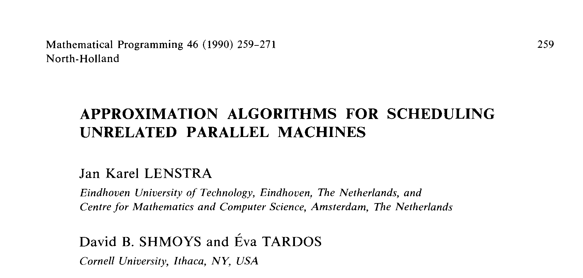
Conclusions
Running time. The bottleneck operation in our 2-approximation is solving one LP with m n + 1 variables.
Remark. Can solve LP using flow techniques on a graph with m + n + 1 nodes: given L, find feasible flow if it exists. Binary search to find L*.
Extensions: unrelated parallel machines. [Lenstra–Shmoys–Tardos 1990]
・Job j takes t_{ij} time if processed on machine i.
・2-approximation algorithm via LP rounding.
・If P ≠ NP, then no no ρ-approximation exists for any ρ < 3/2.

Slide 54
11. Approximation Algorithms
load balancing
center selection
pricing method: weighted vertex cover
LP rounding: weighted vertex cover
generalized load balancing
knapsack problem
Section 11.8

Slide 55
Polynomial-time approximation scheme
PTAS. (1 + ε)-approximation algorithm for any constant ε > 0.
・Load balancing. [Hochbaum–Shmoys 1987]
・Euclidean TSP. [Arora, Mitchell 1996]
Consequence. PTAS produces arbitrarily high quality solution, but trades off accuracy for time.
This section. PTAS for knapsack problem via rounding and scaling.

Slide 56
Knapsack problem
Knapsack problem.
・Given n objects and a knapsack.
・Item i has value v_{i} > 0 and weighs w_{i} > 0.
we assume wi ≤ W for each i
・Knapsack has weight limit W (the weights must be integers).
・Goal: fill knapsack so as to maximize total value.
Ex: { 3, 4 } has value 40.
item | value | weight
1 | 1 | 1
2 | 6 | 2
3 | 18 | 5
4 | 22 | 6
5 | 28 | 7
original instance (W = 11)

Slide 57
Knapsack is NP-complete
KNAPSACK. Given a set X, weights wi ≥ 0, values vi ≥ 0, a weight limit W, and a target value V, is there a subset S ⊆ X such that:
∑ w_{i} ≤ W
i∈S
∑ v_{i} ≥ V
i∈S
SUBSET-SUM. Given a set X, values ui ≥ 0, and an integer U, is there a subset S
⊆ X whose elements sum to exactly U ?
Theorem. SUBSET-SUM ≤ P KNAPSACK.
Pf. Given instance (u1, …, un, U) of SUBSET-SUM, create KNAPSACK instance:
v_{i} = w_{i} = u_{i} ∑ u_{i} ≤ U
i∈S
V = W = U ∑ u_{i} ≥ U
i∈S

Slide 58
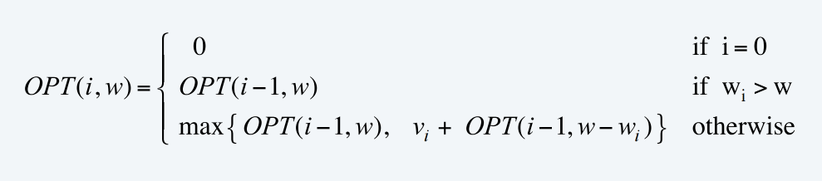
Knapsack problem: dynamic programming I
Def.
OPT(i, w) = max value subset of items 1,..., i with weight limit w.
Case 1. OPT does not select item i.
・OPT selects best of 1, …, i – 1 using up to weight limit w.
Case 2. OPT selects item i.
・New weight limit = w – w_{i}.
・OPT selects best of 1, …, i – 1 using up to weight limit w – w_{i}.
Theorem. Computes the optimal value in O(n W) time.
・Not polynomial in input size.
・Polynomial in input size if weights are small integers.

Slide 59
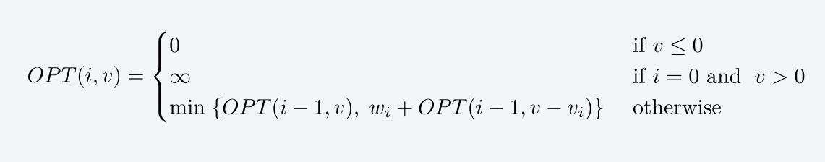
Knapsack problem: dynamic programming II
Def. OPT(i, v) = min weight of a knapsack for which we can obtain a solution of value ≥ v using a subset of items 1,..., i.
Note. Optimal value is the largest value v such that OPT(n, v) ≤ W. Case 1. OPT does not select item i.
・OPT selects best of 1, …, i – 1 that achieves value ≥ v.
Case 2. OPT selects item i.
・Consumes weight w_{i}, need to achieve value ≥ v – v_{i}.
・OPT selects best of 1, …, i – 1 that achieves value ≥ v – v_{i}.
,

Slide 60
Knapsack problem: dynamic programming II
Theorem. Dynamic programming algorithm II computes the optimal value in O(n² vmax) time, where vmax is the maximum of any value.
Pf.
・The optimal value V* ≤ n vmax.
・There is one subproblem for each item and for each value v ≤ V*.
・It takes O(1) time per subproblem. ▪
Remark 1. Not polynomial in input size!
Remark 2. Polynomial time if values are small integers.

Slide 61
Knapsack problem: polynomial-time approximation scheme
Intuition for approximation algorithm.
・Round all values up to lie in smaller range.
・Run dynamic programming algorithm II on rounded/scaled instance.
・Return optimal items in rounded instance.
item | value | weight
1 | 934221 | 1
2 | 5956342 | 2
3 | 17810013 | 5
4 | 21217800 | 6
5 | 27343199 | 7
item | value | weight
1 | 1 | 1
2 | 6 | 2
3 | 18 | 5
4 | 22 | 6
5 | 28 | 7
original instance (W = 11)
rounded instance (W = 11)

Slide 62
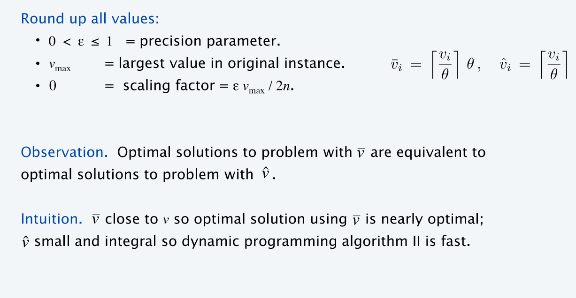
Knapsack problem: polynomial-time approximation scheme

Slide 63
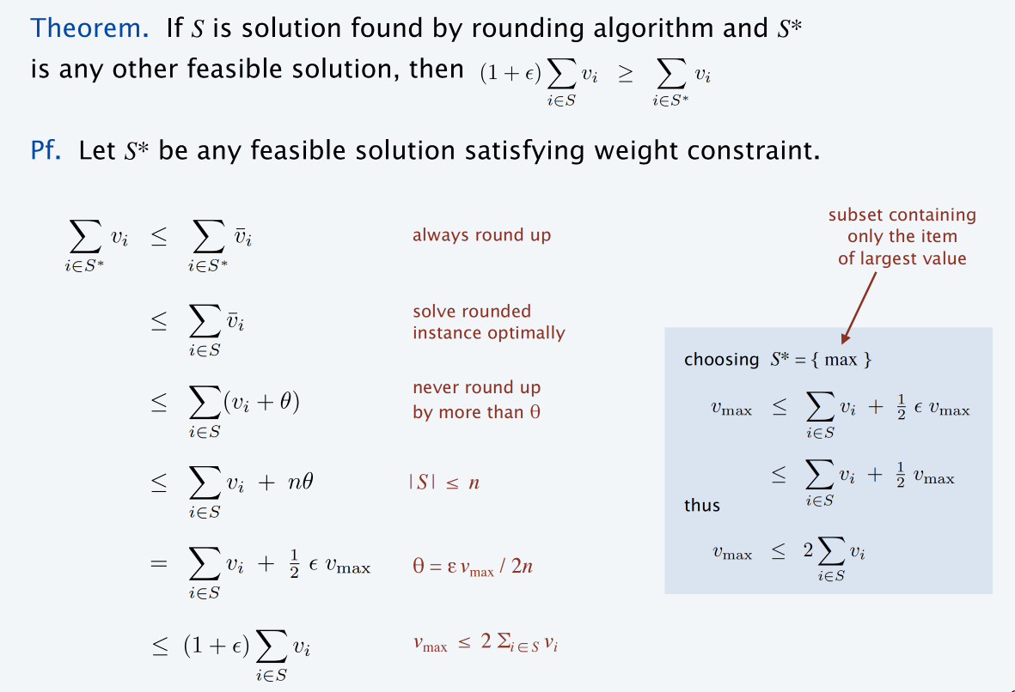
Knapsack problem: polynomial-time approximation scheme

Slide 64
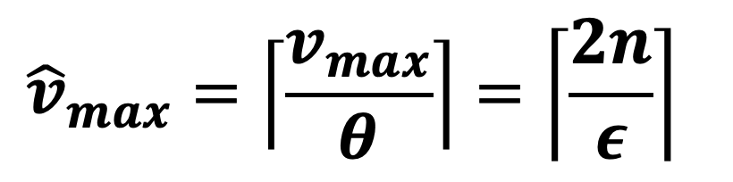
Knapsack problem: polynomial-time approximation scheme
Theorem. For any ε > 0, the rounding algorithm computes a feasible solution whose value is within a (1 + ε) factor of the optimum in O(n³ / ε) time.
Pf.
・We have already proved the accuracy bound.
・
Dynamic program II running time is O(n² vˆ
), where
max
$${\hat{v}}_{max}=\left\lceil \frac{v_{max}}{θ}\right\rceil =\left\lceil \frac{2n}{ε}\right\rceil$$

Slide 65
Knapsack Problem
网络视频
https://www.youtube.com/watch?v=GyDTT3PxFP4
温馨提示：此视频框在点击“上传手机课件”时会进行转换，用手机进行观看时则会变为可点击的视频。此视频框可被拖动移位和修改大小。

