Slide 1
Fibonacci number
Yang Yang

Slide 2
Recursive solution
Base case
General case

Slide 3
Iterative solution
Main Idea:
a₀ + a₁  a₂
a₁ + a₂  a₃
a₂ + a₃  a₄
a₃ + a₄  a₅
☞
a_{p} + a_{q}  a_{r}

Slide 4

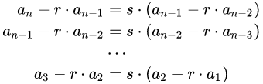
Sophisticated Solution

Slide 5
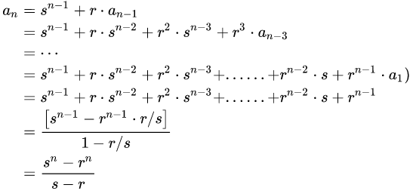

Sophisticated Solution

Slide 6
Task
Implement the 3 solutions for Fibonacci number
Compare the running time of the 3 solutions
Which algorithm is fast?
Deadline: 20th Sep 2021 14:30 PM

