Slide 1
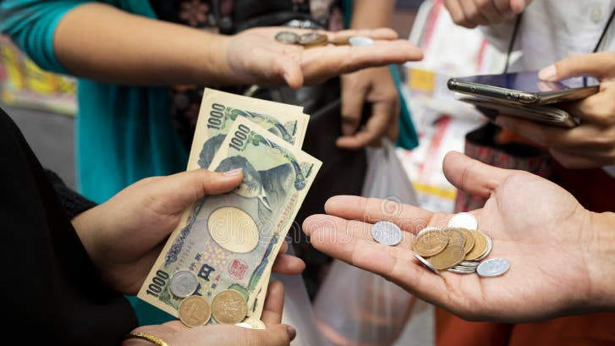
Coin Change

Slide 2
Coin Change
You are given coin denominations {1, 5, 10, 25, 100}. Your task is to pay a customer an amount of N = 50 using the fewest possible number of coins.
Design and implement different algorithms to solve this problem. Compare both the correctness of the results and the runtime as N increases.
  Algorithm A – Brute Force (Exhaustive Search)
  Algorithm B – Greedy Algorithm
  Algorithm C (optional)

Slide 3
Coin Change
Run each algorithm (brute force, greedy, etc.) for various amounts:
N = 10, 20, 30, 40, 50, 60
Measure:
  Execution time (seconds).
  Number of coins produced.
Plot the runtime curves and explain the differences.

Slide 4
Coin Change
Given currency denominations: 1, 10, 21, 34, 70, 100, 350, 1225, 1500. Your task is to pay a customer an amount of N = 42 using the fewest possible number of coins.
Design and implement different algorithms to solve this problem. Compare both the correctness of the results and the runtime as N increases.
  Algorithm A – Brute Force (Exhaustive Search)
  Algorithm B – Greedy Algorithm
  Algorithm C (optional)

Slide 5
Report and Submission Guidelines
Due: 2025/10/8
Students are required to prepare a written report and submit a printed copy. The report must include:
Screenshots of program execution demonstrating your results.
Figures such as plots or charts comparing runtime and coin counts.
Source code (well-commented) for all implemented algorithms.
Analysis of results, discussing correctness, efficiency, and trade-offs between the approaches.

