Slide 1

Minimum Spanning Tree

Slide 2
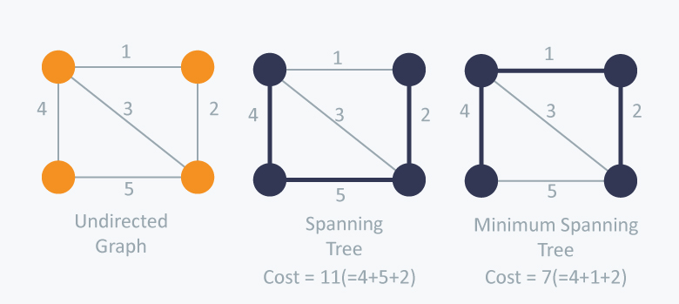
Minimum Spanning Tree
(A minimum spanning tree (MST) is defined as a spanning tree that has the minimum weight among all the possible spanning trees.)

Slide 3
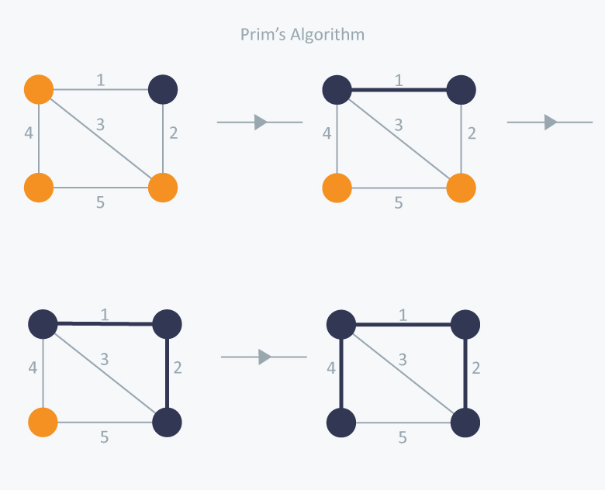
Kruskal Algorithm
Consider edges in ascending order of weight:
・Add to tree unless it would create a cycle.

Slide 4
Prim algorithm
Initialize S = any node. Repeat n – 1 times:
・Add to tree the min weight edge with one endpoint in S.
・Add new node to S.

Slide 5
Task
Implement Kruskal and Prim’s algorithm.
Compare the running time of the 2 solutions (using the graph on the right).
Compare their results.

