Slide 1
Mergesort: Divide and Conquer

Slide 2
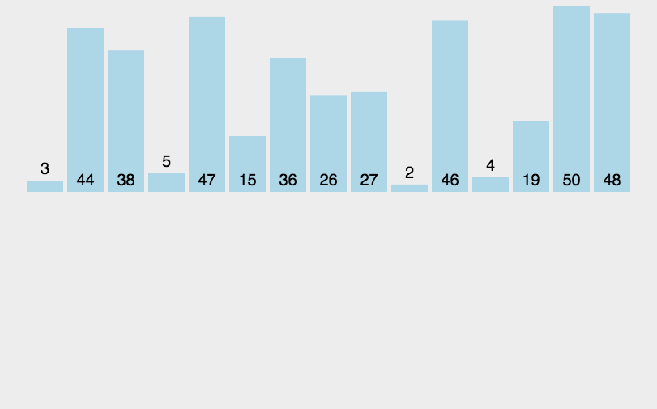
Mergesort
Sort a user input sequence of numbers in ascending order

Slide 3
Mergesort
Deadline: 23th Sep 2022 14:30 PM
Submission: Screen shot + report, zip them and name the zip file after your student id and name, for example 10003242+Chelsea.zip

