Slide 1
Lab4: Hierarchical Clustering

Slide 2
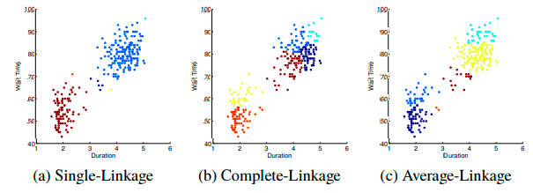
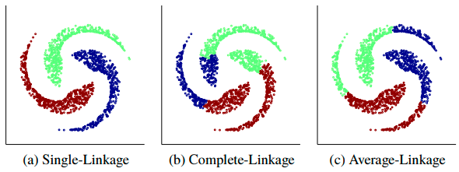
Hierarchical clustering

Slide 3
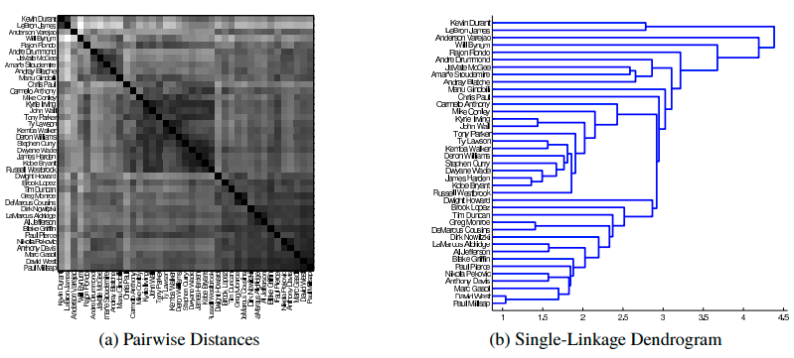
Hierarchical clustering

Slide 4
Due: 2021/11/1
Screenshot
Source code

