Slide 1
Fibonacci Sequence
FAN BI

Slide 2
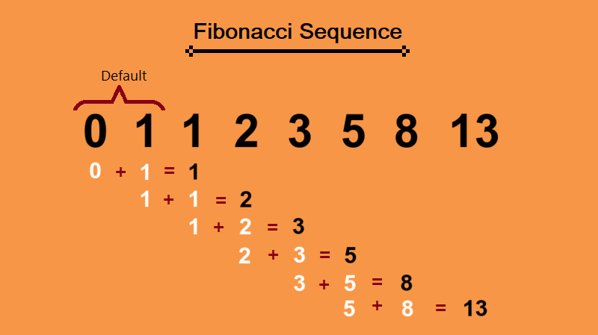
What is Fibonacci sequence?

Slide 3
Recursive solution
Base case
General case

Slide 4
Iterative solution
Main Idea:
a₀ + a₁  a₂
a₁ + a₂  a₃
a₂ + a₃  a₄
a₃ + a₄  a₅
☞
a_{p} + a_{q}  a_{r}

Slide 5
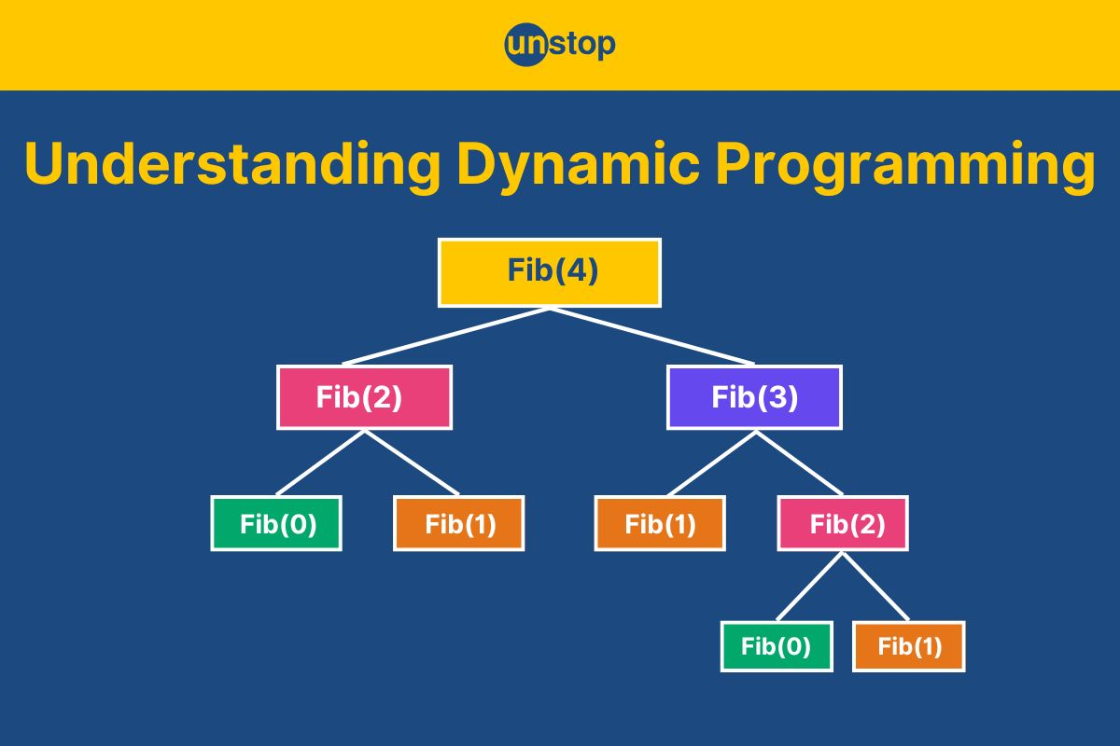
Dynamic programming solution

Slide 6
Task
Implement the 3 solutions for Fibonacci number
Compare the running time of the 3 solutions
  e.g., compare the running time of fib(10), fib(20), fib(30), fib(40)
Which algorithm is fast?

