Slide 1
Course project
FAN BI

Slide 2
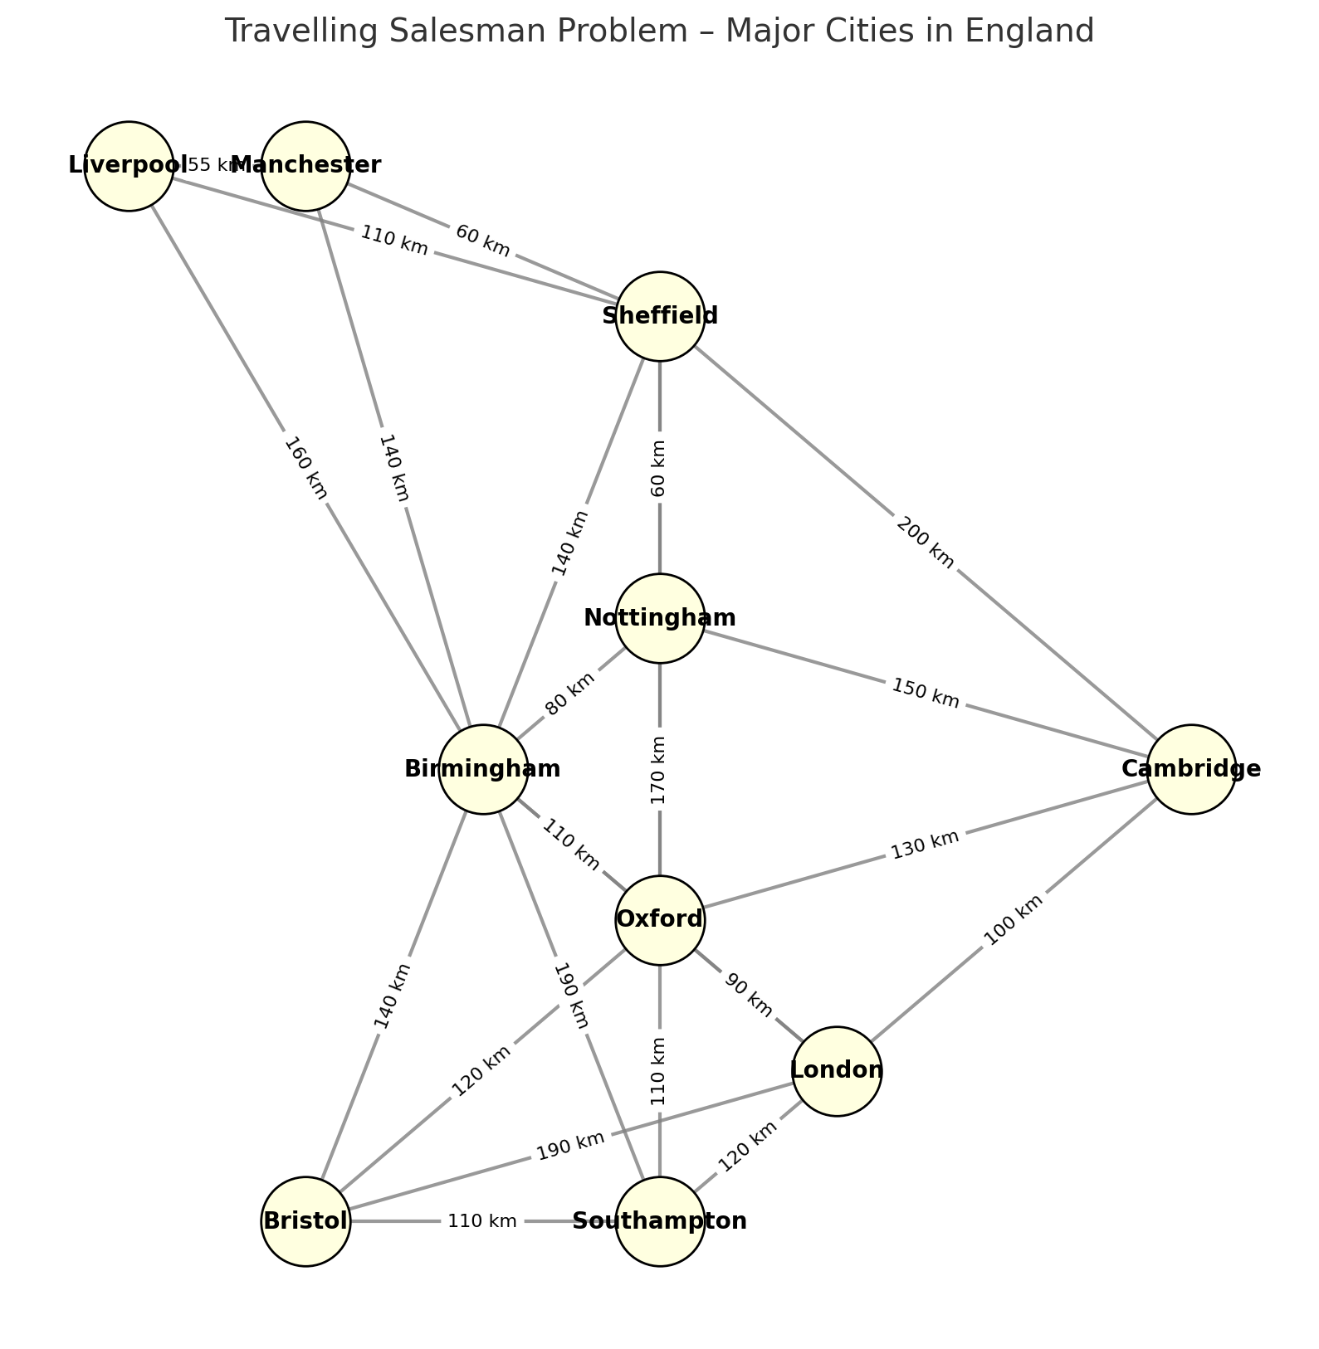
Travelling salesman problem

Slide 3
Travelling Salesman Problem – Designing the Fastest Algorithm for the Shortest Tour
Objective:
A salesman must visit a list of English cities exactly once and return to the starting point, minimising total travel distance.
Cities included:
London, Cambridge, Nottingham, Sheffield, Manchester, Liverpool, Birmingham, Bristol, Southampton, Oxford.

Slide 4
Computational Challenge
10 cities → total possible tours = (10 − 1)! / 2 ≈ 180,000.
Brute Force checks them all → time complexity O(n!).
Goal: find faster algorithms that still give the optimal or near-optimal path (it’s OK not to be optimal!).
Please compare your path length and the running time with the brute-force algorithm in your report

Slide 5
Deadline
18 week
Paper of digital submission

