Slide 1
K-means Clustering

Slide 2
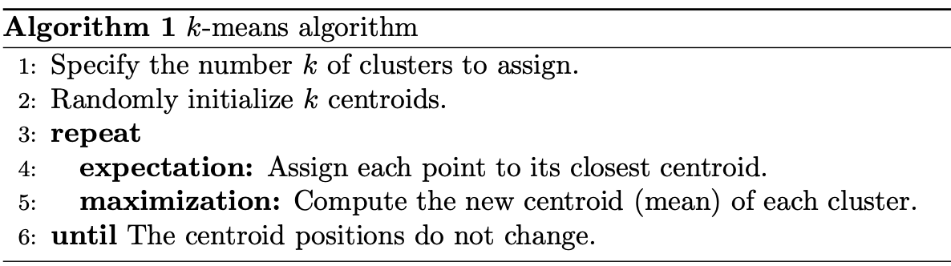
K-means Clustering
The k-means clustering method is an unsupervised machine learning technique used to identify clusters of data objects in a dataset. There are many different types of clustering methods, but k-means is one of the oldest and most approachable.

Slide 3
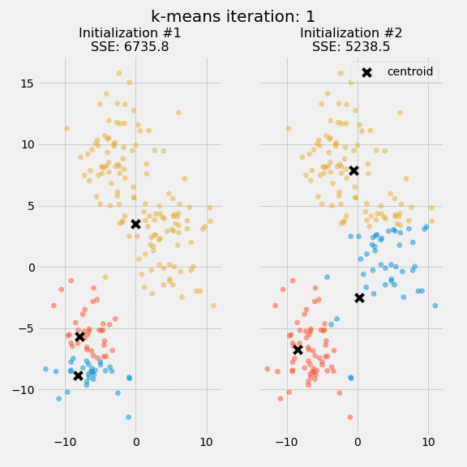
K-means Clustering
Due: 2022/10/21
Screenshot
Source code
Submission: Screen shot + report, zip them and name the zip file after your student id and name, for example 10003242+Chelsea.zip

