Slide 1
Experiment 6: Chessboard Coverage
Yang Yang

Slide 2
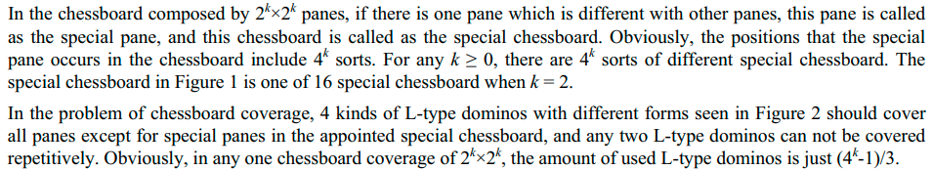
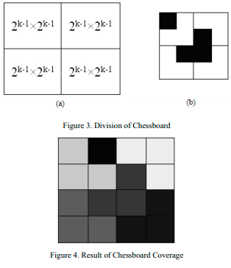
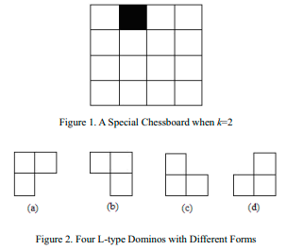
Chessboard Coverage

Slide 3
Task
Solve the chessboard coverage problem with divide and conquere
Deadline: 29th Nov 2021 14:30 PM

