Slide 1
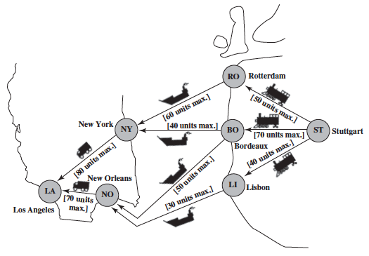
Maximum flow problem

Slide 2
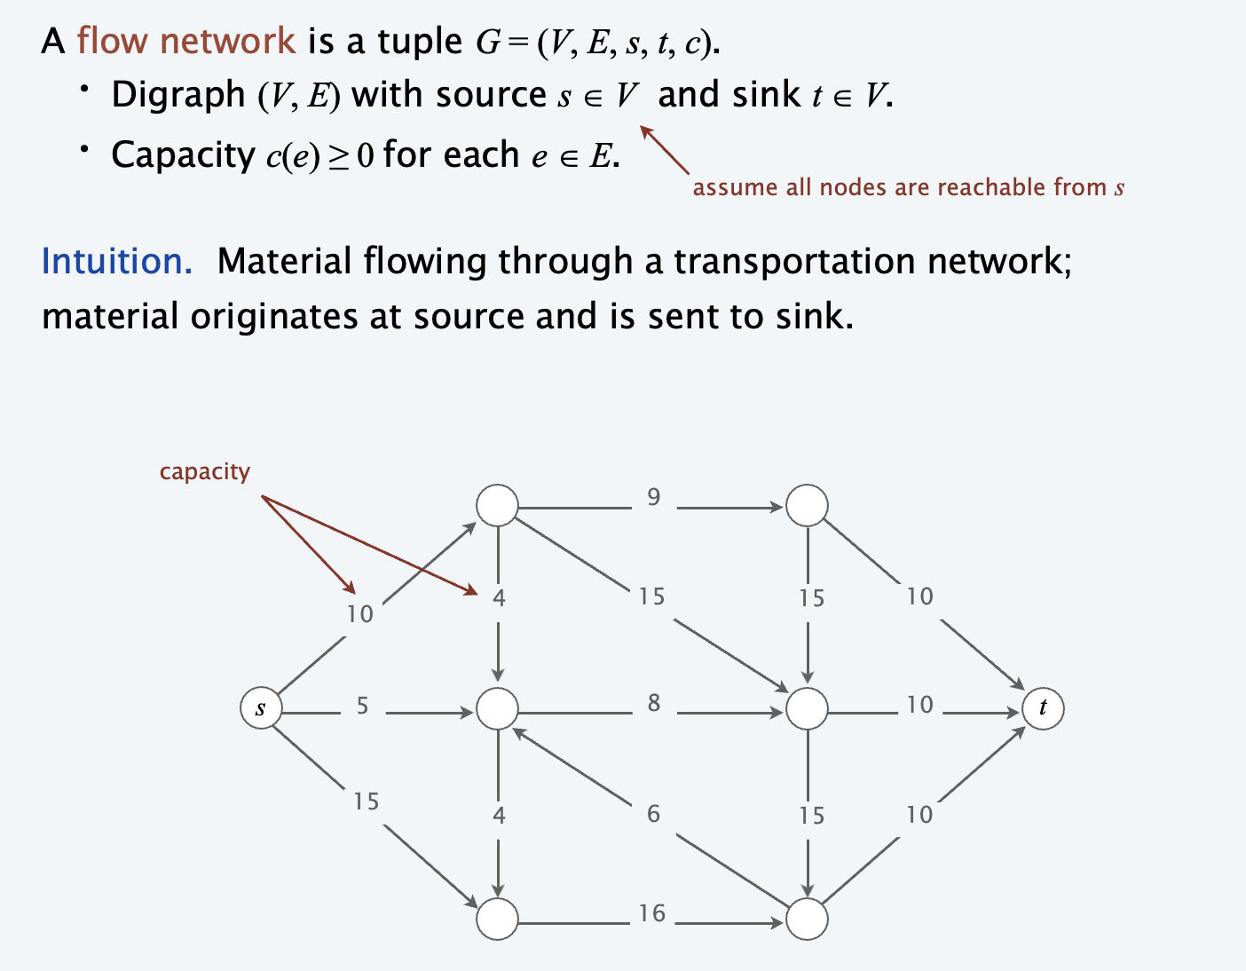
Flow network

Slide 3
Edmonds–Karp algorithm
Start with zero flow on all edges.
Use BFS to find an augmented path where more flow can be sent.
Do a bottleneck calculation to find out how much flow can be sent through that augmented path.
Increase the flow found from the bottleneck calculation for each edge in the augmented path.
Repeat steps 2-4 until max flow is found. This happens when a new augmented path can no longer be found.

Slide 4
Dinitz’s algorithm
Initialize residual graph G as given graph.
Do BFS of G to construct a level graph (or assign levels to vertices) and also check if more flow is possible.
  If more flow is not possible, then return
  Send multiple flows in G using level graph until blocking flow is reached.
  Here using level graph means, in every flow, levels of path nodes should be 0, 1, 2...(in order) from s to t.
A flow is Blocking Flow if no more flow can be sent using level graph, i.e., no more s-t path exists such that path vertices have current levels 0, 1, 2... in order.

Slide 5
Task
Implement Edmonds–Karp algorithm and Dinitz’s algorithm.
Compare the running time of the 2 solutions (using the graph on the right).
Compare their results. (value of the flow & running time)

