Slide 1
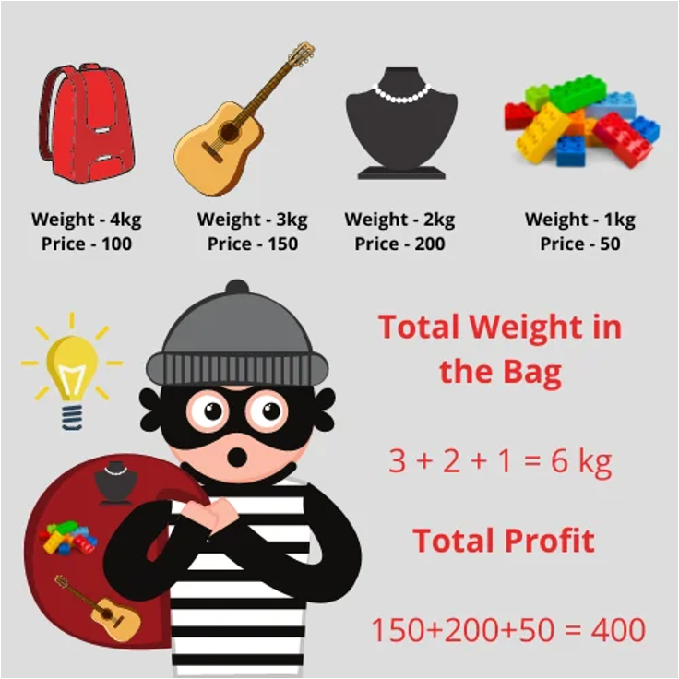
0-1 Knapsack Problem
Course project

Slide 2
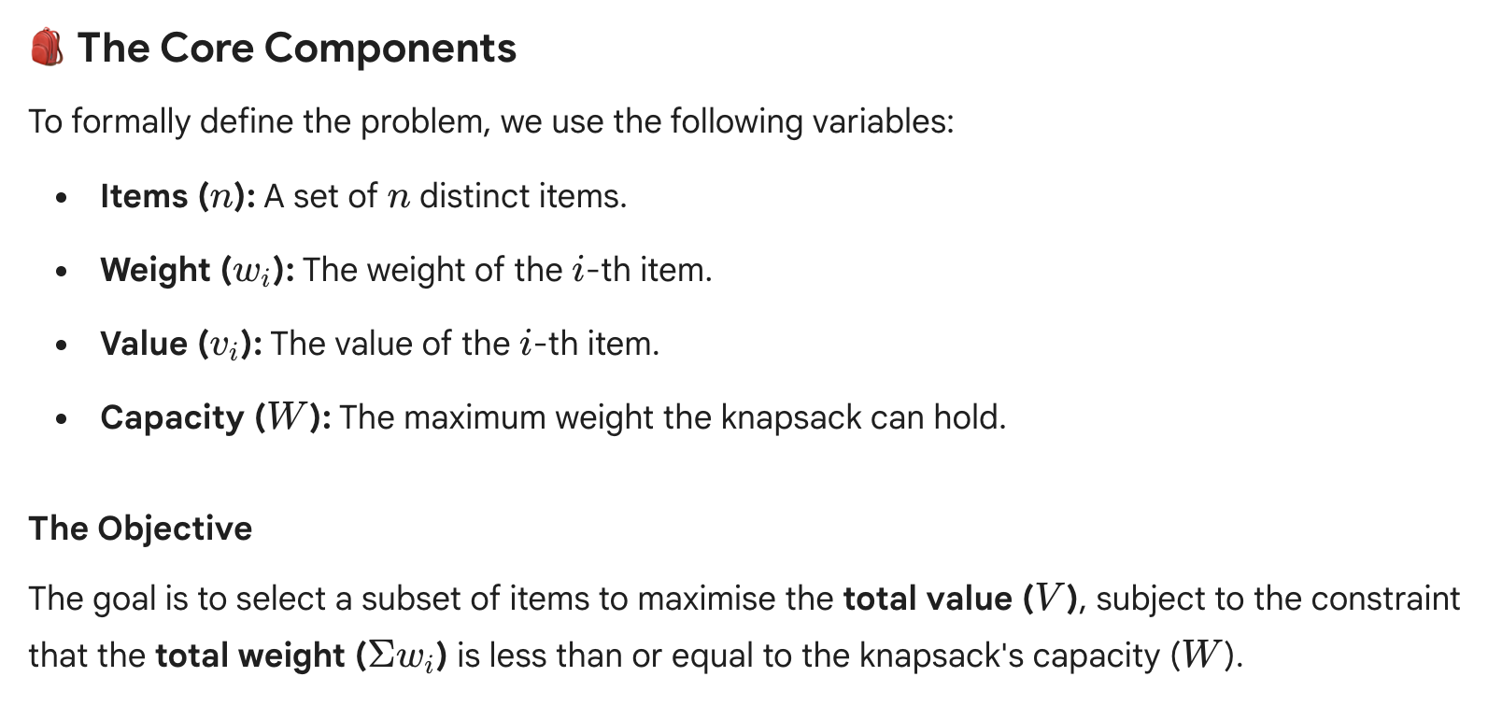
0-1 Knapsack Problem

Slide 3
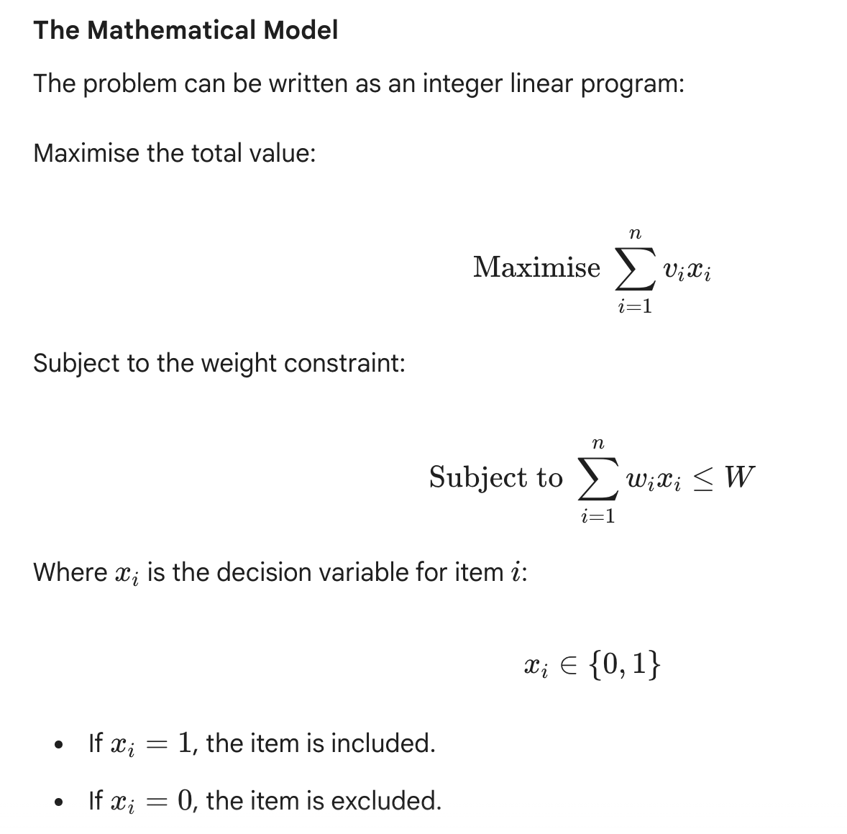
0-1 Knapsack Problem

Slide 4
0-1 Knapsack Problem
Capacity: 15
Items(weight, value):
  (6, 5),
  (5, 6),
  (6, 4),
  (6, 6),
  (3, 5),
  (7, 2),
  (2, 3),
  (4, 6),
  (5, 5),
  (9, 8),
  (4, 3),
  (8, 7),
  (3, 4),
  (2, 2),
  (1, 1),
  (5, 4),
  (7, 5),
  (6, 3),
  (4, 4),
  (3, 2),
  (8, 6),
  (2, 1),
  (9, 9),
  (1, 2),

Slide 5
Task
Prove that the 0-1 Knapsack Problem is NP-hard.
Design and implement a brute-force algorithm.
Design and implement a greedy algorithm.
Design and implement a divide and conquer algorithm.
Design and implement a dynamic programming algorithm.
You could implement another algorithm. (optional)
Compare the total value of the solutions.
Compare the running time of the solutions.
Analyse the results.

