Slide 1
Experiment 5: Minimum Spanning Tree
Yang Yang

Slide 2
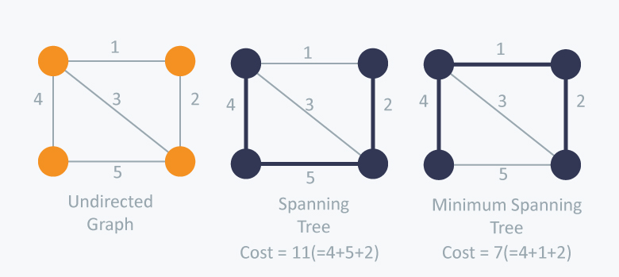
Minimum Spanning Tree

Slide 3
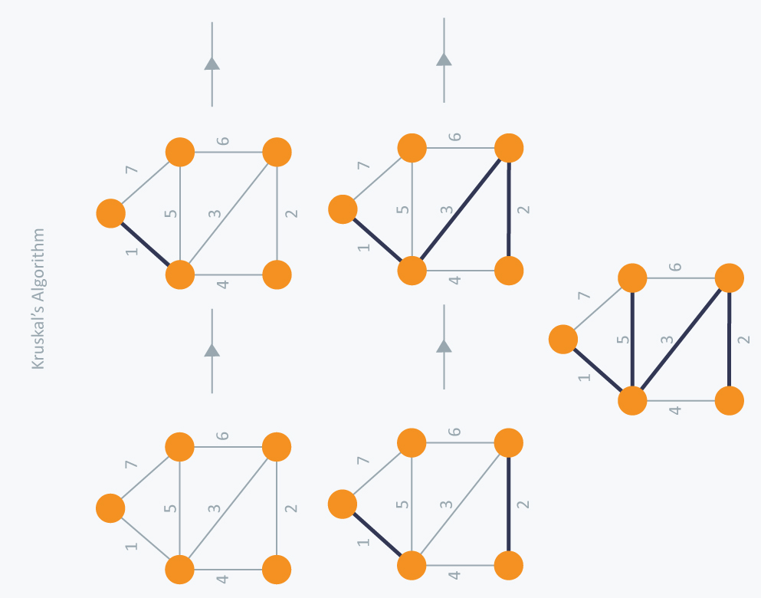
Kruskal

Slide 4
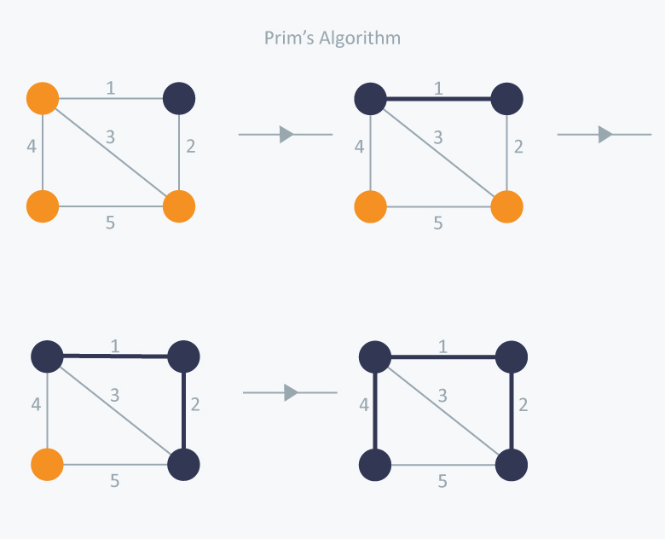
Prim

Slide 5
Task
Implement Kruskal and Prim’s algorithm
Compare the running time of the 2 solutions
Deadline: 18th Nov 2022 14:30 PM

