Slide 1
Integer Multiplication
Yang Yang

Slide 2
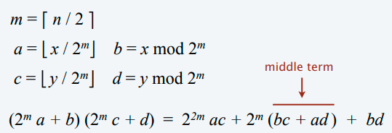
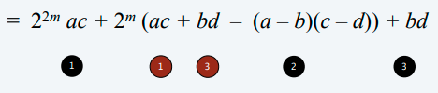
Integer Multiplication
Implement the divide and conquer strategy for integer multiplication

Slide 3
Due
Deadline: 9th Dec 2022 14:30 PM

