Slide 1

Prince
Room: 320

Slide 2

Davis
Room: 320

Slide 3

Mila
Room: 321

Slide 4

Ai
Room: 321

Slide 5

Dorian
Room: 322

Slide 6
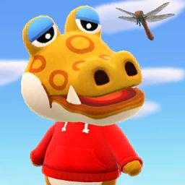
Kanoe
Room: 322

Slide 7
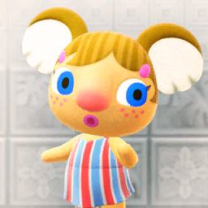
Fardeen
Room: 323

Slide 8
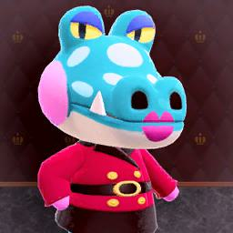
Mackenzie
Room: 323

Slide 9

Omar
Room: 323

Slide 10

Meredith
Room: 324

Slide 11

Shiny
Room: 324

Slide 12

Bella
Room: 324

Slide 13

Yimeng
Room: 324

Slide 14

Kathryn
Room: 325

Slide 15

Angela
Room: 325

Slide 16
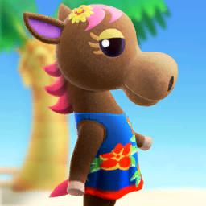
Steven
Room: 326

Slide 17

Paul
Room: 326

Slide 18

Aboijang
Room: 327

Slide 19

Marie
Room: 327

Slide 20
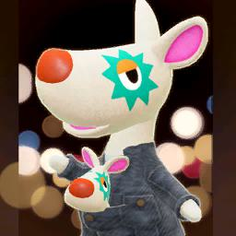
Hongyi
Room: 328

Slide 21

Alex
Room: 328

Slide 22

Qingzhi
Room: 329

Slide 23

Logan
Room: 329

Slide 24
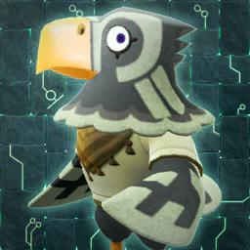
Ishan
Room: 330

Slide 25

Jonathan
Room: 330

Slide 26

Zain
Room: 330

Slide 27

Jackson
Room: 330

Slide 28

Legacy
Room: 330

Slide 29

Rylee
Room: 330

Slide 30

JonJon
Room: 330

Slide 31

Nathan
Room: 331

Slide 32

Richard
Room: 331

Slide 33

Cheng-Hao
Room: 332

Slide 34
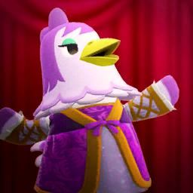
Hanyan
Room: 332

Slide 35

Ari
Room: 334

Slide 36

Molly
Room: 334

Slide 37

Garnet
Room: 335

Slide 38

Mya
Room: 335

Slide 39

Joshua Oliver
Room: 336

Slide 40

Isaac
Room: 336

Slide 41

Ryan
Room: 337

Slide 42

Grant
Room: 337

Slide 43

Rhonda
Room: 338

Slide 44

D
Room: 338

Slide 45

Reagan
Room: 340

Slide 46
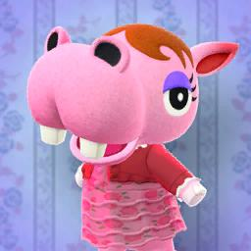
Chloe
Room: 340

Slide 47

Noah
Room: 342

Slide 48

John
Room: 342

Slide 49

Adam
Room: 343

Slide 50

Imaad
Room: 343

Slide 51

Jeneta
Room: 344

Slide 52

Dana
Room: 344

Slide 53

Yamilet
Room: 344

Slide 54

Manisha
Room: 344

Slide 55

Samara
Room: 344

Slide 56

Anissa
Room: 344

Slide 57

Cynthia
Room: 345

Slide 58

Gigi
Room: 345

Slide 59
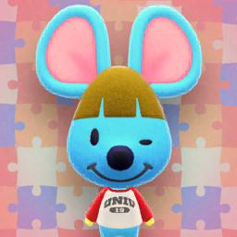
Pedro
Room: 346

Slide 60

Nate
Room: 346

Slide 61

Joey
Room: 347

Slide 62

Jaden
Room: 347

Slide 63
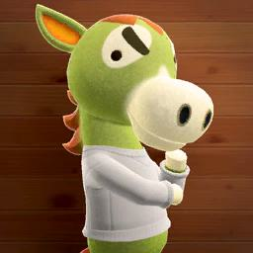
Aaron
Room: 348

Slide 64

Steven
Room: 348

Slide 65

Caiawynn
Room: 349

Slide 66

Lauren
Room: 349

Slide 67

Andy
Room: 350

Slide 68

Brendan
Room: 350

Slide 69

Samir
Room: 350

Slide 70

Ben
Room: 350

Slide 71
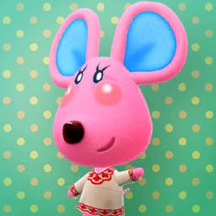
Elisa
Room: 351

Slide 72

Arsema
Room: 351

Slide 73

Divija
Room: 351

Slide 74

Xinran
Room: 352

Slide 75

Jiahe
Room: 352

