Slide 1
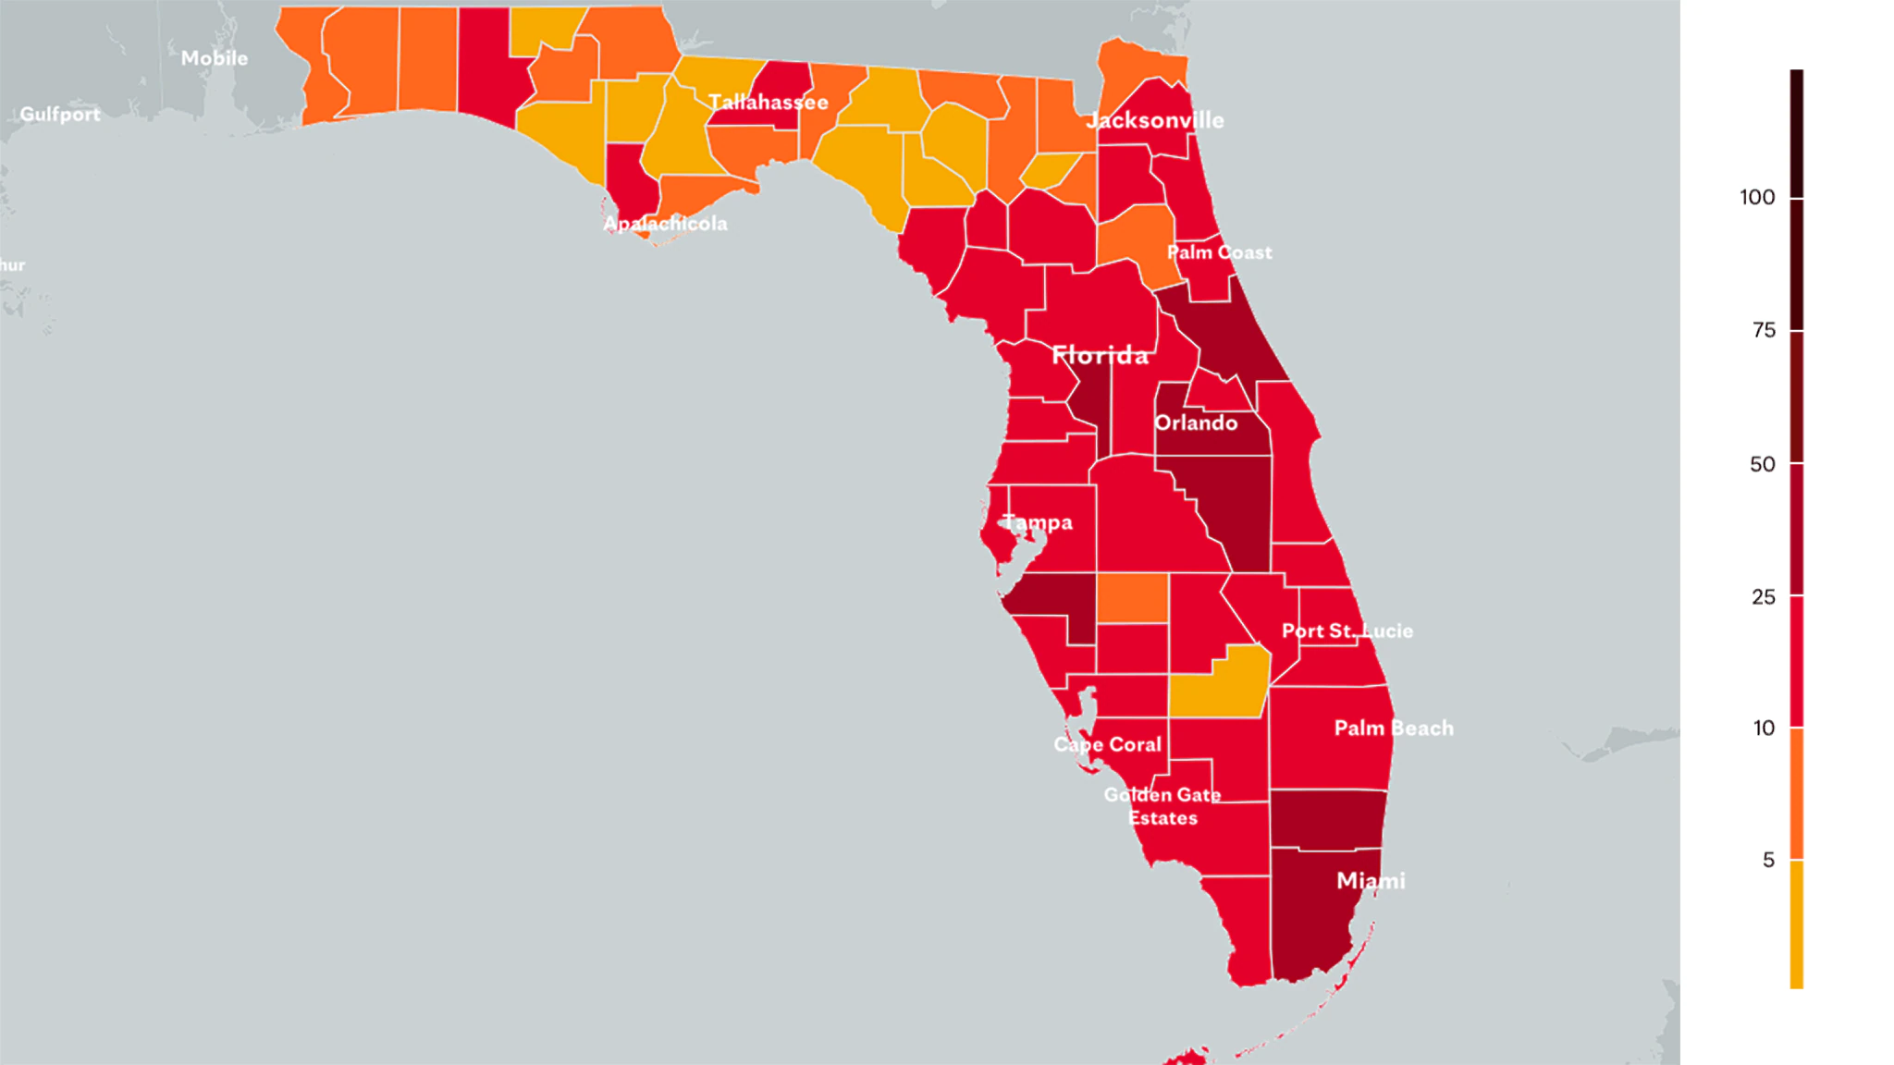
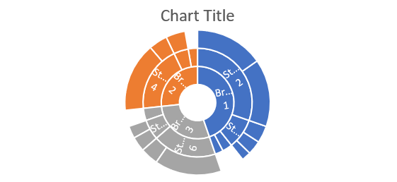
Orange County
population
Population density
1,200,000
125
% Uninsured
% Poverty
22.5
14.3
Vaccination Rate
DAYS TO HIT
5883
165

