Slide 1
RESULTS MODEL
DECEMBER 2022

Slide 2
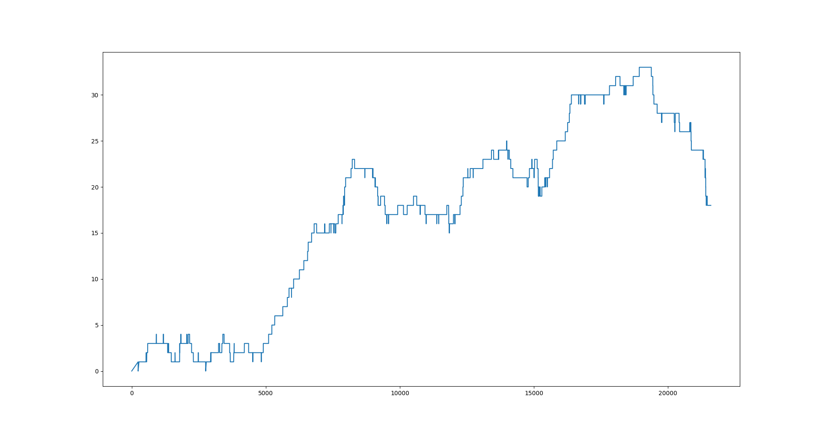
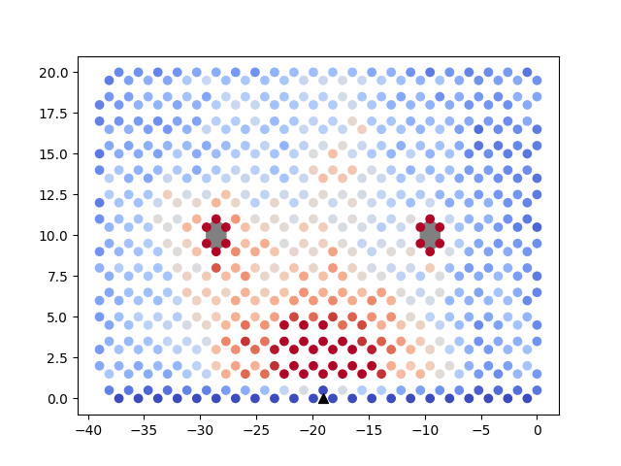
Alpha = 5e-5
Beta = 0,4
G = 0,9
[16.38775754989248,
10.487399370688324,
48.36539039046104,
61.03471809554432,
29.80049967678438,
34.82465424322721,
36.948374436684574,
29.627530222477038,
11.030007049431644,
39.457393359788234,
8.274975179570784,
17.793885524405574]

Slide 3
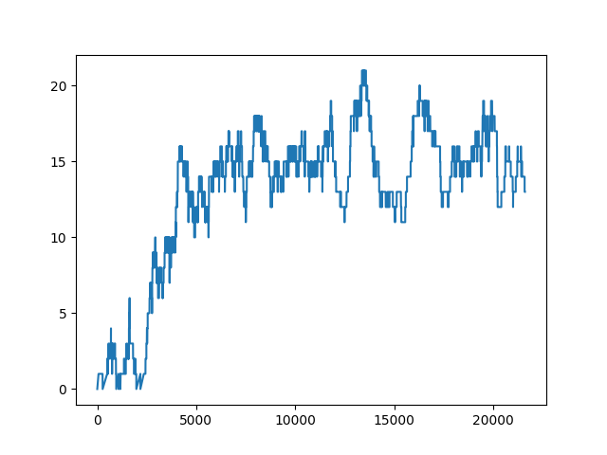
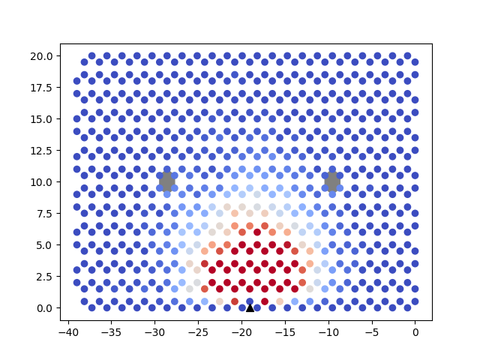
Alpha = 7.5e-5
Beta = 0.4
G = 0.5
[29.123129411297814,
37.87044884481522,
51.5124110450713,
26.65270773190789,
44.239616694354794,
26.63551638781335,
29.30637578641624,
14.313229479328566,
44.571109932049914,
45.242066181932834,
64.28480008149229,
49.628235660762996]

Slide 4
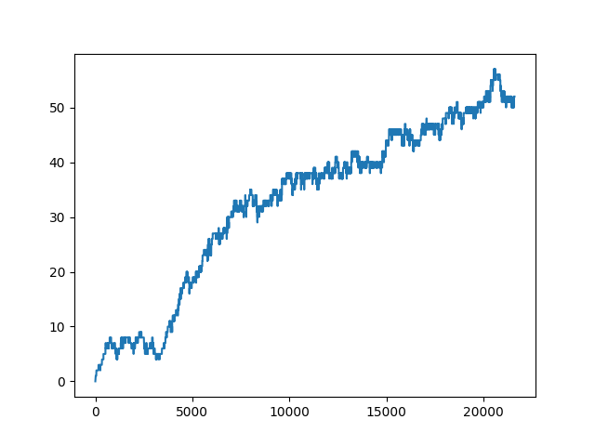
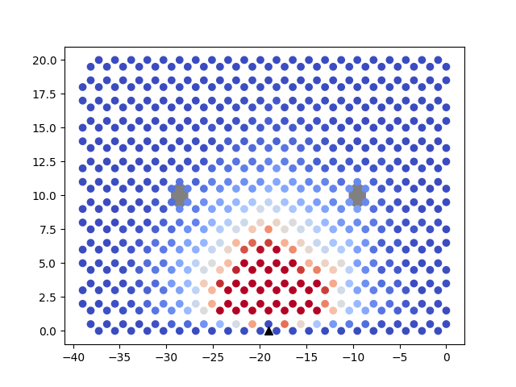
Alpha = 0.0001
Beta = 0.25
G = 0.5
[18.737303559276224,
62.55823311603026,
68.45427978271213,
63.05482815241944,
53.75279974241696,
25.37258916917367,
35.146392847677234,
38.59034174312669,
40.468524708805234,
55.074199184153755,
46.748816440197935,
42.654088455045226]

Slide 5
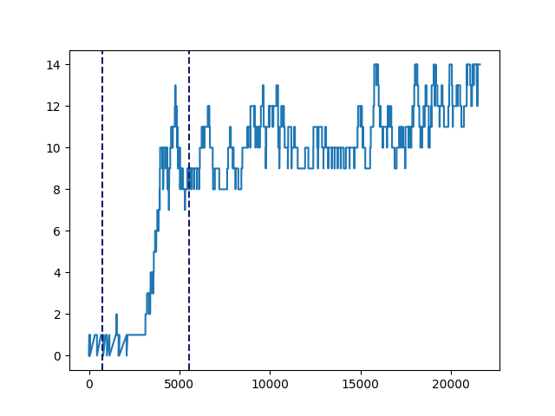
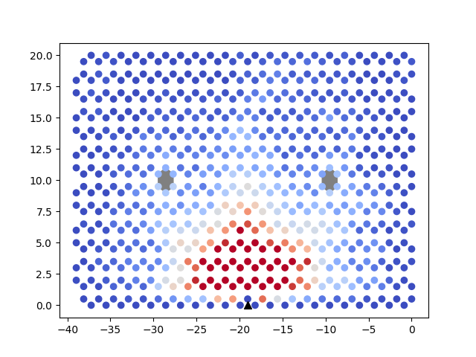
Alpha = 5e-5
Beta = 1
G = 0.75
[8.077742480081143,
36.185334463198764,
30.4611191949219,
39.93921868661962,
33.52648218234653,
30.444349030274104,
41.417044083333465,
40.60794866224444,
39.338380807982055,
41.622629777004725,
45.998769149541346,
6.252643408140368]

