Slide 1
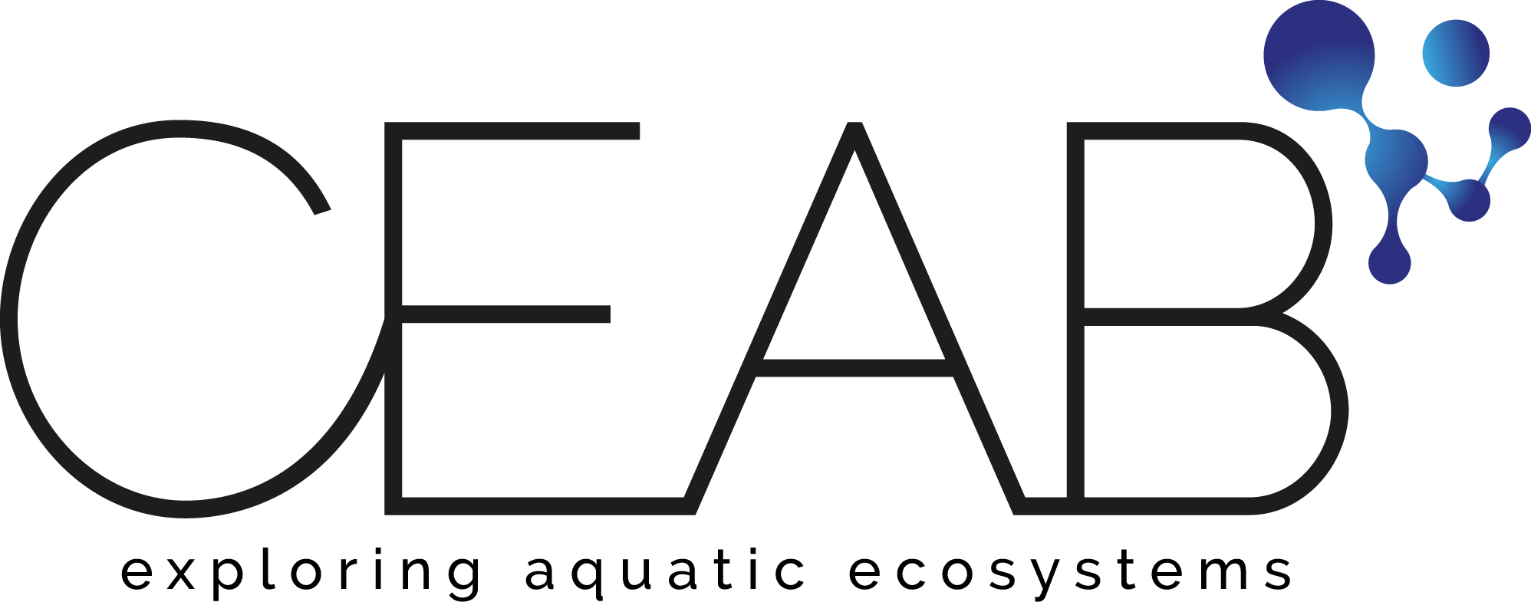


Information flow and behavioural plasticity guide the phases of foraging in Aphaenogaster senilis
¹Pol Fernández-López & ^{1,2,3}Frederic Bartumeus
¹Centre d’estudis avançats de Blanes (CEAB)
²Centre de Recerca Ecològica I Aplicacions Forestals (CREAF)
³Institucio Catalana de Recerca I Estudis Avançats (ICREA)

Slide 2
Ants are social organisms, and as such, they must organize and coordinate in order to respond to the colonies needs.

