Slide 1
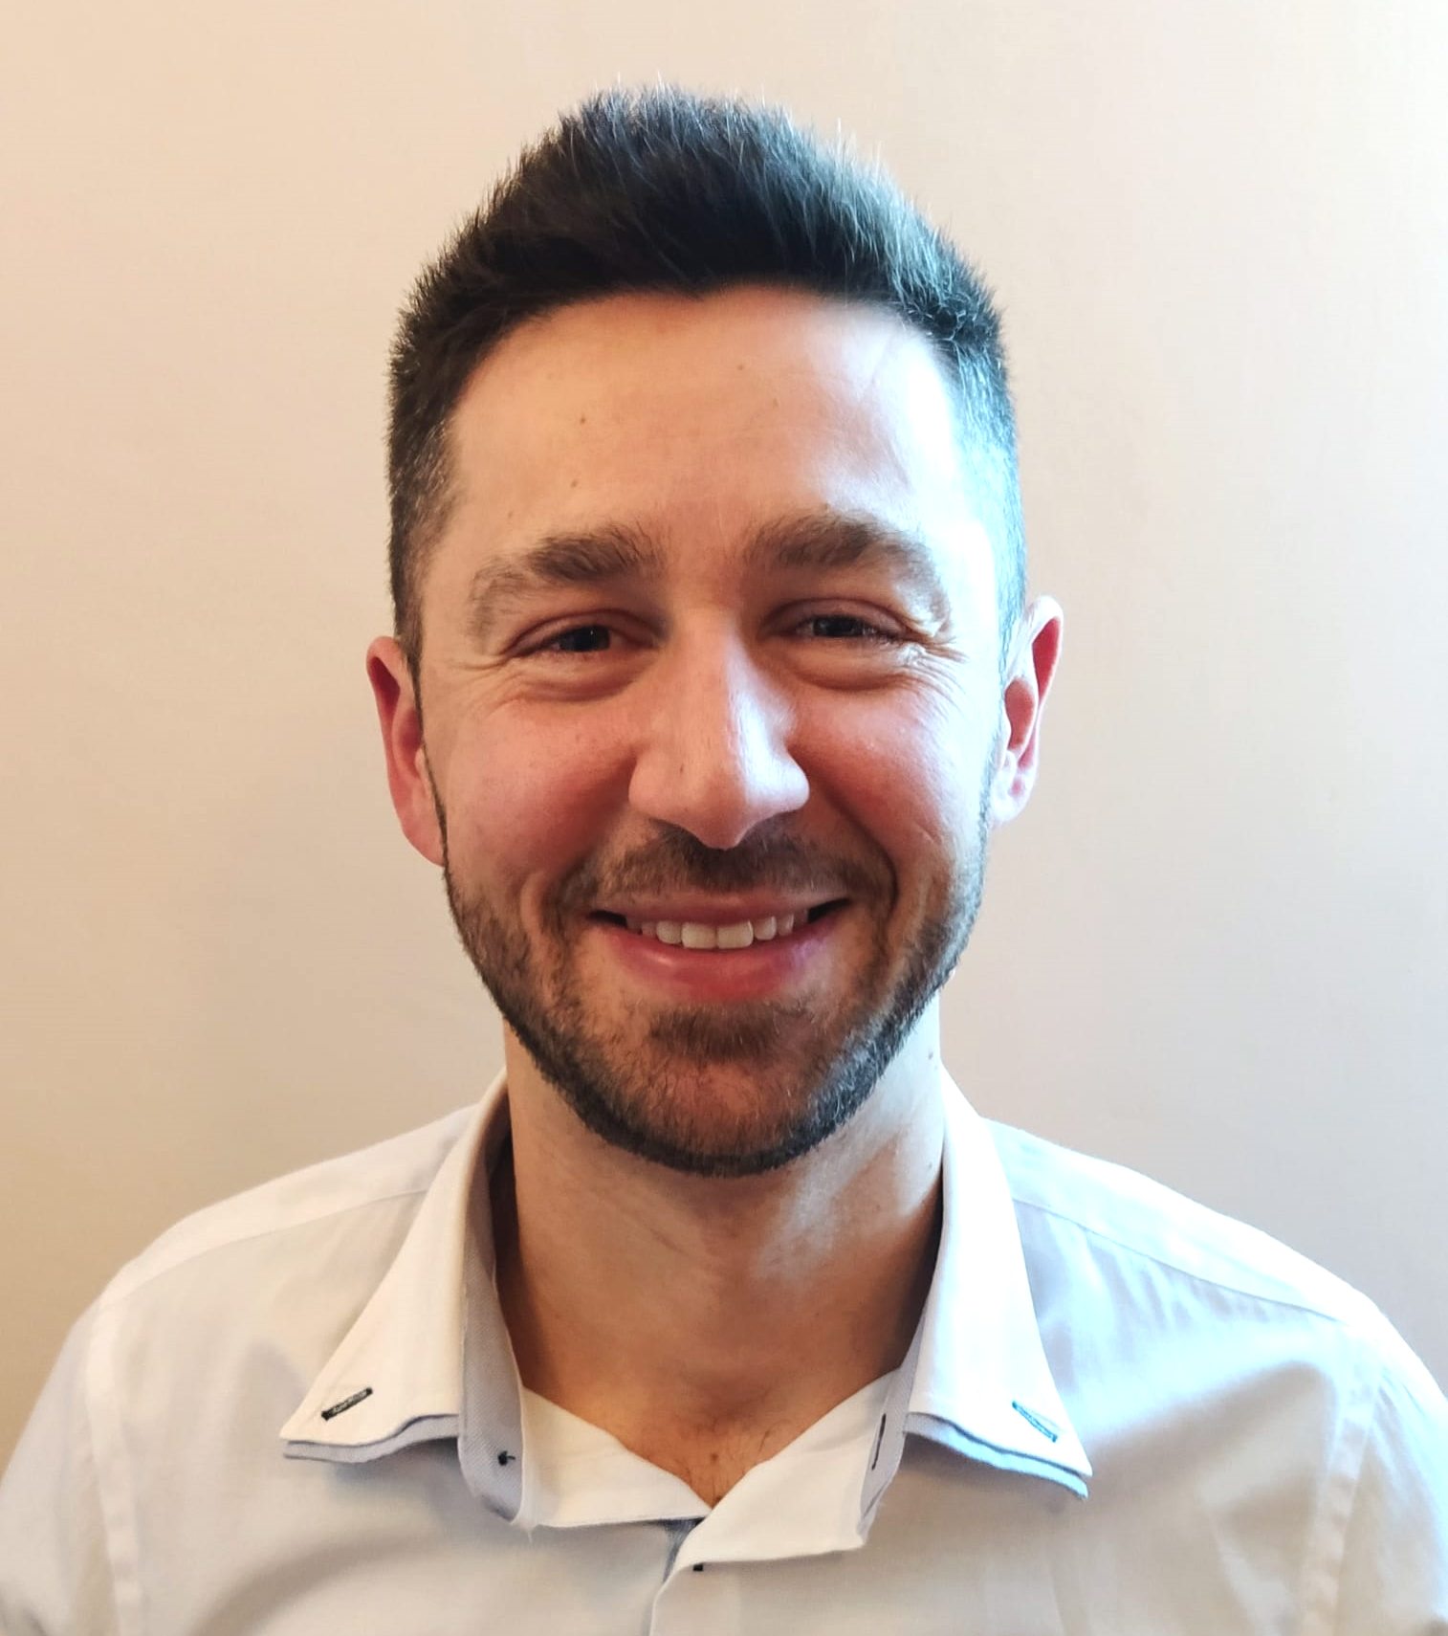
Francesco Basco
SENIOR DEVELOPER @MSC
Github: https://github.com/fbasco81
Linkedin: https://www.linkedin.com/in/francesco-basco-6a827387
Email: fbasco81@gmail.com
Facebook: https://www.facebook.com/francesco.basco.9
Garmin: https://connect.garmin.com/modern/profile/FrancescoBasco

Slide 2
Demo
Thriatlon simulation
.NET Core Console Application + Akka.Net 1.3
@credit - https://github.com/EdwinVW/akka-net-traffic-control
Actor Creation - Actor Selection
Actor Types
PROPS
STATE / THREAD SAFETY
MessageS
SCHEDULING
routing
Supervision
REmote
Mailbox
Lifecycle
Configuration
Extend an actor system

Slide 3


Triathlon
Registration Bib Number
START
FINISH
Time limit / Race duration

Slide 4
Diagrams
Actor hierarchy & Message flow
https://drive.google.com/file/d/1NwedDsuc15MudISMnSJMEBPMds7P6Xjx/view?usp=sharing

Slide 5
A real use case
User migration to azure b2c
~ 160 000 users
1st POC – No Akka.net – No Concurrency = 8 users / sec ~ 6h
2nd POC – No Akka.net = 20 users / sec ~ 2h+
3rd POC - Akka.net = 50 users / sec ~ 53m

