Slide 1




Comparative proteomics of lethal and non-pathogenic Ebolavirus glycoproteins
Francesca Battelli & Elizabeth Giordano

Slide 2
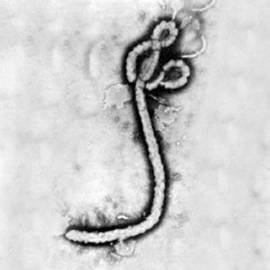
There are six species in the Ebolavirus genus
Zaire ebolavirus (ZEBOV)
Sudan ebolavirus
Bundibugyo ebolavirus
Bombali ebolavirus
Tai Forest ebolavirus
Highly lethal
Frederick A. Murphy, CDC, 1976

Slide 3
There are six species in the Ebolavirus genus
Zaire ebolavirus (ZEBOV)
Sudan ebolavirus
Bundibugyo ebolavirus
Bombali ebolavirus
Tai Forest ebolavirus
Highly lethal
Frederick A. Murphy, CDC, 1976

Slide 4

Reston ebolavirus was discovered a little too close to home
In 1989, cynomolgus macaques at a primate facility in Reston, VA showed symptoms of hemorrhagic fever.
It was confirmed to be a new Ebolavirus species.

Slide 5
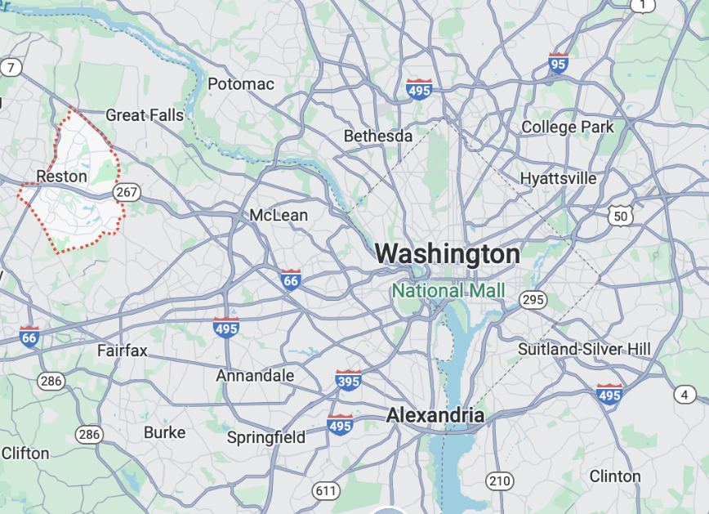
Reston ebolavirus was discovered a little too close to home
A number of employees at the primate facility were seropositive for antibodies to Reston ebolavirus (RESTV), meaning they were infected, but did not become sick.
Why?

Slide 6
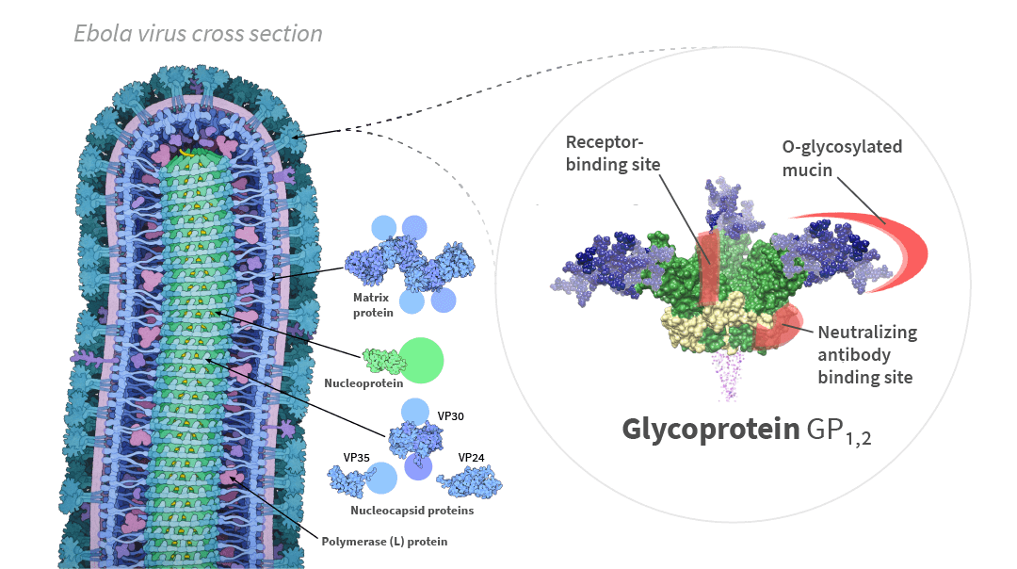
The Ebolavirus surface glycoprotein may mediate pathogenicity
David Goodsell from PDB files / CC BY.
Notes:
This is responsible for virus entry into cells. Target of our antibodies, vaccines - across viruses, think SARS-CoV-2 spike protein and ACE-2 receptors, vaccines
Receptors: TLR4, TIM-1, C-type lectin receptors; infects DC, Mø, monocytes, but also hepatocytes, endothelial cells, etc.
Source: https://excellgene.com/2022/02/17/ebola-research-enables-sars-cov-2-trimeric-spike-proteins/

Slide 7
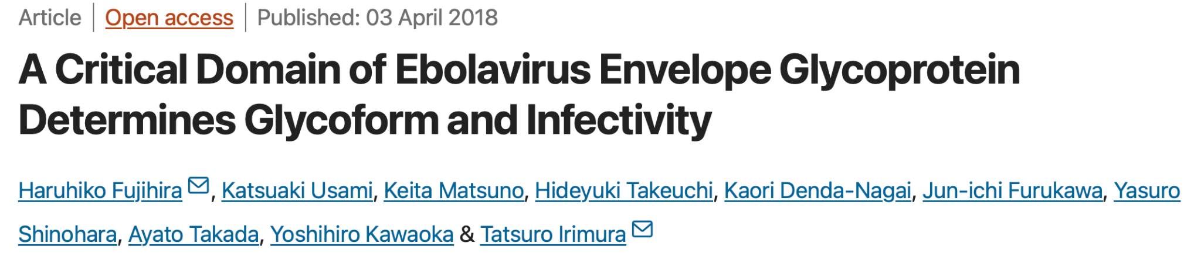
RESTV pseudovirus infection of macrophages in vitro increased dramatically when 18 amino acids at the glycoprotein (GP) N-terminal (aa 33-50) were switched with those of ZEBOV.
We aligned GP amino acids 30-60 to visualize and investigate the changes.
Notes:
They chose this region by generating chimeric glycoproteins of different aa sequences until they found ones with an effect, allowing them to narrow down which stretch of amino acids is actually important. They narrowed it to 33-186, and then chose 33-50 because homology between ZEBOV and RESTV GPs is very low

Slide 8
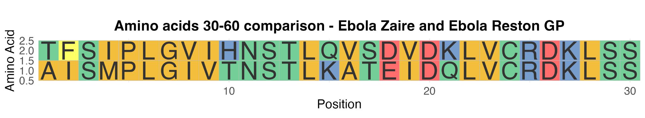
Sequence alignment using ggmsa
Percent identity = 60%
Notes:
Got the sequence of Zaire and Reston from UniProt and decided to focus on amino acids 30-60 to cover the stretch of amino acids found to be important for the glycoprotein ability to infect cells
Zaire on top

Slide 9
Sequence alignment using ggmsa
Percent identity = 60%
Notes:
Got the sequence of Zaire and Reston from UniProt and decided to focus on amino acids 30-60 to cover the stretch of amino acids found to be important for the glycoprotein ability to infect cells

Slide 10
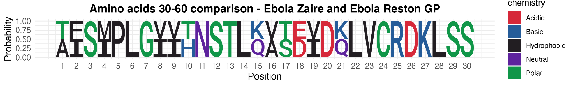
Sequence alignment using ggseqlogo

Slide 11
Sequence alignment using ggseqlogo

Slide 12
Are certain amino acid changes more frequent?
Could these have an impact on protein function and virus pathogenicity?

Slide 13
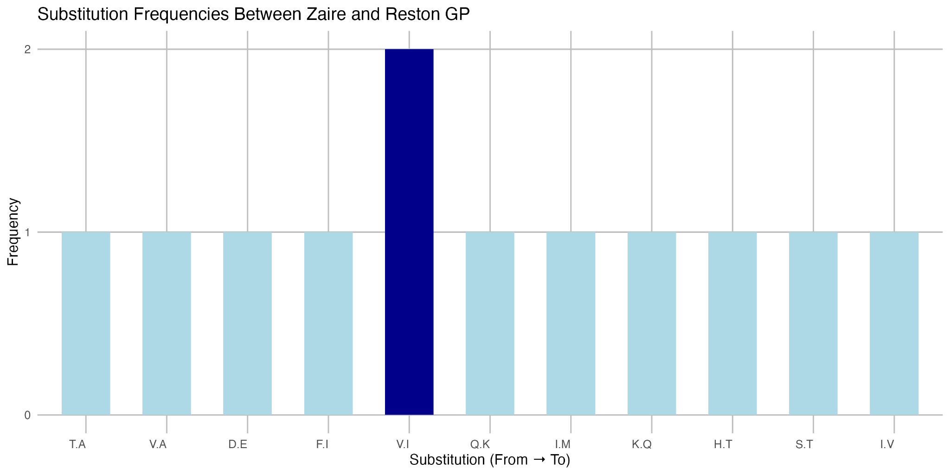
Substitution frequency
Notes:
V.I: Valine (V) in Zaire has been replaced by Isoleucine (I) in Reston and occurs twice suggesting that these changes could have functional importance in the viruses pathogenecity.

Slide 14
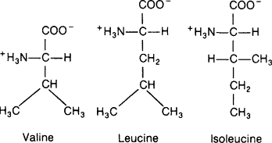
Properties of Valine → Isoleucine
We wrote a block of code to analyze amino acid properties of the initial and changed amino acid:
Valine: Neutral, Small, Hydrophobic
Isoleucine: Neutral, Large, Hydrophobic
We suspected that there would not be much impact on protein activity since the charge and hydrophobicity are the same.
Notes:
We decided to look into V → I more closely because this change occurred the most
We couldve googled the differences but decided to do it in code form, also because we thought perhaps we’d get to analyzing ALL the amino acids… we did not

Slide 15
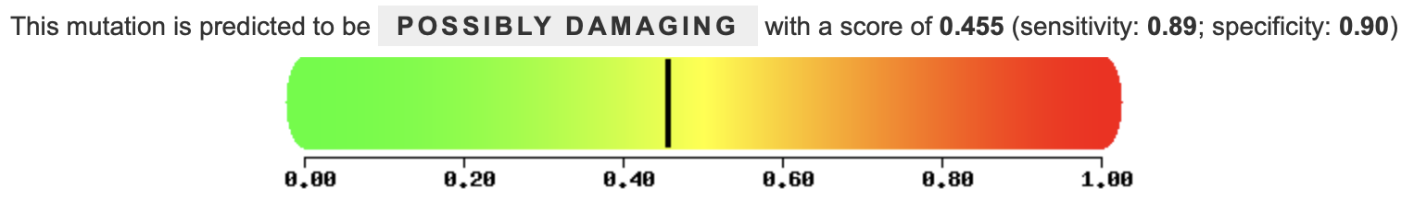
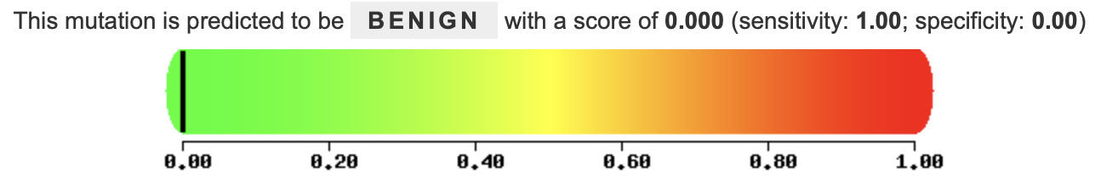
Significance of Valine → Isoleucine
Using PolyPhen2, we looked at the two V → I substitutions.
Position 8:
Position 19:
Notes:
We used PolyPhen2, an online platform that can predict the effect of AA changes on protein function.
PolyPhen2 http://genetics.bwh.harvard.edu/pph2/index.shtml

Slide 16
Conclusions
The most common substitution we observe, V → I, may affect GP pathogenicity at position 8 but not 19
Fujihira et al., 2018 tie the differences in pathogenicity at these sites to a difference in glycosylation, as opposed to protein structure
Notes:
We were able to identify sequences of interest and align them, great exercise in coding
We used R to generate a frequency table and look at properties of the amino acids, also great exercise in coding

Slide 17
Conclusions
*
*
*
The most common substitution we observe, V → I, may affect GP pathogenicity at position 8 but not 19
Fujihira et al., 2018 tie the differences in pathogenicity at these sites to a difference in glycosylation, as opposed to protein structure
Nonetheless, we were able to observe a number of other substitutions that may play a role in pathogenicity, such as F31I, Q44K, and V45A (Cong et al., 2015)
Notes:
We were able to identify sequences of interest and align them, great exercise in coding
We used R to generate a frequency table and look at properties of the amino acids, also great exercise in coding

Slide 18

Questions?

