Slide 1
Neural posterior estimation of population size histories
– Machine Learning in Population Genetics Workshop –
Presenter: Yuxin Ning
Supervisor: Franz Baumdicker

Slide 2
– Machine Learning in Population Genetics Workshop –
Let’s start with:
Population genetics
Simulation-based inference
Infer population size history and hand-on practice

Slide 3
Population Genetics

Slide 4
Study diversity within populations
Identify loci under selection (last session)
Learn about the structure of populations (next session)
Learn about the history of populations, for example their size

Slide 5
Population size is a crucial parameter in population genetic models
The Wright–Fisher (WF) model:
Forward in time
Constant finite size
Discrete generations
The coalescent process:
Backward in time
Alleles merge to their common ancestors
Exponential distribution
MRCA
T2 = N
Time to the past
T2
T3 = N/3
Coalescent event
T3
T4 = N/6

Slide 6
Genalogical trees/relationships contain information about past population sizes
Coalescent rate is larger in smaller populations
past
Expanding Population
Stationary Population
Declining Population
10000
500000
500
500000
500
present

Slide 7
Genalogical trees/relationships contain information about past population sizes
Coalescent rate is larger in smaller populations
Mutations along the branches of the trees can thus generate informative pattern.
past
Expanding Population
Stationary Population
Declining Population
10000
500000
500
500000
500
present

Slide 8
A population can be simulated given:
Recombination rate (⍴) → determines how frequently the genealogy along the genome changes
Mutation rate (μ)
The ancestral effective population sizes (N_{e})
Aligns an idealized population with the actual one, while evolutionary factors stay the same
Influenced by actual population fluctuation and structure

Slide 9
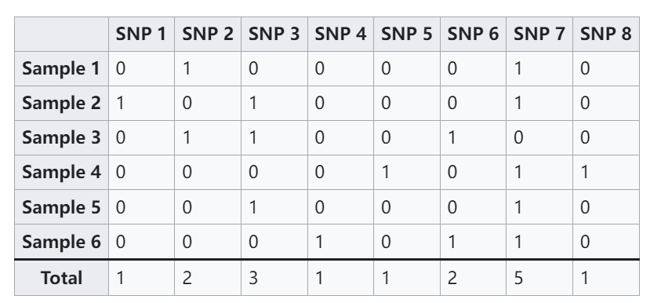
Single nucleotide polymorphisms
(SNP) matrix
Summary statistics
Allele frequency spectrum (AFS):
Distribution of allele frequencies
Linkage disequilibrium (LD):
Non-random association between alleles
(4, 2, 1, 0, 1)

Slide 10
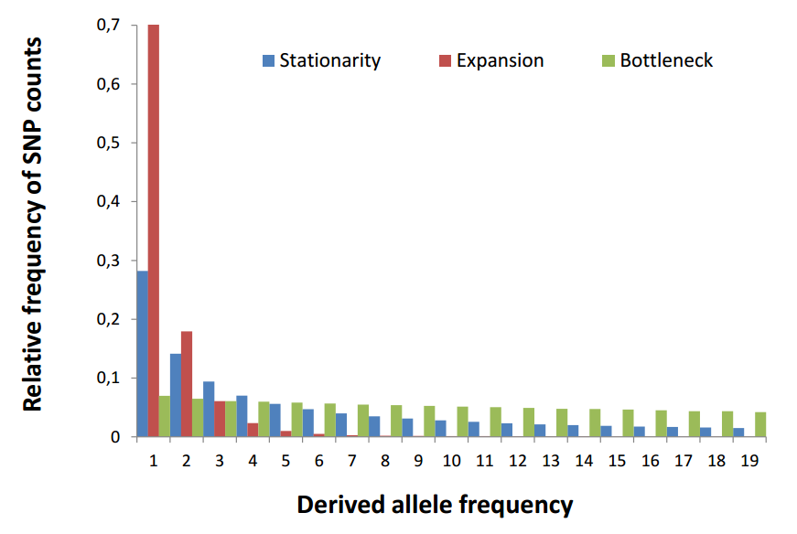
Summary statistics reflect the population history

Slide 11
2. Simulation-based inference

Slide 12

Bayes' theorem
Genome data generated from an unknown/complex stochastic process
often intractable!
P(H): the prior (N_{e})
P(H∣E): the posterior probability
P(E∣H): the likelihood
P(E): observed data
Simulations instead of Likelihood

Slide 13
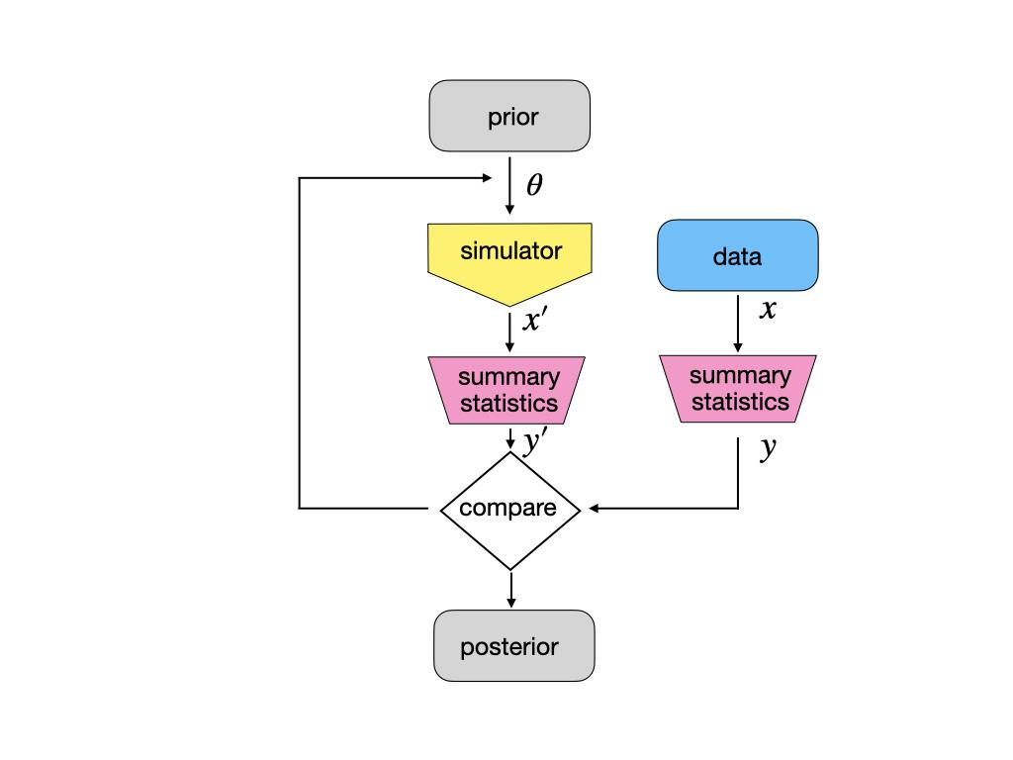
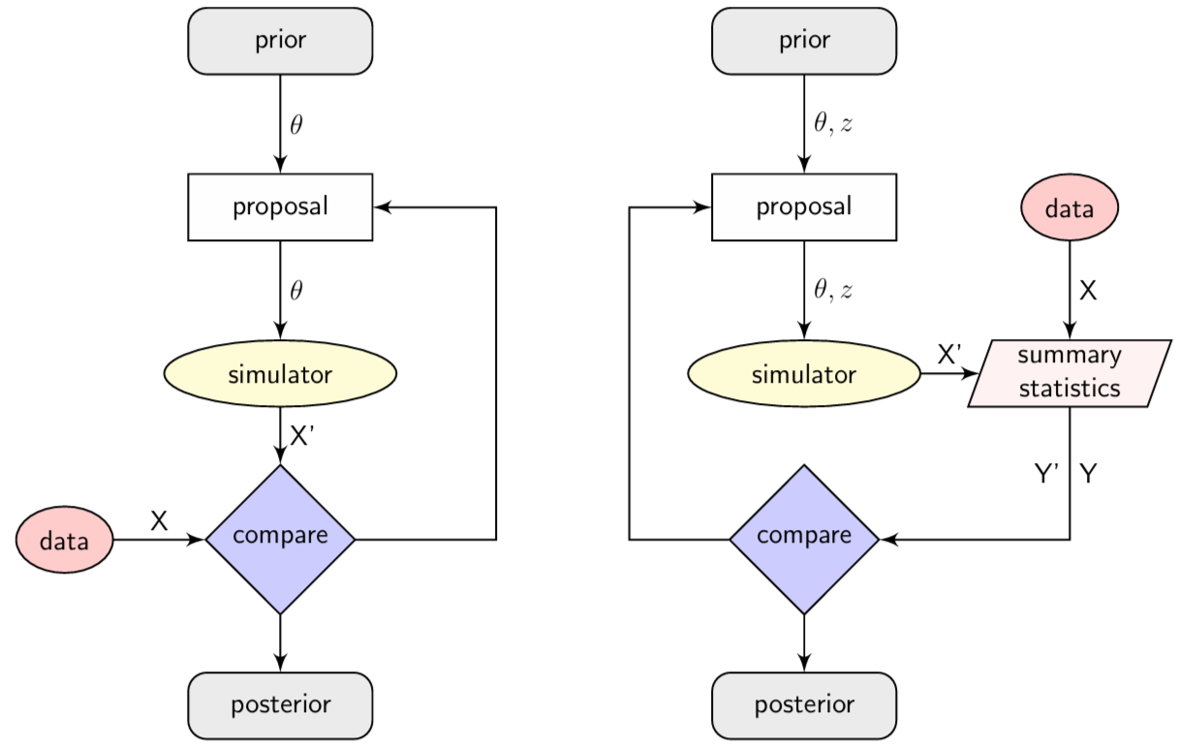
Approximate Bayesian Computation
Distance measurement
Compare simulated data with the observed ones
posterior distribution is approximated (possibly with regression-based correction method)

Slide 14
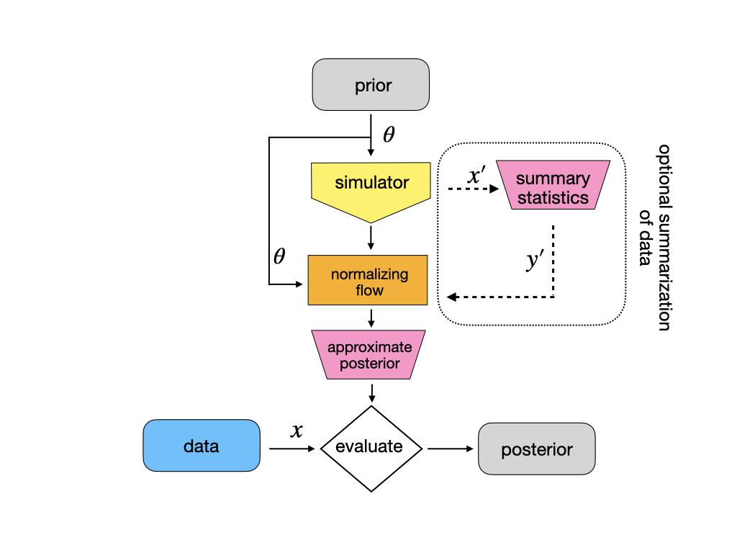
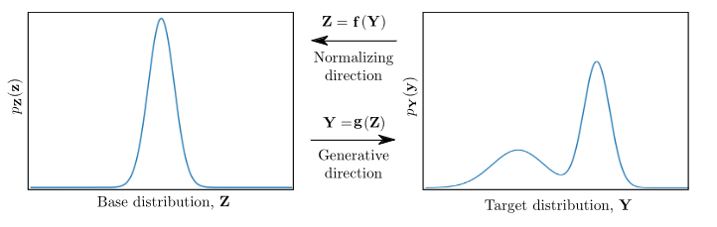
Neural Posterior Estimation
The normalizing flow: a learned, invertible mapping that transforms a simple distribution into a flexible approximation of the posterior

Slide 15
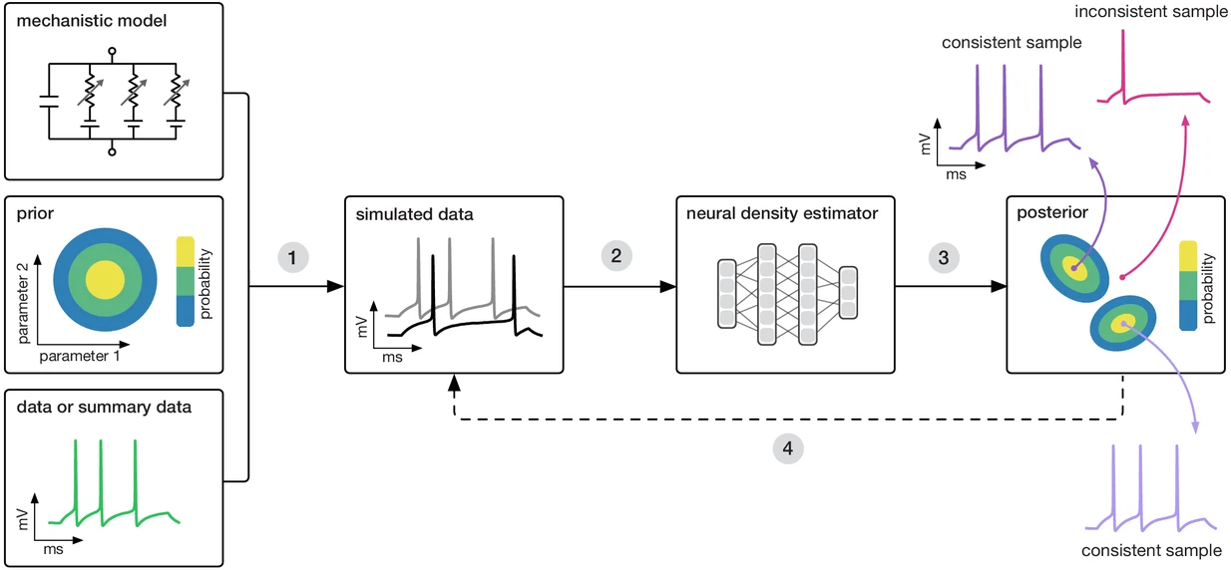
NPE in SBI toolkit
Sampling parameters
Generating synthetic datasets
Training deep neural network
Obtaining the posterior distribution.
Pedro J Gonçalves, Jan-Matthis Lueckmann, et al., (2020) Training deep neural density estimators to identify mechanistic models of neural dynamics eLife 9:e56261(https://doi.org/10.7554/eLife.56261)
Notes:
sampling parameters from the prior and generating synthetic datasets based on these sampled parameters.
a deep neural network trained for density estimation is employed to learn the probabilistic relationships between the data (or its features) and the underlying parameters.
This trained network is then utilized on the empirical data to identify the full range of parameter values that align with the data and the prior, thereby obtaining the posterior distribution. Parameters that match both the data and the prior are assigned high posterior probabilities, while those that do not match are assigned low probabilities.
If necessary, the initial posterior estimate can be used to iteratively guide further simulations, refining the results to be more consistent with the observed data.

Slide 16
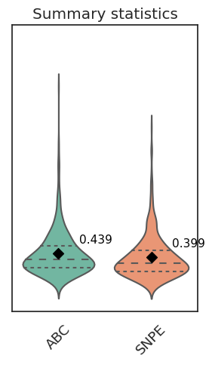
NPE is considered more efficient
Proved outstanding performance
Potentially more accurate in complicated cases
Amortized posterior
Once trained, much faster than ABC
No need to manually select summary statistics
Prediction error

Slide 17
3. Infer population size history

Slide 18
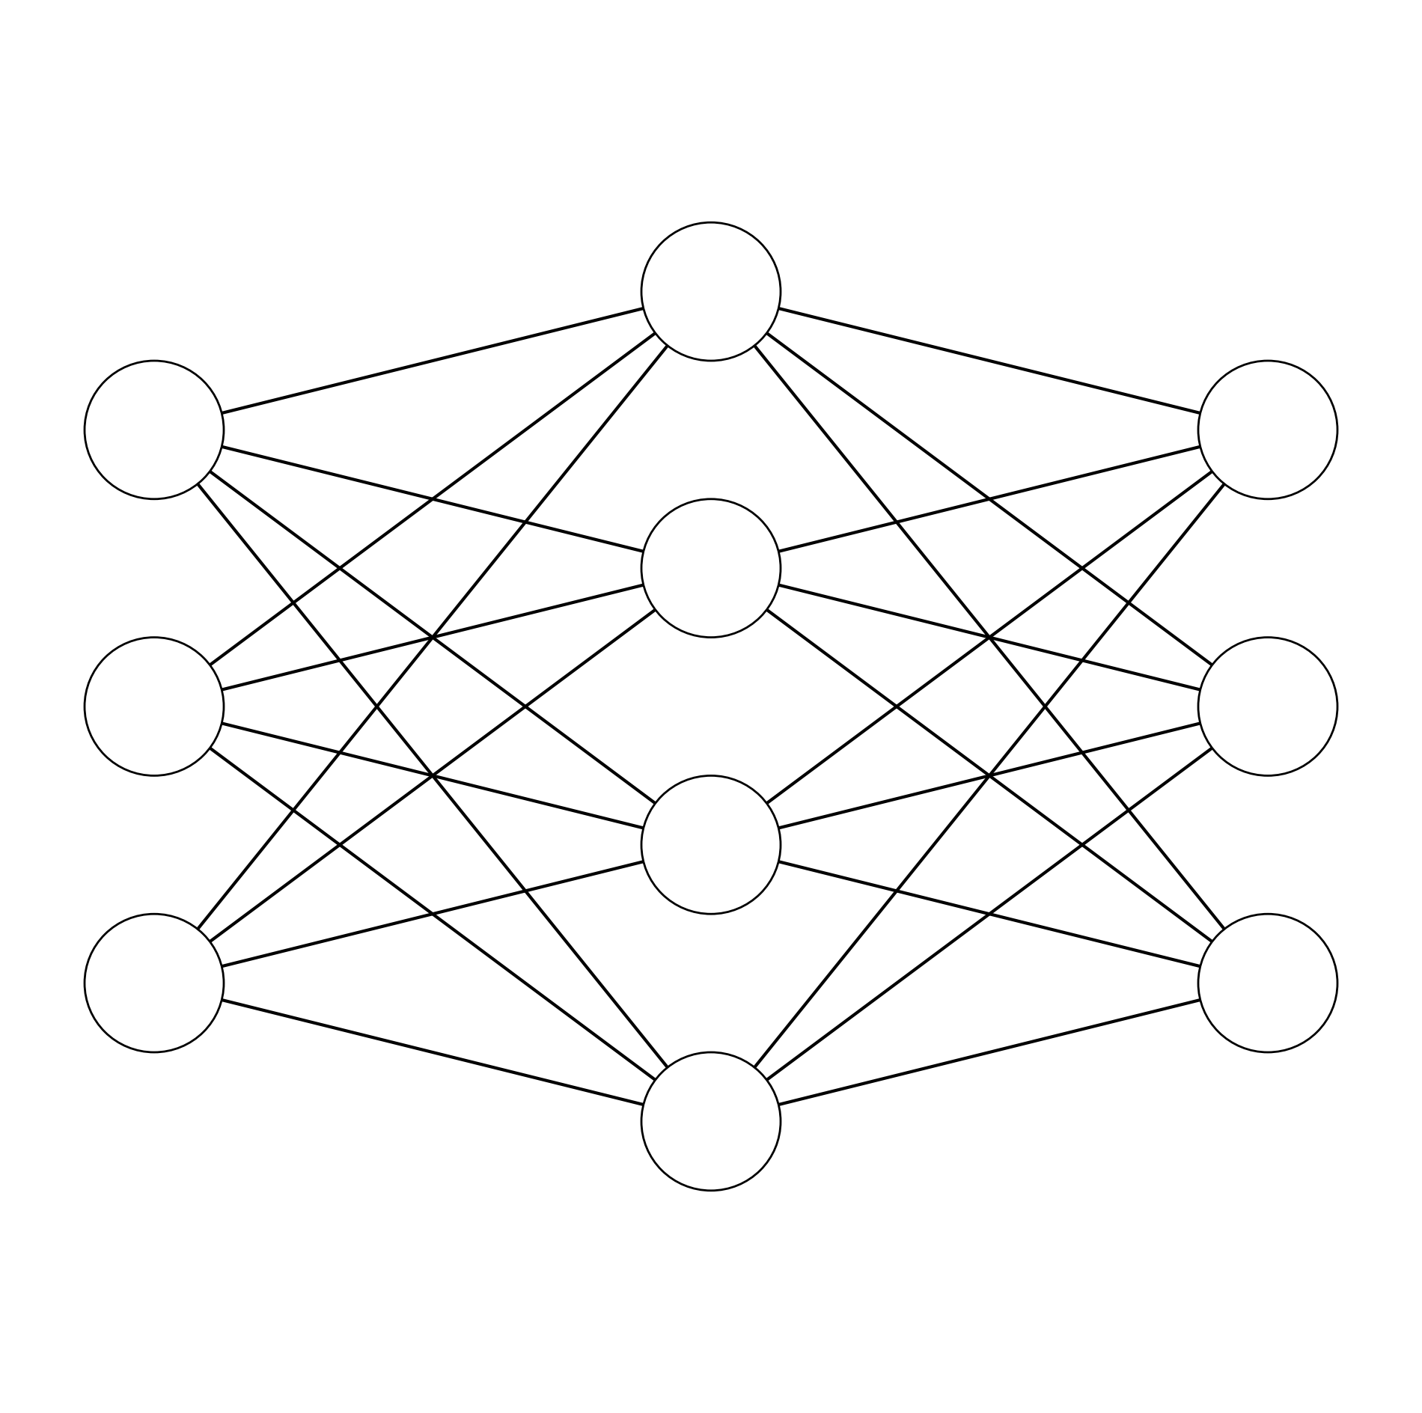
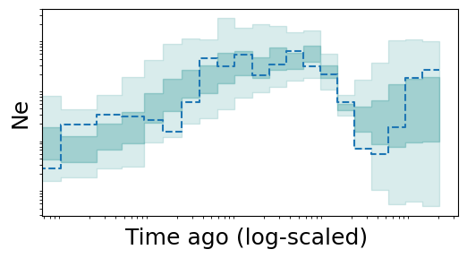
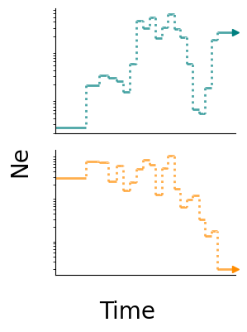
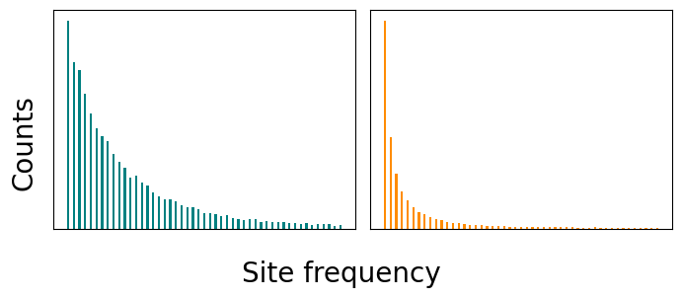
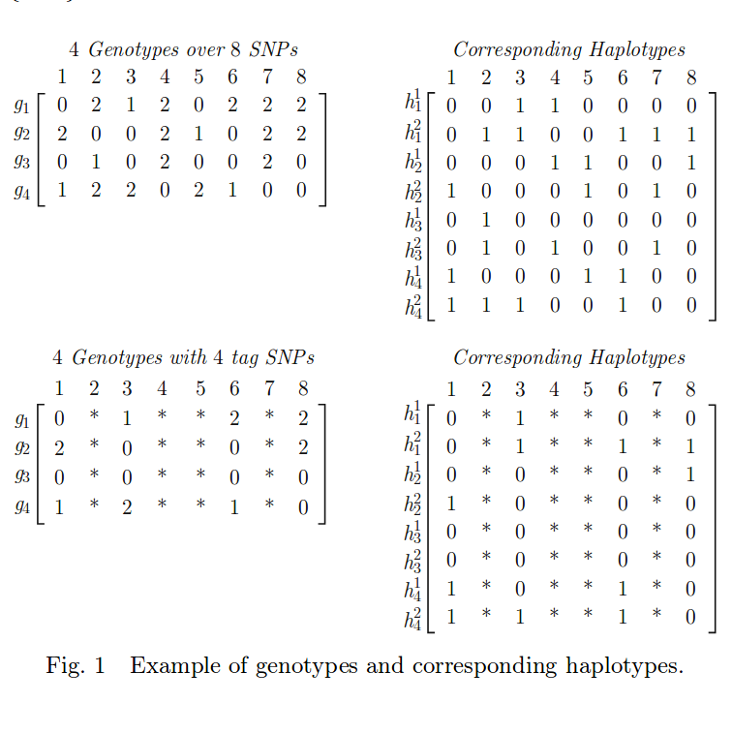
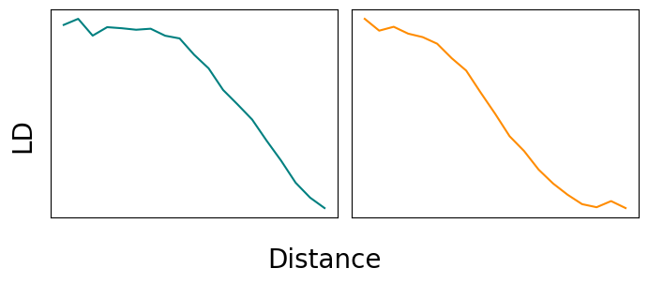
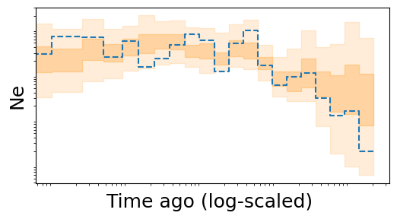
Conceptual overview of the workflow
CNNs
Summary statistics
SNPs
Prior
(ρ, N_{e}¹, N_{e}²,...,N_{e}²¹)
Random
sampling
Msprime
simulator
NPE

Slide 19
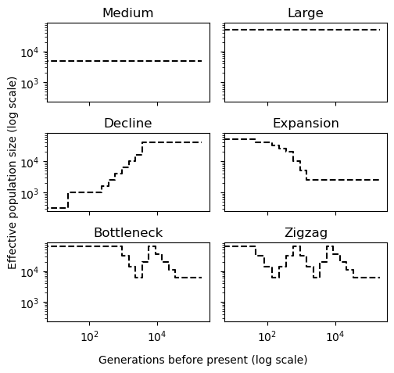
Model details
A single (cattle) population, multiple scenarios
1 recombination rate (random)
1 mutation rate (fixed)
21 ancestral populations sizes
Exponentially distributed time windows

Slide 20
Model details
A single (cattle) population, multiple scenarios
1 recombination rate (random)
1 mutation rate (fixed)
21 ancestral populations sizes
Exponentially distributed time windows
Filtered scenarios (SNPs > 400)
Standardization
Training NN

Slide 21
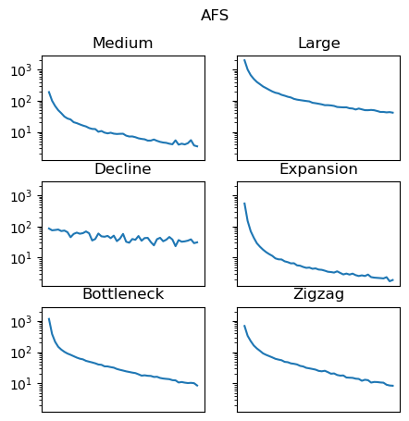
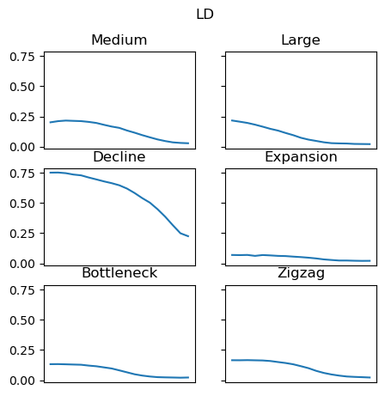
More about summary statistics

Slide 22
Thank you
More in the hands-on session

