Slide 1

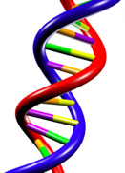
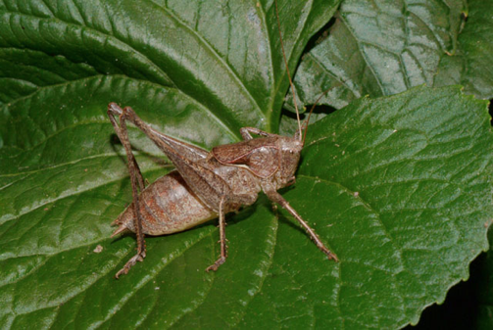
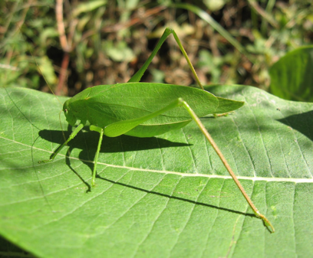
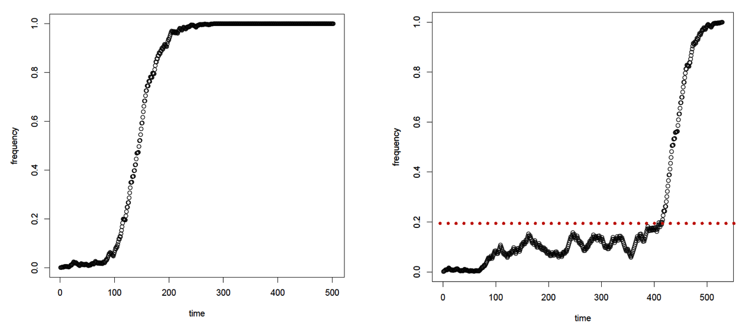
Positive selection
mutation + selection
This is called a “selective sweep”

Slide 2
Selective sweeps skew patterns of diversity
11 sequences, 8 “haplotypes”
11 sequences, 5 “haplotypes”
U-shaped Site Frequency Spectrum:
-Reduced diversity
Fraction of polymorphisms
-Excess linkage disequilibrium (LD)

Slide 3
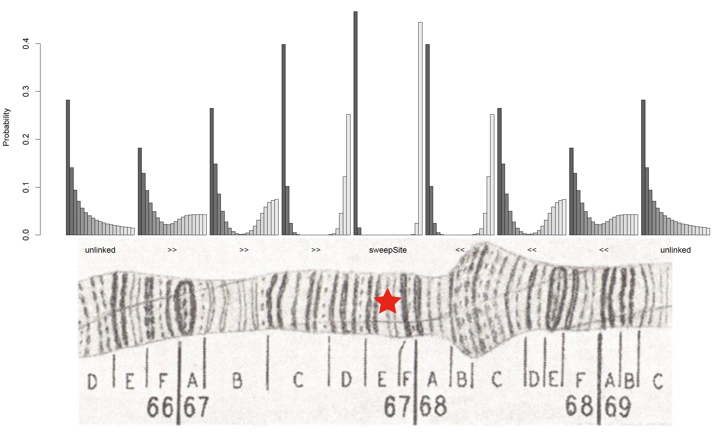
Sweeps and the spatial skew in allele frequencies
Nielsen et al. (2005)

Slide 4
Two modes of adaptation:
Change in environment
Selection on de novo mutation
“Hard Sweep”
Selection on standing variation
“Soft Sweep”
These models produce quantitatively and qualitatively different effects on spatial patterns of variation.

Slide 5
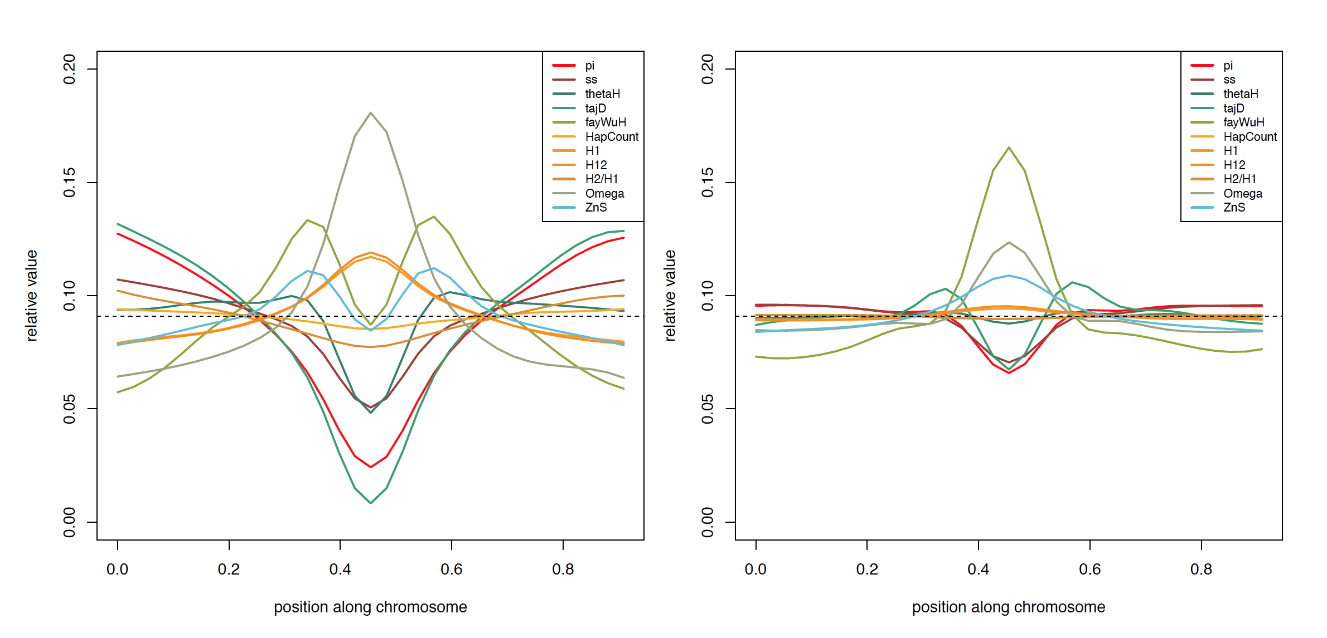
The spatial effect of a sweep is multi-dimensional
Hard Sweep
Soft Sweep
Idea: calculate each of these statistics in several windows around the focal site

Slide 6


When to use machine learning?
Good for cases where mechanistic models are hard to come by
Supervised learning: good when lots of training data can be obtained
Good for high-dimensional data!

