Slide 1
One-dimensional Port-and-Sweep Solitaire Armies
Filip Belik and Ha Le

Slide 2
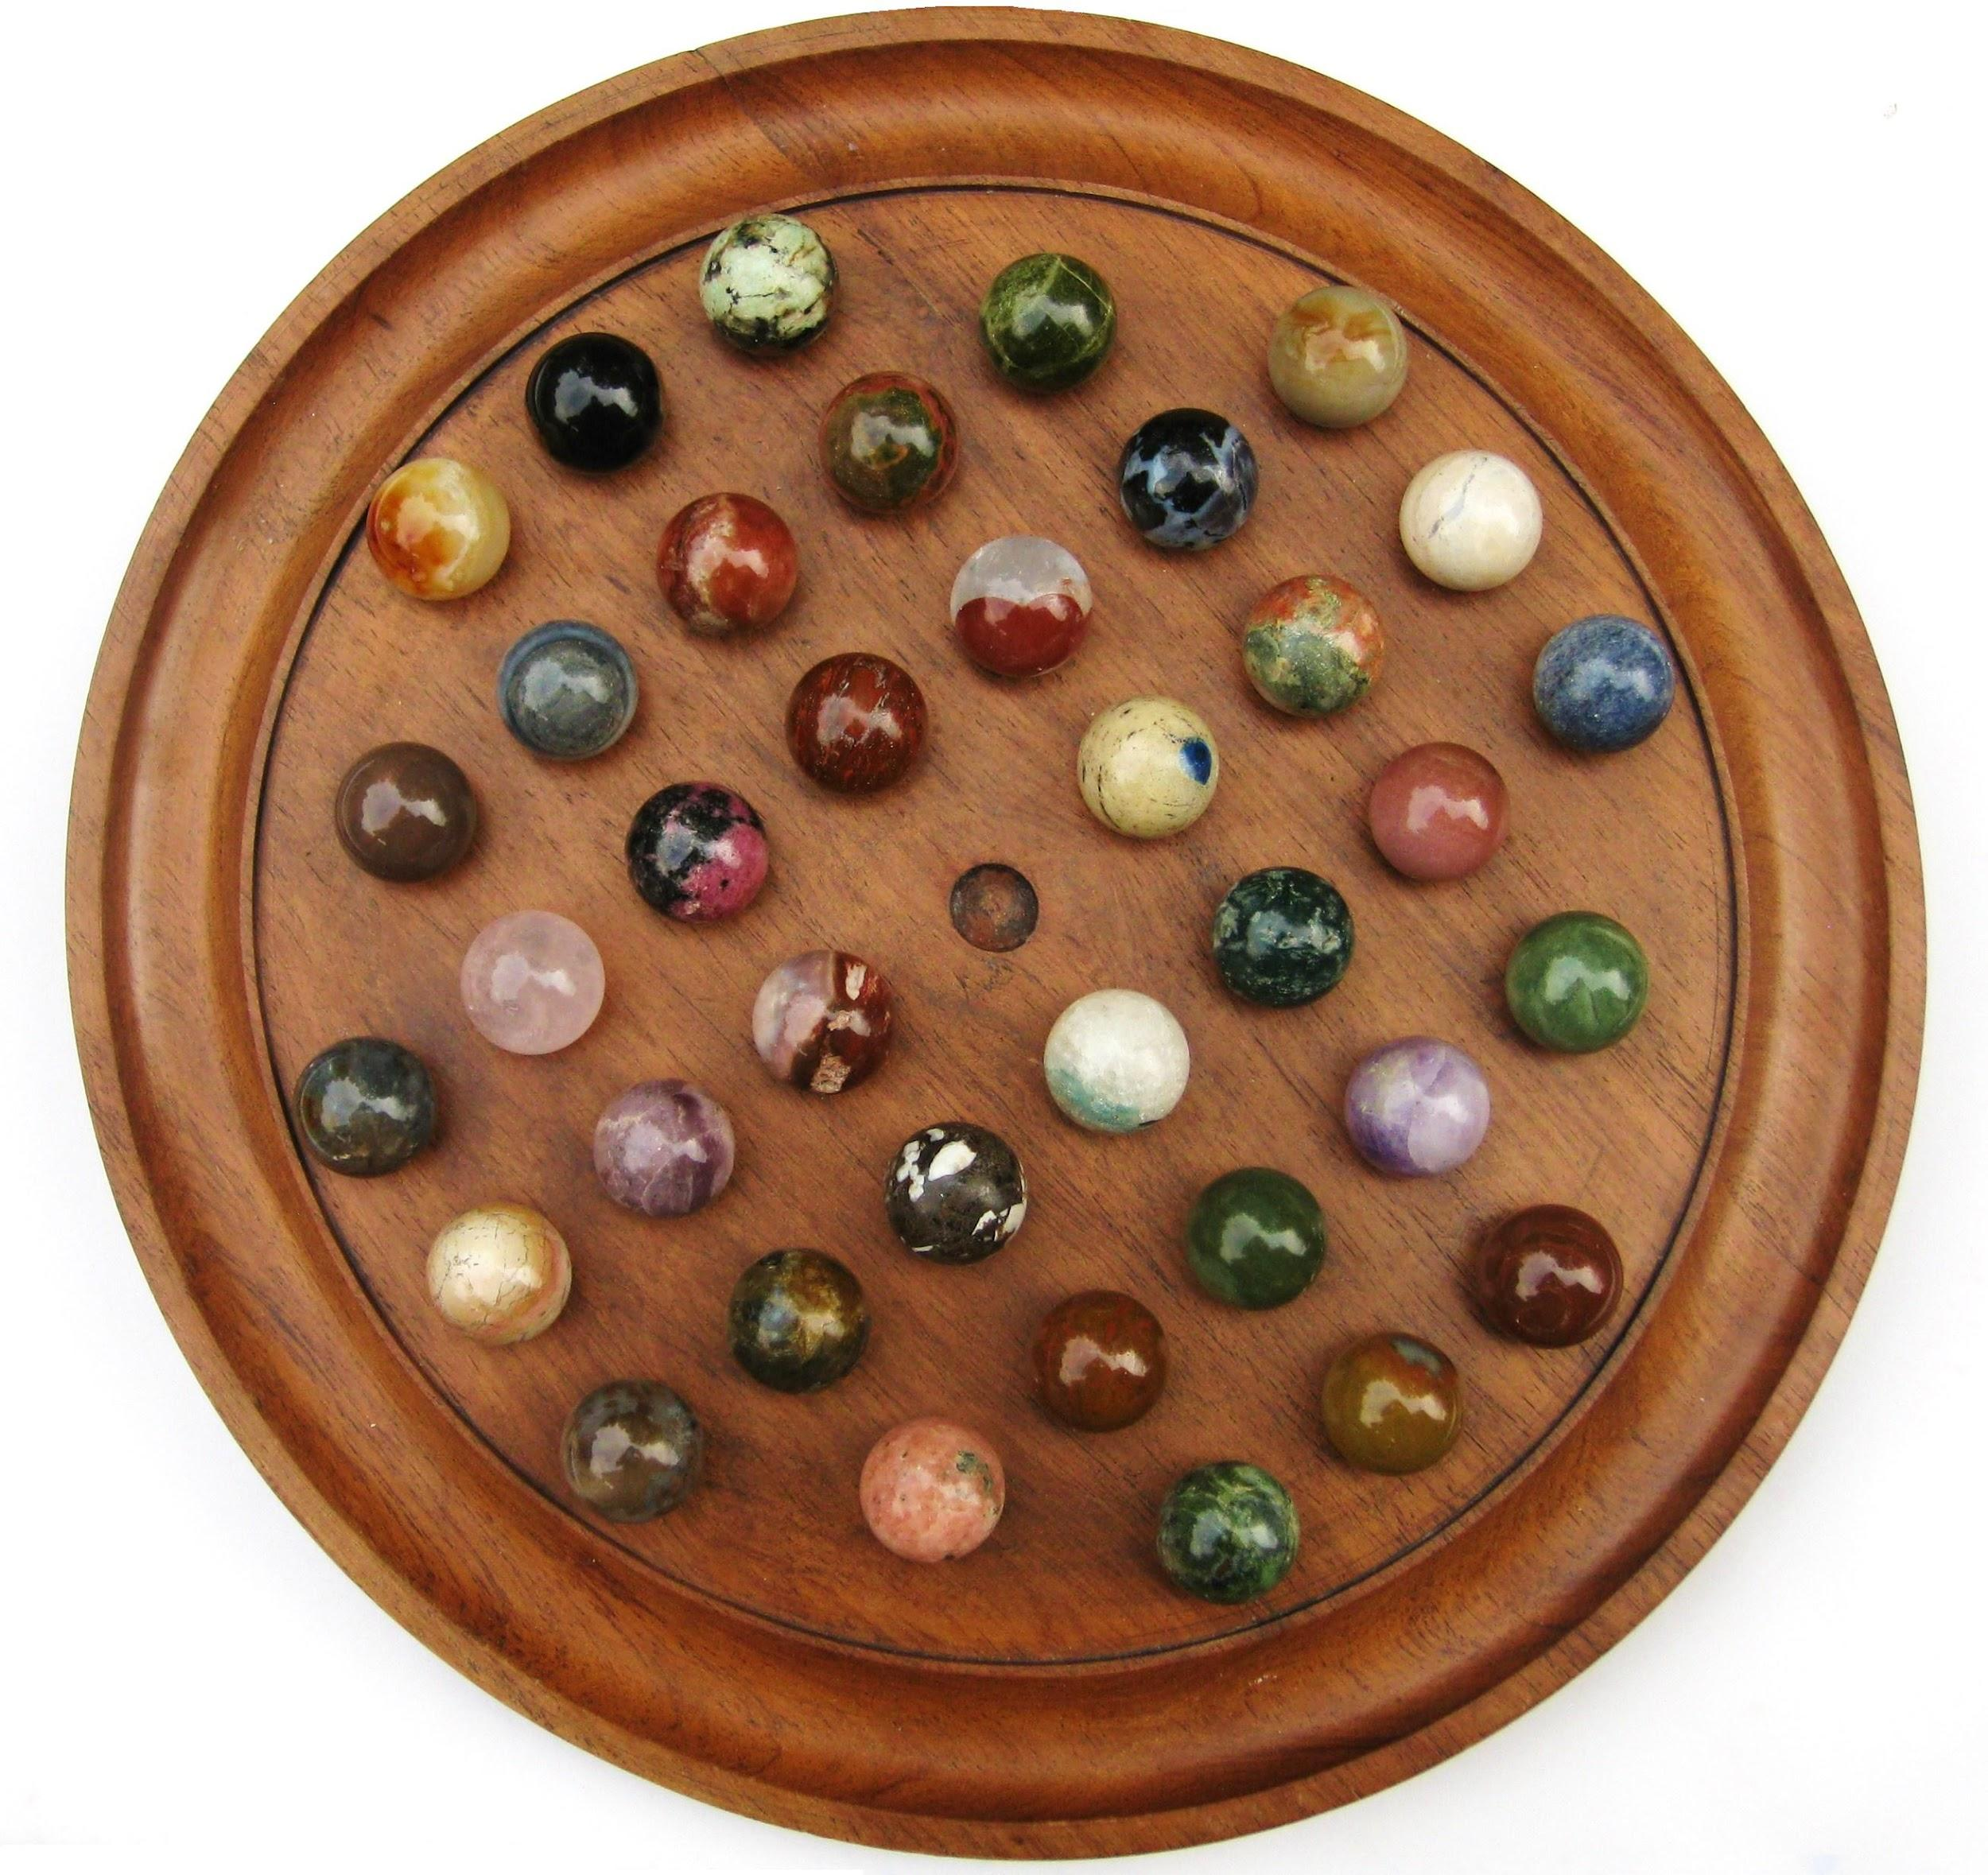
Peg Solitaire
Goal of reducing to one peg
Use of jump moves where jumped peg is removed
Lots of research done on this puzzle alone
Conway Pagoda Function
NP-Completeness
Regular Languages

Slide 3
Solitaire Army Problem 1D
. . .
1
2
3
4
5
6
. . .

Slide 4
Solitaire Army Problem 2D
. . .
1
2
3
4
5
6
. . .

Slide 5
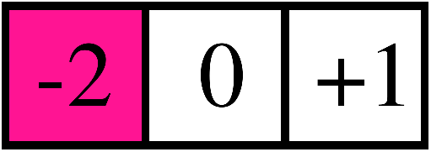

Port-and-Sweep Solitaire (PaSS) Rules
Game is played on a 2D grid similar to Peg Solitaire
Spaces can now hold up to 2 counters
Two types of moves (can be played up, down, left, right).
Port Move --------
Sweep Move ----
2
1
2
2
2
1
2
1
2
1
2
1

Slide 6

Example puzzle

Slide 7
PaSS Army Problem 1D
Q: What is the furthest distance any army can advance?
. . .
2
2
2
1
2
3
4
5
6
. . .
1
1
1
2
1

Slide 8
Resource Counts
Using the idea of a weight function, α, which gives a specific value to any board configuration
Let α ≈ 1.2338, the value of a counter at position i is given by α^{i}
The alpha-value of a board is given by the sum of values of all counters
Think of the alpha-value as a “resource count”
Non-increasing value by construction
. . .
-5
-4
-3
-2
-1
0
1
2
3
4
5
6
. . .

Slide 9
Resource Counts
Alpha value of the below board is given as follows
Alpha value = α⁻² + 2α⁰ + α² ≈ 4.18
We can calculate the maximum possible initial resource of an army as so
Maximum army alpha value = 2α⁰ + 2α⁻¹ + 2α⁻² + … ≈ 10.56
. . .
-5
-4
-3
-2
-1
0
1
2
3
4
5
6
. . .
1
2
1
2
. . .
-5
-4
-3
-2
-1
0
1
2
3
4
5
6
. . .
2
2
2
2
2
2

Slide 10
Distances of 10+
Distance of 12 requires too high of a resource count
Starting alpha-value <= 10.56 <= 12.44 ≈ α¹²
Hence, army advances of 12+ are impossible
A single counter at cell 10 implies a port from cell 8
Starting alpha-value <= 10.56 <= 10.74 ≈ 2α⁸
Hence, army advances of 10+ are impossible as well
. . .
1
2
3
4
5
6
7
8
9
10
11
12
. . .
2
1
1

Slide 11
Distance of 9
We have shown that in order to get a single counter at cell 9, these following moves have to be made at some points:
A rightwards port from 7 to 9
A rightwards port from 4 to 6
A rightwards port from 3 to 5
[maximum starting resource] - [resource loss by moves] ≈ 6.47
However, α⁹ ≈ 6.62
Hence, army advances of 9 are impossible

Slide 12
Distance of 8
A distance of 8 is difficult to prove by deductive strategy.
Assumption:
No leftwards (backwards) moves are made
No debris left behind
Approach:
Linear algebra (linear combination of vectors)
Computer generation
Able to show given above assumptions, no army can advance a distance of 8

Slide 13
Possible Advances
Here is the configuration to achieve a distance of 6 with 10 counters
How many counters do you think are needed to advance 7 spaces?
12?
15?
20?
50?
. . .
-5
-4
-3
-2
-1
0
1
2
3
4
5
6
. . .
2
2
2
2
2

Slide 14


Thank you
More reading about game here:
Collection of puzzles to try:
Professor Jacob Siehler
Stephen Hilding Fund

