Slide 1
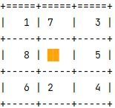
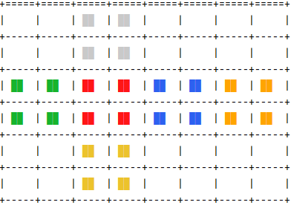
one hot encoding
one hot encoding
one hot encoding
81
9 x 3x3
144
144
81 x 2x2
600
600
300
300
300
300 (x 1x1)
100
100
100
600
1
12
1
300
h
a
h
100
1
h

