Slide 1
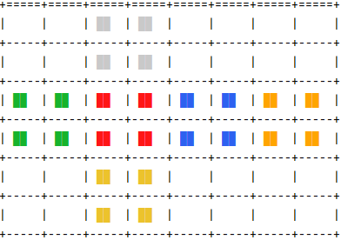
one hot encoding
one hot encoding
144
144
600
600
300
300
100
100
100
1
12
1
h
a
h

Slide 2
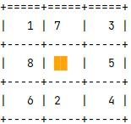
one hot encoding
81
9 x 3x3
81 x 2x2
one hot encoding
81
300
300 (x 1x1)
600
600
300
300
100
100
1
1
h
h

