Slide 1
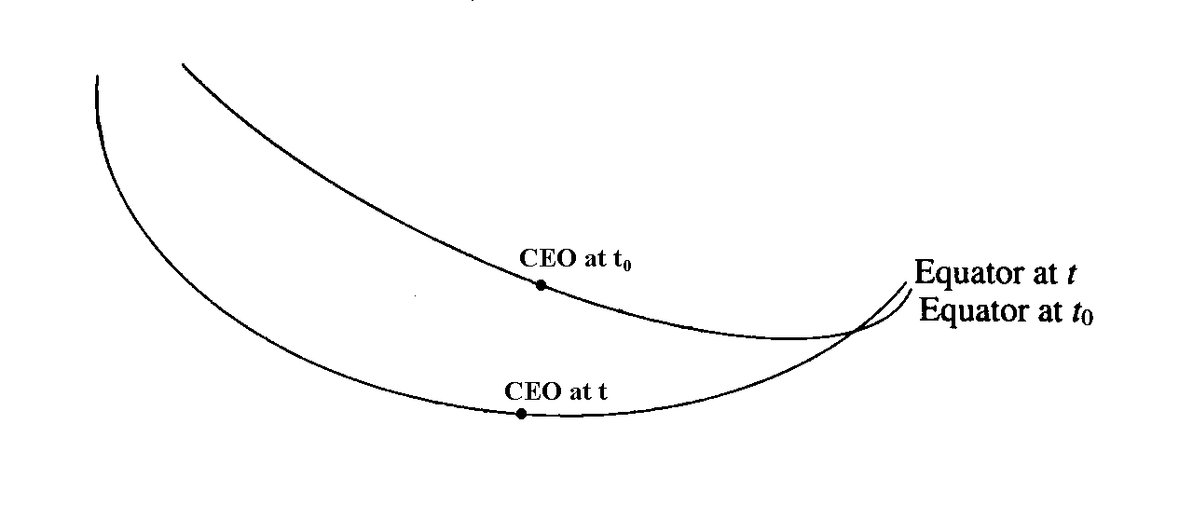

SOFA software support for IAU 2000
Patrick Wallace
Rutherford Appleton Laboratory, UK
ptw@star.rl.ac.uk
AAS 2004 Denver, 2004 May 31

Slide 2
Presentation outline
Introduction to SOFA
IAU 2000 and SOFA
Software design choices
Examples

Slide 3
SOFA
SOFA (Standards of Fundamental Astronomy) is an IAU initiative to provide authoritative implementations of standard algorithms.
Controlled by the international SOFA Reviewing Board.
Currently offers 121 Fortran subroutines:
  Vectors and matrices
  Calendars and time scales
  Precession, nutation
  Reference frames
  etc.

Slide 4
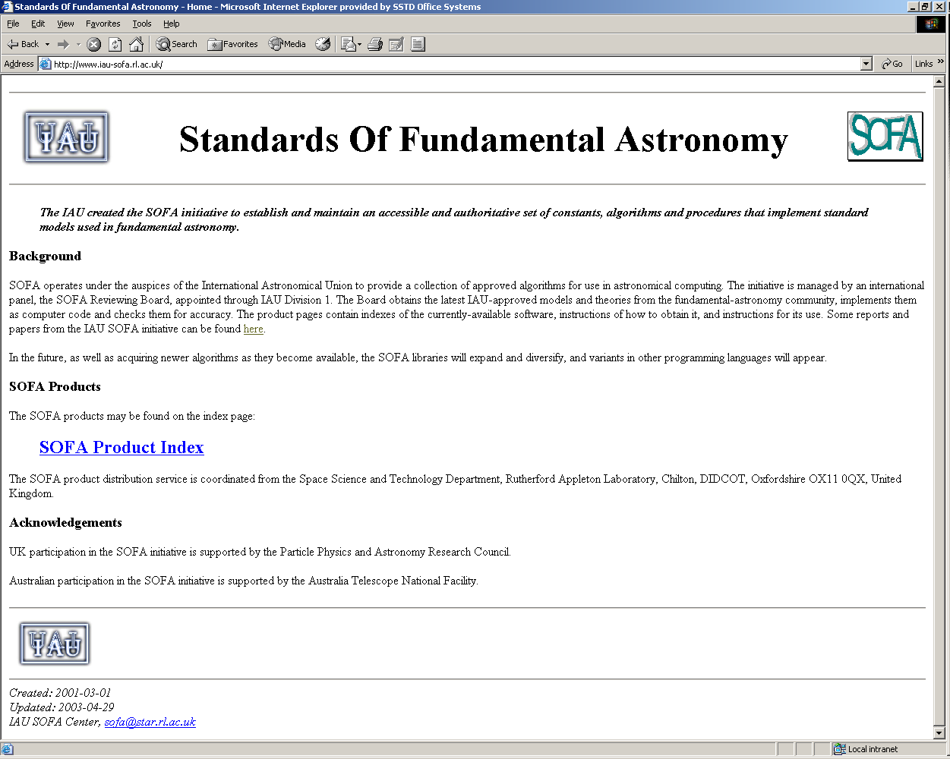
www.iau-sofa.rl.ac.uk

Slide 5
IAU 2000 inputs to SOFA software
New, quasi-classical, model for precession-nutation of the “celestial intermediate pole”:
  Starts with IAU 1976 precession and IAU 1980 obliquity
  New nutation series + bias and precession corrections
  Alternative abridged nutation model
New way to express Earth rotation:
  “Earth rotation angle” proportional to UT1
  Zero point for matching RA is a “non-rotating origin”

Slide 6
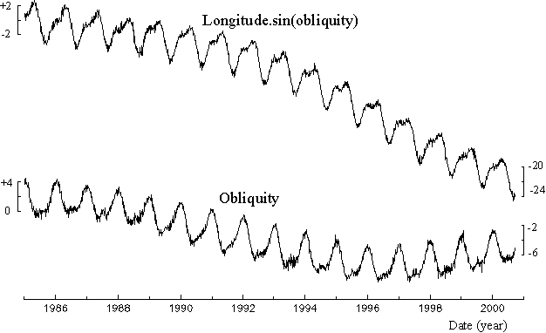
Why there needed to be changes
Errors in 1976/1980 precession-nutation model (mas) from VLBI

Slide 7
Numbers
  1 mas ~ aberration you get from walking pace
  1 μas ~ 30 μm at Earth’s surface (~ 1 thou)
  Earth orientation known to 300 μas RMS, ~ 1 cm
  Smallest terms in nutation model ~ 1 μas
  Number of coefficients in nutation model = 2730
  Error in IAU 1976 precession ~ 1 mas/y
  Uncertainty in IAU 2000 precession ~ 30 μas/y
  Nutation-model noise floor ~ 500 μas (from FCN)

Slide 8
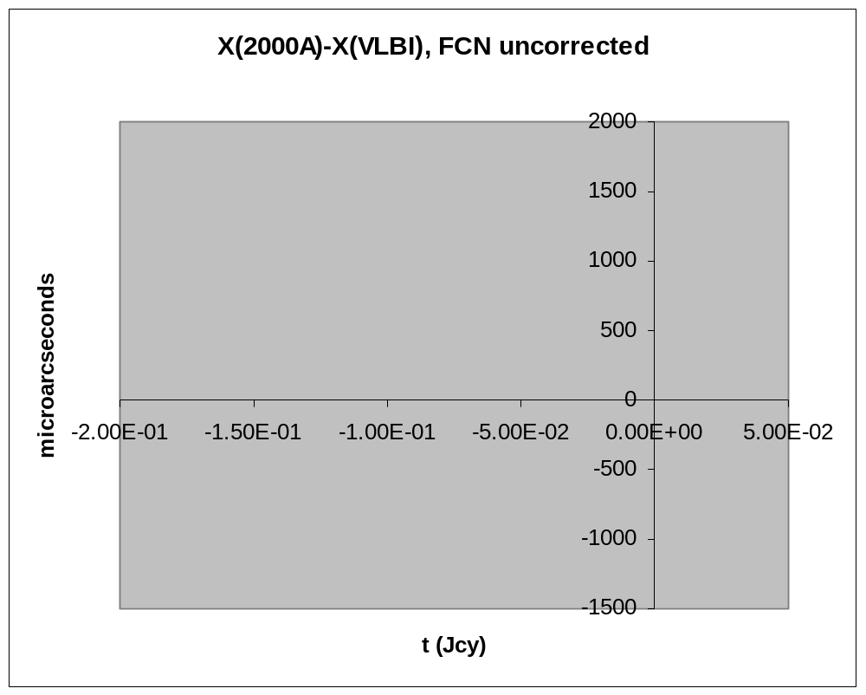
Free core nutation: the noise floor

Slide 9
Earth rotation, old and new
The old (classical) way:
GST₁₉₈₂ (0h) = 24110.54841 + 8640184.812866 t + 0.093104 t² - 6.2e-6 t³
+ Δψ cos ε + small correction terms
t is UT. The terms in red are “cross-talk” from precession-nutation.
The new (IAU 2000) way:
ERA (0h) = 24110.54841 + 8639877.317376 t
Calculating Greenwich hour angles:
For GHA = ERA-RA to work (cf. GHA = GST-RA), we simply use a different zero-point for RA, namely the CEO in place of the equinox.
Note the clean separation between Earth rotation and precession-nutation
in the new system.

Slide 10
IAU 2000 GST expression
Former IAU 1982/94 expression:
GST₁₉₈₂ (0h) = 24110.54841 + 8640184.812866 t
+ 0.093104 t² - 6.2e-6 t³
+ Δψ cos ε + small correction terms (2)
IAU 2000 compatible expression:
GST₂₀₀₀ (0h) = 24110.5493771 + 8639877.3173760 t_{u}
+ 307.4771600 t_{e} + 0.0931118 t_{e}²
- 0.0000062 t_{e}³ + 0.0000013 t_{e}⁴ + Δψ cos ε + small correction terms (34)
cf.
ERA (0h) = 24110.54841 + 8639877.317376 t_{u}

Slide 11
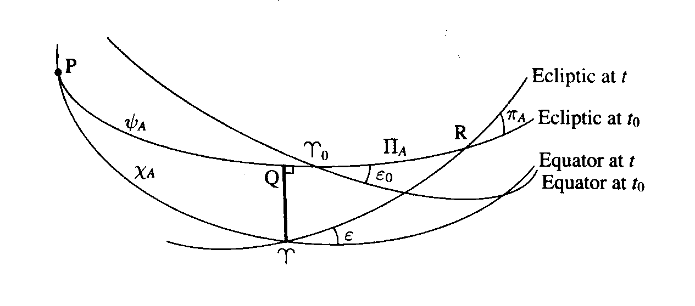
Zero points of right ascension
Classical: zero point defined geometrically, by intersection with ecliptic. Messy (intersection of two moving planes) but familiar.
New: zero point defined kinematically. Tidy but unfamiliar.

Slide 12
Where is the CEO?
The CEO is merely a point on the moving celestial equator that stays as still as it can.
Obviously, it has to move north-south in the sky as the equator precesses…
…but it doesn’t move along the equator: from moment to moment it moves only at right-angles to the equator.
In fact it does creep along a bit, but very slowly.
The CEO’s present α_{ICRS} is about 00^{h} 00^{m} 00^{s}.0001; by the end of the century it will have drifted only as far as α_{ICRS} = 0^{h} 00^{m} 00^{s}.0046.
The CEO can be thought of as “a kinematically defined place on the celestial equator close to where the ICRS prime meridian crosses”.

Slide 13
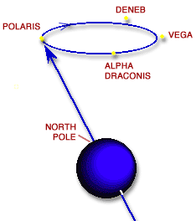
What is precession?
Astronomers have traditionally talked of “the precession of the equinoxes” and also have distinguished between luni-solar precession, planetary precession and general precession.
Lay people just talk about what the pole does.
Indeed, precession can simply be regarded as the slow component of the motion of the Earth’s axis; this is the IAU 2000 picture.
In IAU 2000, the clean separation between the pole’s motion and Earth rotation makes things clearer and reduces “cross-talk” effects.

Slide 14
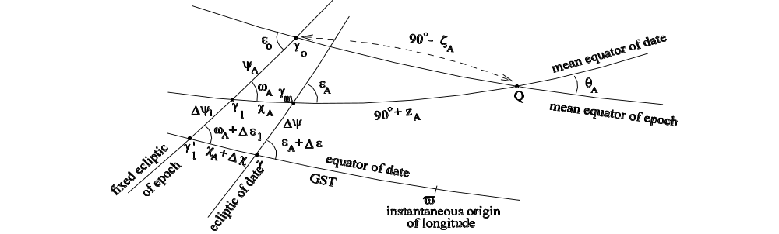
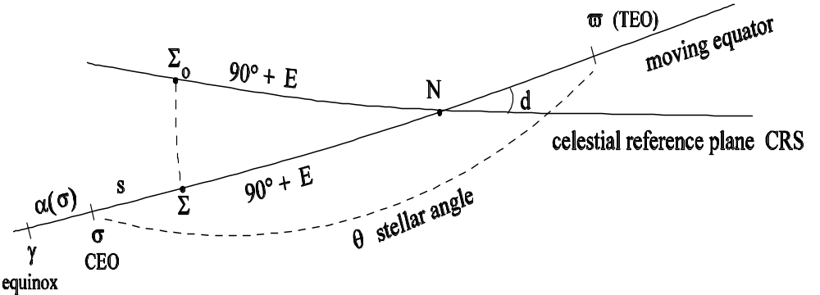
Precession-nutation, old and new
Classical: equinox-based
← Precession of the equator
← nutation of the equator
↑
Precession
of the
ecliptic
Precession-nutation
of the equator
New: CEO-based

Slide 15
So what happened to the ecliptic?
The ecliptic remains important in a qualitative and descriptive sense…
…and is part of constructing a precession model…
…but is no longer needed to define the zero point of right ascension.
The ecliptic is in any case a rather slippery concept:
  Is the ecliptic defined by the EMB’s path, or the orbital angular momentum vector? n.b. Difference ~ 0.1 arcsec.
  Does it go through the Sun? Solar system barycentre? Earth-Moon-Sun barycentre?
  What about long-period nutation terms?
There is no “IAU 2000 ecliptic” in the SOFA software.

Slide 16
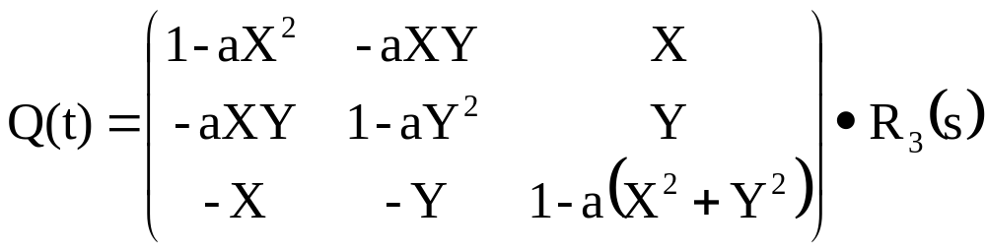
Precession-nutation matrix, new method
  R(t )=R₃(-E) · R₂(-d) · R₃(E + s - θ) = Q(t) · R₃(-θ)
    X = sin d cos E, Y = sin d sin E, and Z = cos d
    where a = ½ + (X² + Y²)/8

Slide 17
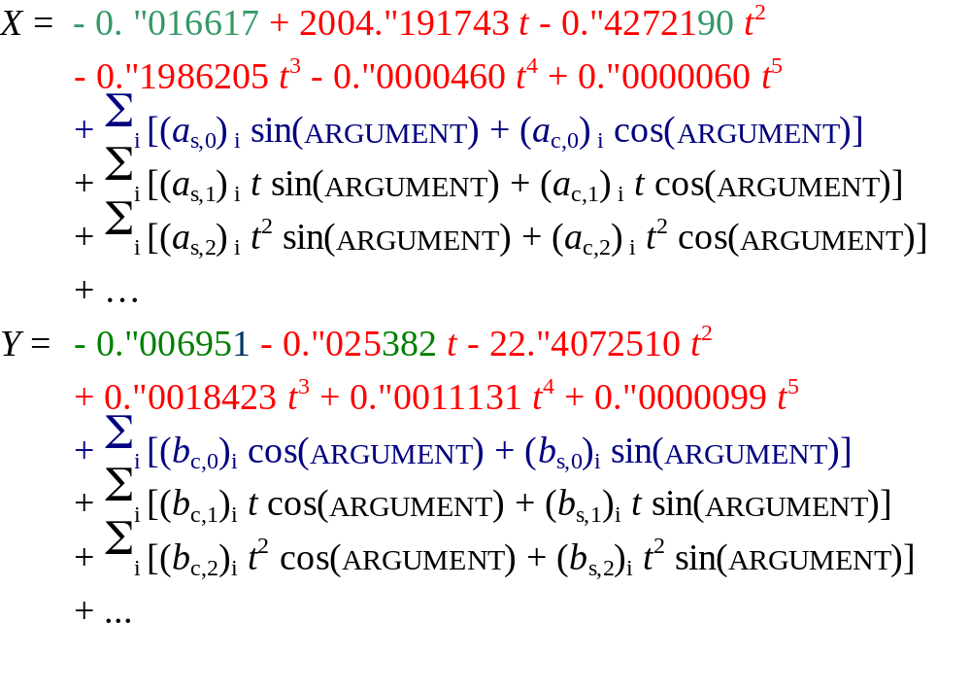
Direct models for CIP X,Y
(Capitaine, Chapront, Lambert, Wallace 2003, A&A 400)
precession; bias effect; nutation; cross terms precession × nutation

Slide 18
X,Y from classical precession-nutation matrix
v_{GCRS} = B · P · N · v_{TRUE} = R · v_{TRUE}
B = frame bias matrix (GCRS → mean J2000)
= R₃(-Δα₀)·R₂(-Δξ₀)·R₁(Δη₀)
P = precession matrix
= R₁(-ε₀) · R₃(ω_{A}) · R₁(ψ_{A}) · R₃(-χ_{A})
N = nutation matrix
= R₁(-ε_{A}) · R₂(Δψ) · R₁(ε_{A}+Δε)
R = classical precession-nutation matrix = B·P·N
(X,Y)_{CIP} = matrix elements R(1,3) and R(2,3)

Slide 19
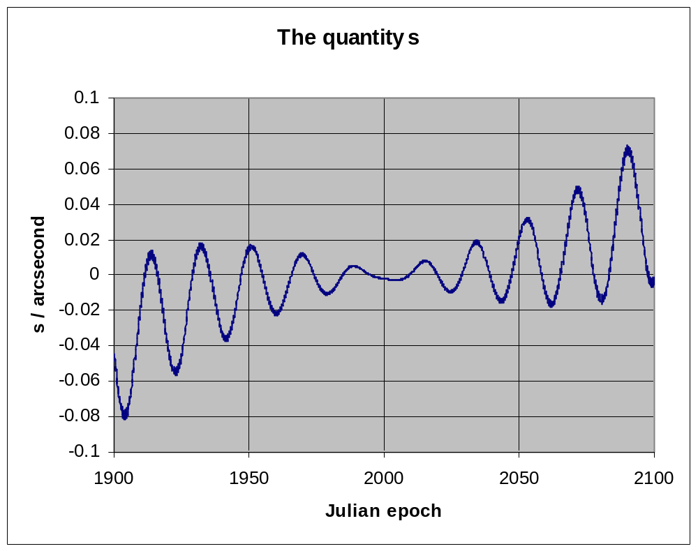
The quantity s

Slide 20
SOFA provision for IAU 2000
SOFA supports both the new (CEO-based) and the classical (equinox-based) procedures.
  The CEO-based algorithms are definitive, but the classical equivalents deliver equal accuracy for practical purposes.
Both IAU 2000A and IAU 2000B are supported.
  The IAU 2000B nutation series is almost as accurate (1 mas) as the full IAU 2000A series, despite being shorter than the IAU 1976 series.
All these choices mean that IAU 2000 support accounts for nearly a third of the 121 SOFA routines.
  The routines range from building blocks (e.g. compute nutation Δψ,Δε) to high-level ensembles (e.g. compute celestial-to-terrestrial matrix), enabling different simplicity/efficiency trade-offs.

Slide 21
Using the SOFA software
The improved classical procedures are, as far as possible, “plug-compatible” with existing ones.
  However, frame bias is new, and GST requires both UT and TT, so applications will need to be changed accordingly.
You don’t have to understand the new CEO-based methods in order to benefit from the improved accuracy.
  But for newcomers the CEO/ERA method is simpler.
SOFA is Fortran-only at present.
  Programmers in C++, Java etc. can use the SOFA routines as blueprints and benchmarks.

Slide 22
Other software supporting IAU 2000
IERS routines: http://maia.usno.navy.mil/ch5subs.html
IAU2000A: MHB_2000 nutation
IAU2000B: abbreviated nutation
XYS2000A: X, Y and s
GMST2000: GMST
GST2000: GST
EE2000: equation of the equinoxes
EECT2000: complementary terms
In preparation:
ERA2000: Earth Rotation Angle
SP2000: s’
T2C2000: TRS-to-CRS matrix
POM2000: polar motion matrix
CBPN2000: classical bpn matrix
BPN2000: new N•P•B matrix
NU2000A: nutation, IAU 2000A
NU2000B: nutation, IAU 2000B
NOVAS
SLALIB

Slide 23
Greenwich Hour Angles, old and new: methods
ICRS α,δ etc.
space motion
parallax
light deflection
aberration
frame bias
precession
GCRS → CIP,CEO
nutation
Greenwich Mean Sidereal Time
Earth Rotation Angle
equation of the equinoxes
polar motion
h,δ

Slide 24
Greenwich hour angles, old and new: example
2004 May 31, 22h UTC
λ = −104.9950, φ = +39.7427
Fictitious star
Old-style prediction using Sidereal Time
ICRS 23 32 55.171 +52 16 38.29
Apparent RA,Dec 23 33 06.176 +52 17 43.50
Local HA,Dec + 8 05 50.276 +52 17 43.66
New-style prediction using Earth Rotation Angle
ICRS 23 32 55.171 +52 16 38.29
Intermediate RA,Dec 23 32 53.329 +52 17 43.50
Local HA,Dec + 8 05 50.276 +52 17 43.66

