Slide 1
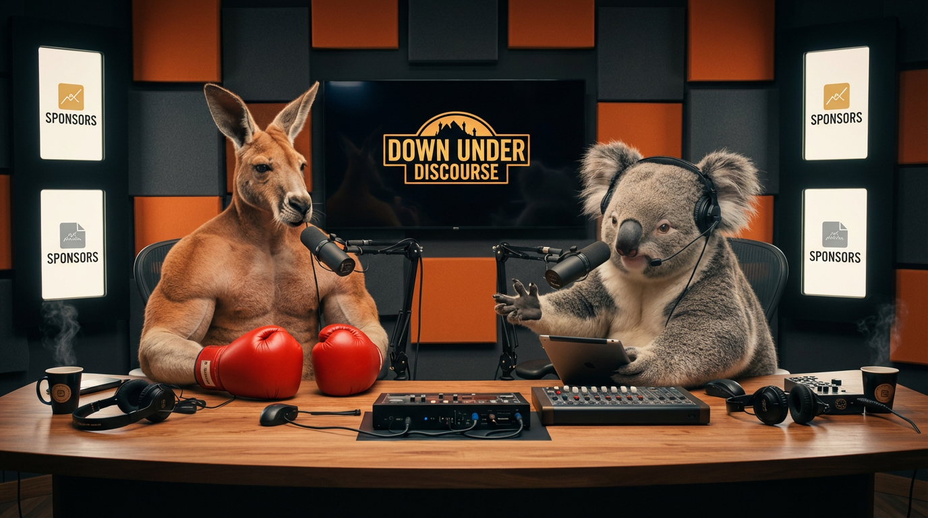
AUSTRALIAN ENTERTAINMENT IP
CAMPAIGNS
BUILT TO
ENTERTAIN.
Character-led comedy where the product provokes the episode — rather than interrupting it.
BOOMER & KEV
B&K / COMMERCIAL CREATIVES / PRE-LAUNCH V0
01

Slide 2
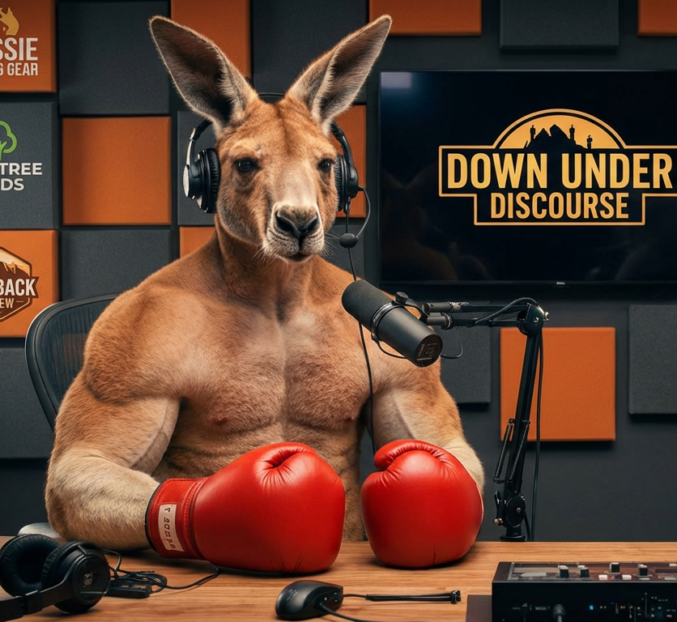
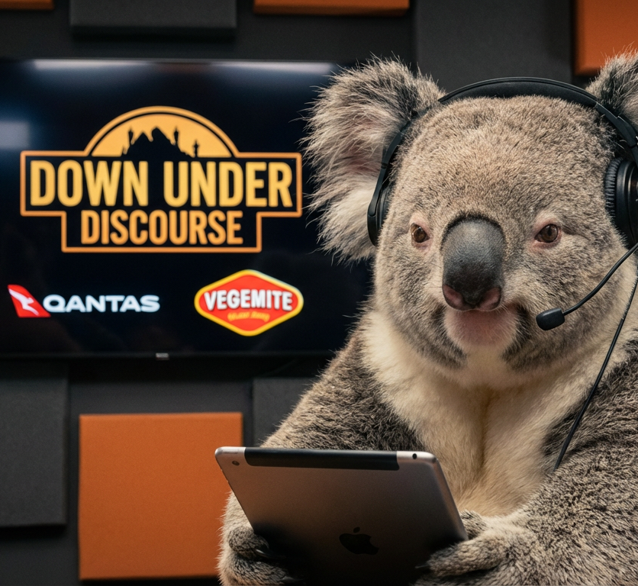
THE FORMAT
ONE TENSION MAKES THE BRAND FEEL NATIVE.
DESIRE
MEETS
DOUBT
FICTIONAL
SET
THE
OBJECTION
The audience gets the energy of a pitch and the credibility of an objection — inside the same joke.
BOOMER / urgency · exaggeration · action
KEV / objection · restraint · credibility
B&K / COMMERCIAL CREATIVES / PRE-LAUNCH V0
02

Slide 3
NATIVE INTEGRATION
THE PRODUCT DOES NOT PAUSE THE STORY. IT STARTS IT.
01
02
03
04
→
→
→
TENSION
CHAOS
PROOF
PAYOFF
A real audience problem or desire.
Boomer turns the product into a bad idea.
Kev forces the useful truth into view.
The CTA lands after the joke earns it.
Remove the logo and CTA: if the scene stops being entertaining, the integration is not ready.
B&K / COMMERCIAL CREATIVES / PRE-LAUNCH V0
03

Slide 4
COMMERCIAL MODEL
ONE PROPERTY. THREE WAYS TO CREATE VALUE.
01
MEDIA
Access to the audience
Native integrations · presented series · affiliate
02
CREATIVE
Assets for the brand
Branded sketches · performance variants · cutdowns
03
IP
Extensions of the universe
Merchandise · collaborations · character licensing
B&K / COMMERCIAL CREATIVES / PRE-LAUNCH V0
04

Slide 5
WAYS TO WORK TOGETHER
START WITH PROOF. SCALE WITH RIGHTS AND RECURRENCE.
05
IP COLLABORATION
04
SEASON PARTNER
03
CAMPAIGN SYSTEM
02
BRANDED SKETCH
01
INTEGRATION TEST
One native moment
One dedicated story
Controlled variants
Recurring inventory
Products + licensing
B&K / COMMERCIAL CREATIVES / PRE-LAUNCH V0
05

Slide 6


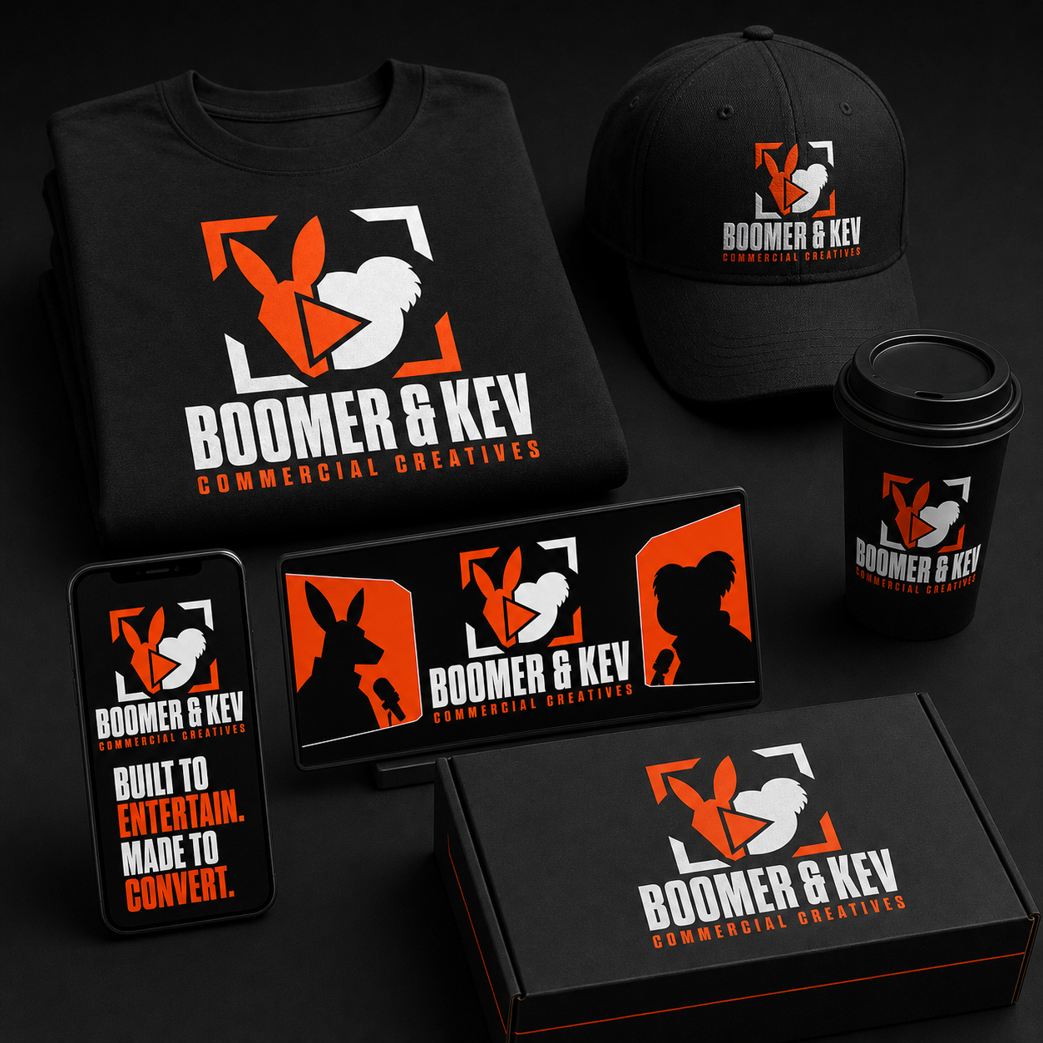
CAMPAIGN SYSTEM
ONE APPROVED IDEA BECOMES A CONTROLLED FORMAT SYSTEM.
16:9 / HERO · YOUTUBE · DISPLAY
9:16 / SHORT
1:1 / APPROVAL BOARD
Concept artwork · internal demonstration · not client work
B&K / COMMERCIAL CREATIVES / PRE-LAUNCH V0
06

Slide 7
MEASUREMENT
WE MEASURE THE STORY BEFORE WE CLAIM COMMERCIAL VALUE.
ATTENTION HEALTH
COMMERCIAL HEALTH
1 / 3 / 6-second retention
Retention through integration
Average percentage viewed
Verified clicks + code use
Completion + rewatch
Hook and CTA comparison
Shares + comments per 1,000
Campaign margin
Follower growth by video
Renewal + recurring revenue
NO INVENTED AUDIENCE DATA · NO GUARANTEED VIEWS · NO GUARANTEED ROAS
B&K / COMMERCIAL CREATIVES / PRE-LAUNCH V0
07

Slide 8
COMMERCIAL RIGHTS
PRODUCTION IS ONE FEE. ACCESS AND RIGHTS ARE SEPARATE VALUE.
PRODUCTION
PUBLICATION
USAGE
PAID MEDIA
EXCLUSIVITY
+
+
+
+
Concept · script · assets
Access to B&K channels
Term · territory · channels
Spark · partnership · whitelist
Category · duration
THE BRAND RECEIVES A DEFINED LICENCE.
BOOMER & KEV RETAINS ITS CHARACTERS, VOICES, LORE AND SYSTEM.
Perpetual, all-media ownership is not a standard offer.
B&K / COMMERCIAL CREATIVES / PRE-LAUNCH V0
08

Slide 9
FIRST PARTNER PROFILE
GIVE THE
PRODUCT
SOMETHING FUNNY TO DO.
Clear product truth
Visible demonstration
Room for character
Transparent partnership
PARTNERSHIP ENQUIRIES
Commercial contact to be confirmed
before external distribution.
B&K / COMMERCIAL CREATIVES / PRE-LAUNCH V0
09

