Slide 1
Book1
File created on: 17/11/22 18:52:34 GMT+01:00

Slide 2
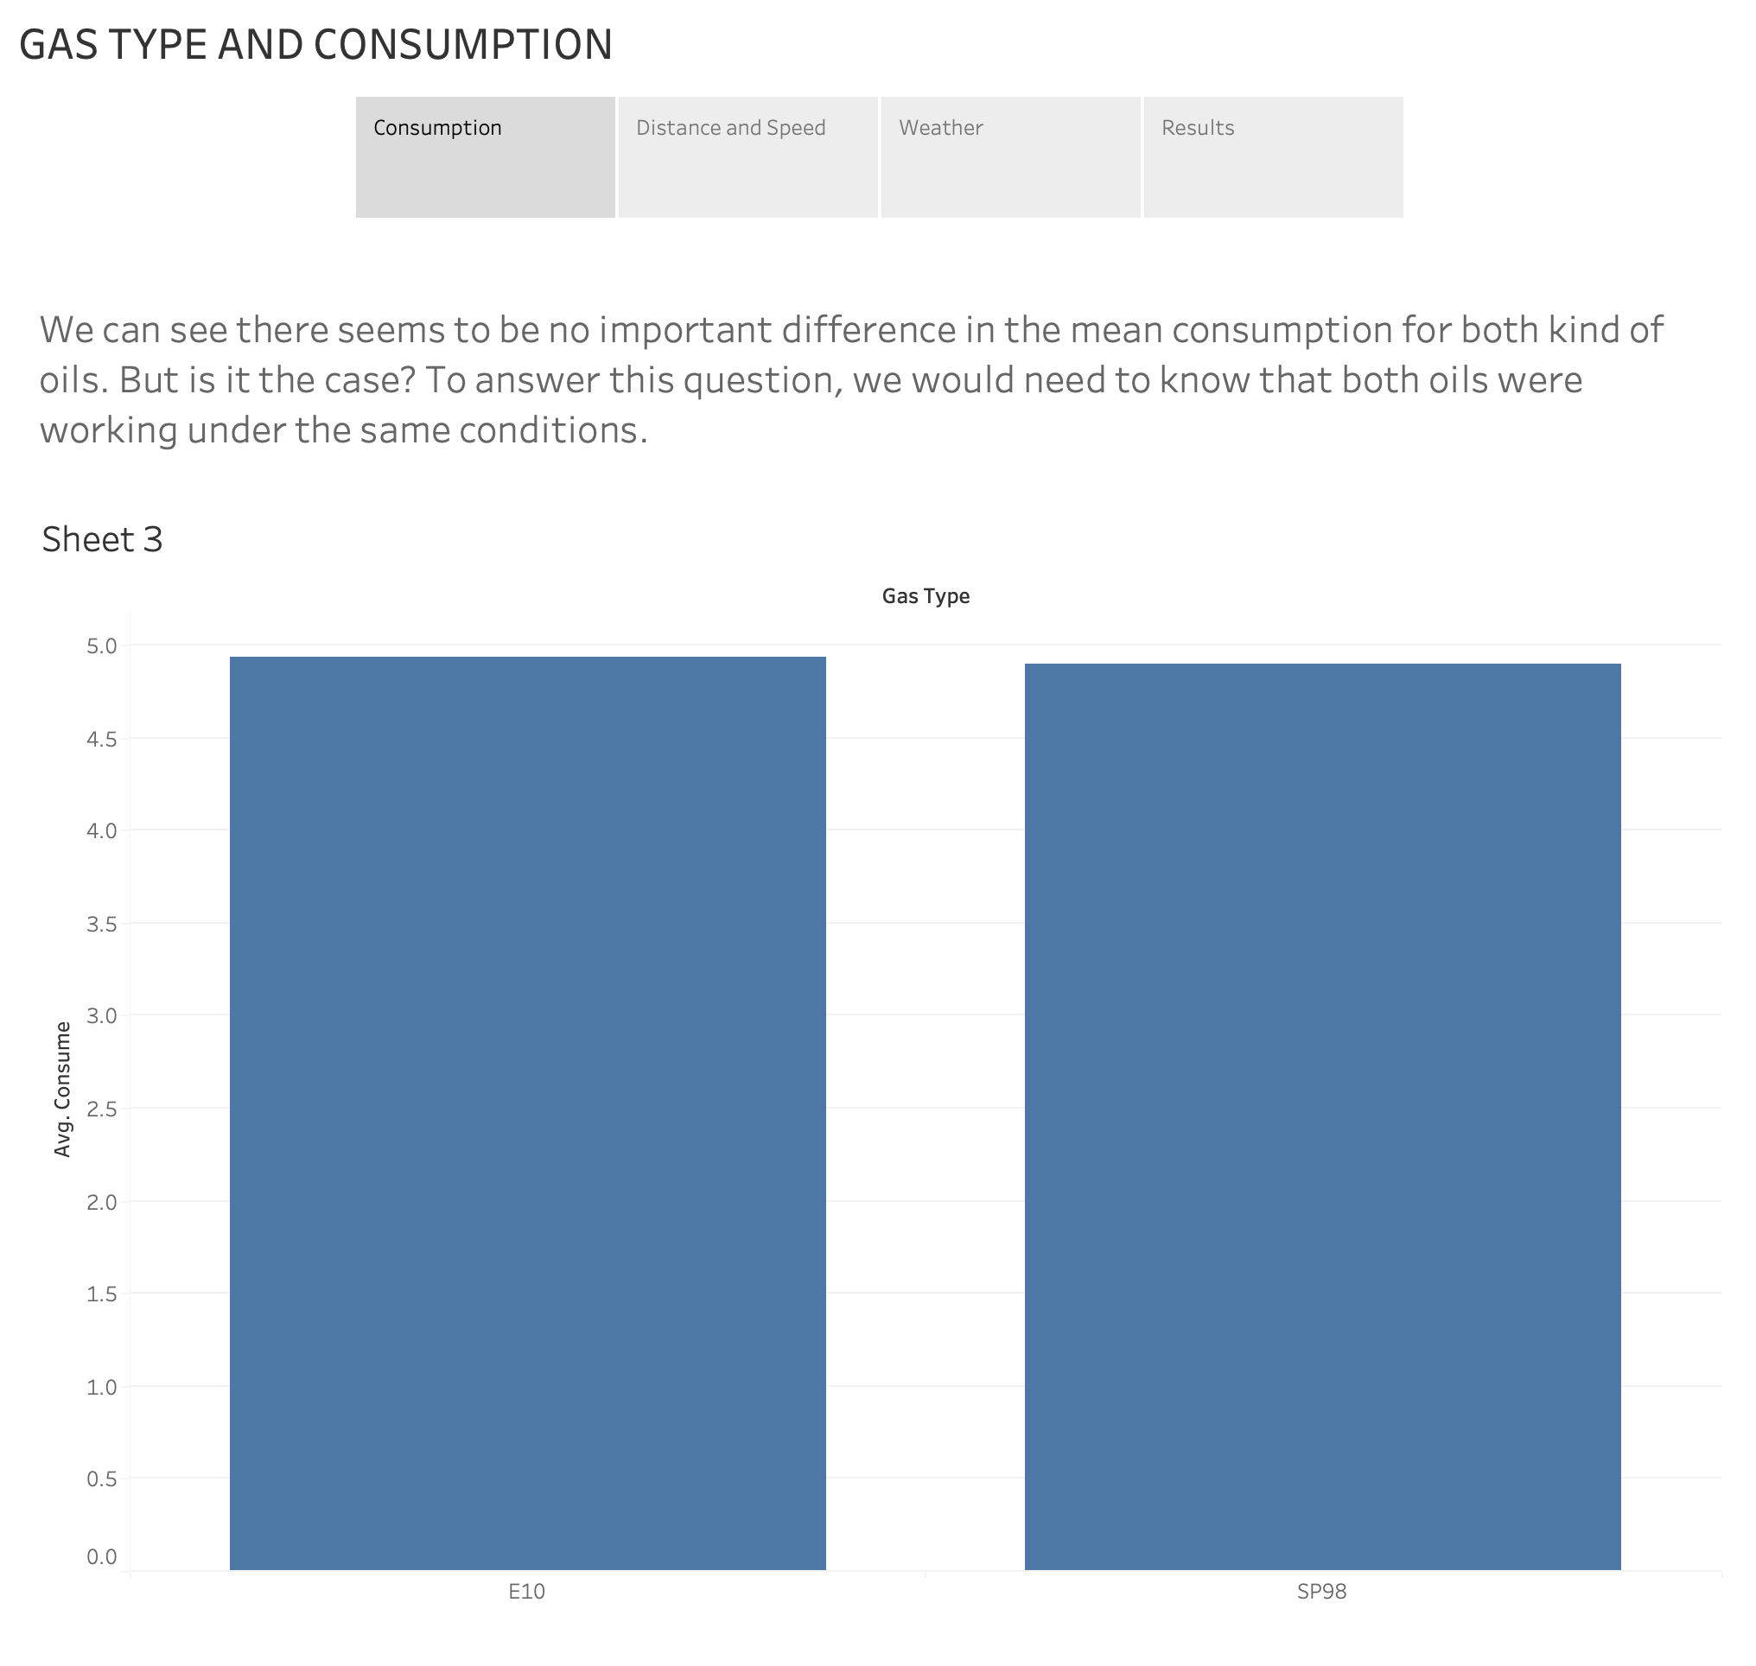

Slide 3
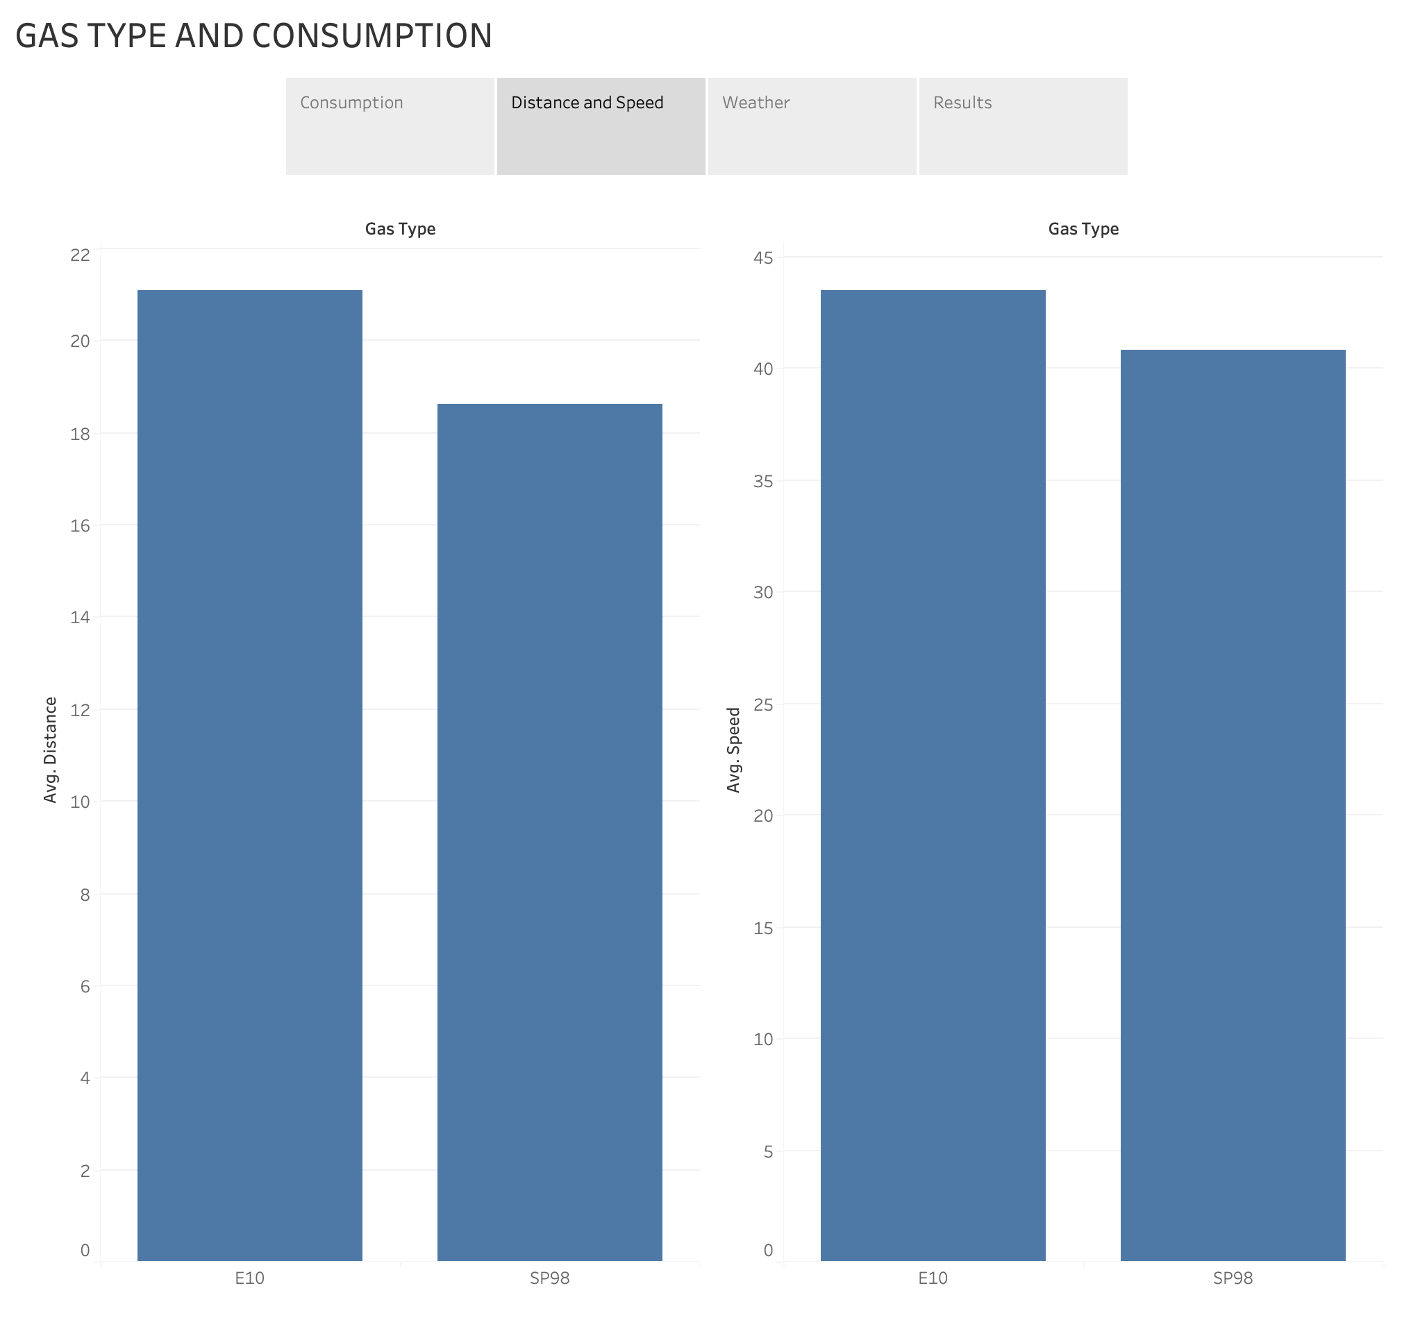

Slide 4
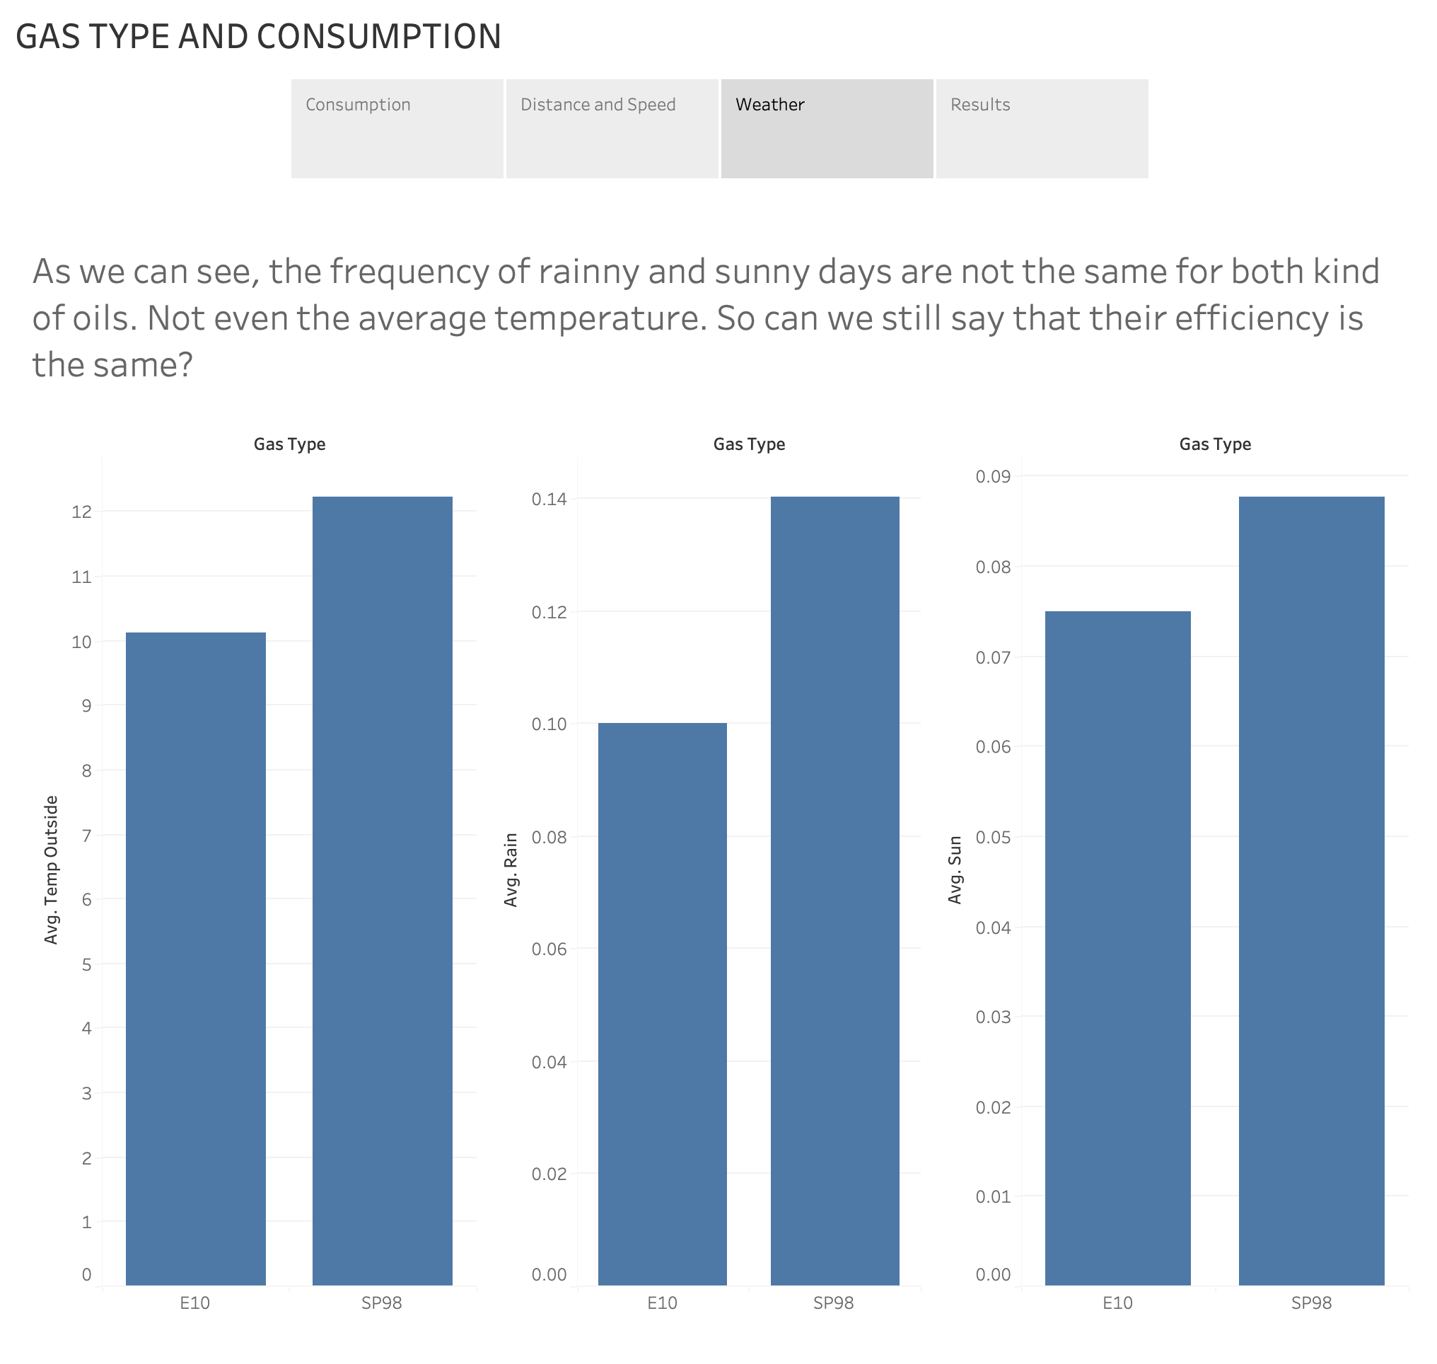

Slide 5
