Slide 1
.NET Threading Mysteries
Florian Biermann

Slide 2
What
.NET uses “threads” to structure concurrent computations.
A thread is an independent unit of execution.
Lots of benefits: responsive GUI, higher throughput, more modular code.
Lots of problems: race conditions, deadlocks, starvation, and so on.
Problems are real and hard to detect.

Slide 3
Concurrent Programming
Writing correct threading code is:
“easy”: if you follow the basic patterns; but
“hard”: if you want to have really high performance, throughput, etc.
Analyzing threading bugs is:
“harder”: occur spuriously, “Heisenbugs”, debugger interferes.

Slide 4
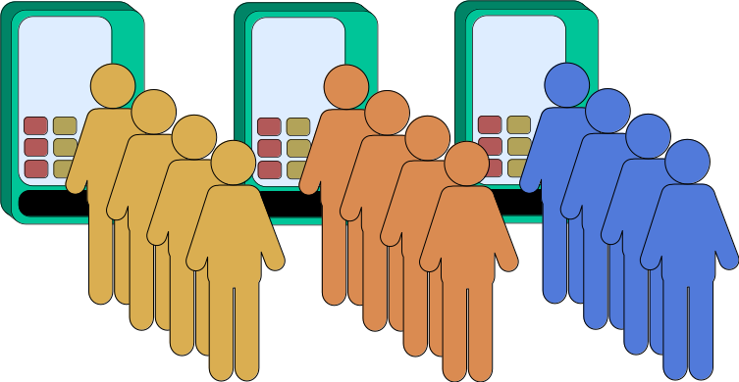
Parallelism

Slide 5
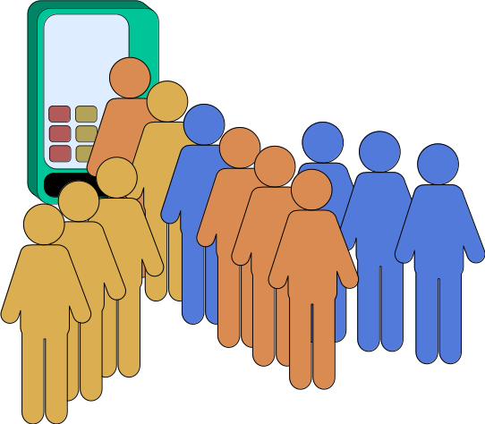
Concurrency

Slide 6
Crash Course in .NET Threading 1/2
var t = new Thread(() => ...);
t.Start(); // Start thread t.
t.Join(); // Wait for t to finish.
var s = Task.Run(() => ...); // Submit task to thread pool.
s.Wait(); // Wait for task s to finish.

Slide 7
Crash Course in .NET Threading 2/2
class C {
readonly object o = new(); // Why readonly?
public void F() {
// Lock on o from calling thread.
lock (o) { ... }
}}

Slide 8
This Session
There are six “threading mysteries”. Each mystery:
takes some kind of input (numbers, files, …);
does something with .NET threads; and
comes in up to three variants (A, B, C.)
Goals:
experience unexpected(?) behavior;
build a hypothesis about causes; and
connect the two.

Slide 9
Your Task for Today
In small groups (2-3), your task is to:
compile the code;
DO NOT look at the sources; instead
run each variant, use different arguments.
Observe and interpret!

Slide 10
Do Now!
$ git clone https://codeberg.org/fbie/threading-mysteries.git
$ cd threading-mysteries
$ dotnet build threading-mysteries.slnx -c Release
$ dotnet test threading-mysteries-tests.slnx

Slide 11
Solving the Mysteries
In the code we display:
modifiers like readonly are omitted, unless important; and
constructors are omitted.

Slide 12
Mystery 1
interface ISequenceBuilder {
bool Next();
}
ISqeuenceBuilder b = ...;
var t = new Thread(() => { while (b.Next()); });
t.Start();
while (b.Next());
t.Join();

Slide 13
Mystery 1: A
class SequenceBuilderA(int _n) : ISequenceBuilder {
List<int> _ns = new List<int>();
int _current = 0;
public bool Next() {
if (_current++ < _n) {
_ns.Add(_current);
return true;
}
return false;
}}

Slide 14
Mystery 1: B
class SequenceBuilderB(int _n) : ISequenceBuilder {
List<int> _ns = new List<int>();
volatile int _current = 0;
public bool Next() {
if (_current++ < _n) {
_ns.Add(_current);
return true;
}
return false;
}}

Slide 15
Mystery 1: C
class SequenceBuilderC(int _n) : ISequenceBuilder {
List<int> _ns = new List<int>();
int _current = 0;
public bool Next() {
lock (_ns) {
if (_current++ < _n) {
_ns.Add(_current);
return true;
}
return false;
}}}

Slide 16
Mystery 2
interface IHistogram {
void Add(char c);
void Print();
}
IHistogram h = ...;
for (var i = 1; i < args.Length; i++) {
var arg = args[i];
new Thread(() => {
var content = File.ReadAllText(arg);
foreach (var c in content)
if (char.IsLetterOrDigit(c))
h.Add(c);
}).Start();
}

Slide 17
Mystery 2: A
class HistogramA : IHistogram {
Dictionary<char, int> _chars = new();
public void Add(char c) {
if (_chars.TryGetValue(c, out var i))
_chars[c] = i + 1;
else
_chars[c] = 1;
}}

Slide 18
Mystery 2: B
class HistogramB : IHistogram {
Dictionary<char, int> _chars = new();
public void Add(char c) {
lock (_chars) {
if (_chars.TryGetValue(c, out var i))
_chars[c] = i + 1;
else
_chars[c] = 1;
}}}

Slide 19
Mystery 2: C
class HistogramC : IHistogram {
ConcurrentDictionary<char, int> _chars = new();
public void Add(char c) {
chars.AddOrUpdate(c,
_ => 1,
(_, i) => i + 1);
}}

Slide 20
Mystery 3
abstract class Set {
public int Id { get; }
public int Size { get; set; }
public Set Parent { get; set; }
public Set Find() {
if (Parent != this) {
Parent = Parent.Find();
}
return Parent;
}
public abstract Set Union(Set other);

Slide 21
Mystery 3 (continued)
for (var i = 2; i < args.Length; i++) {
var arg = args[i];
new Thread(() => {
var lines = File.ReadAllLines(arg);
foreach (var line in lines) {
var (x, y) = Split(line);
sets[x].Union(sets[y]);
}
}).Start();
}

Slide 22
Mystery 3: B
class SetB : Set {
public Set Union(Set other) => Assign(this, other);
static Set Assign(Set x, Set y) {
x = x.Find(); y = y.Find();
if (x == y) return x;
if (x.Size < y.Size) (x, y) = (y, x);
y._parent = x;
var size = x.Size + y.Size;
x.Size = size; y.Size = size;
return x;
}
}

Slide 23
Mystery 3: C
class SetC : Set {
public Set Union(Set other) {
var x = this.Find();
var y = other.Find();
lock (x) {
lock (y) {
return Assign(x, y);
}}}}

Slide 24
Mystery 3: A
class SetA : Set {
public Set Union(Set other) {
var x = this.Find();
var y = other.Find();
if (y.Id < x.Id) {
(x, y) = (y, x);
}
lock (x) {
lock (y) {
return Assign(x, y);
}}}}

Slide 25
Mystery 4
interface ICounter {
long Value { get; }
void Add(long value);
}
ICounter c = ...;
for (var i = 0; i < threads; i++)
new Thread(() => {
for (var j = 0; j < increments; j++)
counter.Increment();
}).Start();
}

Slide 26
Mystery 4: C
class CounterC : ICounter {
readonly object _lock = new object();
long _value = 0L;
public long Value { get {
lock (_lock) { return _value; }
}}
public void Add(long value) {
lock (_lock) { _value += value; }
}}

Slide 27
Mystery 4: A
class CounterA : ICounter {
long _value = 0L;
public long Value
=> Interlocked.Read(ref _value);
public void Add(long value) {
Interlocked.Add(ref _value, value);
}}

Slide 28
Mystery 4: B
public class CounterB : ICounter
{
[StructLayout(LayoutKind.Explicit, Size=64)]
struct PaddedLong { [FieldOffset(0)] public long Value; }
readonly PaddedLong[] _values = new PaddedLong[32];
public long Value
=> _values.Sum(p => Interlocked.Read(ref p.Value));
public void Add(long value) {
var n = Thread.CurrentThread.ManagedThreadId % 32;
Interlocked.Add(ref _values[n].Value, value);
}}

Slide 29
CPU Caches and False Sharing
Cache Line | 1 | 2 | 3 | 4 | 5 | 6 | 7 | 8
1
2
3
4
5
6
7
8

Slide 30
Mystery 5
interface IFactorizer {
void Run();
}
IFactorizer f = ...;
ConcurrentBag<int> input = ...;
var factors = f.Run(input);

Slide 31
Mystery 5: A
class FactorizerA : IFactorizer {
public Factors Run(ConcurrentBag<int> ns) {
Factors fs = new();
var ts = new List<Thread>(ns.Count);
while (_ns.TryTake(out var n)) {
var t = new Thread(() => {
fs[n] = Util.Factorize(n);
});
t.Start();
ts.Add(t);
}
foreach (var t in ts)
t.Join();
return fs;
}}

Slide 32
Mystery 5: B
class FactorizerB : IFactorizer {
public Factors Run(ConcurrentBag<int> ns) {
Factors fs = new();
var ts = new List<Task>(_ns.Count);
while (_ns.TryTake(out var n))
ts.Add(Task.Run(() => {
fs[n] = Util.Factorize(n);
}));
foreach (var t in ts)
t.Wait();
return fs;
}}

Slide 33
Mystery 5: C
class FactorizerC : IFactorizer {
public Factors Run(ConcurrentBag<int> ns) {
Factors fs = new();
Parallel.ForEach(_ns, n => {
fs[n] = Util.Factorize(n);
});
return fs;
}
}

Slide 34
Mystery 6
interface IWaiter {
void Wait(Barrier barrier);
}
IWaiter waiter = ...;
var barrier = new Barrier(n + 1);
for (var i = 0; i < n; i++)
waiter.Wait(barrier);
barrier.SignalAndWait();

Slide 35
Mystery 6: A
class WaiterA : IRunner {
public void Wait(Barrier barrier) {
new Thread(() => {
barrier.SignalAndWait();
})
.Start();
}}

Slide 36
Mystery 6: B
class WaiterB : IRunner {
public void Wait(Barrier barrier) {
Task.Run(() => {
barrier.SignalAndWait();
});
}}

Slide 37
Mystery 7
interface IDownloader {
public Task<int> Download(string url);
}
IDownloader downloader = ...;
var bytes = Task.WhenAll(args[1..].Select(url => downloader.Download(Fixup(url)))).Result.Sum();

Slide 38
Mystery 7: A
public Task<int> Download(string url) {
int bytes = 0;
var t = new Thread(() => {
bytes = client.GetByteArrayAsync(url).Result.Length;
});
t.Start();
t.Join();
return Task.FromResult(bytes);
}

Slide 39
Mystery 7: B
public Task<int> Download(string url)
=> Task.Run(() => client
.GetByteArrayAsync(url)
.ContinueWith(t => t.Result.Length));
}

Slide 40
Mystery 7: C
public async Task<int> Download(string url)
{
var bytes = await client.GetByteArrayAsync(url);
return bytes.Length;
}

Slide 41
Mystery 7: C behind the scenes
The C# compiler generates an abstract state-machine that handles task resumption and exceptions more robustly than Task.ContinueWith()!
$ ilspycmd -lv CSharp4 -t AsyncDownloader bin/Release/net10.0/07.dll

Slide 42
Take-Aways
Shared mutable state is the root of all evil.
Purely functional program guards against this; but
there is still state somewhere, so beware!
Different models of concurrency: message passing, actors etc.

Slide 43
Recommended Reading
“Java Concurrency in Practice”, Brian Goetz with Tim Peierls et al., 2006
“C# Precisely”, Peter Sestoft, 2nd edition, 2012
“The Art of Multiprocessor Programming”, Herlihy & Shavit, 2012
“Teaching Programming languages by experimental and adversarial thinking.”, Pombrio, J., Krishnamurthi, S. & Fisler, K., SNAPL 2017
https://github.com/shriram/mystery-languages

