Slide 1
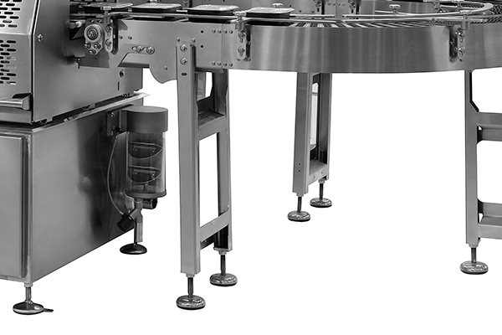
Screw
Bolt

