Slide 1
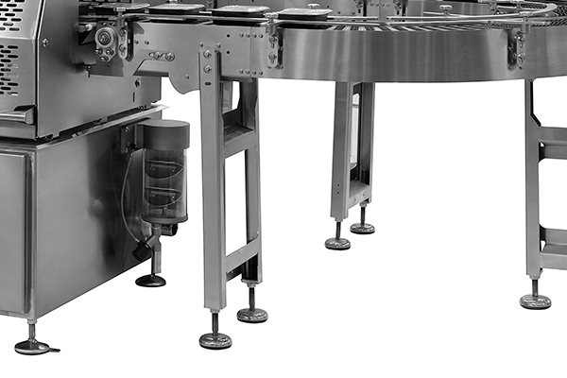
Screw
Bolt
Hinge

