Slide 1

SMART INDIA HACKATHON 2026
TITLE PAGE
Problem Statement ID – SIH26102
Problem Statement Title – Development of an AI-powered system to detect anomalies, fraud, and inefficiencies in MPLAD Scheme implementation regd.
Theme – Smart Automation
PS Category – Software
Team ID – <Team ID>
Team Name – <Team Name>

Slide 2
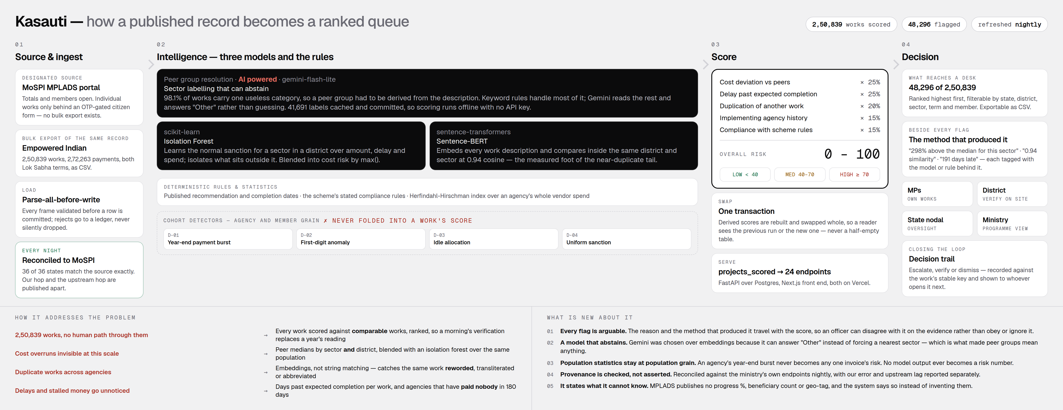
KASAUTI
<Team Name>
Proposed Solution (Describe your Idea/Solution/Prototype)
Detailed explanation of the proposed solution
How it addresses the problem
Innovation and uniqueness of the solution
DEMO VIDEO
2 minute walkthrough
PROTOTYPE
the running system
GITHUB
loader · scorer · API · tests

Slide 3
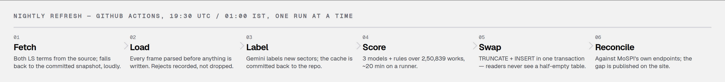
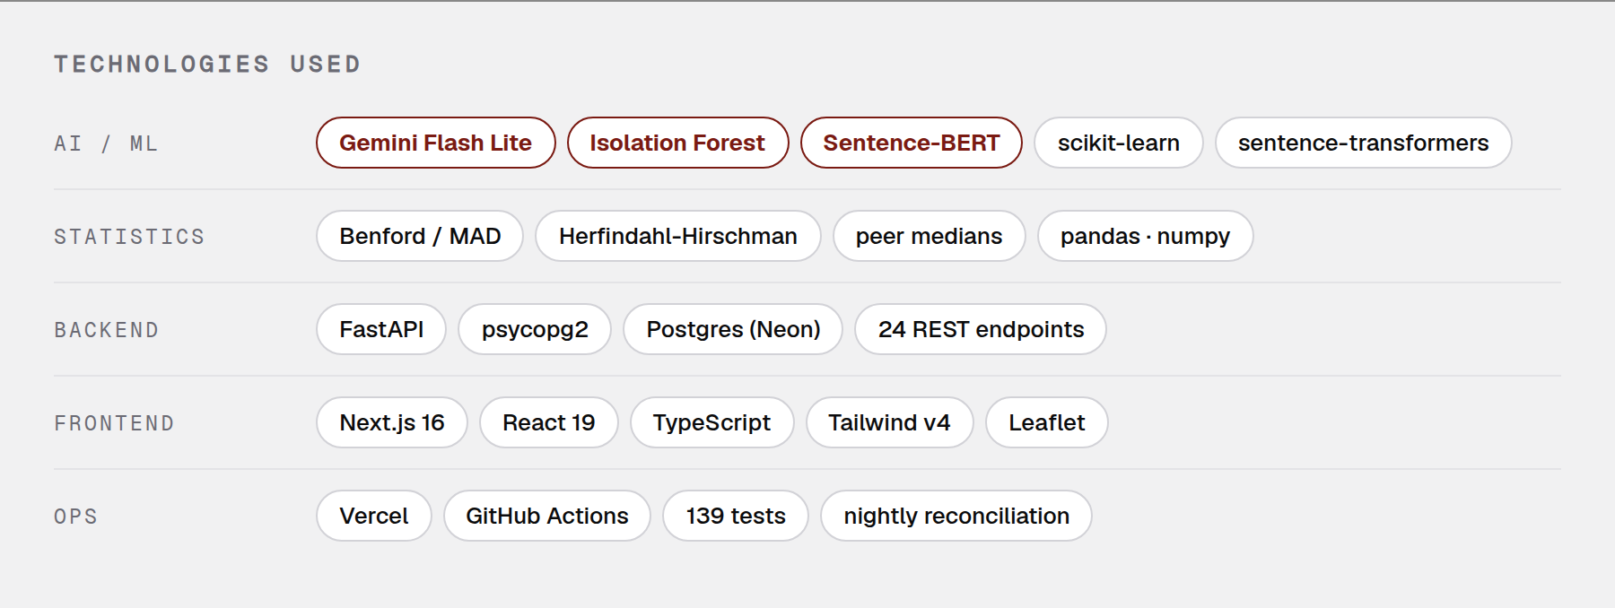
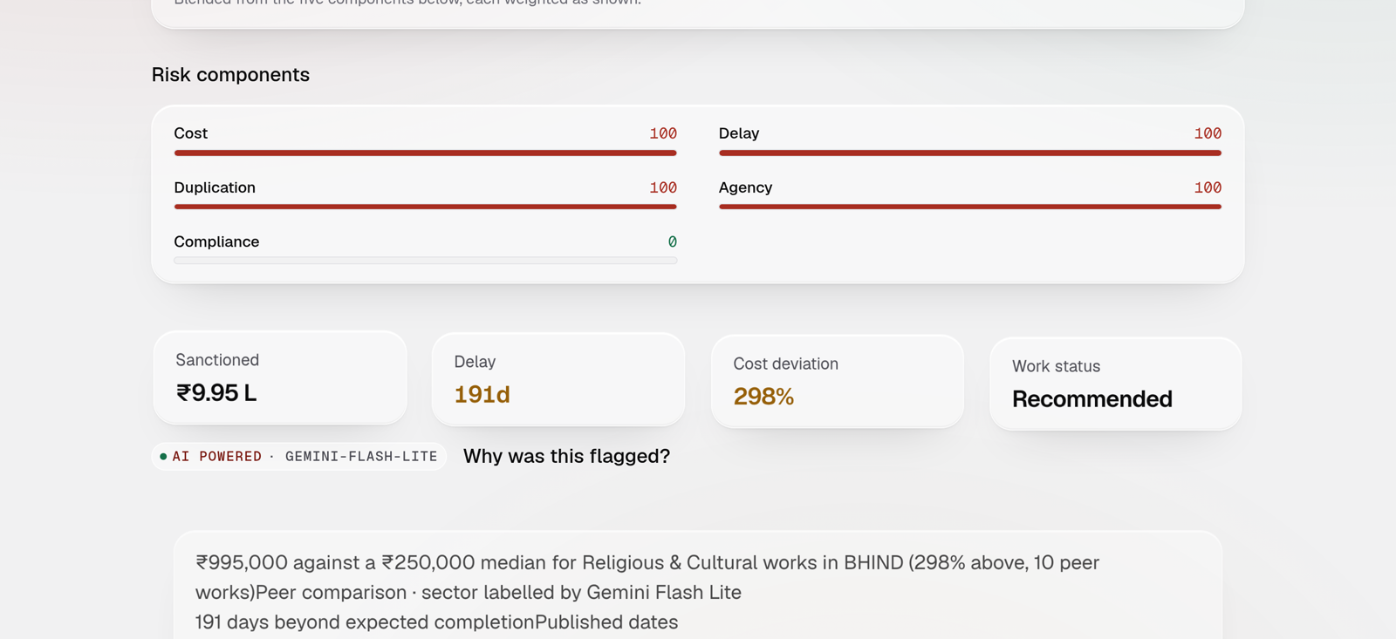
TECHNICAL APPROACH
<Team Name>
Technologies to be used (e.g. programming languages, frameworks, hardware)
Methodology and process for implementation (Flow Charts/Images/ working prototype)
Every flag carries the method that produced it — a scored work, live

Slide 4
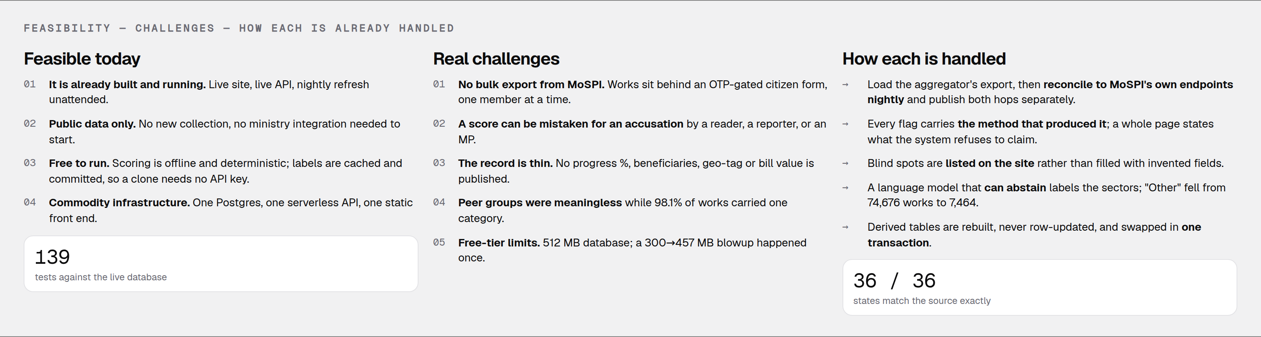
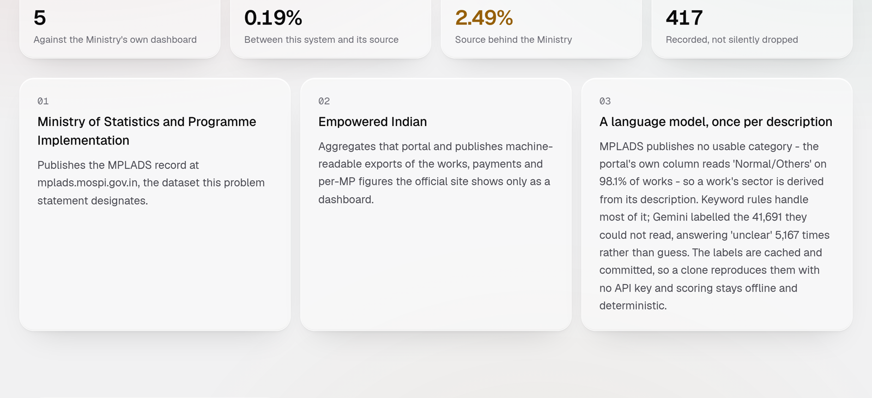
FEASIBILITY AND VIABILITY
<Team Name>
Analysis of the feasibility of the idea
Potential challenges and risks
Strategies for overcoming these challenges
Provenance is checked, not asserted.
Both hops are published separately — ours to the source, and the source to MoSPI — so a gap is never read as our error when it is upstream lag. Worst gap on the last run: 3.77%. 36 of 36 states match the source exactly.
DEMO VIDEO
2 minute walkthrough
PROTOTYPE
the running system
GITHUB
loader · scorer · API · tests

Slide 5
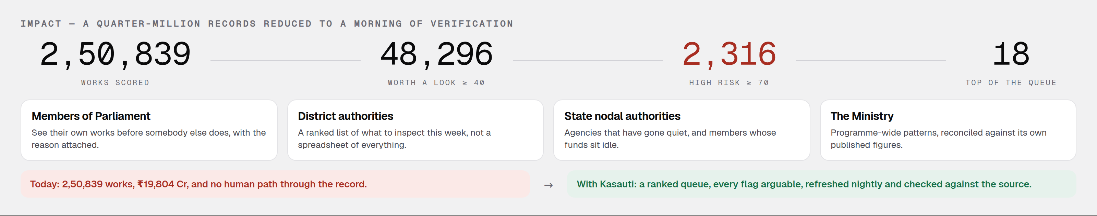
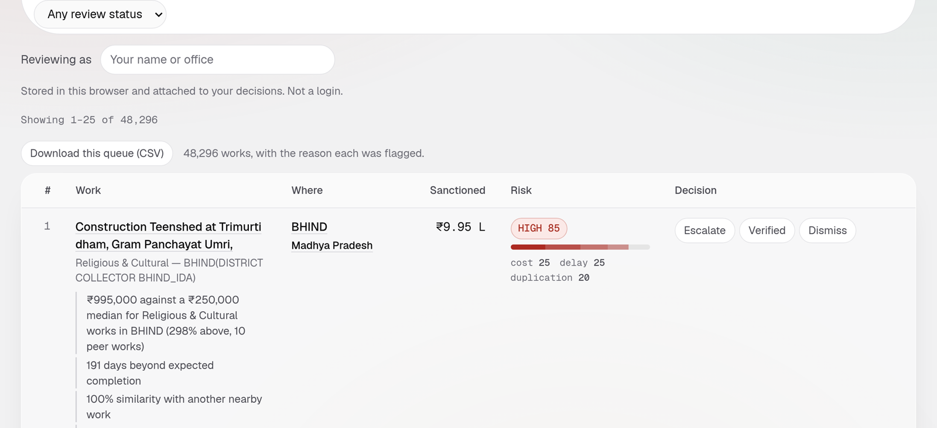
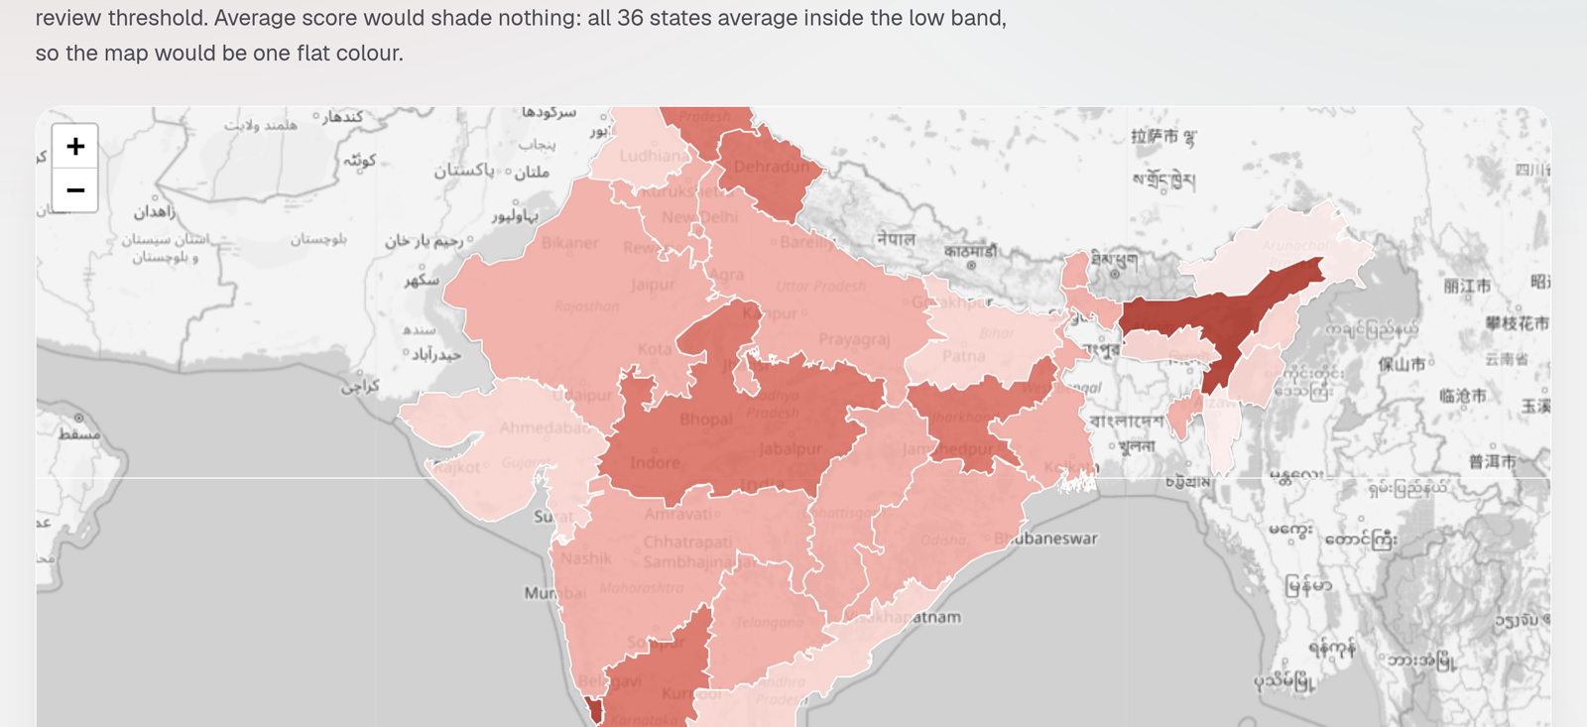
IMPACT AND BENEFITS
<Team Name>
Potential impact on the target audience
Benefits of the solution (social, economic, environmental, etc.)
The queue an official works through
Risk by state, every district covered

Slide 6
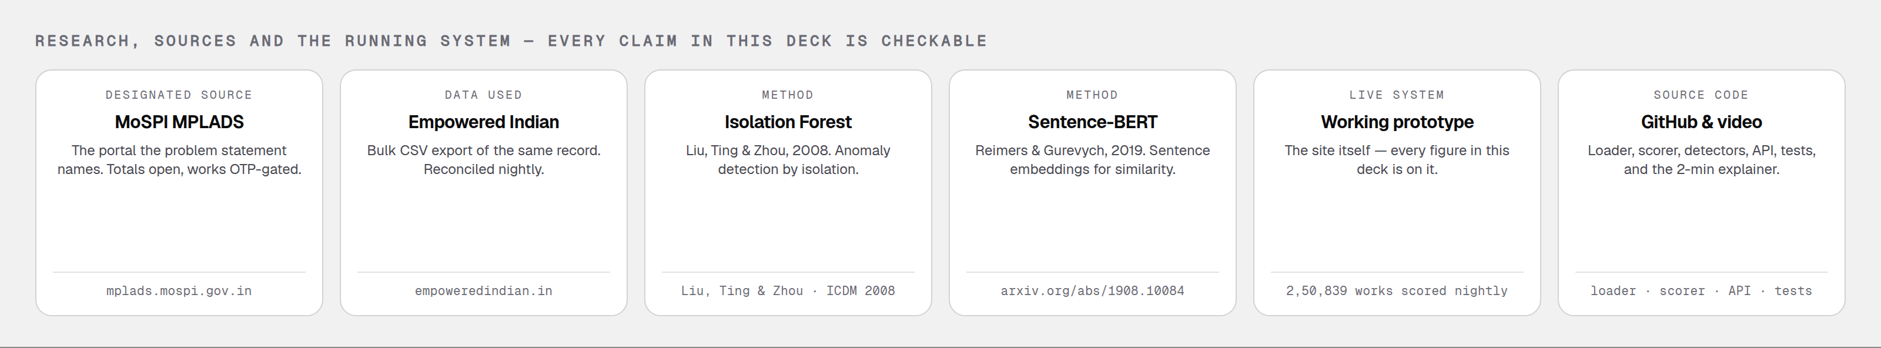
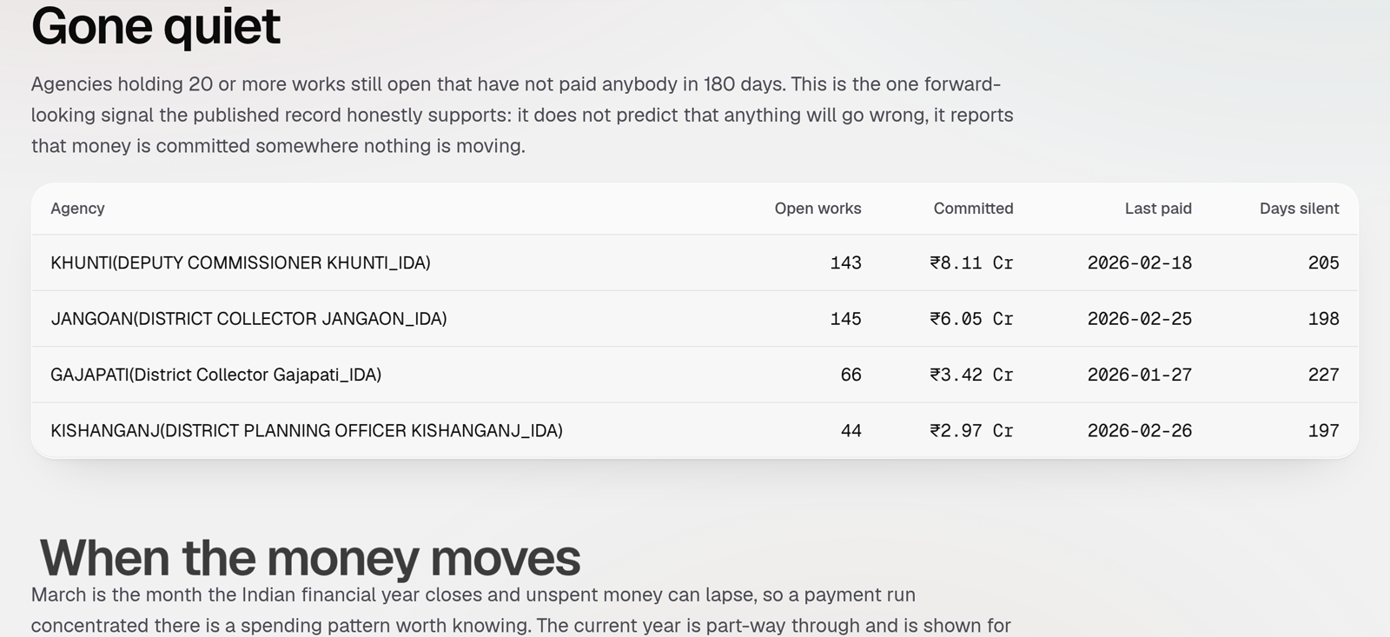
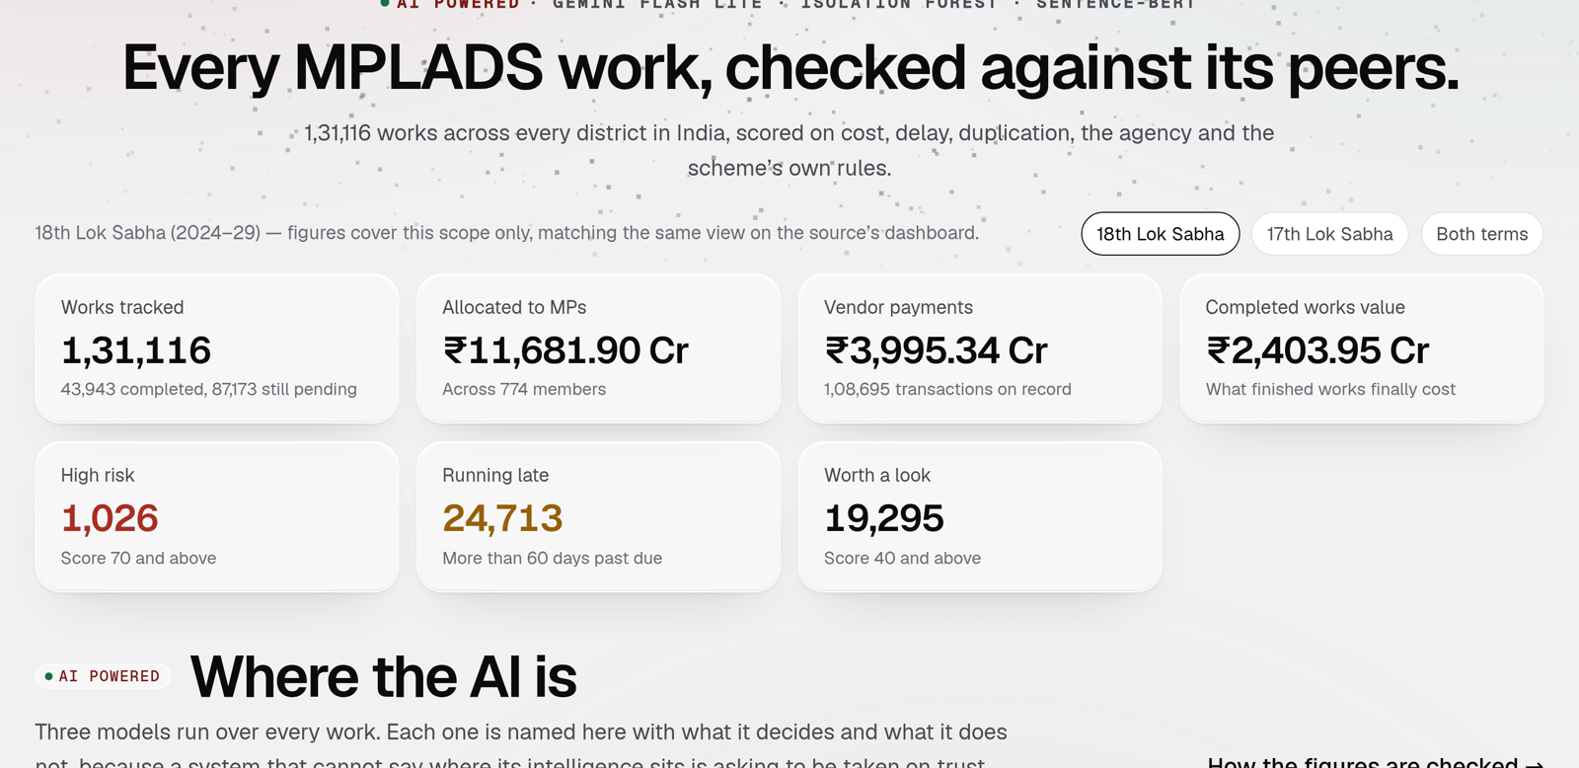
RESEARCH AND REFERENCES
<Team Name>
Details / Links of the reference and research work
Every figure in this deck is live on the prototype, refreshed nightly and reconciled against the ministry's own dashboard.
DEMO VIDEO
2 minute walkthrough
PROTOTYPE
the running system
GITHUB
loader · scorer · API · tests

Slide 7
IMPORTANT INSTRUCTIONS
Please ensure below pointers are met while submitting the Idea PPT:
Kindly keep the maximum slides limit up to six (6). ( Including the title slide)
Try to avoid paragraphs and post your idea in points /diagrams / Infographics /pictures
Keep your explanation precise and easy to understand
Idea should be unique and novel.
You can only use provided template for making the PPT without changing the idea details pointers (mentioned in previous slides).
You need to save the file in PDF and upload the same on portal. No PPT, Word Doc or any other format will be supported.
Note - You can delete this slide (Important Pointers) when you upload the details of your idea on SIH portal.

