Slide 1


Optimal Train Routing and Scheduling
Case Study – Final Presentation
Fabian Bleile, Sándor Daróczi, Simon Ramoser, Tobias Müller

Slide 2
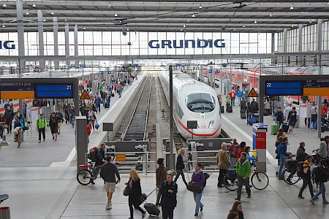
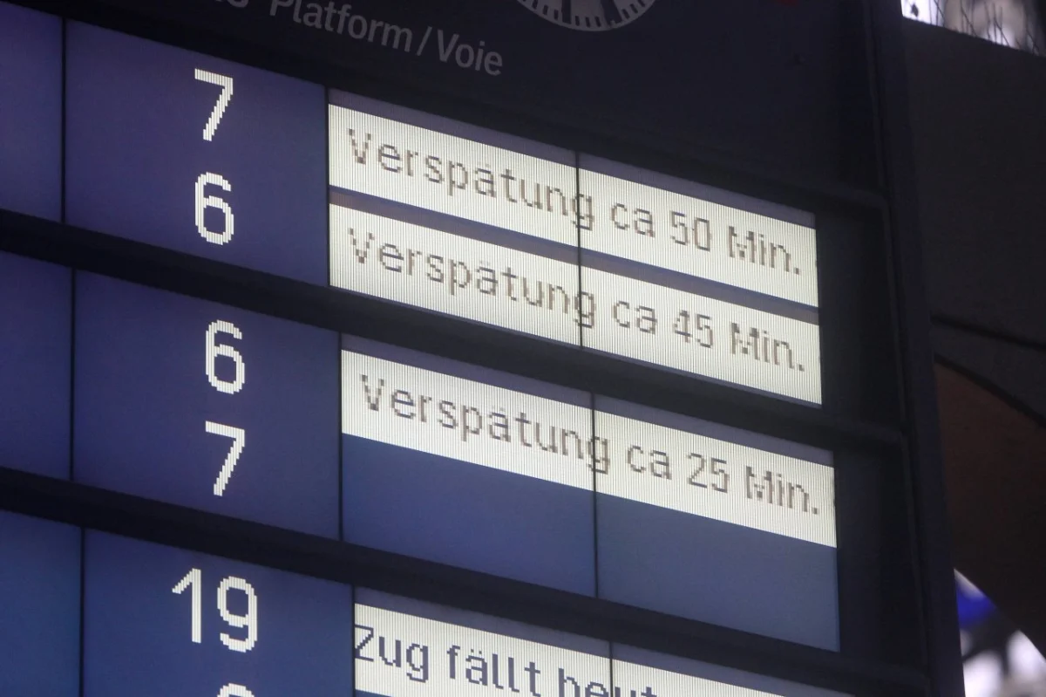
https://www.openpetition.de/petition/online/umsteigen-im-muenchner-hauptbahnhof-leichter-machen-bau-einer-zusaetzlichen-bahnsteigverbindung
https://www.derwesten.de/panorama/vermischtes/deutsche-bahn-zug-verspaetung-app-entschaedigung-ausfall-id233567353.html
No, not again!

Slide 3
Agenda
01
Problem Description
02
Combined Approach
03
Decoupled Approach
04
Experiments
05
Summary

Slide 4

Problem Description
Train 3
Train 2
Train 1
A
B
C
D

Slide 5



Problem Description
Train 3
Train 2
Train 1
$$\text{Delay} \text{= 20 }\text{min}$$
A
B
C
D
What should Trains 2 and 3 do to minimize overall delay?

Slide 6



Problem Description
Train 3
Train 2
Train 1
$$\text{Delay} \text{= 20 }\text{min}$$
A
B
Train 4
C
Conflict
D
Whole network might be affected
Exponentially many routes in general
It can be shown that the problem is NP-hard

Slide 7
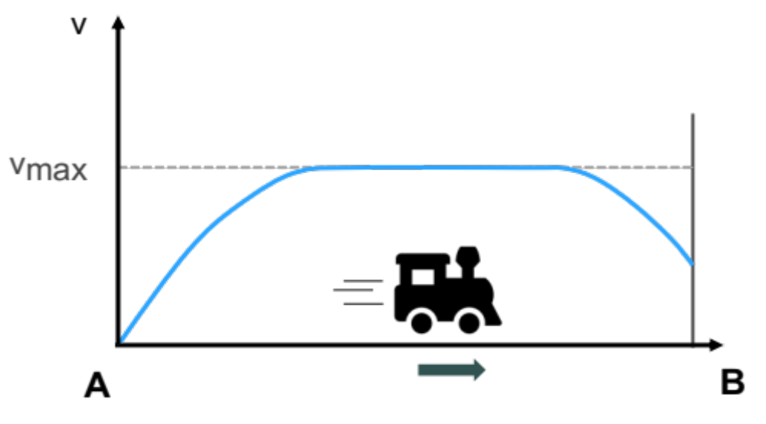
Problem Description
Additionally, train dynamics also have to be considered:
  Acceleration
  Braking
  Maximum speed
  …

Slide 8
Problem Description
Optimization Problem
1
Inputs
2
Goal
3
Objective

Slide 9



Problem Description
1
Inputs
Railway network with initial schedules and delays
Parameters for train dynamics
$$\text{Delay} \text{= 20 }\text{min}$$
A
B
$${\text{a}}_{\text{max}}$$
weight
$${\text{v}}_{\text{max}}$$
C
D

Slide 10



Problem Description
Optimization Problem
$$\text{Delay} \text{= 20 }\text{min}$$
1
Inputs
A
B
$${\text{a}}_{\text{max}}$$
weight
$${\text{v}}_{\text{max}}$$
C
D
2
Goal
3
Objective

Slide 11
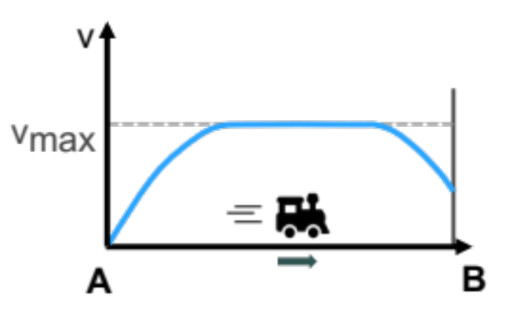
Problem Description
2
Goal
Compute a set of feasible routes and schedules
2. Determine speed profiles
A
B
C
D

Slide 12

Problem Description
Optimization Problem
$$\text{Delay} \text{= 20 }\text{min}$$
1
Inputs
A
B
$${\text{a}}_{\text{max}}$$
weight
$${\text{v}}_{\text{max}}$$
C
D
2
Goal
A
B
C
D
3
Objective

Slide 13
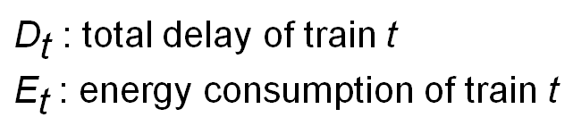
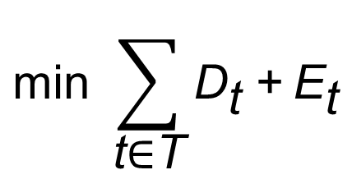
Problem Description
3
Objective
$${\text{min}}^{ }{\sum_{\text{t}\text{∈}\text{T}}{{\text{D}}_{\text{t}} \text{+}{ \text{E}}_{\text{t}}}}$$
${\text{D}}_{\text{t}}$ : total delay of train $\text{t}$
${\text{E}}_{\text{t}}$: energy consumption of train $\text{t}$

Slide 14
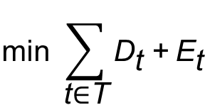
Problem Description
Optimization Problem
$$\text{Delay} \text{= 20 }\text{min}$$
1
Inputs
A
B
$${\text{a}}_{\text{max}}$$
weight
$${\text{v}}_{\text{max}}$$
C
D
2
Goal
A
B
C
D
$${\text{min}}^{ }{\sum_{\text{t}\text{∈}\text{T}}{{\text{D}}_{\text{t}} \text{+}{ \text{E}}_{\text{t}}}}$$
3
Objective

Slide 15
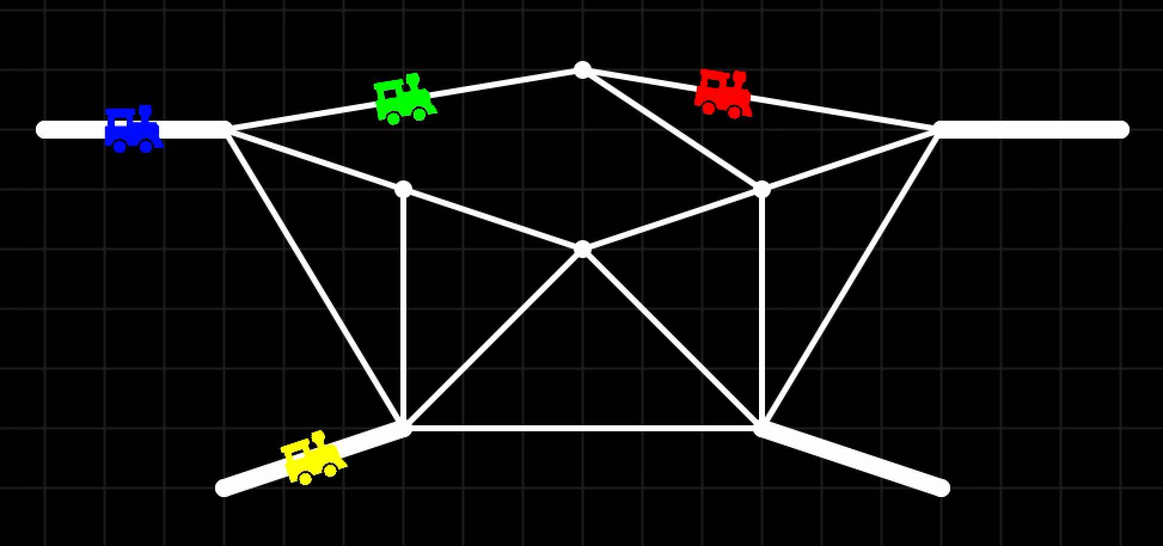
Desired Output

Slide 16
Agenda
01
Problem Description
02
Combined Approach
03
Decoupled Approach
04
Experiments
05
Summary

Slide 17
Dynamics: One Train, One Segment
segment

Slide 18
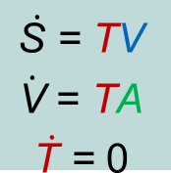
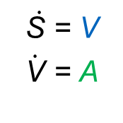




Dynamics: One Train, One Segment
$$\dot{\text{S} }\text{= }\text{V}$$
$$\dot{\text{V}}\text{ = }\text{A}$$
$$\dot{\text{S} }\text{= }\text{T}\text{V}$$
$$\dot{\text{V}} \text{= }\text{T}\text{A}$$
$$\dot{\text{T} }\text{=} \text{0}$$
$${\text{V}}_{\text{out}}$$
$${\text{V}}_{\text{in}}$$
$${\text{T}}_{\text{in}}$$
$${\text{T}}_{\text{out}}$$
T
segment

Slide 19
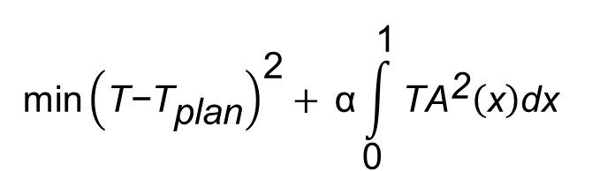
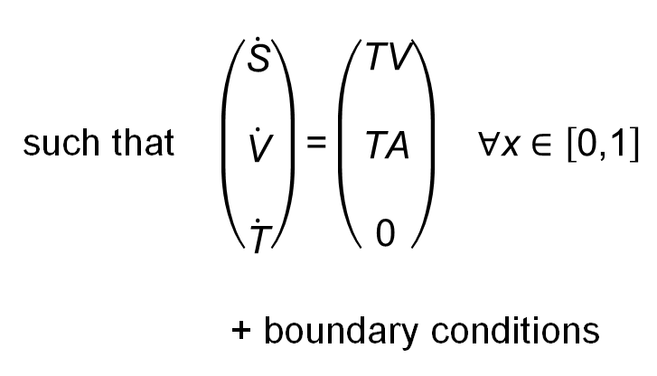
Optimal Control Problem
$$\text{min}{\left(\text{T}\text{−}{\text{T}}_{\text{plan}}\right)}^{\text{2}}+{\text{α}\int_{\text{0}}^{\text{1}}{{\text{T}\text{A}}^{\text{2}}\left(\text{x}\right)\text{d}\text{x} }}$$
such that $\left(\begin{aligned}\dot{\begin{aligned}\text{S} \\ \end{aligned}} \\ \dot{\begin{aligned}\text{V} \\ \end{aligned}} \\ \dot{\text{T}}\end{aligned}\right)\text{=}\left(\begin{aligned}\text{TV} \\ \\ \text{TA} \\ \\ \text{0}\end{aligned}\right) \text{∀}\text{x}\text{ ∈ }\left[\text{0,1}\right]$
+ boundary conditions

Slide 20
How to Merge the Segment Dynamics?
1
Preprocessing
2
Modeling
3
Solving

Slide 21
Preprocessing
1
Preprocessing
2
Modeling
Compute set of routes for each train
3
Solving
A
B
C
D

Slide 22













Optimization Model
1
Preprocessing
2
Modeling
For each train t : variables ${\text{R}}_{\text{1}}^{\text{t}}$, ${\text{R}}_{\text{2}}^{\text{t}} \text{∈ \{0,1\}}$
3
Solving
$${\text{T}}_{\text{0}}$$
$${\text{T}}_{\text{2}}$$
$${\text{T}}_{\text{1}}$$
$${\text{T}}_{\text{4}}$$
$${\text{T}}_{\text{5}}$$
$${\text{T}}_{\text{0}}$$
A
$${\text{T}}_{\text{1}}$$
$${\text{T}}_{\text{2}}$$
$${\text{T}}_{\text{3}}$$
$${\text{T}}_{\text{5}}$$
B
$${\text{T}}_{\text{6}}$$
$${\text{T}}_{\text{3}}$$
$${\text{T}}_{\text{4}}$$
C
D

Slide 23
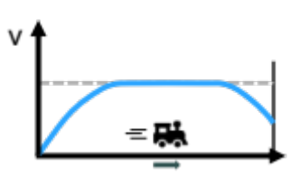






Optimization Model
1
Preprocessing
2
Modeling
3
Solving
$${\text{T}}_{\text{0}}$$
$${\text{T}}_{\text{1}}$$
$${\text{T}}_{\text{2}}$$
$${\text{T}}_{\text{3}}$$
$${\text{T}}_{\text{4}}$$
$${\text{T}}_{\text{5}}$$
A
B

Slide 24





Conflict Constraints
1
Preprocessing
2
Modeling
3
Solving
$${\text{T}}_{\text{0}}$$
$${\text{T}}_{\text{2}}$$
$${\text{T}}_{\text{1}}$$
$${\text{T}}_{\text{4}}$$
$${\text{T}}_{\text{5}}$$
$${\text{T}}_{\text{0}}$$
A
$${\text{T}}_{\text{1}}$$
$${\text{T}}_{\text{2}}$$
$${\text{T}}_{\text{3}}$$
$${\text{T}}_{\text{5}}$$
B
$${\text{T}}_{\text{6}}$$
$${\text{T}}_{\text{3}}$$
$${\text{T}}_{\text{2}}$$
$${\text{T}}_{\text{4}}$$
$${\text{T}}_{\text{1}}$$
$${\text{T}}_{\text{3}}$$
$${\text{T}}_{\text{0}}$$
C
D
$${\text{T}}_{\text{4}}$$

Slide 25
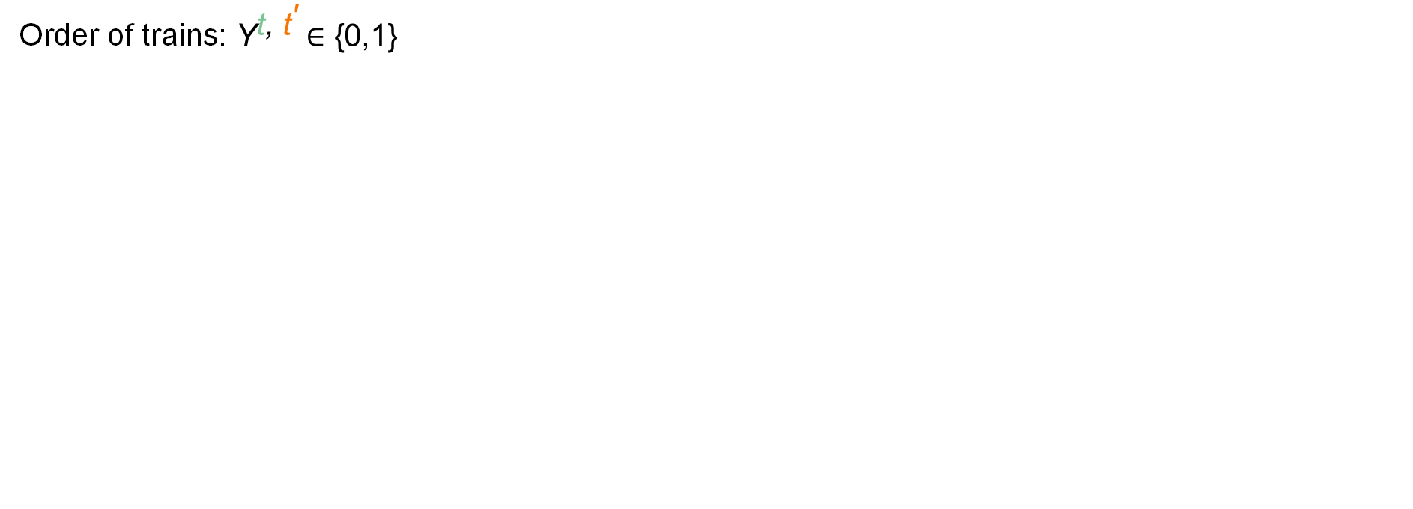





Conflict Constraints
1
Preprocessing
2
Modeling
Order of trains: ${\text{Y}}^{\text{t}\text{, }{\text{t}}^{\text{′}}} \text{∈ \{0,1\}}$
$${\text{T}}_{\text{3}}$$
$${\text{T}}_{\text{4}}$$
3
Solving
$${\text{T}}_{\text{2}}$$
$${\text{T}}_{\text{3}}$$
$${\text{T}}_{\text{3}} \text{≤ }{\text{T}}_{\text{3}} \text{+ }\text{M}\text{⋅} \text{(3}\text{ − }{\text{R}}^{\text{t}}\text{ − }{\text{R}}^{{\text{t}}^{\text{′}}}\text{−}{ \text{Y}}^{\text{t}\text{, }{\text{t}}^{\text{′}}}\text{)}$$
Green first
$${\text{T}}_{\text{4}} \text{≤ }{\text{T}}_{\text{2}} \text{+} \text{M}\text{⋅} \text{(3 −}{ \text{R}}^{\text{t}} \text{−} {\text{R}}^{{\text{t}}^{\text{′}}}\text{−} \text{(1 − }{\text{Y}}^{\text{t}\text{, }{\text{t}}^{\text{′}}}\text{)}\text{)}$$
Orange first

Slide 26

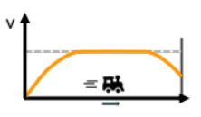
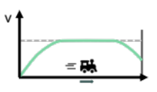


















Optimization Model Overview
1
Preprocessing
2
Modeling
Framework
Train rides
3
Solving
$${\text{T}}_{\text{0}}$$
$${\text{T}}_{\text{2}}$$
$${\text{T}}_{\text{1}}$$
$${\text{T}}_{\text{4}}$$
$${\text{T}}_{\text{5}}$$
…
$${\text{T}}_{\text{0}}$$
A
$${\text{T}}_{\text{1}}$$
$${\text{T}}_{\text{2}}$$
$${\text{T}}_{\text{3}}$$
$${\text{T}}_{\text{3}}$$
$${\text{T}}_{\text{5}}$$
B
$${\text{T}}_{\text{6}}$$
…
$${\text{T}}_{\text{2}}$$
$${\text{T}}_{\text{4}}$$
C
$${\text{T}}_{\text{1}}$$
$${\text{T}}_{\text{3}}$$
D
$${\text{T}}_{\text{0}}$$
$${\text{T}}_{\text{4}}$$
…
Mixed Integer Optimal Control Problem

Slide 27
Solving the Problem
1
Preprocessing
2
Modeling
3
Solving
Direct multiple shooting
(with forward Euler)
Mixed Integer Optimal Control Problem
Mixed Integer Nonlinear Program

Slide 28
Agenda
01
Problem Description
02
Combined Approach
03
Decoupled Approach
04
Experiments
05
Summary

Slide 29
Combined vs. Decoupled Approach
Combined
Decoupled

Slide 30


Combined vs. Decoupled Approach
Combined
Decoupled
Network, Schedule
Mixed Integer Optimal Control Program (MIOCP)
Solution
Trains

Slide 31
Combined vs. Decoupled Approach
Decoupled
Combined
Network, Schedule
Mixed Integer LP
One route per train
Train order
Combined Approach
Solution
Trains
Route-based ansatz (simplified dynamics)
Segment-based ansatz (no dynamics)

Slide 32
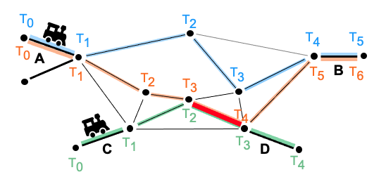




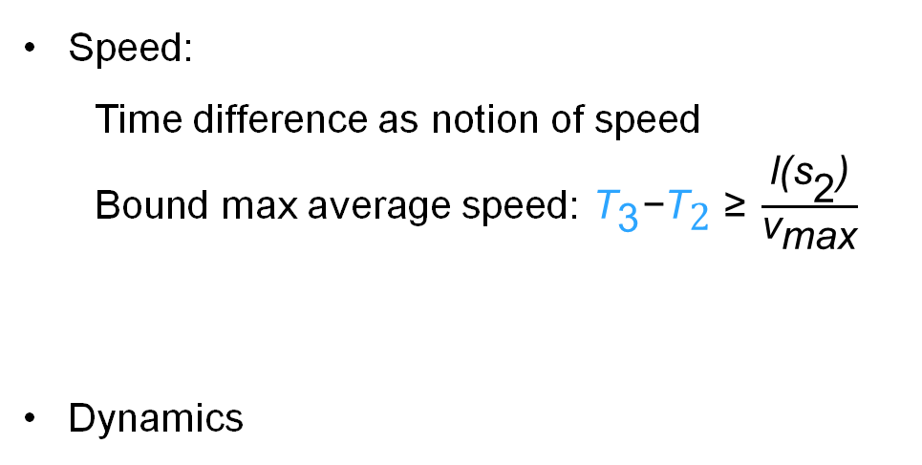
Route-based Ansatz
What to keep
What changes
Preprocessing routes
Conflict constraints
Speed:
  Time difference as notion of speed
  Bound max average speed: ${\text{T}}_{\text{3}}\text{−}{\text{T}}_{\text{2}} \text{≥ }\frac{\text{l}\text{(}{\text{s}}_{\text{2}}\text{)}}{{\text{v}}_{\text{max}}}$
Dynamics
$${\text{T}}_{\text{2}}$$
$${\text{T}}_{\text{3}}$$
$${\text{s}}_{\text{2}}$$
$${\text{T}}_{\text{3}} \text{≤ }{\text{T}}_{\text{3}} \text{+ }\text{M} \text{(}\text{3} \text{− }{\text{R}}^{\text{t}}\text{ − }{\text{R}}^{{\text{t}}^{\text{′}}}\text{−}{\text{Y}}^{\text{t}\text{, }{\text{t}}^{\text{′}}}\text{)}$$

Slide 33


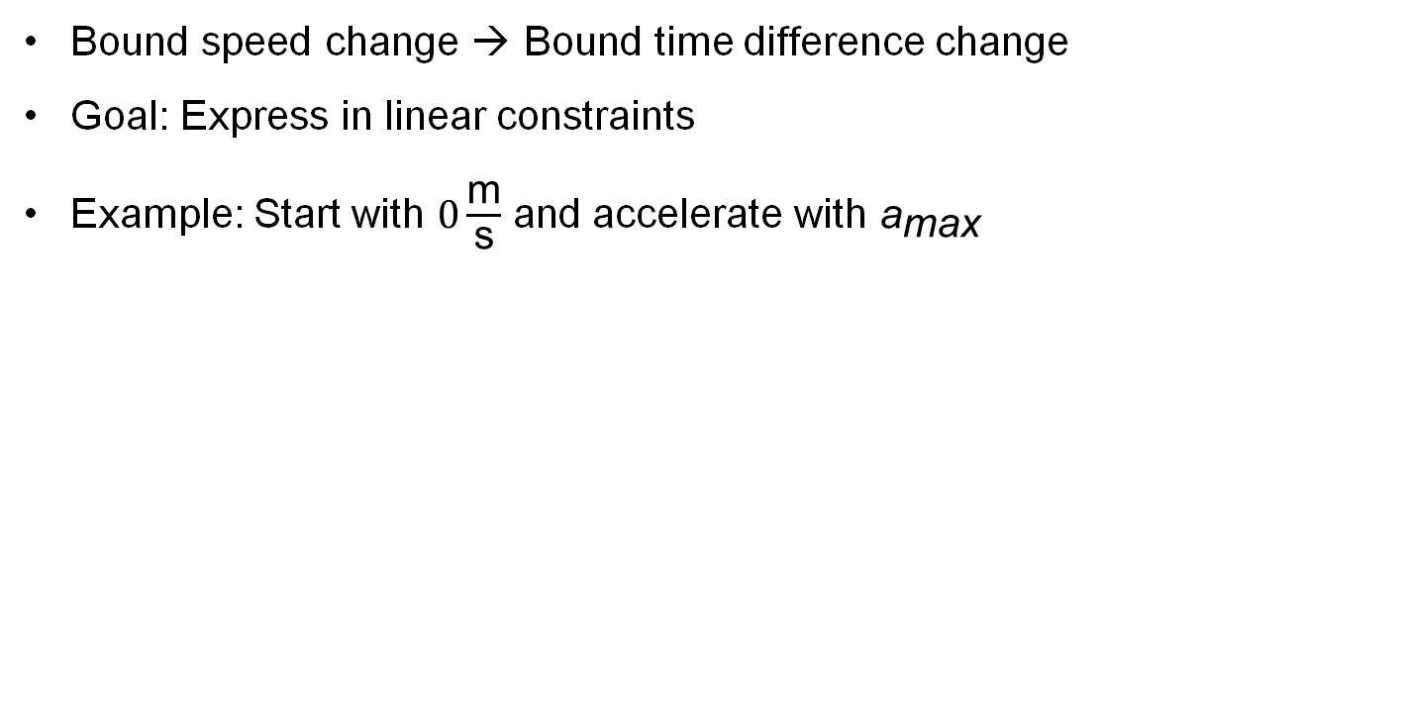








Linearized Dynamics
Bound speed change → Bound time difference change
Goal: Express in linear constraints
Example: Start with $0\frac{\text{m}}{\text{s}}$ and accelerate with ${\text{a}}_{\text{max}}$
$${\text{T}}_{\text{1}}$$
$${\text{s}}_{\text{1}}$$
$${\text{T}}_{\text{2}}$$
$${\text{s}}_{\text{2}}$$
$${\text{T}}_{\text{3}}$$
$${\text{s}}_{\text{3}}$$
$${\text{T}}_{\text{4}}$$
$${\text{s}}_{\text{4}}$$
$${\text{T}}_{\text{5}}$$
$${\text{length}\text{(}\text{s}}_{\text{i}}\text{)} \text{=} \text{1000} \text{m}$$

Slide 34








Time difference bounds: Example
Speed $\text{v}$
$${\text{v}}_{\text{max}}$$
T₂ – T₁ = 100s; T₃ – T₂ = 55s → f(100) ≥ 55
T₃ – T₂ = 55s; T₄ – T₃ = 45s → f(55) ≥ 45
…
$$= 1000m$$
Time t
$${\text{T}}_{\text{1}}$$
$$=0$$
$${\text{T}}_{\text{2}}$$
$${\text{T}}_{\text{3}}$$
$${\text{T}}_{\text{4}}$$
$${\text{T}}_{\text{5}}$$
100s
55s
45s
37s

Slide 35
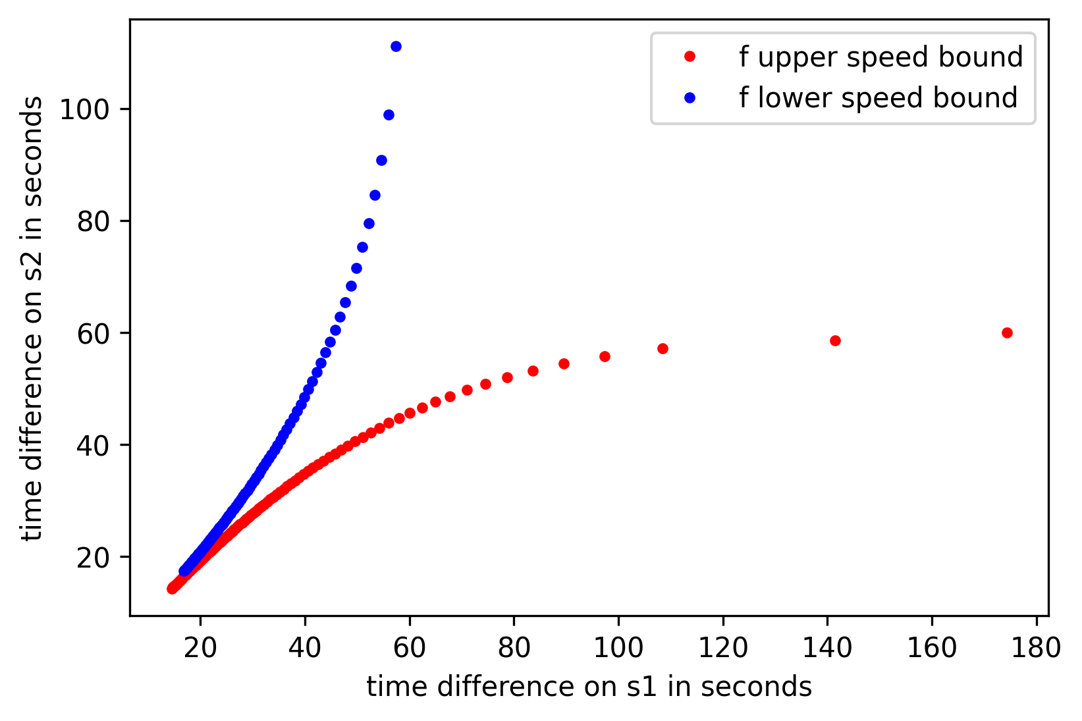







Time difference bounds
g
(40 s, 50 s)
$${\text{T}}_{\text{i}}$$
$${\text{T}}_{\text{i}\text{+1}}$$
$$1000m$$
$${\text{s}}_{\text{i}}$$
(100 s, 55 s)
(55 s, 45 s)
$${\text{T}}_{\text{i}\text{−1}}$$
$${\text{T}}_{\text{i}}$$
$$1000m$$
$${\text{s}}_{\text{i}\text{−1}}$$
Notes:
v_max = 70, granularity = 1000, acc_max = 0.1

Slide 36
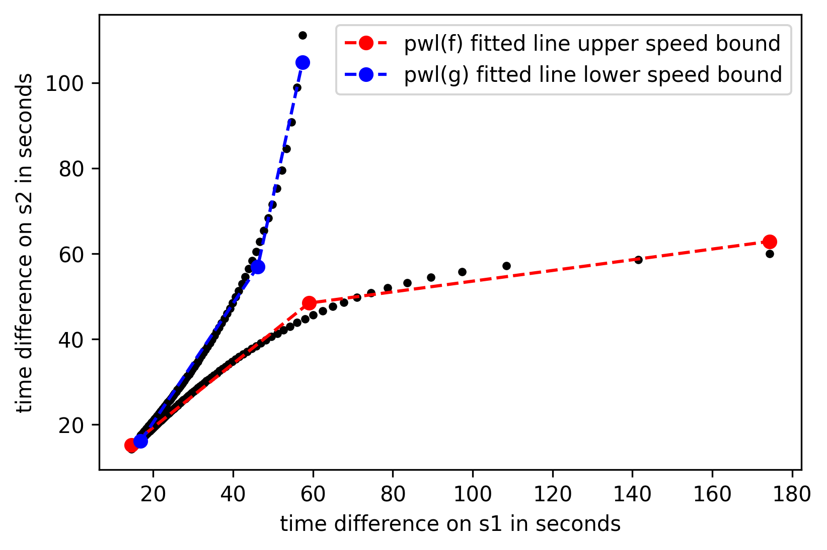
Linearized Dynamics: PWL Approximation
Feasible speed changes
$${\text{T}}_{\text{i}}$$
$${\text{T}}_{\text{i}\text{+1}}$$
$$1000m$$
$${\text{s}}_{\text{i}}$$
(100 s, 80 s)
$${\text{T}}_{\text{i}\text{−1}}$$
$${\text{T}}_{\text{i}}$$
$$1000m$$
$${\text{s}}_{\text{i}\text{−1}}$$
Notes:
v_max = 70, granularity = 1000, acc_max = 0.1

Slide 37
Linearized Dynamics: Example
Green train: output of MILP with dynamics modeled with linear constraints
Red train: output of combined approach
velocity in m/s
distance in m
Notes:
v_max = 70, granularity = 4000, acc_max = 0.1

Slide 38
Segment-based Ansatz
Network, Schedule
Mixed Integer LP
One route per train
Train order
Combined Approach
Solution
Trains
Route-based ansatz (simplified dynamics)
Segment-based ansatz (no dynamics)

Slide 39





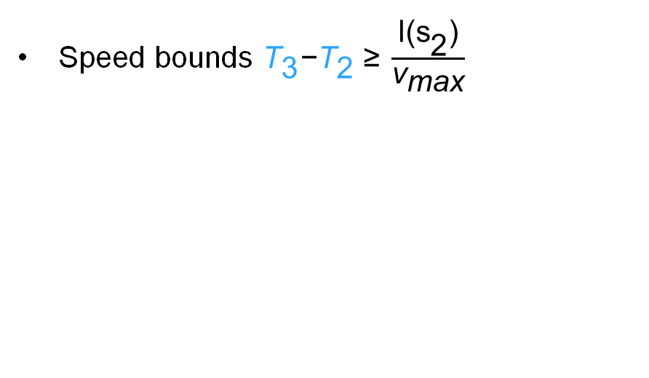


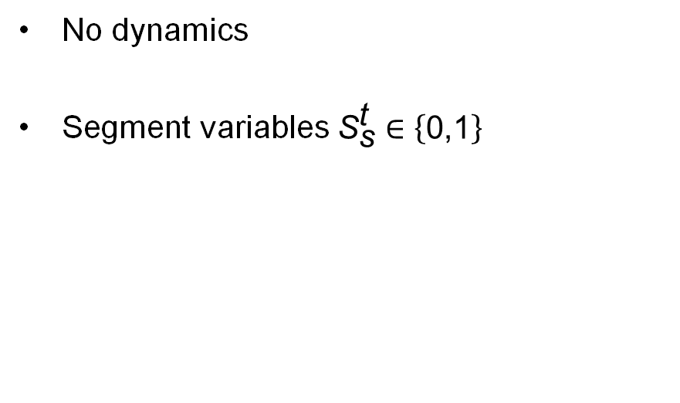


Segment-based Ansatz
What to keep
What changes
Conflict constraints
Speed bounds ${\text{T}}_{\text{3}}\text{−}{\text{T}}_{\text{2}} \text{≥ }\frac{\text{l}\text{(}{\text{s}}_{\text{2}}\text{)}}{{\text{v}}_{\text{max}}}$
No dynamics
Segment variables ${\text{S}}_{\text{s}}^{\text{t}}∈\left\{\text{0,1}\right\}$
$${\text{T}}_{\text{2}}$$
$${\text{T}}_{\text{3}}$$
$${\text{s}}_{\text{2}}$$
$${\text{T}}_{\text{3}} \text{≤ }{\text{T}}_{\text{3}} \text{+ }\text{M}\text{⋅} \text{(3}\text{ − }{\text{S}}^{\text{t}}\text{ − }{\text{S}}^{{\text{t}}^{\text{′}}}\text{−}{\text{Y}}^{\text{t}\text{, }{\text{t}}^{\text{′}}}\text{)}$$
$${\text{T}}_{\text{3}} \text{≤ }{\text{T}}_{\text{3}} \text{+ }\text{M}\text{⋅} \text{(3}\text{ − }{\text{R}}^{\text{t}}\text{ − }{\text{R}}^{{\text{t}}^{\text{′}}}\text{−}{\text{Y}}^{\text{t}\text{, }{\text{t}}^{\text{′}}}\text{)}$$
$${\text{T}}_{\text{3}}$$
$${\text{T}}_{\text{4}}$$
$${\text{T}}_{\text{2}}$$
$${\text{T}}_{\text{3}}$$
Notes:
Say: „Routes will be determined by segment variables“

Slide 40
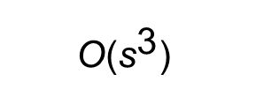
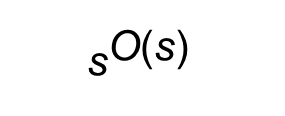
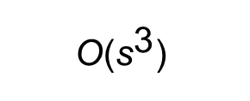
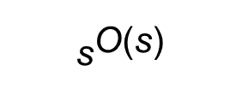
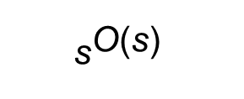
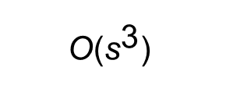
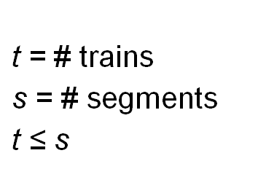
Model Complexity
Binary
Variables
Nonlinear Constraints
$\text{t}\text{ =}$ # trains
$\text{s}\text{ =}$ # segments
$$\text{t}\text{ ≤ }\text{s}$$
Combined
$${\text{s}}^{\text{O}\text{(}\text{s}\text{)}}$$
$${\text{s}}^{\text{O}\text{(}\text{s}\text{)}}$$
Decoupled
route-based
$${\text{s}}^{\text{O}\text{(}\text{s}\text{)}}$$
$$\text{O}\text{(}{\text{s}}^{\text{3}}\text{)}$$
Decoupled
segment-based
$$\text{O}\text{(}{\text{s}}^{\text{3}}\text{)}$$
$$\text{O}\text{(}{\text{s}}^{\text{3}}\text{)}$$
Notes:
Theoretically, that‘s nice, but let‘s see how this looks in practice!

Slide 41
Agenda
01
Problem Description
02
Combined Approach
03
Decoupled Approach
04
Experiments
05
Summary

Slide 42
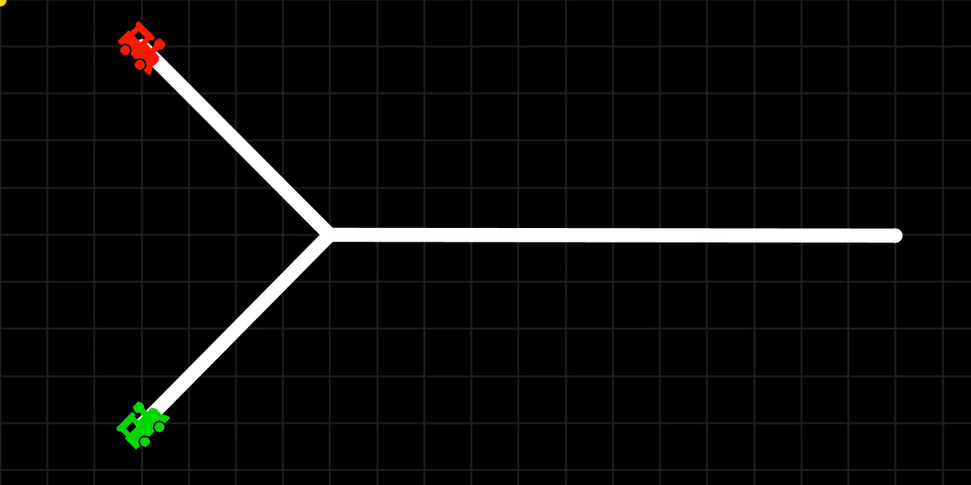
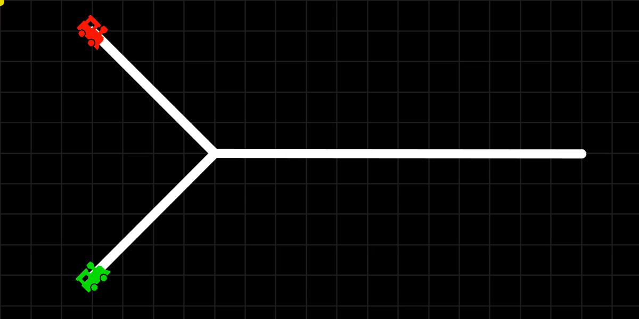
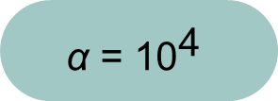
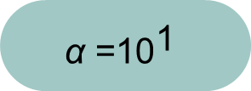
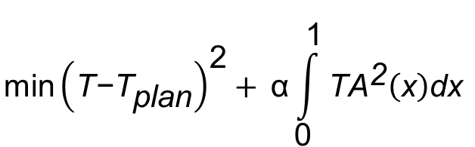
Choice of $\text{α}$
$$\text{min}{\left(\text{T}\text{−}{\text{T}}_{\text{plan}}\right)}^{\text{2}}+{\text{α}\int_{\text{0}}^{\text{1}}{{\text{TA}}^{\text{2}}\left(\text{x}\right)\text{dx} }}$$
$$\text{α}\text{ =}{\text{10}}^{\text{1}}$$
$$\text{α}\text{ = }{\text{10}}^{\text{4}}$$

Slide 43
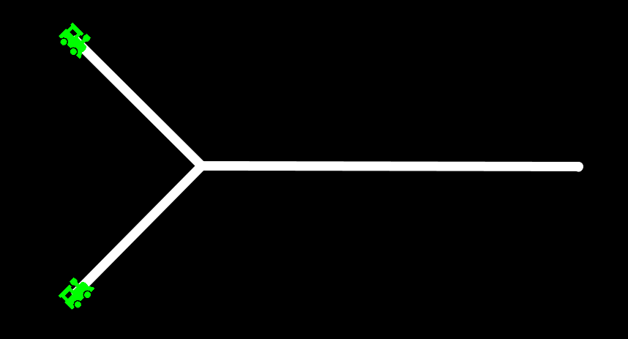
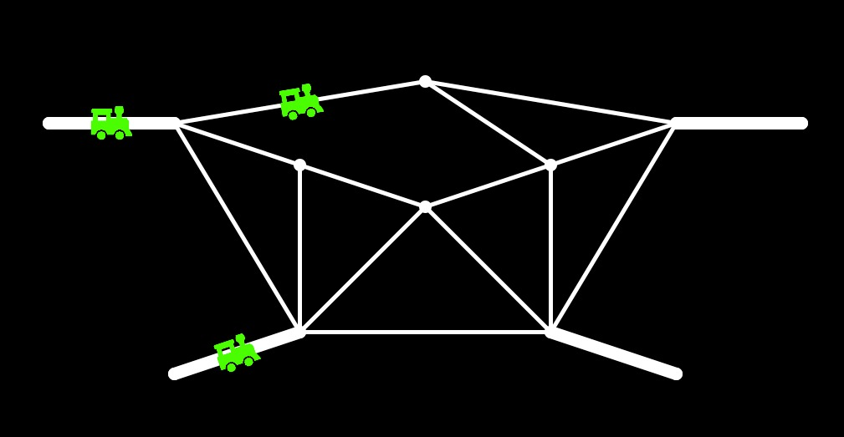
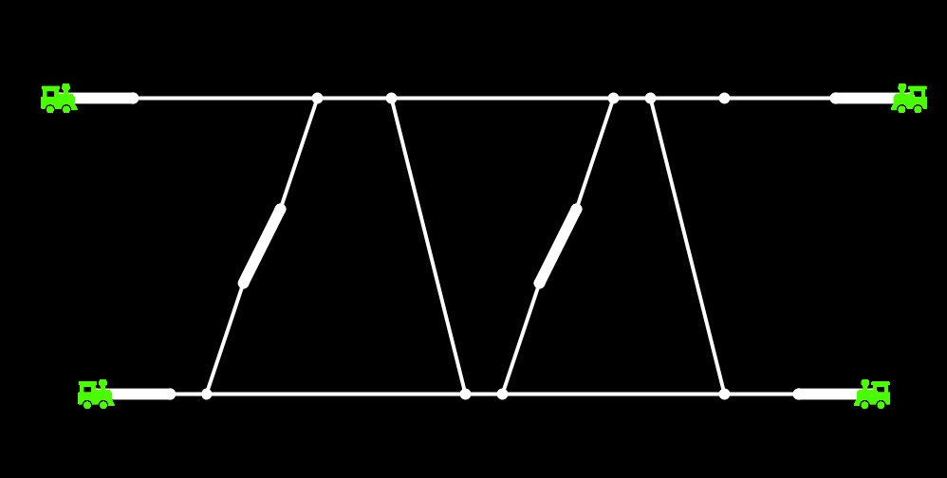
Test Examples
Y-Network
Intro Example
CAIMI (Literature)
3 Segments
2 Trains
17 Segments
4 Trains
23 Segments
4 Trains

Slide 44
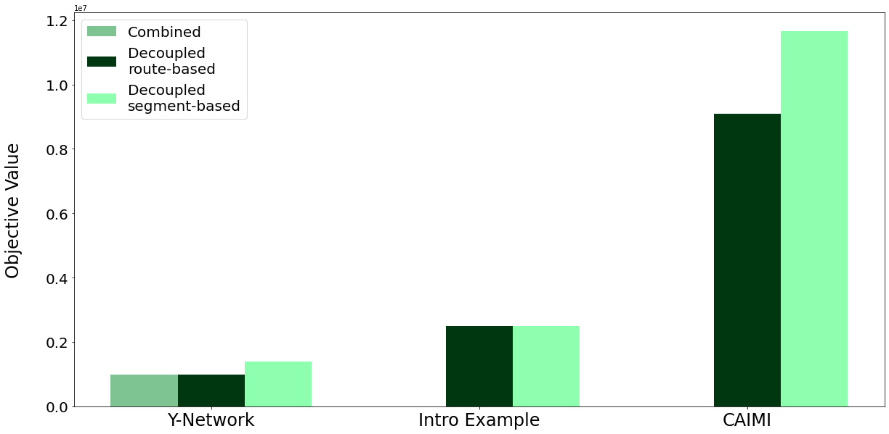
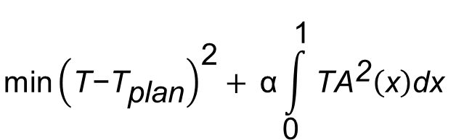
Total Objective
$$\text{min}{\left(\text{T}\text{−}{\text{T}}_{\text{plan}}\right)}^{\text{2}}+{\text{α}\int_{\text{0}}^{\text{1}}{{\text{TA}}^{\text{2}}\left(\text{x}\right)\text{dx} }}$$

Slide 45
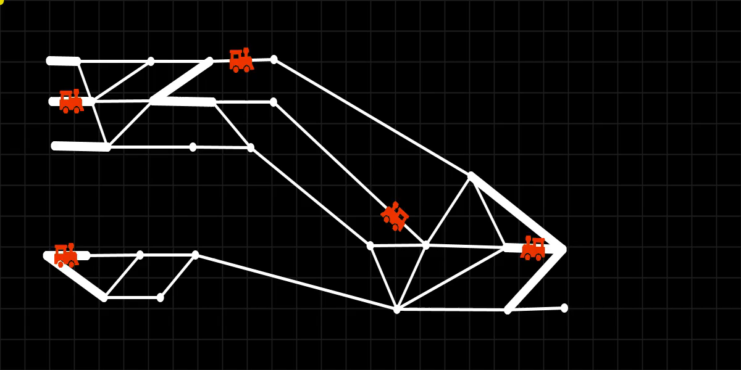
Decoupled Route-based vs. Segment-based
Green trains: output route-based
Red trains: output segment-based
40 Segments
5 Trains
Notes:
Motivation: in reality multiple complex parts (stations) are connected via few (long) segments

Slide 46
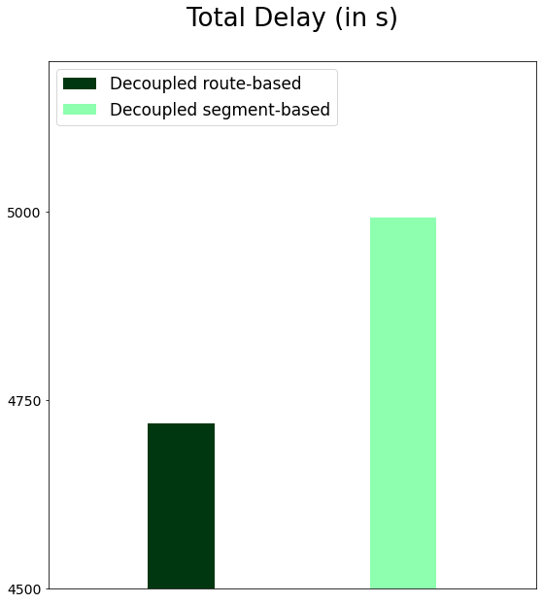
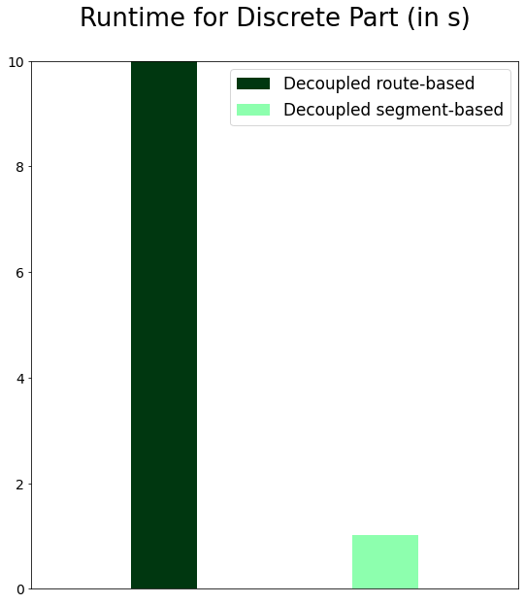
Decoupled Route-based vs. Segment-based

Slide 47
Agenda
01
Problem Description
02
Combined Approach
03
Decoupled Approach
04
Experiments
05
Summary

Slide 48

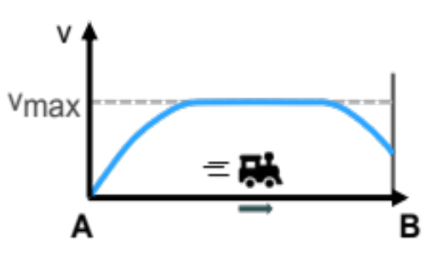


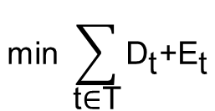
Summary
Problem
Input
Output
Objective
A
B
A
B
$${\text{min}}^{ }{\sum_{\text{t}\text{∈}\text{T}}{{\text{D}}_{\text{t}}\text{+}{\text{E}}_{\text{t}}}}$$
B
$${\text{a}}_{\text{max}}$$
weight
$${\text{v}}_{\text{max}}$$

Slide 49
Summary
Problem
Input
Output
Objective
Approach
B

Slide 50
Summary
Approach
Combined
Decoupled
B

Slide 51
Summary
Problem
Input
Output
Objective
Approach
Combined
Decoupled
B
Combined:
More accurate
Conclusion
Decoupled:
More efficient

Slide 52
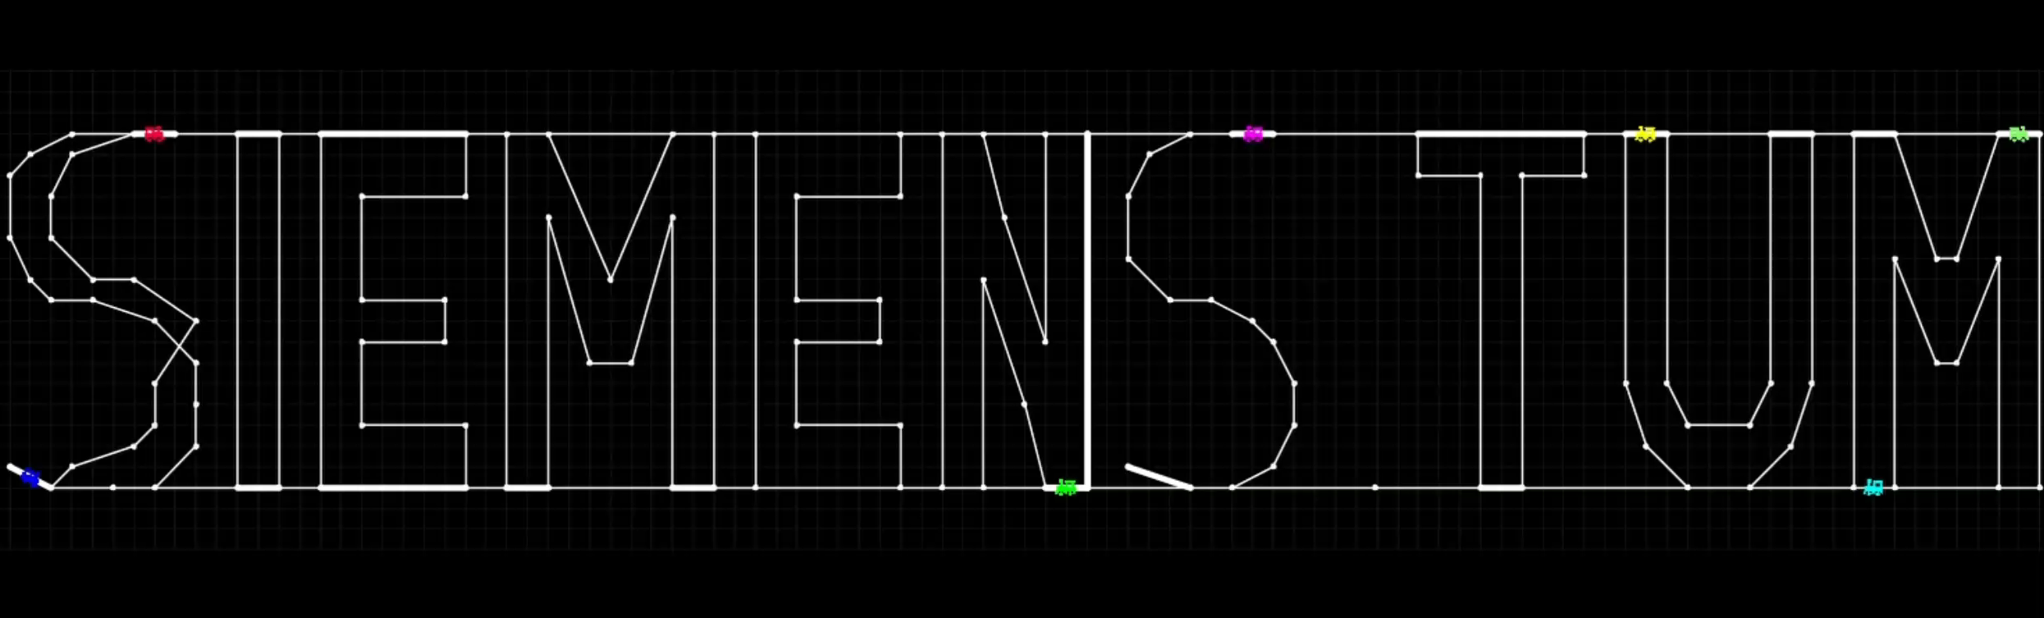
Notes:
This example has:
159 segments
134 connectors
20 stations
9 trains
Interesting fact about runtime:
~4min for dynamic part
~12min for discrete part
→ now, the discrete part is the computational bottleneck

Slide 53
Backup-Slides

Slide 54
Egal wie gut du fährst, Züge fahren Güter.
~ Jan Delay

Slide 55
Outlook
What have we done additionally?
Greedy algorithm by Fabi
Heuristic Conflict Based Search (CBS)
Model dynamics as path through speed graph (nodes = different speeds and edge if train can reach next speed in next segment)
Refine pwl dynamics by simplifying dynamics around stations
…
What could have been done?
Segment-based combined approach
Job-shop scheduling for solving the discrete part (segments = machines, trains = jobs)
Multi-commodity flow for solving discrete part
Separation Oracle for route-based discrete parts (?)
Choose only ‚good‘ routes from the exponential-sized set of routes
Merge decoupled approaches to solve huge networks
Solve local areas and combine to solve huge networks
Reduce conflict constraints when conflict is unlikely (relevant for route-based approach)

Slide 56
Assumptions for simplification
• Trains have no length
• A train arrives at a station once it reaches the exact center of the corresponding segment
• We do not respect complex physical laws, so only basic physics are assumed

Slide 57
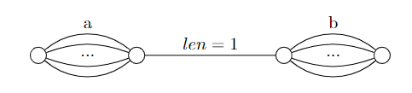








Hardness

Slide 58



Moving Trains in decoupled approach
Decoupled approach
The simpler the dynamics in MILP - the higher the approximation error
Approximation error 2 trains, one switch
(MILP) Compute routes and track occupancy using
simplified dynamics
(OCP) Compute optimal trajectories

Slide 59
Approximation Error Example
Red train
max speed 40 m/s
lightweight
Minimize sum of delays here
Blue train
max speed same as red
heavyweight
Which train enters the common segment first?
Optimal: Red before Blue Train

Slide 60
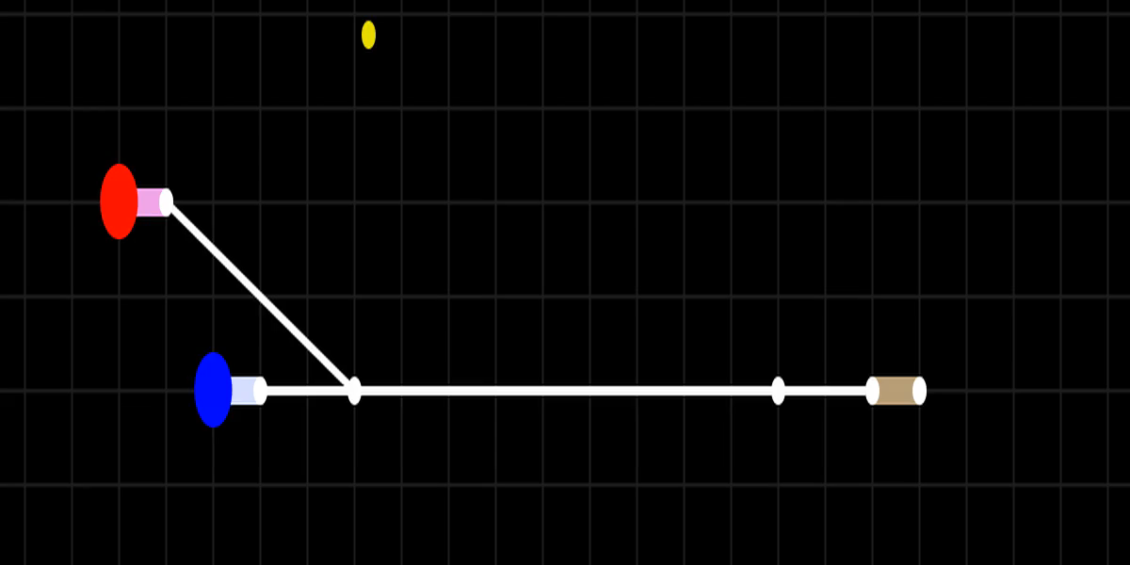
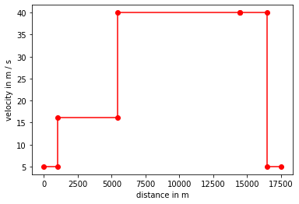
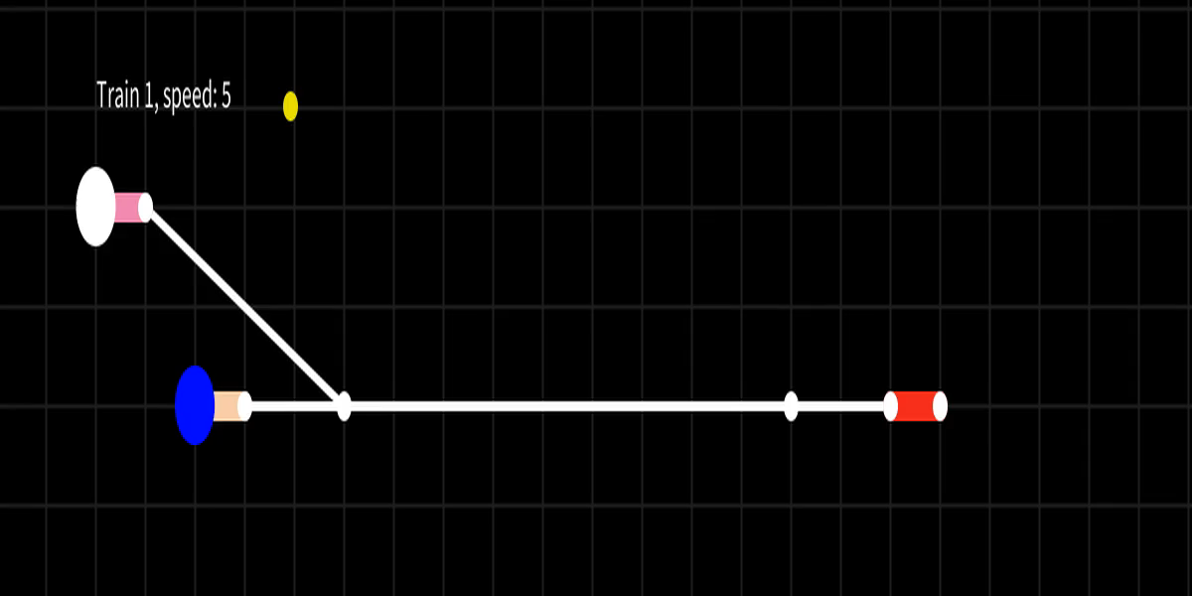

Spectrum of 'simplified dynamics'
No dynamics: arbitrary speed changes from segment to segment
PWL-approximated dynamics: controlled speed changes on subsegments

Slide 61


Segment-based Ansatz
Binary decision variables
Routes (sequence of segments) for each train (${\text{S}}_{\text{s}}^{\text{t}}∈\{0,1\}$)
Train order on segments for each pair of trains (${\text{Y}}_{\text{s}}^{\text{tt}\text{′}}∈\{0,1\}$)
…
Continuous decision variables
Segment occupation intervals ${[α}_{\text{s}}^{\text{t}},β_{\text{s}}^{\text{t}}]⊆ℝ_{+}$
…
Segment occupation for segment s
$${\text{β}}_{}^{\text{t}} \text{≥}{ \text{α}}_{}^{\text{t}} \text{+} {\text{W}}_{}^{\text{t}} \text{+} \frac{\text{l}\text{(}\text{s}\text{)}}{{\text{v}}_{\text{t}}^{ \text{m}\text{ax}}} \text{⋅}{ \text{S}}_{}^{\text{t}} \text{∀} \text{t} \\ {\text{α}}_{}^{\text{t}} \text{≥}{ \text{β}}_{}^{\text{t}\text{′}}\text{ −} \text{M} \text{⋅}{ \text{(}\text{3} \text{−} \text{S}}_{}^{\text{t}}\text{ −}{ \text{S}}_{}^{\text{t}\text{′}}\text{−}{\text{Y}}_{}^{\text{t}{\text{t}\text{′}}^{}}\text{)} \text{∀} \text{t}\text{, }\text{t}\text{′}$$

Slide 62


Total Delay
$$\text{T}\text{−}{\text{T}}_{\text{plan}}$$

Slide 63

Runtime
Notes:
Questions
Which models are most complex (number of binary variables, non-linear constraints, …)
Is the complexity reflected in the runtime of the corresponding pipelines?
Assumption: w.l.o.g. trains cannot go over segments twice
Note: for the decoupled route-based approach, there are two bottlenecks in terms of runtime:
the preprocessing to find routes (enumerating all routes is exponential in general (in K_n, there are ⌊(n−2)!e⌋ paths between each pair of vertices), k-shortest paths is pseudo-polynomial (O(kn(m+nlogn))))
the dynamic part with its nonlinear constraints
Possible recommendation: since realistic networks are often only complex locally near stations and trains are slow there, neglect dynamics inside stations
Use combined approach globally on a simplified network (where all stations are simplified to parallel segments between the same two connectors)
Use segment-based discrete part locally in complex parts of the network to route the trains there (as it is done e.g. in the Dang paper)

Slide 64


Slide 65

Notes:
Optimal solution in 2s :’D

Slide 66
Network, Schedule
Mixed Integer Optimal Control Program (MIOCP)
Solution
Trains
[Section 4.4]
Network, Schedule
Mixed Integer LP
Combined Approach
Solution
Trains
Route-based ansatz (simplified dynamics)
[Section 4.2]
Segment-based ansatz (no dynamics)
[Section 4.3]

Slide 67


Slide 68
References
[1] Joel A E Andersson, Joris Gillis, Greg Horn, James B Rawlings and Moritz Diehl. ‘CasADi – A software framework for nonlinear optimization and optimal control’. In: Mathematical Programming Computation (2018).
[2] Jerome Berclaz, Engin Turetken, Francois Fleuret and Pascal Fua. ‘Multiple Object Tracking using K-Shortest Paths Optimization’. In: IEEE Transactions on Pattern Analysis and
Machine Intelligence 33 (2011), pp. 1806–1819. doi: https://doi.org/10.1109/TPAMI.2011.21. url: http://infoscience.epfl.ch/record/164041.
[3] Gabrio Caimi, Fabian Chudak, Martin Fuchsberger, Marco Laumanns and Rico Zenklusen. ‘A new resource-constrained multicommodity flow model for conflict-free train routing and scheduling’. In: Transportation science 45.2 (2011), pp. 212–227.
[4] Andrea D’Ariano, Marco Pranzo and Ingo A. Hansen. ‘Conflict Resolution and Train Speed Coordination for Solving Real-Time Timetable Perturbations’. In: IEEE Transactions on Intelligent Transportation Systems 8.2 (2007), pp. 208–222. doi: 10.1109/TITS.2006.888605.
[5] Quoc Khanh Dang, Thomas Bourdeaud’Huy, Khaled Mesghouni and Armand Toguyeni. ‘Low-Level Modeling for Optimal Train Routing and Scheduling in Busy Railway Stations’. In: International Journal of Transport and Vehicle Engineering (2019). url: https://hal. science/hal-03462793.
[6] J. Du and J.Y.-T. Leung. ‘Minimizing total tardiness on one machine is NP-hard’. In: Math. Oper. Res. 15.3 (1990), pp. 483–495.
[7] Omid Gholami, Yuri Sotskov and Frank Werner. ‘Job-Shop Scheduling with Objectives Appropriate for Train Scheduling in a Single-Track Railway’. In: July 2012.
[8] Banafsheh Khosravi, Julia Bennell and Chris Potts. ‘Train scheduling and rescheduling in the UK with a modified shifting bottleneck procedure’. In: OpenAccess Series in Informatics 25 (Jan. 2012), pp. 120–131. doi: 10.4230/OASIcs.ATMOS.2012.120.
[9] Paola Pellegrini, Gr ́egory Marli`ere and Joaquin Rodriguez. ‘Optimal train routing and scheduling for managing traffic perturbations in complex junctions’. In: Transportation Research Part B: Methodological 59 (2014), pp. 58–80.
[10] Ben Roberts and Dirk P. Kroese. ‘Estimating the Number of s-t Paths in a Graph’. In: Journal of Graph Algorithms and Applications 11.1 (2007), pp. 195–214. doi: 10.7155/jgaa.00142.
[11] Mauricio Salerno, Yolanda E-Mart ́ın, Raquel Fuentetaja, Alba Gragera, Alberto Pozanco and Daniel Borrajo. ‘Train Route Planning as a Multi-agent Path Finding Problem’. In: Advances in Artificial Intelligence. Ed. by Enrique Alba, Gabriel Luque, Francisco Chicano, Carlos Cotta, David Camacho, Manuel Ojeda-Aciego, Susana Montes, Alicia Troncoso, Jos ́e Riquelme and Rodrigo Gil-Merino. Cham: Springer International Publishing, 2021, pp. 237–246.
[12] Marcella Sam`a, Paola Pellegrini, Andrea D’Ariano, Joaquin Rodriguez and Dario Pacciarelli. ‘Ant colony optimization for the real-time train routing selection problem’. In: Transportation Research Part B: Methodological 85 (2016), pp. 89–108.
[13] Yihui Wang, Bart De Schutter, Ton JJ van den Boom and Bin Ning. ‘Optimal trajectory planning for trains–a pseudospectral method and a mixed integer linear programming approach’. In: Transportation Research Part C: Emerging Technologies 29 (2013), pp. 97–114.

