Slide 1
Chapter 8 & 9 (Part a) Statistical Inference: Confidence Interval and Hypothesis Test for Population Proportion

Slide 2
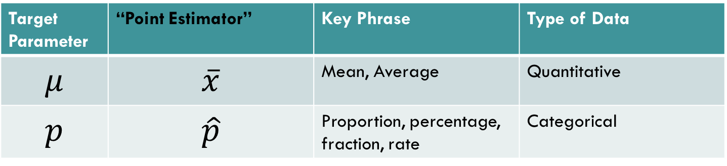
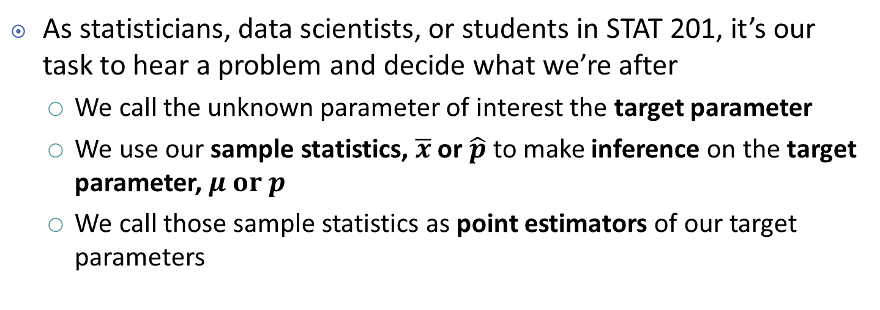
Telling Which Parameter We’re After
As statisticians, data scientists, or students in STAT 201, it’s our task to hear a problem and decide what we’re after
We call the unknown parameter of interest the target parameter
We use our sample statistics, $\overline{x}$ or $\hat{p}$to make inference on the target parameter, $μ or p$
We call those sample statistics as point estimators of our target parameters
Target Parameter | “Point Estimator” | Key Phrase | Type of Data
$$μ$$ | $$\overline{x}$$ | Mean, Average | Quantitative
$$p$$ | $$\hat{p}$$ | Proportion, percentage, fraction, rate | Categorical

Slide 3

Point Estimation vs. Interval Estimation
Point Estimation
Interval Estimation
Target Parameter

Slide 4
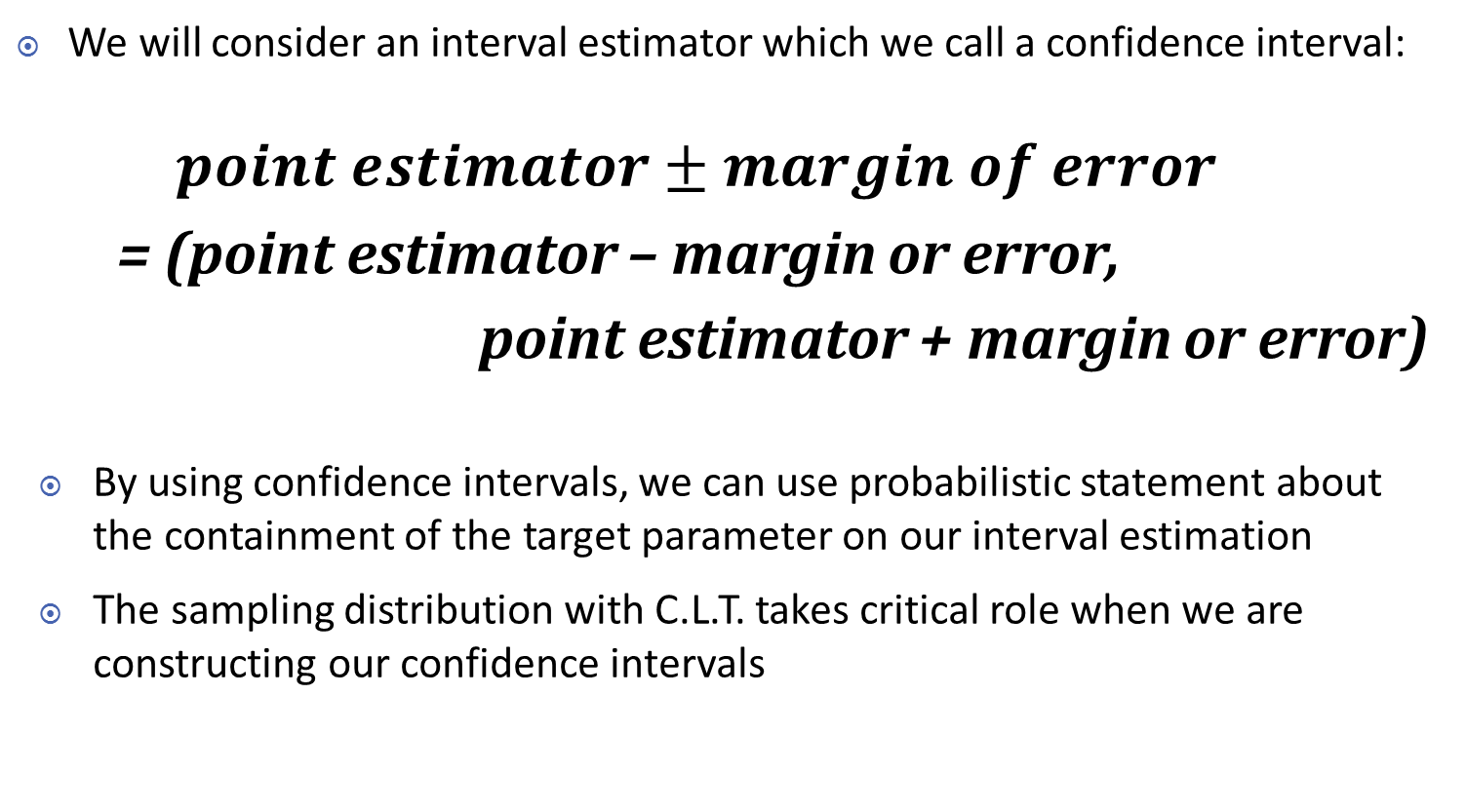
Interval Estimation
We will consider an interval estimator which we call a confidence interval:
$$point estimator±margin of error$$
= (point estimator – margin or error,
point estimator + margin or error)
By using confidence intervals, we can use probabilistic statement about the containment of the target parameter on our interval estimation
The sampling distribution with C.L.T. takes critical role when we are constructing our confidence intervals

Slide 5
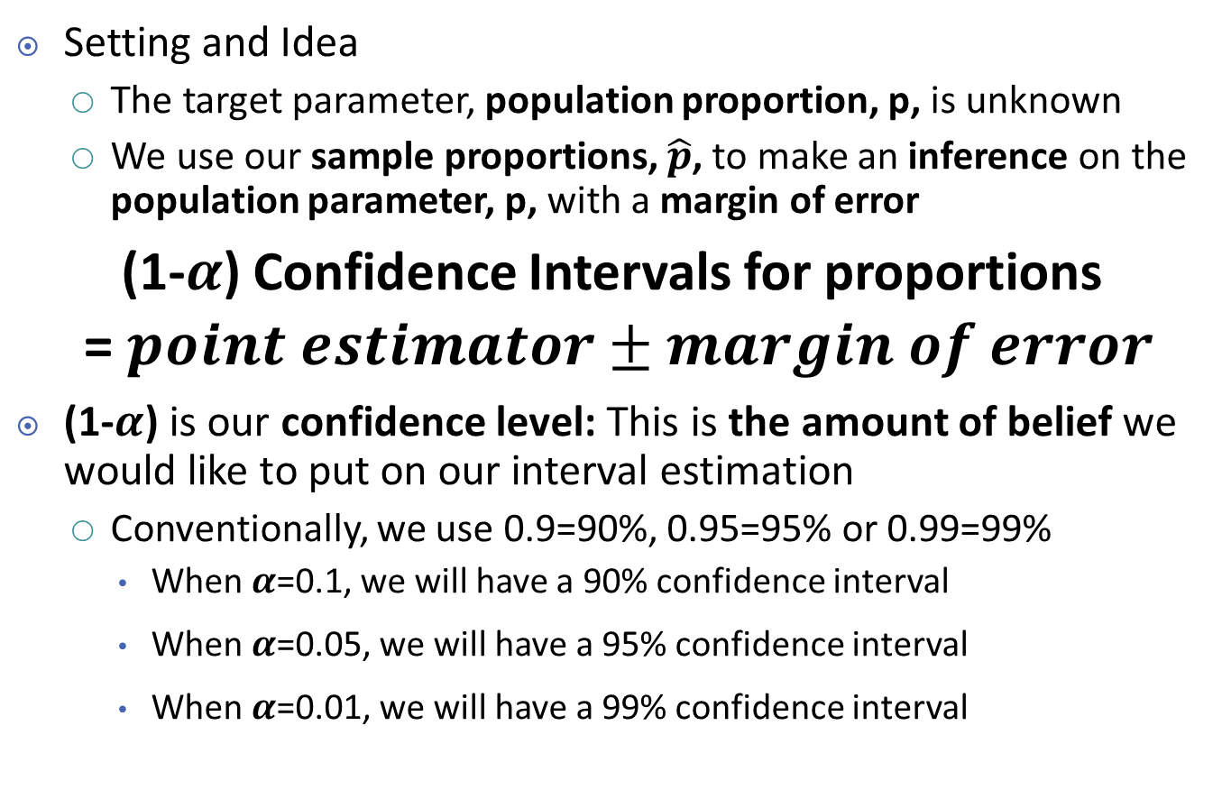
Vocabulary of Confidence Interval: Confidence Level
Setting and Idea
The target parameter, population proportion, p, is unknown
We use our sample proportions, $\hat{p}$, to make an inference on the population parameter, p, with a margin of error
(1-$α$) Confidence Intervals for proportions
= $point estimator±margin of error$
(1-$α$) is our confidence level: This is the amount of belief we would like to put on our interval estimation
Conventionally, we use 0.9=90%, 0.95=95% or 0.99=99%
When $α$=0.1, we will have a 90% confidence interval
When $α$=0.05, we will have a 95% confidence interval
When $α$=0.01, we will have a 99% confidence interval

Slide 6
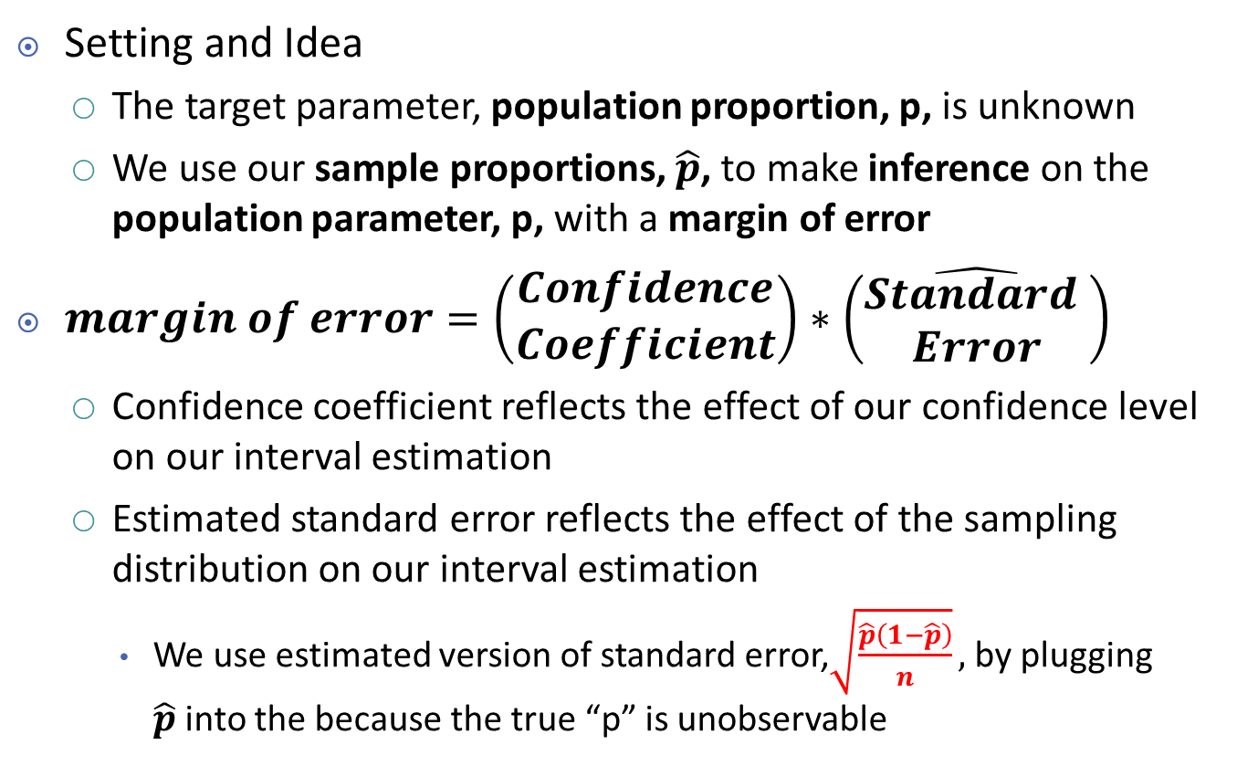
Vocabulary of Confidence Interval: Margin of Error
Setting and Idea
The target parameter, population proportion, p, is unknown
We use our sample proportions, $\hat{p}$, to make inference on the population parameter, p, with a margin of error
$margin of error=\left(\begin{matrix}Confidence \\ Coefficient\end{matrix}\right)∗\left(\hat{\begin{matrix}Standard \\ Error\end{matrix}}\right)$
Confidence coefficient reflects the effect of our confidence level on our interval estimation
Estimated standard error reflects the effect of the sampling distribution on our interval estimation
We use estimated version of standard error,$\sqrt{\frac{\hat{p}\left(1−\hat{p}\right)}{n}},$ by plugging $\hat{p}$into the because the true “p” is unobservable

Slide 7
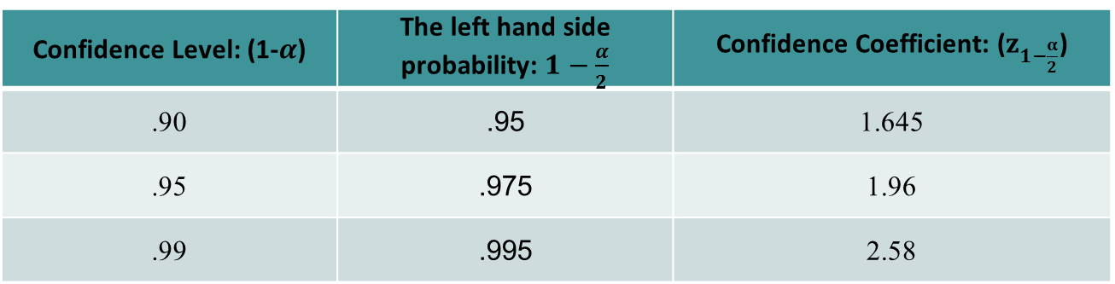

Confidence Coefficient
$$margin of error=\left(\begin{matrix}Confidence \\ Coefficient\end{matrix}\right)∗\left(\hat{\begin{matrix}Standard \\ Error\end{matrix}}\right)$$
Form of a confidence interval for a population proportion,
$$\hat{p}±z_{1−\frac{α}{2}}∗\sqrt{\frac{\left(\hat{p}\left(1−\hat{p}\right)\right)}{n}}$$
Confidence Level: (1-$α$) | The left hand side probability: $1−\frac{α}{2}$ | Confidence Coefficient: ($z_{1−\frac{α}{2}}$)
.90 | .95 | 1.645
.95 | .975 | 1.96
.99 | .995 | 2.58

Slide 8
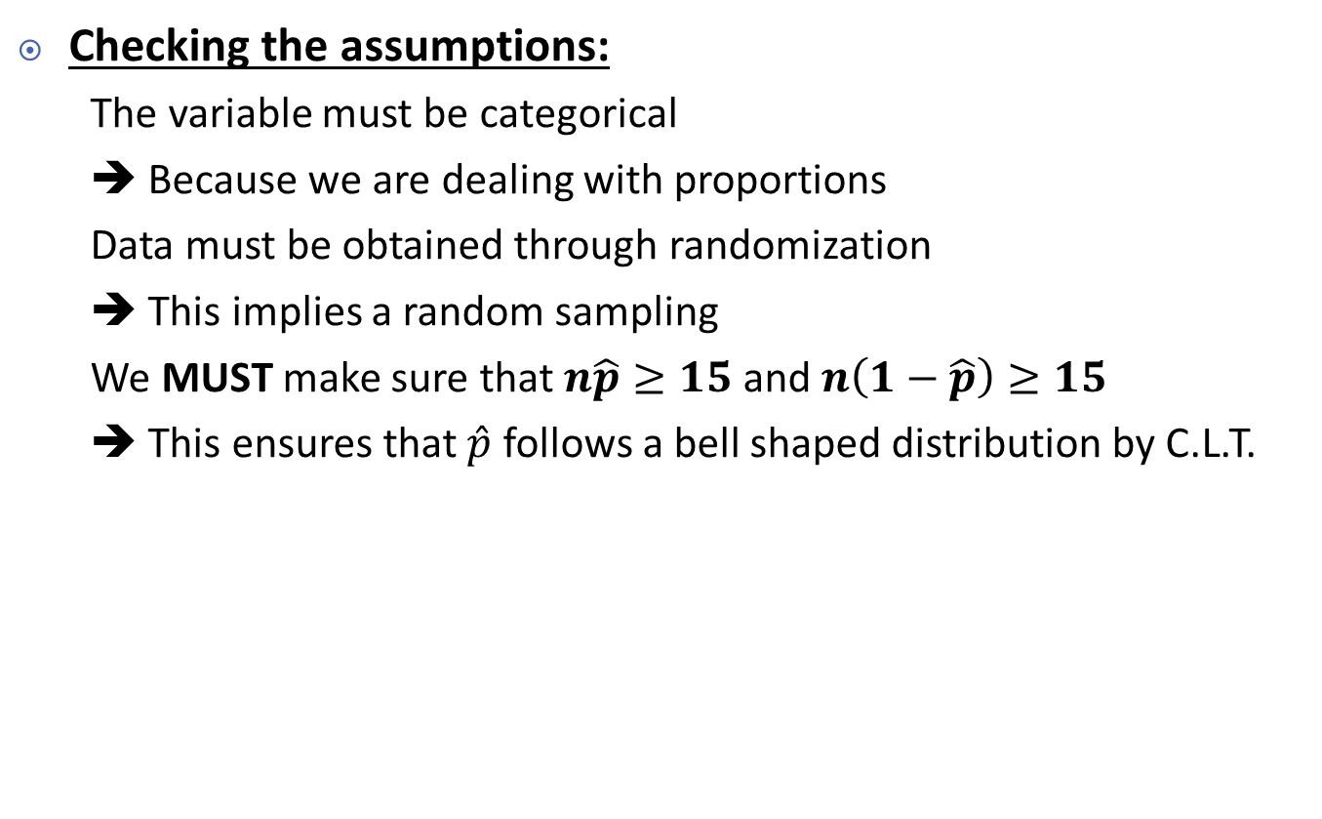
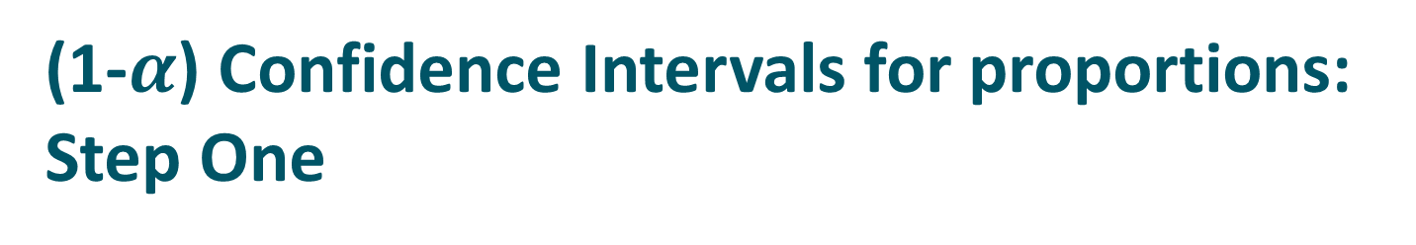
(1-$α$) Confidence Intervals for proportions: Step One
Checking the assumptions:
The variable must be categorical
➔ Because we are dealing with proportions
Data must be obtained through randomization
➔ This implies a random sampling
We MUST make sure that $n\hat{p}≥15$ and $n\left(1−\hat{p}\right)≥15$
➔ This ensures that $\hat{p}$ follows a bell shaped distribution by C.L.T.

Slide 9


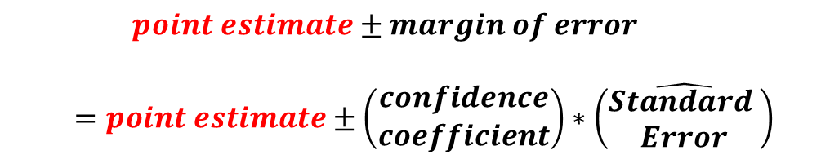
(1-$α$) Confidence Intervals for proportions: Step Two
Calculating the three components
$\hat{p}$ is our point-estimate for the population proportion
Our ‘best’ guess for the true population proportion, $p$, is our sample proportion, $\hat{p}$
$$point estimate±margin of error$$
$$=point estimate±\left(\begin{matrix}confidence \\ coefficient\end{matrix}\right)∗\left(\hat{\begin{matrix}Standard \\ Error\end{matrix}}\right)$$

Slide 10
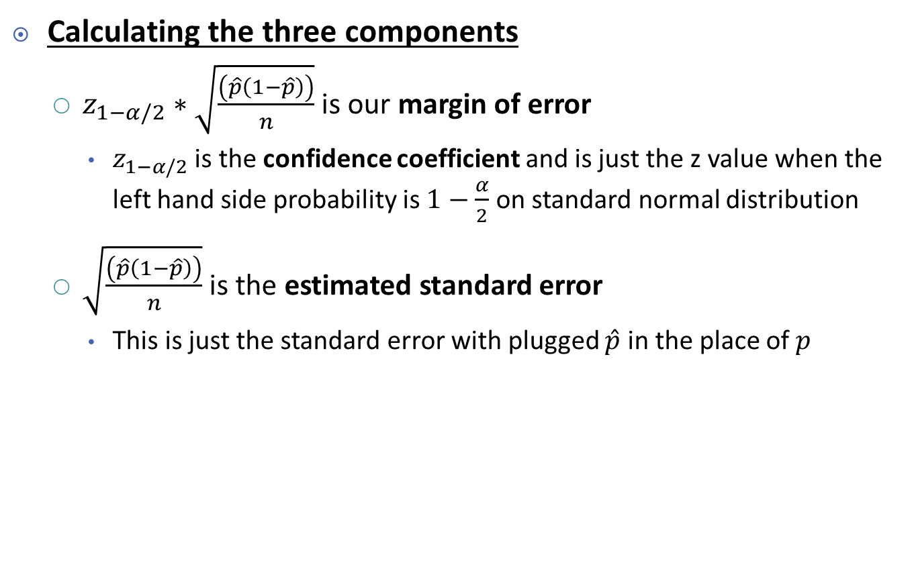

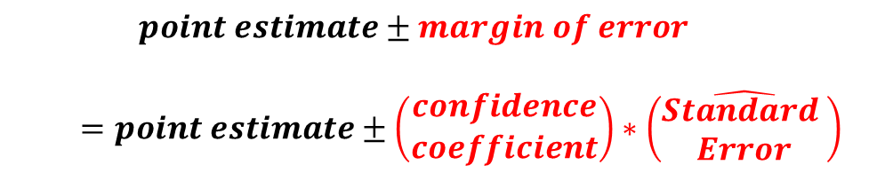
(1-$α$) Confidence Intervals for proportions: Step Two
Calculating the three components
$z_{1−α/2}∗\sqrt{\frac{\left(\hat{p}\left(1−\hat{p}\right)\right)}{n}}$ is our margin of error
$z_{1−α/2}$ is the confidence coefficient and is just the z value when the left hand side probability is $1−\frac{α}{2}$ on standard normal distribution
$\sqrt{\frac{\left(\hat{p}\left(1−\hat{p}\right)\right)}{n}}$ is the estimated standard error
This is just the standard error with plugged $\hat{p}$ in the place of $p$
$$point estimate±margin of error$$
$$=point estimate±\left(\begin{matrix}confidence \\ coefficient\end{matrix}\right)∗\left(\hat{\begin{matrix}Standard \\ Error\end{matrix}}\right)$$

Slide 11
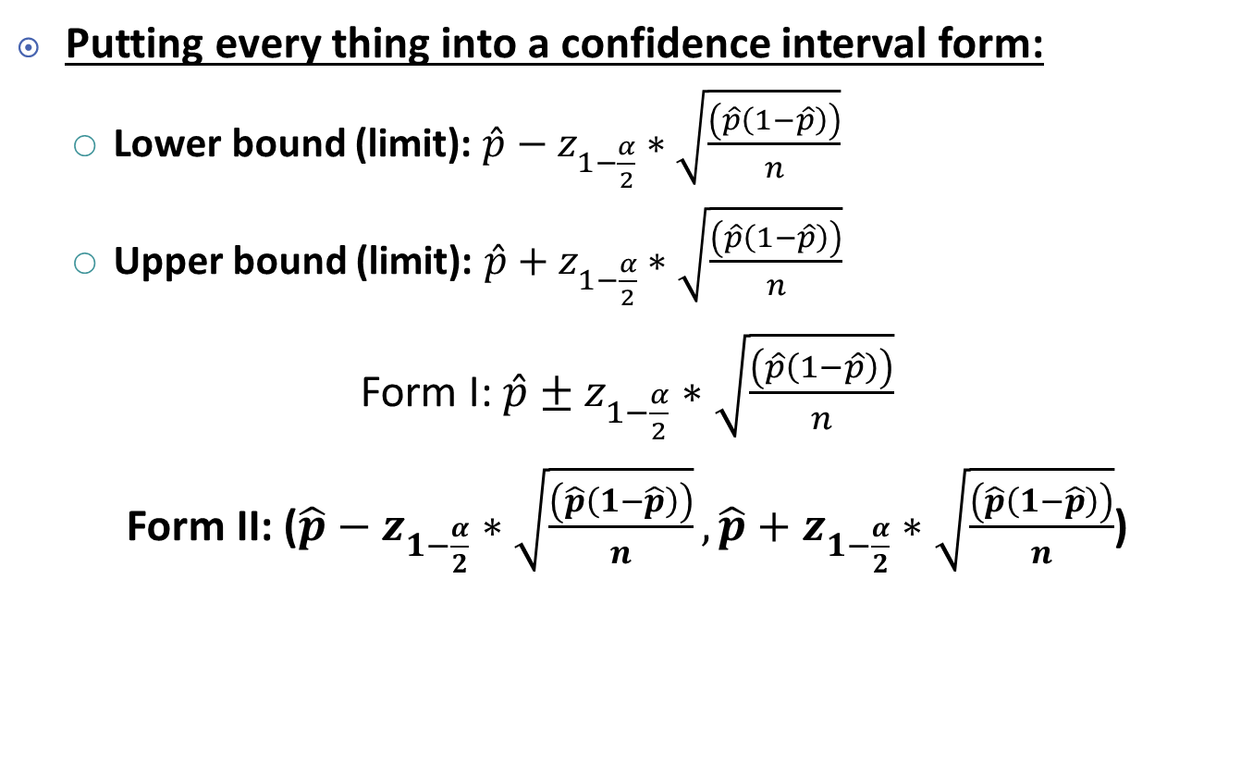
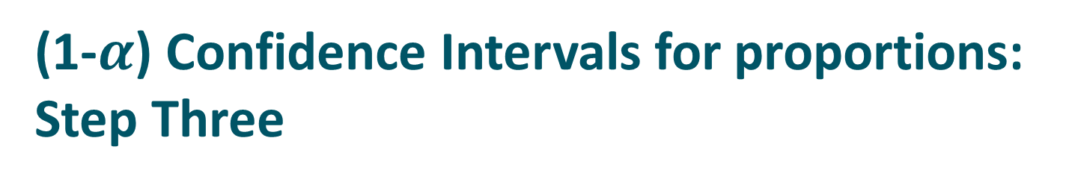
(1-$α$) Confidence Intervals for proportions: Step Three
Putting every thing into a confidence interval form:
Lower bound (limit): $\hat{p}−z_{1−\frac{α}{2}}∗\sqrt{\frac{\left(\hat{p}\left(1−\hat{p}\right)\right)}{n}}$
Upper bound (limit): $\hat{p}+z_{1−\frac{α}{2}}∗\sqrt{\frac{\left(\hat{p}\left(1−\hat{p}\right)\right)}{n}}$
Form I: $\hat{p}±z_{1−\frac{α}{2}}∗\sqrt{\frac{\left(\hat{p}\left(1−\hat{p}\right)\right)}{n}}$
Form II: ($\hat{p}−z_{1−\frac{α}{2}}∗\sqrt{\frac{\left(\hat{p}\left(1−\hat{p}\right)\right)}{n}}, \hat{p}+z_{1−\frac{α}{2}}∗\sqrt{\frac{\left(\hat{p}\left(1−\hat{p}\right)\right)}{n}}$)

Slide 12
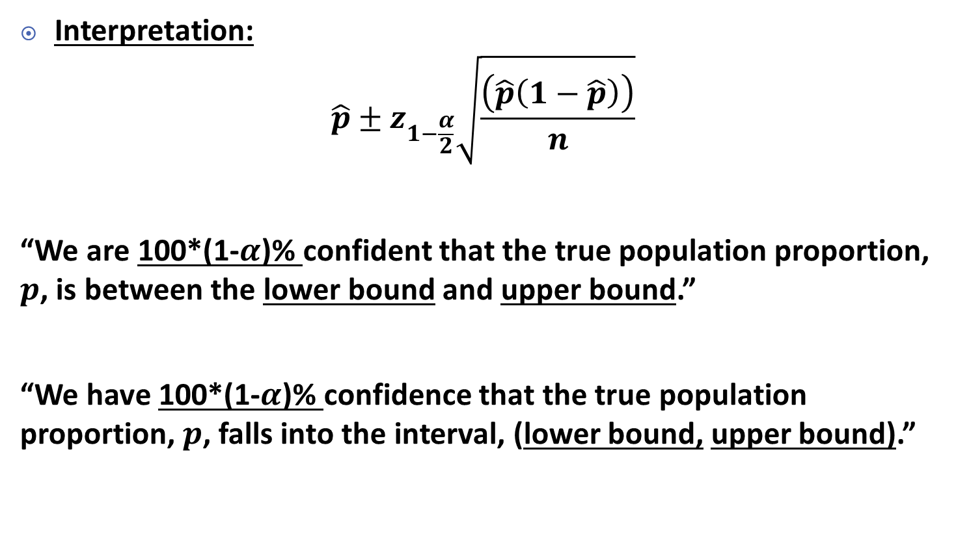
(1-$α$) Confidence Intervals for proportions: Step Three
Interpretation:
$$\hat{p}±z_{1−\frac{α}{2}}\sqrt{\frac{\left(\hat{p}\left(1−\hat{p}\right)\right)}{n}}$$
“We are 100*(1-$α$)% confident that the true population proportion, $p$, is between the lower bound and upper bound.”
“We have 100*(1-$α$)% confidence that the true population proportion, $p$, falls into the interval, (lower bound, upper bound).”

Slide 13
Example
We are interested in the population proportion of home team’s win in MLB
A random sample of MLB home games showed that the home teams won 167 of 304 games
Find the 95% confidence interval for the population proportion
Do you think there is a home field advantage?

Slide 14
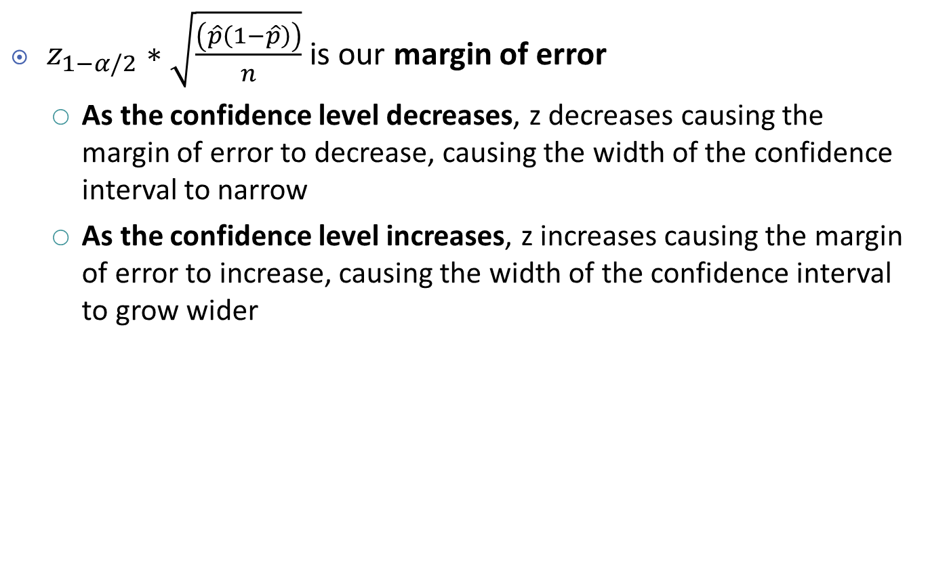
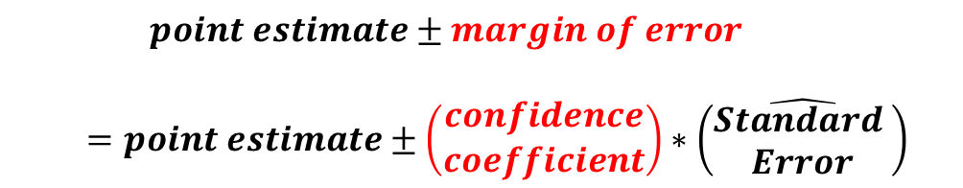
Factors affect Width of Confidence Interval: Confidence Level
$z_{1−α/2}∗\sqrt{\frac{\left(\hat{p}\left(1−\hat{p}\right)\right)}{n}}$ is our margin of error
As the confidence level decreases, z decreases causing the margin of error to decrease, causing the width of the confidence interval to narrow
As the confidence level increases, z increases causing the margin of error to increase, causing the width of the confidence interval to grow wider
$$point estimate±margin of error$$
$$=point estimate±\left(\begin{matrix}confidence \\ coefficient\end{matrix}\right)∗\left(\hat{\begin{matrix}Standard \\ Error\end{matrix}}\right)$$

Slide 15

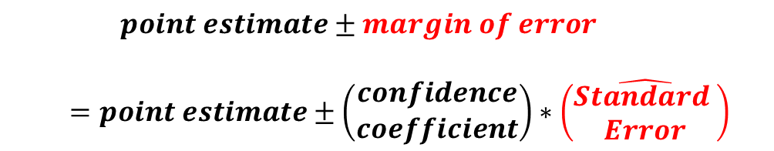
Factors affect Width of Confidence Interval: Sample Size
$z_{1−α/2}∗\sqrt{\frac{\left(\hat{p}\left(1−\hat{p}\right)\right)}{n}}$ is our margin of error
As n increases, the margin of error decreases causing the width of the confidence interval to narrow
As n decreases, the margin of error increases causing the width of the confidence interval to grow wider
$$point estimate±margin of error$$
$$=point estimate±\left(\begin{matrix}confidence \\ coefficient\end{matrix}\right)∗\left(\hat{\begin{matrix}Standard \\ Error\end{matrix}}\right)$$

Slide 16
Vocabulary of Hypothesis Testing
A Hypothesis is a statement about a population, usually of the form that a certain parameter takes a particular numerical value or falls in a certain range of values
The main goal in many research studies is to check whether the data support certain hypothesis

Slide 17
Vocabulary of Hypothesis Testing
The null hypothesis (H₀) is the hypothesis we conclude to be true unless we have data that is sufficient to suggest otherwise – think “innocent until proven guilty”
The alternative hypothesis (H_{a} or H₁) is the hypothesis that we conclude to be true if we have data that is sufficient to suggest the null hypothesis is not true
Hypothesis testing is a procedure based on evidence found in a sample to test hypothesis – to see if we have enough evidence to suggest the alternative hypothesis

Slide 18
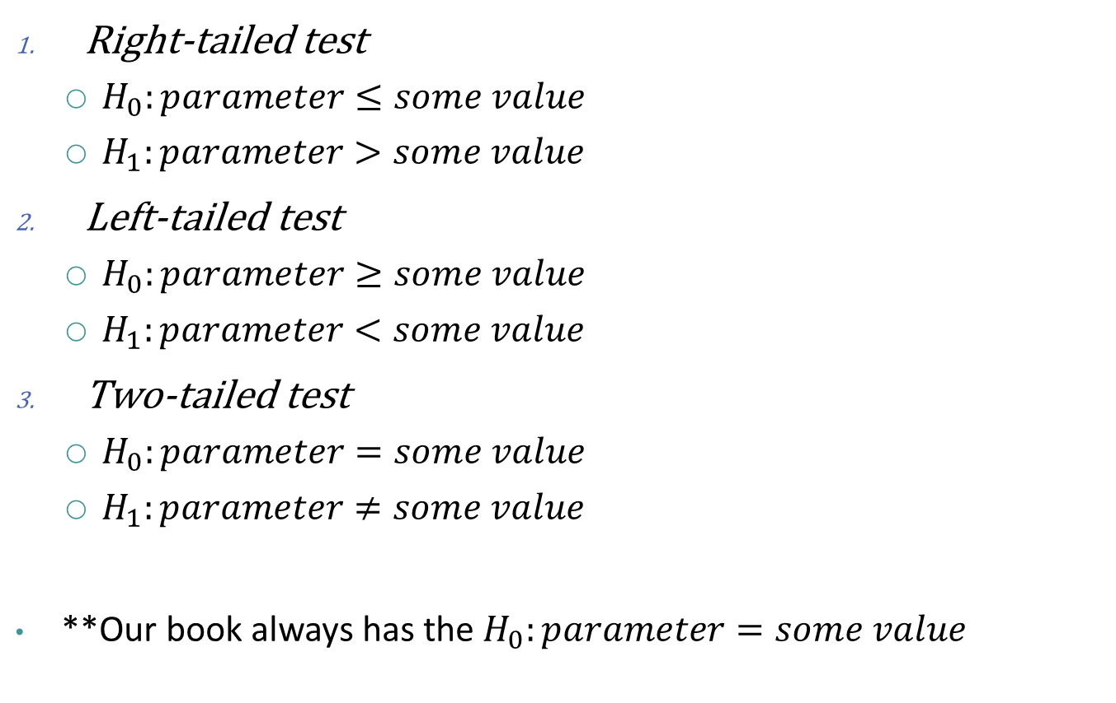
Form of Null and Alternative Hypotheses
Right-tailed test
$H_{0}:parameter≤some value$
$H_{1}:parameter>some value$
Left-tailed test
$H_{0}:parameter≥some value$
$H_{1}:parameter<some value$
Two-tailed test
$H_{0}:parameter=some value$
$H_{1}:parameter≠some value$
**Our book always has the $H_{0}:parameter=some value$

Slide 19
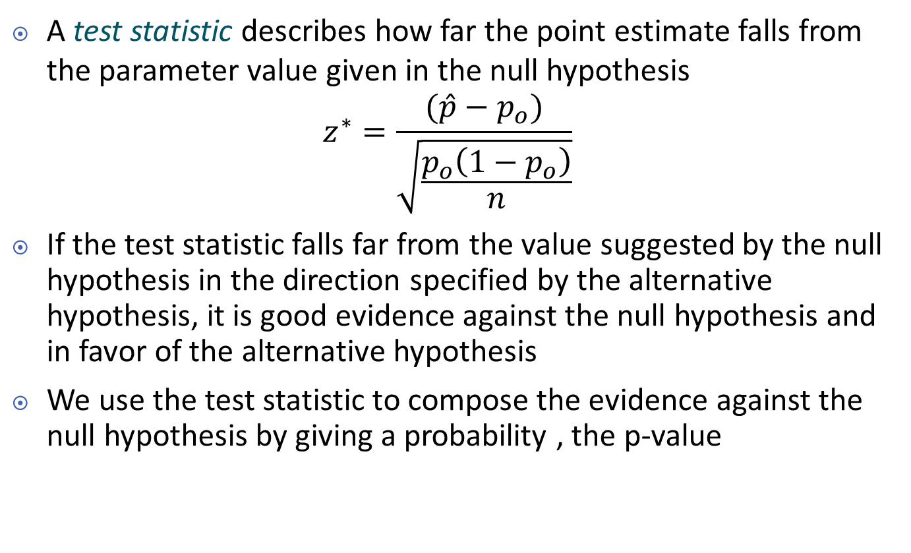
Test Statistic
A test statistic describes how far the point estimate falls from the parameter value given in the null hypothesis
$$z^{∗}=\frac{(\hat{p}−p_{o})}{\sqrt{\frac{p_{o}\left(1−p_{o}\right)}{n}}}$$
If the test statistic falls far from the value suggested by the null hypothesis in the direction specified by the alternative hypothesis, it is good evidence against the null hypothesis and in favor of the alternative hypothesis
We use the test statistic to compose the evidence against the null hypothesis by giving a probability , the p-value

Slide 20
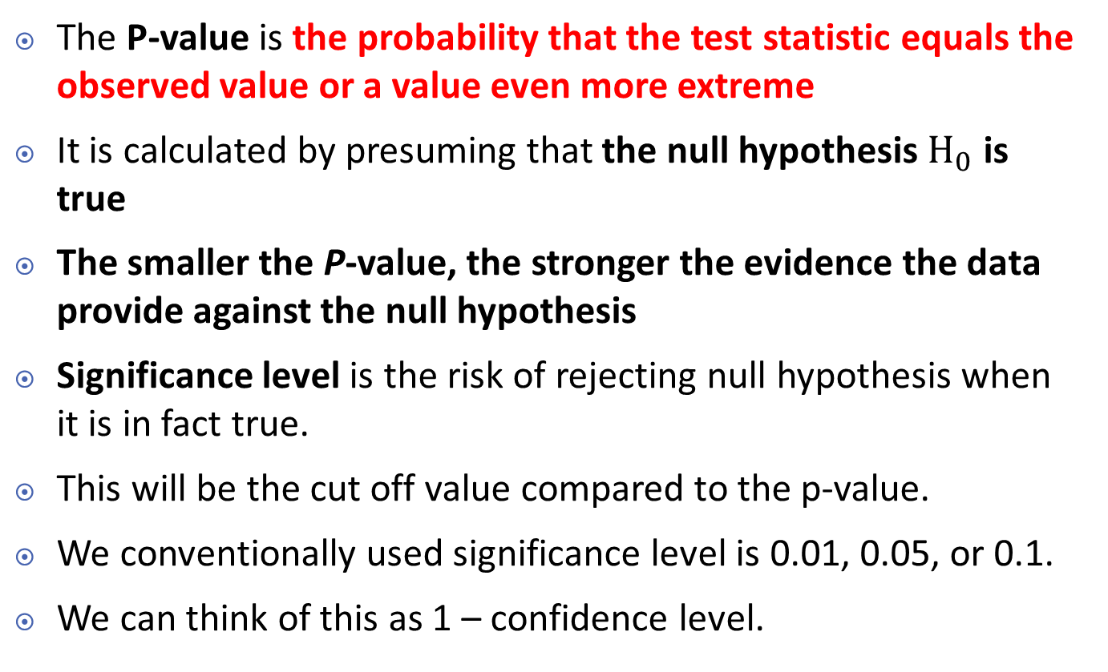
P-value and Significance Level
The P-value is the probability that the test statistic equals the observed value or a value even more extreme
It is calculated by presuming that the null hypothesis $H_{0}$ is true
The smaller the P-value, the stronger the evidence the data provide against the null hypothesis
Significance level is the risk of rejecting null hypothesis when it is in fact true.
This will be the cut off value compared to the p-value.
We conventionally used significance level is 0.01, 0.05, or 0.1.
We can think of this as 1 – confidence level.

Slide 21

Hypothesis Test for Proportions: Step 1 (Assumption)
Checking the assumptions:
The variable must be categorical
The data should be obtained using randomization
The sample size is sufficiently large where $p_{o}$ is the testing value
$np_{o}≥15$ and$n\left(1−p_{o}\right)≥15$

Slide 22
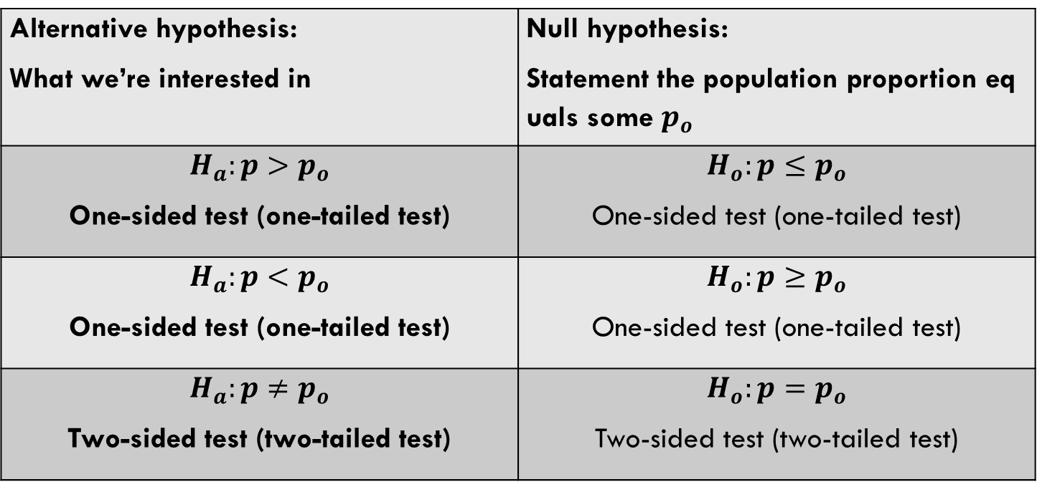

Hypothesis Test for Proportions: Step 2 (Hypotheses)
State Hypotheses to some value we’re interested in, $p_{o}$: it’s usually easier to start with $H_{a}$
Alternative hypothesis: What we’re interested in | Null hypothesis: Statement the population proportion equals some $p_{o}$
$$H_{a}:p>p_{o}$$ One-sided test (one-tailed test) | $$H_{o}:p≤p_{o}$$ One-sided test (one-tailed test)
$$H_{a}:p<p_{o}$$ One-sided test (one-tailed test) | $$H_{o}:p≥p_{o}$$ One-sided test (one-tailed test)
$$H_{a}:p≠p_{o}$$ Two-sided test (two-tailed test) | $$H_{o}:p=p_{o}$$ Two-sided test (two-tailed test)

Slide 23
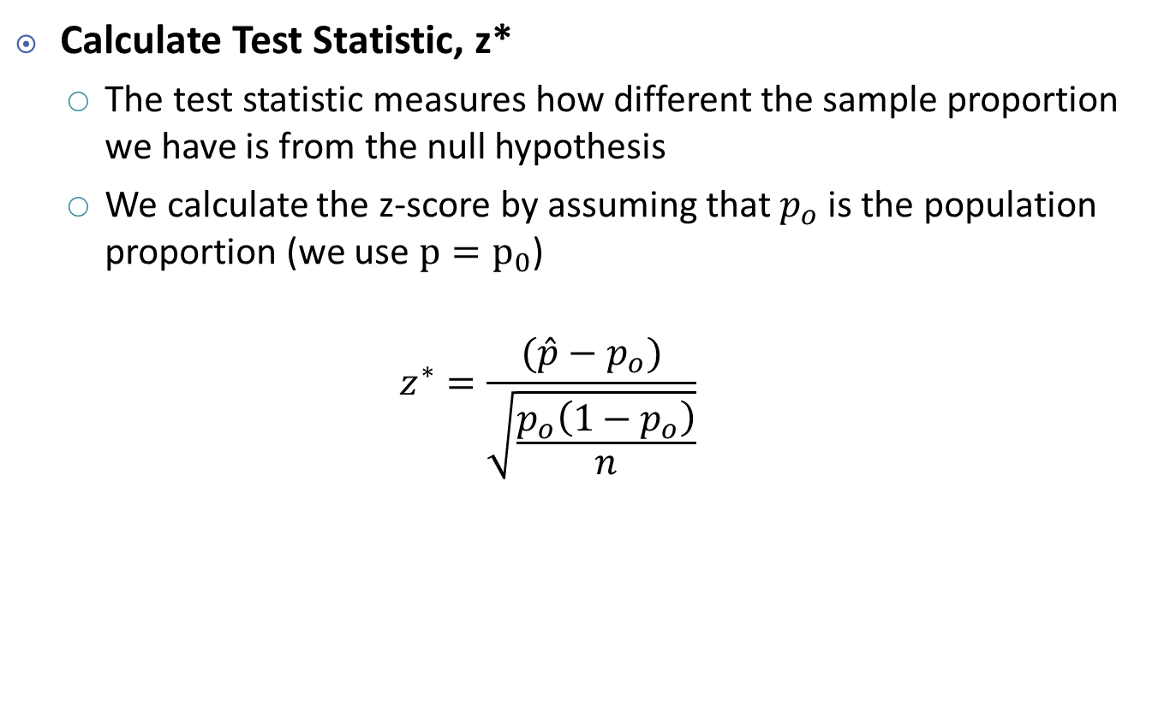
Hypothesis Test for Proportions: Step 3 (Test Statistic)
Calculate Test Statistic, z*
The test statistic measures how different the sample proportion we have is from the null hypothesis
We calculate the z-score by assuming that $p_{o}$ is the population proportion (we use $p=p_{0}$)
$$z^{∗}=\frac{(\hat{p}−p_{o})}{\sqrt{\frac{p_{o}\left(1−p_{o}\right)}{n}}}$$

Slide 24
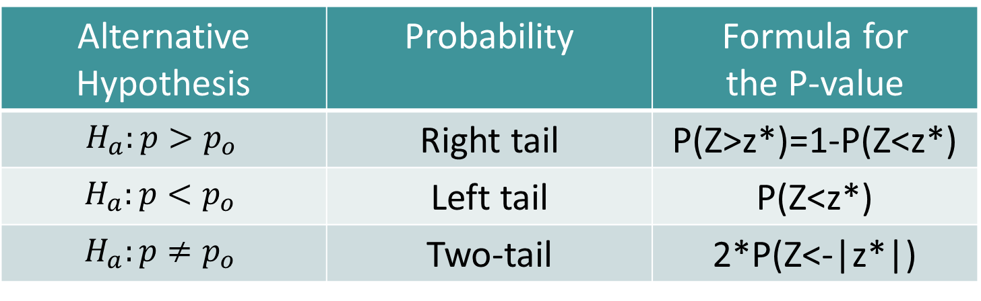

Hypothesis Test for Proportions: Step 4 (p-value)
Determine the p-value
The p-value describes how unusual the sample data would be if $H_{o}$ were true, which is what we’re assuming ($p=p_{0}$)
z* is the test statistic from step 3
Alternative Hypothesis | Probability | Formula for the P-value
$$H_{a}:p>p_{o}$$ | Right tail | P(Z>z*)=1-P(Z<z*)
$$H_{a}:p<p_{o}$$ | Left tail | P(Z<z*)
$$H_{a}:p≠p_{o}$$ | Two-tail | 2*P(Z<-|z*|)

Slide 25
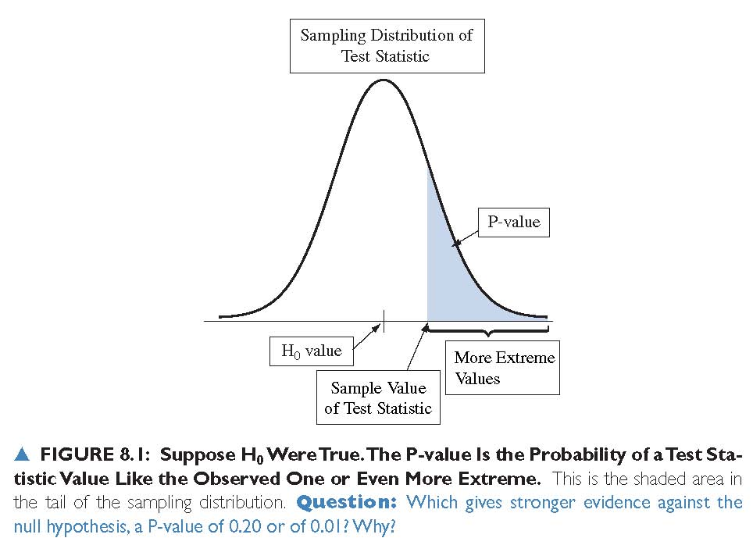
P-value

Slide 26
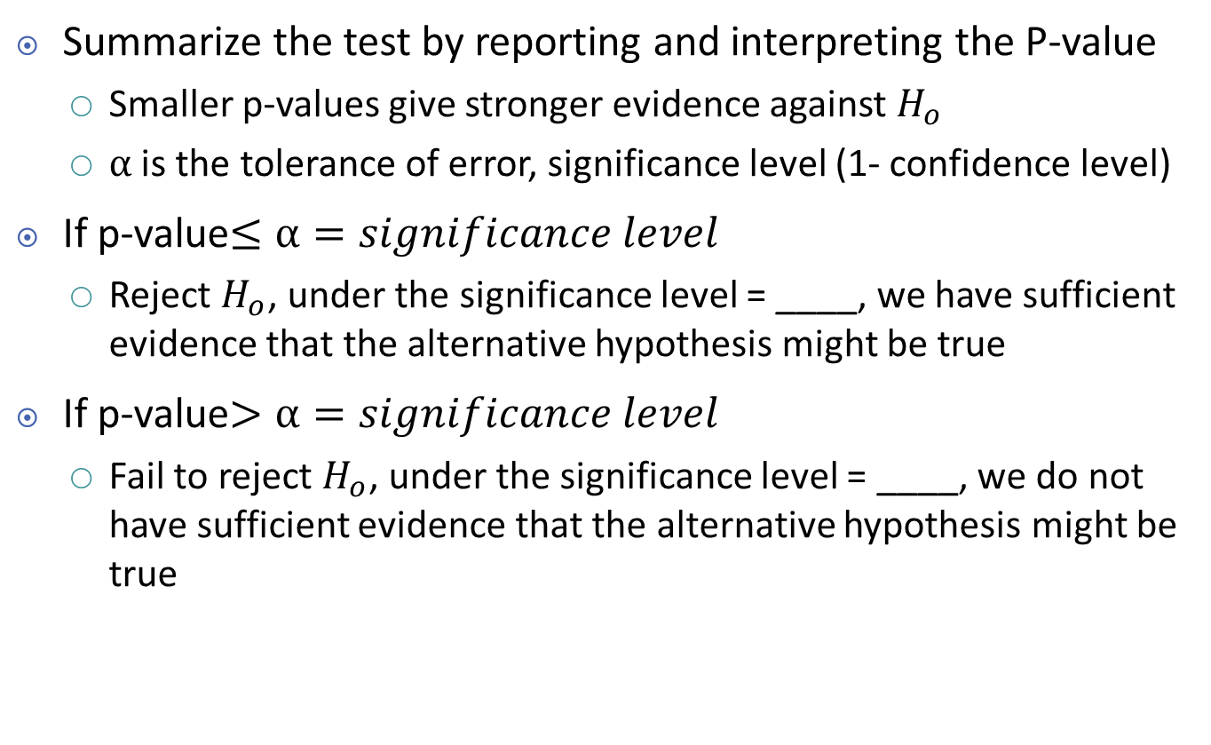
Hypothesis Test for Proportions: Step 5 (Conclusion)
Summarize the test by reporting and interpreting the P-value
Smaller p-values give stronger evidence against $H_{o}$
$α$ is the tolerance of error, significance level (1- confidence level)
If p-value$≤α=significance level$
Reject $H_{o}$, under the significance level = ____, we have sufficient evidence that the alternative hypothesis might be true
If p-value$>α=significance level$
Fail to reject $H_{o}$, under the significance level = ____, we do not have sufficient evidence that the alternative hypothesis might be true

Slide 27
Example
A random sample of MLB home games showed that the home teams won 167 of 304 games.
At the .05 level of significance is there evidence that there is a home field advantage?
Assumption
Hypotheses
Test statistics
P-value
Conclusion

Slide 28
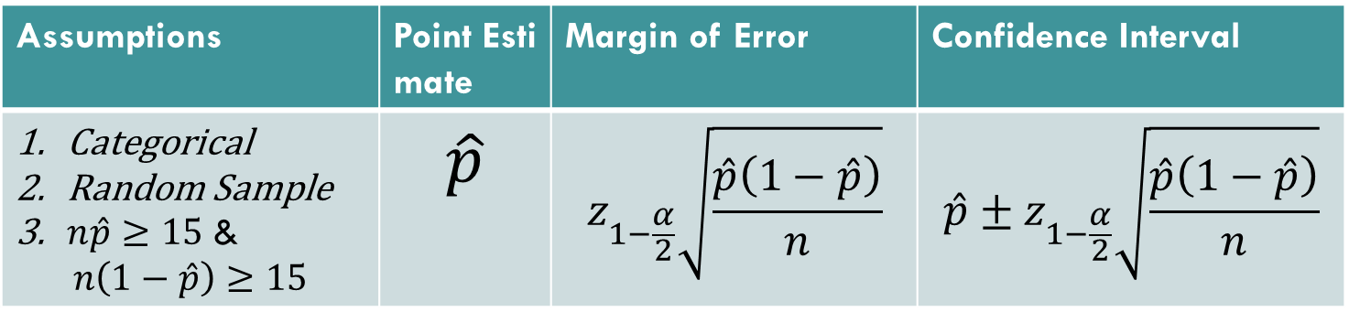
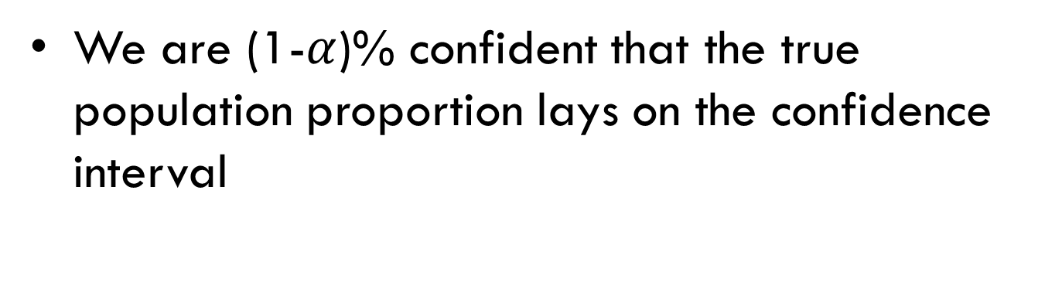
Confidence Intervals
Assumptions | Point Estimate | Margin of Error | Confidence Interval
Categorical Random Sample $n\hat{p}≥15$ & $$n\left(1−\hat{p}\right)≥15$$ | $$\hat{p}$$ | $$z_{1−\frac{α}{2}}\sqrt{\frac{\hat{p}\left(1−\hat{p}\right)}{n}}$$ | $$\hat{p}±z_{1−\frac{α}{2}}\sqrt{\frac{\hat{p}\left(1−\hat{p}\right)}{n}}$$
We are (1-$α$)% confident that the true population proportion lays on the confidence interval

Slide 29
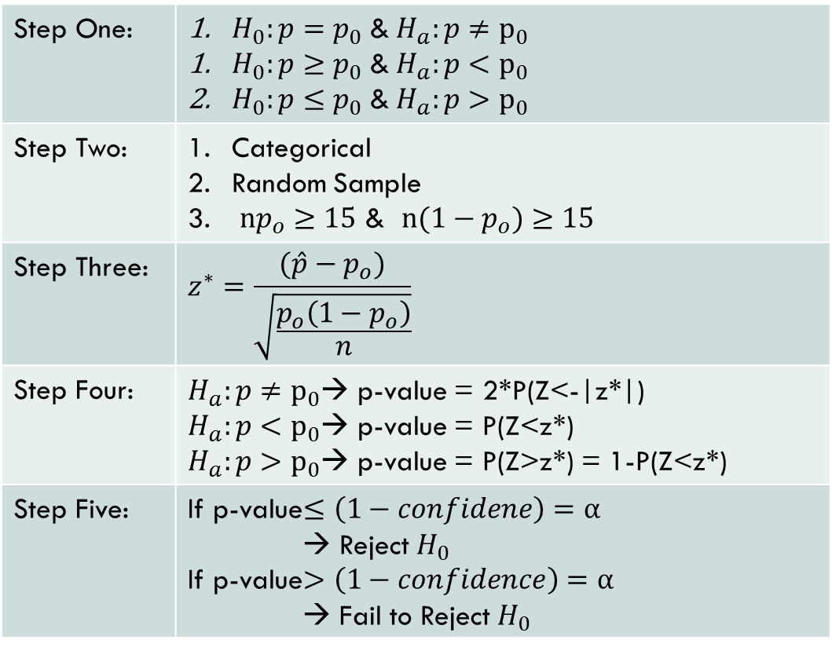
Hypothesis Testing
Step One: | $H_{0}:p=p_{0}$ &$H_{a}:p≠p_{0}$ $H_{0}:p≥p_{0}$ &$H_{a}:p<p_{0}$ $H_{0}:p≤p_{0}$ &$H_{a}:p>p_{0}$
Step Two: | Categorical Random Sample $np_{o}≥15$ & $n(1−p_{o})≥15$
Step Three: | $$z^{∗}=\frac{(\hat{p}−p_{o})}{\sqrt{\frac{p_{o}\left(1−p_{o}\right)}{n}}}$$
Step Four: | $H_{a}:p≠p_{0}$→ p-value = 2*P(Z<-|z*|) $H_{a}:p<p_{0}$→ p-value = P(Z<z*) $H_{a}:p>p_{0}$→ p-value = P(Z>z*) = 1-P(Z<z*)
Step Five: | If p-value$≤\left(1−confidene\right)=α$ → Reject $H_{0}$ If p-value$>\left(1−confidence\right)=α$ → Fail to Reject $H_{0}$

