Slide 1
DOCKER

Slide 2
agenda
DOCKER introduction
How CONTAINERS work
Practice

Slide 3
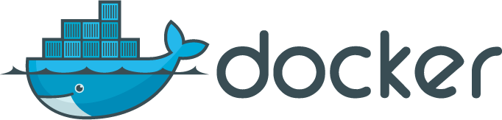
About DOCKER
Docker is a tool that packages, provisions and runs containers independent of the OS. Container technology is available through the operating system: A container packages the application service or function with all of the libraries, configuration files, dependencies and other necessary parts to operate. Each container shares the services of one underlying operating system.
Docker was created to work on the Linux platform, but has extended to offer greater support for non-Linux operating systems, including Microsoft Windows and Apple OS X. Versions of Docker for Amazon Web Services (AWS) and Microsoft Azure are available.

Slide 4
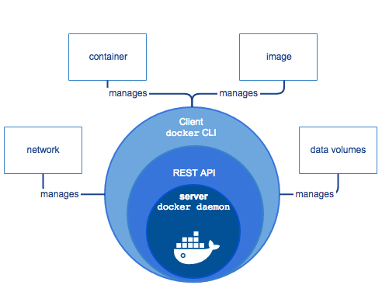
Main components
Docker daemon
Underlying client-server tool that supports container technology to handle the tasks and workflows involved in building container-based applications.
Provides a server-side daemon to host images, containers, networks and storage volumes
Docker Rest API
RESTful API for interacting with the Docker daemon
(ex. Instead of “docker ps” we can make a request like “GET /containers/json”)
Docker CLI (command-line interface)
Client-side daemon that allows users to interact with the Docker engine

Slide 5
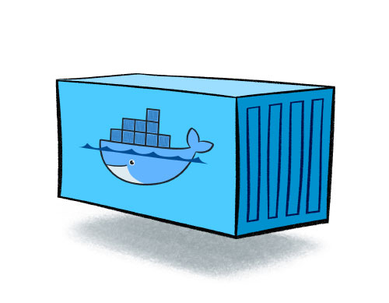
What is a container
Standardized packaging for software and dependencies
Isolate apps from each other
Share the same OS kernel
Works with all major OS’s
Be careful: containers don’t persist data upon they’re restarts, to do this we use volumes.

Slide 6
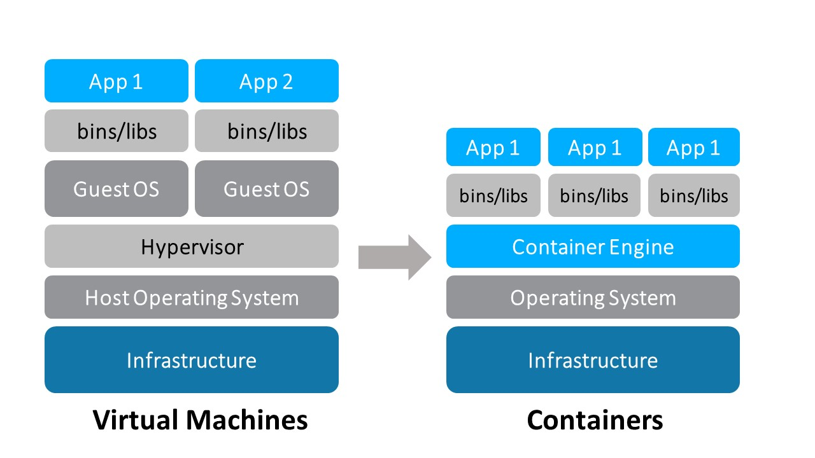
Isn’t containerization just the “new” virtualization?
Not exactly. It does share some similarity. The system resources of the underlying system are shared. The biggest advantage of containerization is the substantially smaller footprint means that for the same hardware, substantially more containers can be run than virtual machines.

Slide 7
Steps for creating a docker container
Three steps
Container building
The Dockerfile – a plain text file with no extension where you write a set of instructions that take an existing image, then apply changes and configuration to it
Container publishing
To the official DockerHub repository which contains dozens of “official” images as well as thousands of user-defined container images
Container deployment
Running a container either from a image build with a Dockerfile or pulled from DockerHub

Slide 8
Container networking
When you start a container, it has a private network, For outside network communications, ports from the container host get forwarded to individual container instance ports.
These ports are mentioned in the Dockerfile or passed as parameters to the run command
the forwarding occurs in one of two ways: you can explicitly map ports from the host machine to the container, or if not explicitly mapped, the Docker container server maps the declared container port to an available ephemeral port (typically ranging from 32768 to 61000)
Also custom networks can be created, to dictate how containers communicate with each other.

Slide 9
Docker commands
docker ps [-a] This command will list all running containers, showing information on them including their ID, name, base image name, and port forwarding. The -a option is for showing all containers, even the ones that are not running.
docker build This command is used to define a container — it processes the Dockerfile and creates a new container definition.
docker pull [image name] This command pulls the container image from the remote repository and stores the definition locally.
docker run [–d] [--name] [-p] [-v host_path:container_path] [image_name] This command starts a container based on a local or remote (e.g. DockerHub) container definition. The -d option is for running the container as a daemon(in background), --name is for specifying a name, -p is for port forwarding and –v is for specifying the volume.
ex: docker run -d --name jenkins -p 8080:8080 -p 50000:50000 -v /home/vagrant/jenkins:/var/jenkins_home jenkinsdocker
docker push This command publishes a built container definition to a repository, typically DockerHub.
docker stats [container name/ID] [container name/ID] This command will show the current load on each container specified – it will show CPU%, memory usage, and network traffic.
docker logs [-f] [container name/ID] This command shows the latest output from the container. The -f option “follows” the output, much like a console “tail-f” command would.
docker inspect [container name/ID] This command dumps all of the configuration information on the container in JSON format.
docker port [container name/ID] This command shows all of the port forwarding between the container host and the container.
docker exec [-i] [-t] [container name/ID] [shell_to_start] This command executes a command on the target container (-i indicates to run interactively, -t is pseudo-tty). Usually the shell will be /bin/bash.
docker images
This command is used to list all docker images downloaded or created on the system.
docker rmi
This command deletes images.
docker rm
This command deletes containers.

Slide 10
The dockerfile
ENTRYPOINT
This command will specify what application will start every time a container is created using the image.
ADD
Copies files from <src> to <dest>. ADD allows <src> to be an URL. If the <src> is an archive it’s compression will be recognized and it will be unpacked
EXPOSE
This command is used to associate a specified port to enable networking between the running process inside the container and the outside world (ex. the host).
USER
Is used to set the UID (or username) which is to run the container based on the image being built.
VOLUME
Is used to enable access from your container to a directory on the host machine.
MANTAINER
This command can be specified anywhere in the Dockerfile. It declares the author of the Dockerfile.
FROM
This command will specify the base image for the current Dockerfile. If you don’t want to start from a base image you must specify FROM scratch. This command must be on the first line of the Dockerifle.
ENV
This command is used to set the environment variables (one or more). These variables consist of “key value” pairs which can be accessed within the container by scripts and applications alike.
WORKDIR
This command is used to set where the commands defined with CMD will be executed from .
RUN
This command is the central executing directive for Dockerfiles. It runs commands during build time (docker build) and is used to .
CMD
This command can be used to execute a specific command. It is not run during build time, but when a container is instantiated using the image being built (docker run).

Slide 11
Questions ???

Slide 12
bibliography
https://www.digitalocean.com/community/tutorials/docker-explained-using-dockerfiles-to-automate-building-of-images
https://docs.docker.com/get-started/

Slide 13
Practice
Setup the build server and application server
Local Environment (OS)
VirtualBox: 192.168.50.10:XXXX
Other Virtualization App
Docker Daemon
CI Server
Jenkins:8080->8080
SSH:22->8022
APP Server
Tomcat:9090->9090
SSH:22->8122

Slide 14
THANK YOU!
Bogdan Fusa
JUNIOR Devops engineer
bogdan.fusa@endava.com
Skype: fbm_95

