Slide 1
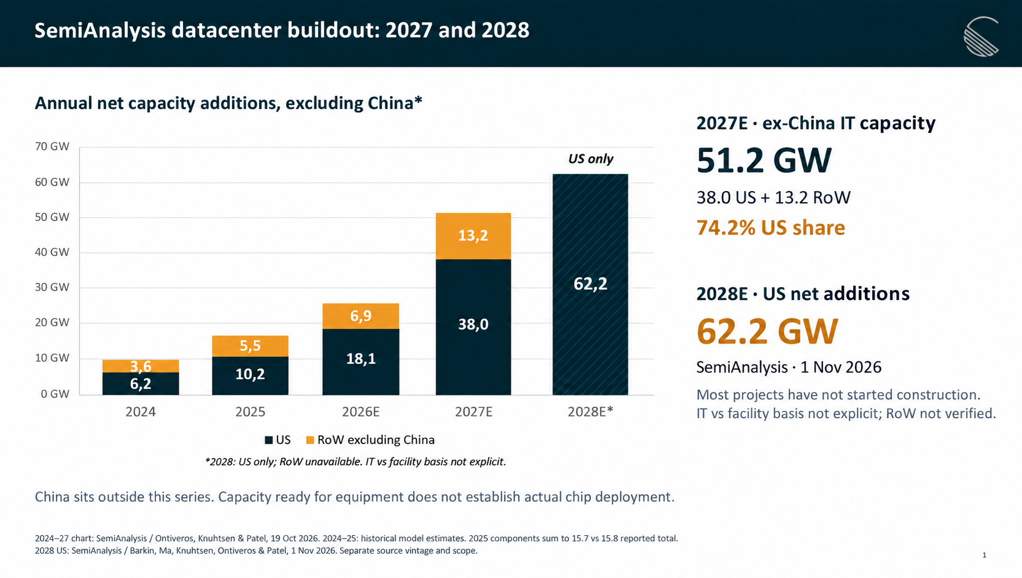
Annual net capacity additions, excluding China*
2027E · ex-China IT capacity
US only
51.2 GW
38.0 US + 13.2 RoW
74.2% US share
2028E · US net additions
62.2 GW
SemiAnalysis · 1 Nov 2026
Most projects have not started construction.
IT vs facility basis not explicit; RoW not verified.
*2028: US only; RoW unavailable. IT vs facility basis not explicit.
China sits outside this series. Capacity ready for equipment does not establish actual chip deployment.
2024–27 chart: SemiAnalysis / Ontiveros, Knuhtsen & Patel, 19 Oct 2026. 2024–25: historical model estimates. 2025 components sum to 15.7 vs 15.8 reported total.
2028 US: SemiAnalysis / Barkin, Ma, Knuhtsen, Ontiveros & Patel, 1 Nov 2026. Separate source vintage and scope.

