Slide 1
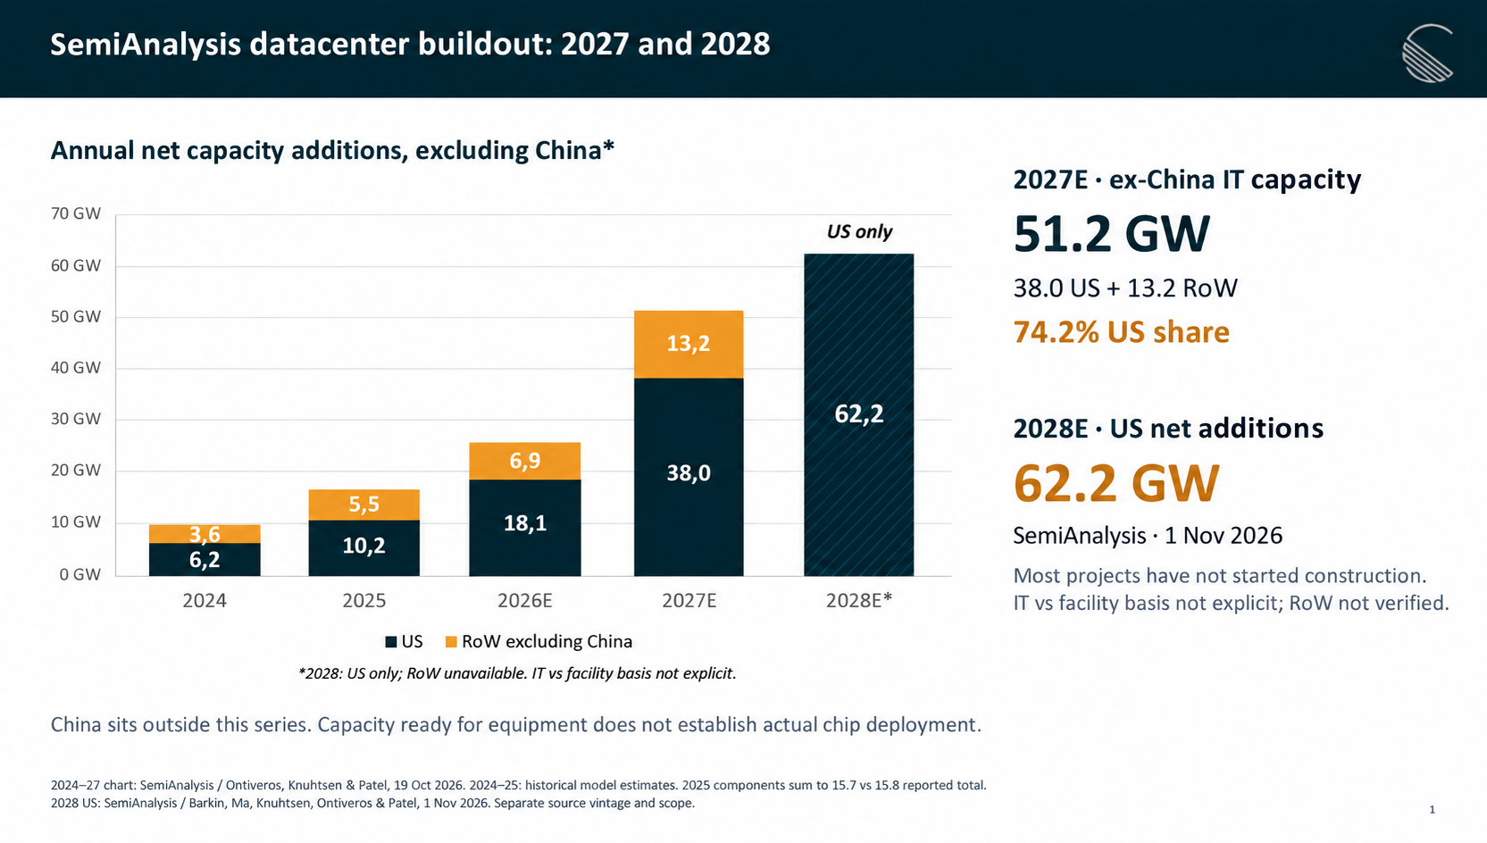
Annual net capacity additions, excluding China*
2027E · ex-China IT capacity
US only
51.2 GW
38.0 US + 13.2 RoW
74.2% US share
2028E · US net additions
62.2 GW
SemiAnalysis · 1 Nov 2026
Most projects have not started construction.
IT vs facility basis not explicit; RoW not verified.
*2028: US only; RoW unavailable. IT vs facility basis not explicit.
China sits outside this series. Capacity ready for equipment does not establish actual chip deployment.
2024–27 chart: SemiAnalysis / Ontiveros, Knuhtsen & Patel, 19 Oct 2026. 2024–25: historical model estimates. 2025 components sum to 15.7 vs 15.8 reported total.
2028 US: SemiAnalysis / Barkin, Ma, Knuhtsen, Ontiveros & Patel, 1 Nov 2026. Separate source vintage and scope.

Slide 2
Morgan Stanley shifts 4.9 GW from 2028 to 2029
Annual change in global data center capacity
2028E
4.9 GW deferred to 2029
43.3 GW
Global annual additions
4.9 GW shifted to 2029
2029E
51.9 GW
Includes the 4.9 GW shift
2030E unchanged at 44.8 GW
Morgan Stanley forecasts a timing shift into 2029, with the 2030 buildout unchanged.
Source: Morgan Stanley Research, DC team, Exhibit 5. Report date not provided. Source and team confirmed by the user.
Scope: global capacity additions. IT vs facility basis is not specified in the supplied exhibit. Source totals shown to one decimal.

