Slide 1
BCG vaccine effects in DO mice

Slide 2
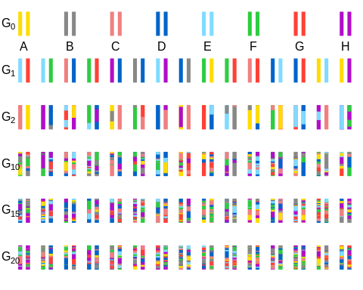
Study design
Haplotype size decreases as generation number increases in Diversity Outbred mice.

Slide 3
???
Nearly 1000 DO mice
Vaccinated and unvaccinated are challenged with Mtb
Measured lung CFU, spleen CFU, lung histopathology, and body weight
In nearly 100 vaccinated mice, obtained blood samples (pre- and post-vaccination) for RNA seq analysis

Slide 4
Follow-up plans for RNA seq analysis
Align reads to individual DO genomes
Quantify reads and calculate quantitative traits for QTL mapping
Compare and integrate results with CC QTL mapping
Do RNAseq peaks overlap with peaks in CC?
Can we infer allelic series at QTL in DO cohort and detect similar QTL in CC?

