Slide 1

My research Goals
Fred Boehm, M.D., Ph.D.
Department of Mathematics and Statistics

Slide 2
TRAINING
2007
M.D., M.S., U. Wisconsin-Madison
2019
Ph.D. (Statistics), U. Wisconsin-Madison
2021
Postdoctoral researcher, U. Massachusetts Medical School
2024
Postdoctoral researcher, U. Michigan 2024

Slide 3
Research interests
Statistical methods in human genetics
Genome-wide association studies
Polygenic risk scores
Multi-trait analyses
Joint longitudinal & time to event modeling
Statistical Collaborations
Bison genomics
Research Design & Analysis Center
Data science education
Capstone projects
Latent Dirichlet allocation topic models & text analysis

Slide 4
RESearch Projects
Project 1: “Multi-trait Analysis of GWAS Summary Results in Polygenic Score Construction”
Project 2: “Bayes Factors in Genome-Wide Association Studies and Polygenic Scores”
Project 3: “Assembling and Interpreting the Bison Genome”

Slide 5
Project 1
“Multi-trait Analysis of GWAS Summary Results in Polygenic Score Construction”
Challenge: Researchers typically analyze one trait at a time, despite measuring many traits on every subject
Key innovation: Jointly analyze multiple related traits
Expected outcome: Greater statistical power to detect associations & better predictive performance for PGS

Slide 6
Project 2
“Bayes Factors in Genome-Wide Association Studies and Polygenic Scores”
Challenge: While multiple traits are measured on every subject, many possible statistical models are available
Key innovation: Partition traits into 3 sets & use Bayes factors to assess fit of different models
Expected outcome: Detect new associations & build better PGS

Slide 7
Project 3
“Assembling and Interpreting the Bison Genome”
Challenge: North American bison are thought to have limited genetic diversity due to near extinction in the late 1800s
Key innovation: Obtained DNA samples from 95 bison in Custer State Park & sequenced them
Expected outcome: Assembled a new bison genome & calculated measures of genetic diversity in the Custer herd

Slide 8
Research roadmap
Longitudinal topic models of texts
Joint longitudinal & time-to-event modeling
Multi-biobank analyses & federated learning
Genetic ancestries
Electronic health records

Slide 9
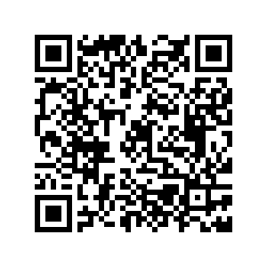
Thank you!
Fred Boehm <Frederick.Boehm@sdstate.edu>

