Slide 1
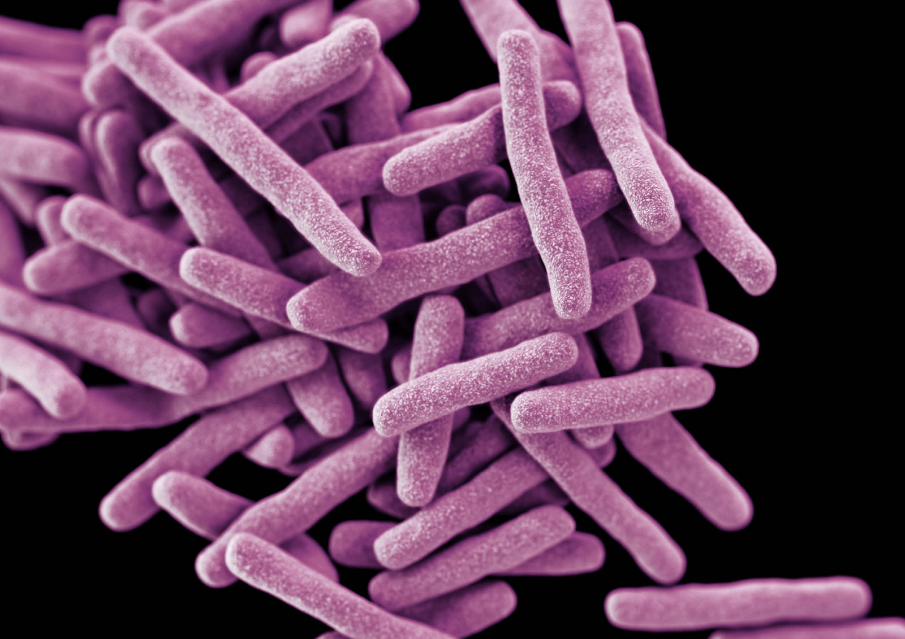

Measure lung & spleen CFU and lung cytokines
Mtb
Sacrifice

