Slide 1
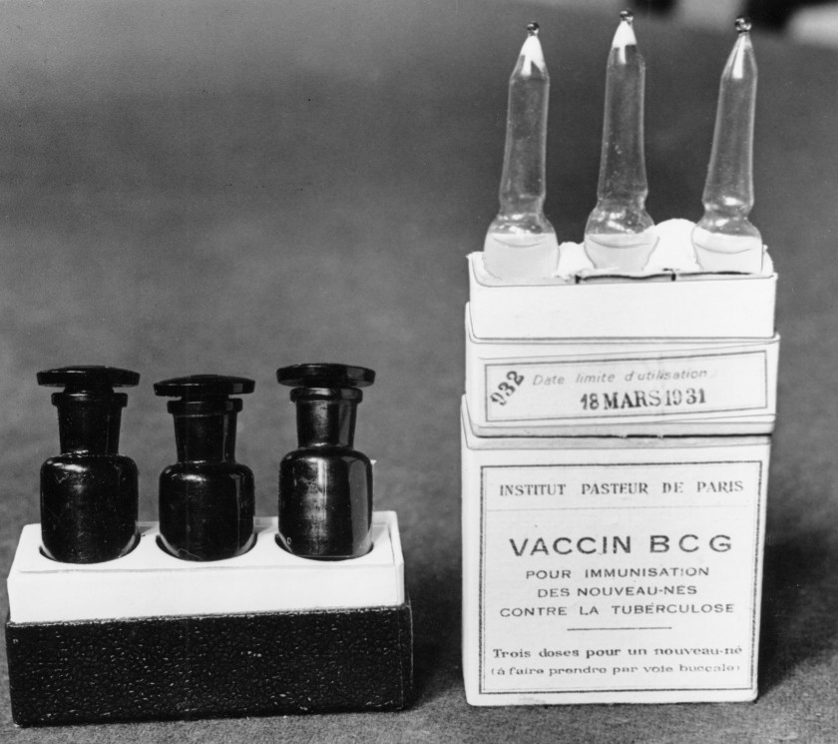
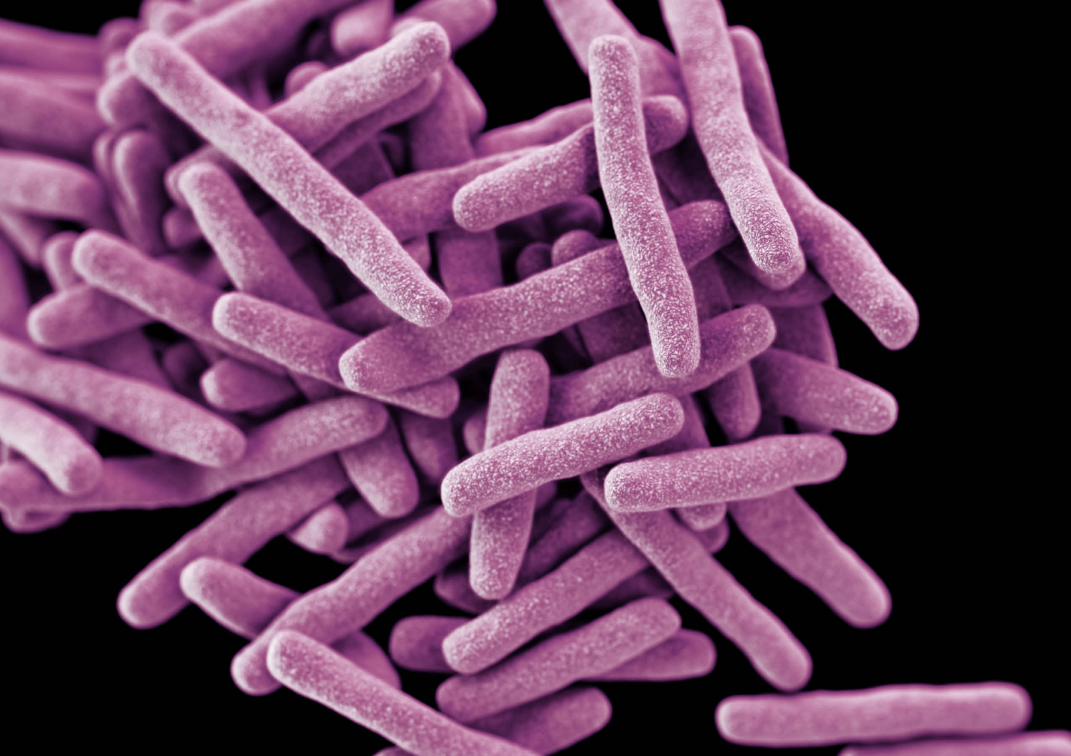

Measure lung & spleen CFU
BCG
Mtb
Sacrifice

