Slide 1
Handwritten number recognition
Fran Borčić (UNISI Erasmus 2020/2021) – Neural Network course project

Slide 2
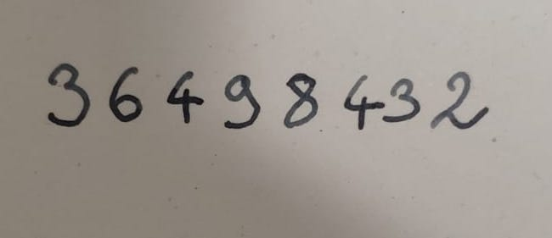
Approach
assumption – input is an image of a single N-digit handwritten number on a white piece of paper
first step – preprocess the image to isolate the individual digits in the right order
second step – classify the isolated digits using a convolutional neural network previously trained on the MNIST dataset
36498432

Slide 3
Preprocessing steps
conversion to grayscale
thresholding – conversion to binary bitmap
removing unnecessary vertical whitespace
finding features as connected components by flood-fill
removing features that are too small
joining overlapping features
extracting features, scaling and antialiasing

Slide 4
Thresholding (binarization)
the threshold needs to be determined automatically to account for different lighting conditions and writing utensils
standard algorithms like Otsu’s method don’t work well when the area of the foreground is much smaller than the area of the background
shadows are usually darkest at the corners, so that’s where black pixels start to appear when the threshold is too high
exploiting this fact leads to satisfactory results – search for the maximum threshold such that the density of black pixels at the vertical extremes is below a set value (empirically determined to be 15%)

Slide 5
Finding and isolating features
after thresholding, some vertical whitespace is removed by analyzing pixel densities along the vertical axes
the resulting images are analyzed for connected components by flood filling – starting with a randomly chosen black pixel, the component is spread to the neighbouring pixels until no such pixels can be found
the components are then filtered so that those that are too small are discounted
horizontally overlapping components are then joined together to account for discontinuities
each component is then isolated and scaled to match the MNIST format with significant downsampling – this converts them back to grayscale due to antialiasing

Slide 6
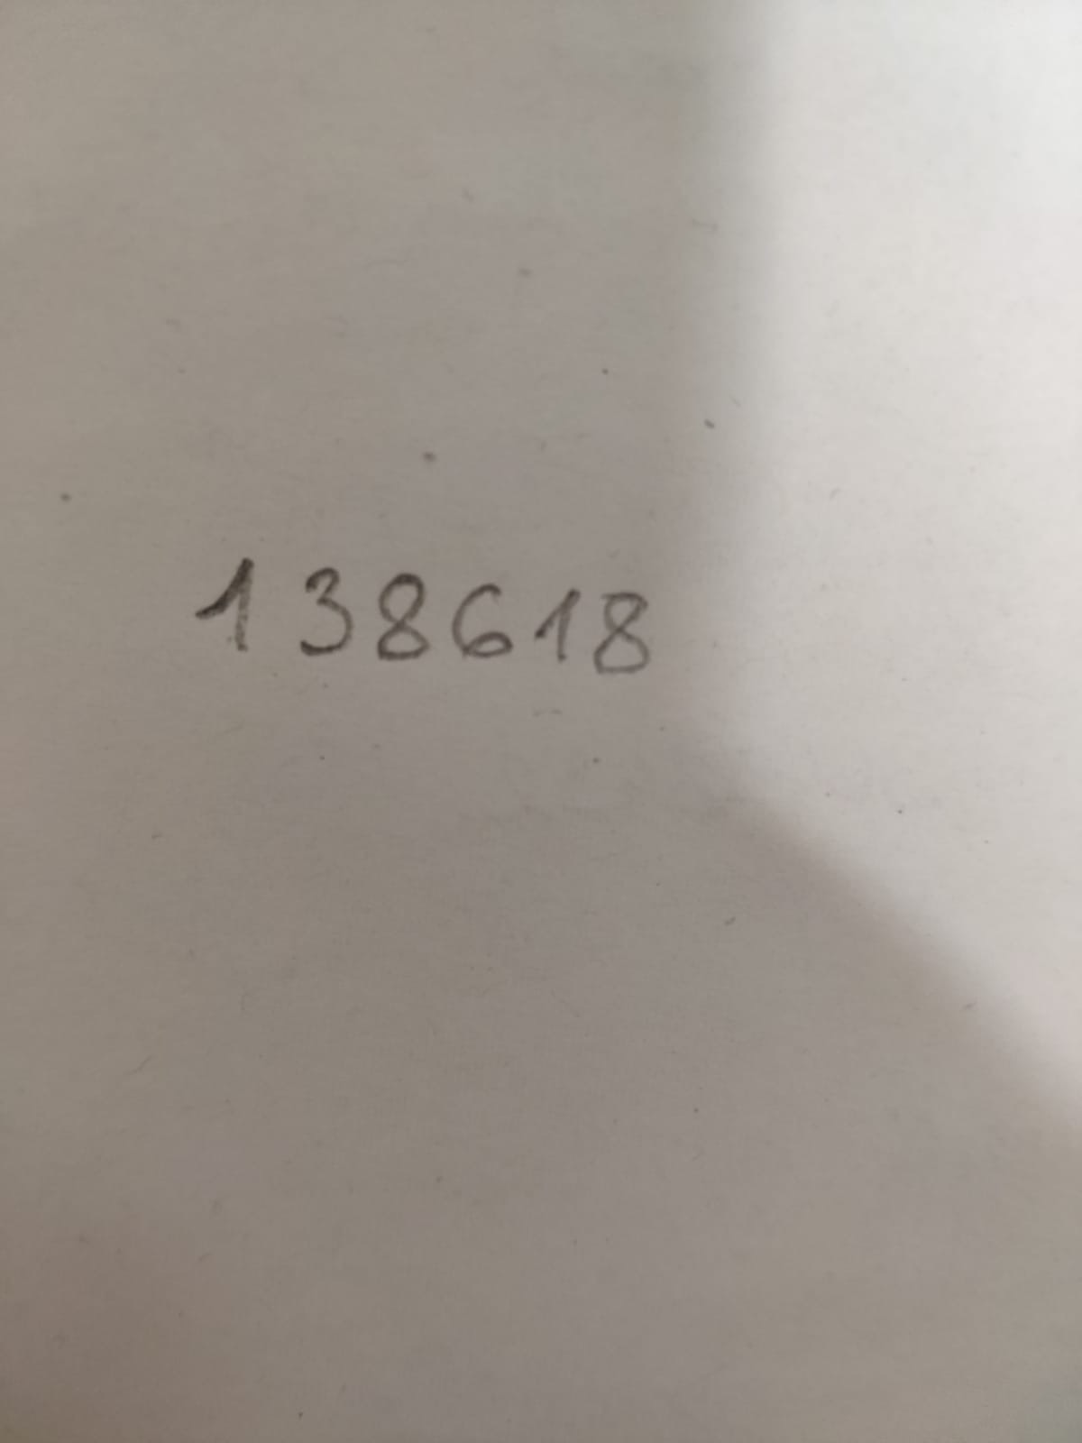
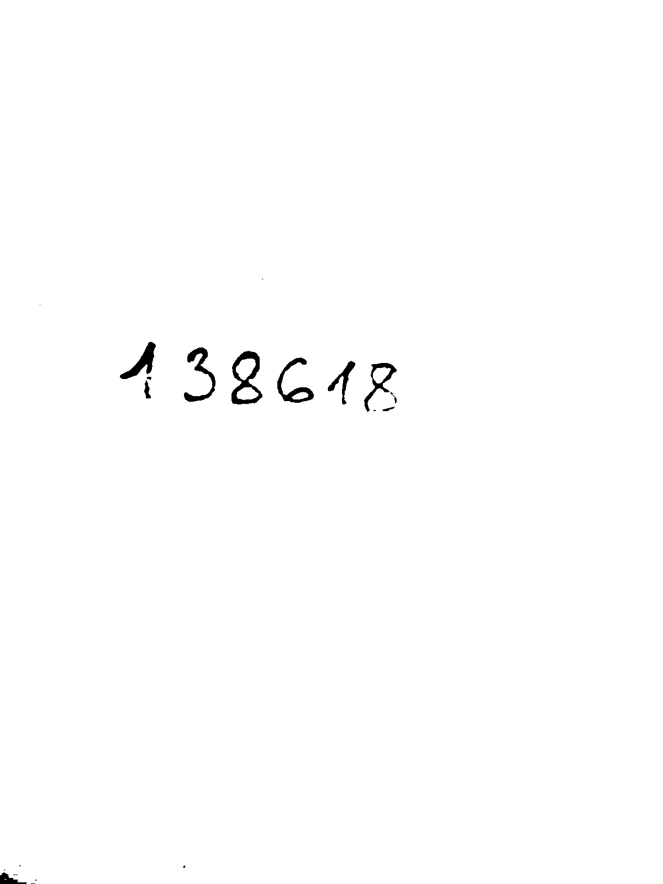
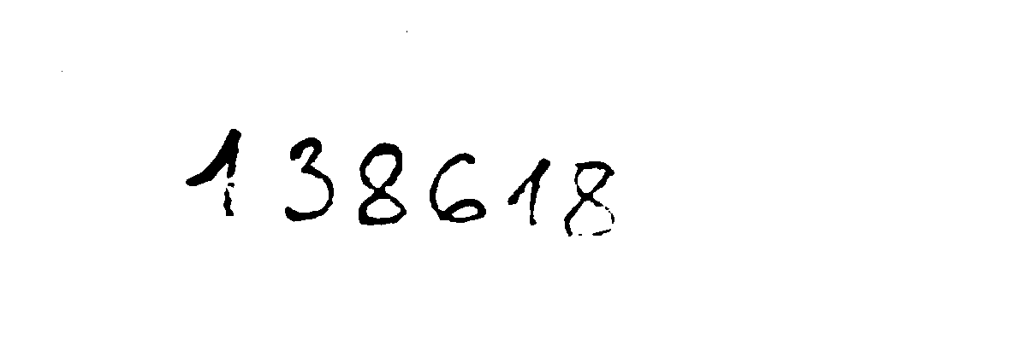
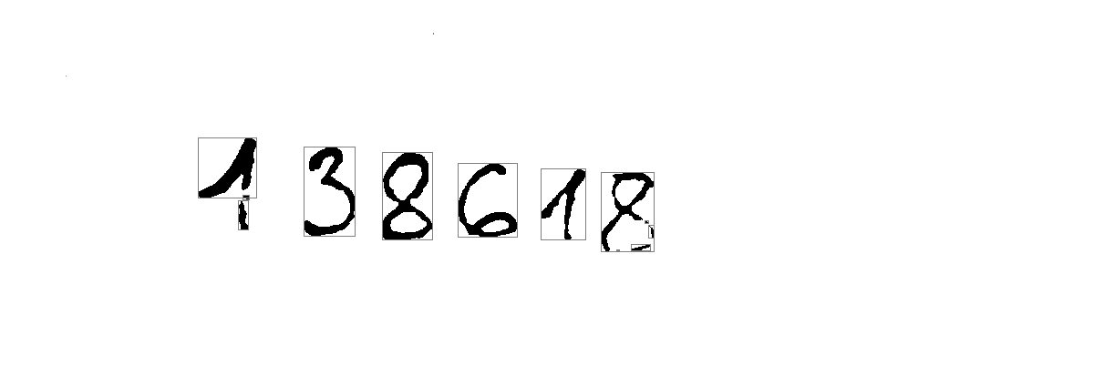
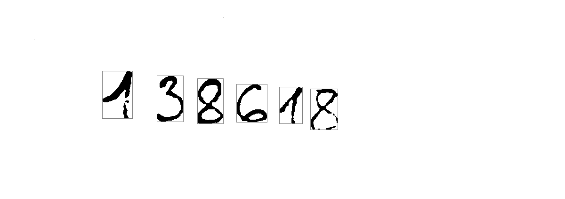







Slide 7
Identifying digits
images are classified using a convolutional neural network
the network follows a common architecture for this problem – two convolutional layers (32 and 64 features) with max-pooling in between, then two fully connected layers followed by a softmax output layer
the fully connected layers are trained with dropout
the network is trained on the MNIST training set (60.000 digit images) using mini-batch learning
hyperparameters – batches of 64 samples, learning rate of 1 with decay of 0.7 per each training epoch – later shown not to be very important

Slide 8
Results
the neural network classifies MNIST digits well – 99.37% accuracy on the MNIST test set after 10 epochs of training
on the limited set of handwritten images 41 digits out of 47 are classified correctly (~87% accuracy)
changing the network architecture and hyperparameters does not result in better accuracy – the limiting factor is the training set which does not generalize well (e.g., all the 1s consist only of one stroke so those with two strokes aren’t recognized)

Slide 9
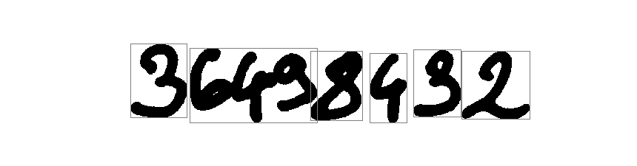
Limitations and improvements
a large limitation is that the digits in the input must not touch each other – separating them in that case would be a hard problem
for a practical use, a much more varied set than MNIST should be used
the numbers are required to be written horizontally (easily remedied by a PCA on pixel density or a Hough transform)
the thresholding function could be improved by using morphological operations to subtract the background shadow – impractical to implement in pure python/numpy

